Slide 1
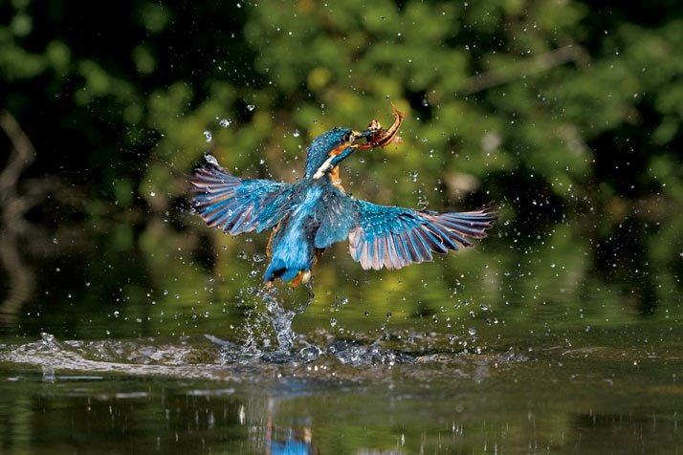
BIOMIMETICS
The kingfisher
By: Àngel Térmens Forcada

Slide 2
Summary
What do “Biomimetics” mean?
The Kingfisher
Why is Kingfisher useful at technology research?

Slide 3
What do “Biomimetics” mean?
According to what I’ve found on the web, biomimesis is the science that studies the way to develop technology, and improve the current technological situation that we are living, from nature; since the creation of the Earth, nature is a very complex mechanism and a good example of improvement and constant evolution that has never failed in millions of years. This is the fact that I understand that it motivates biomimesis. I also think that it is quite interesting to think that it is developed according to what technology is based on the models established by nature.

Slide 4
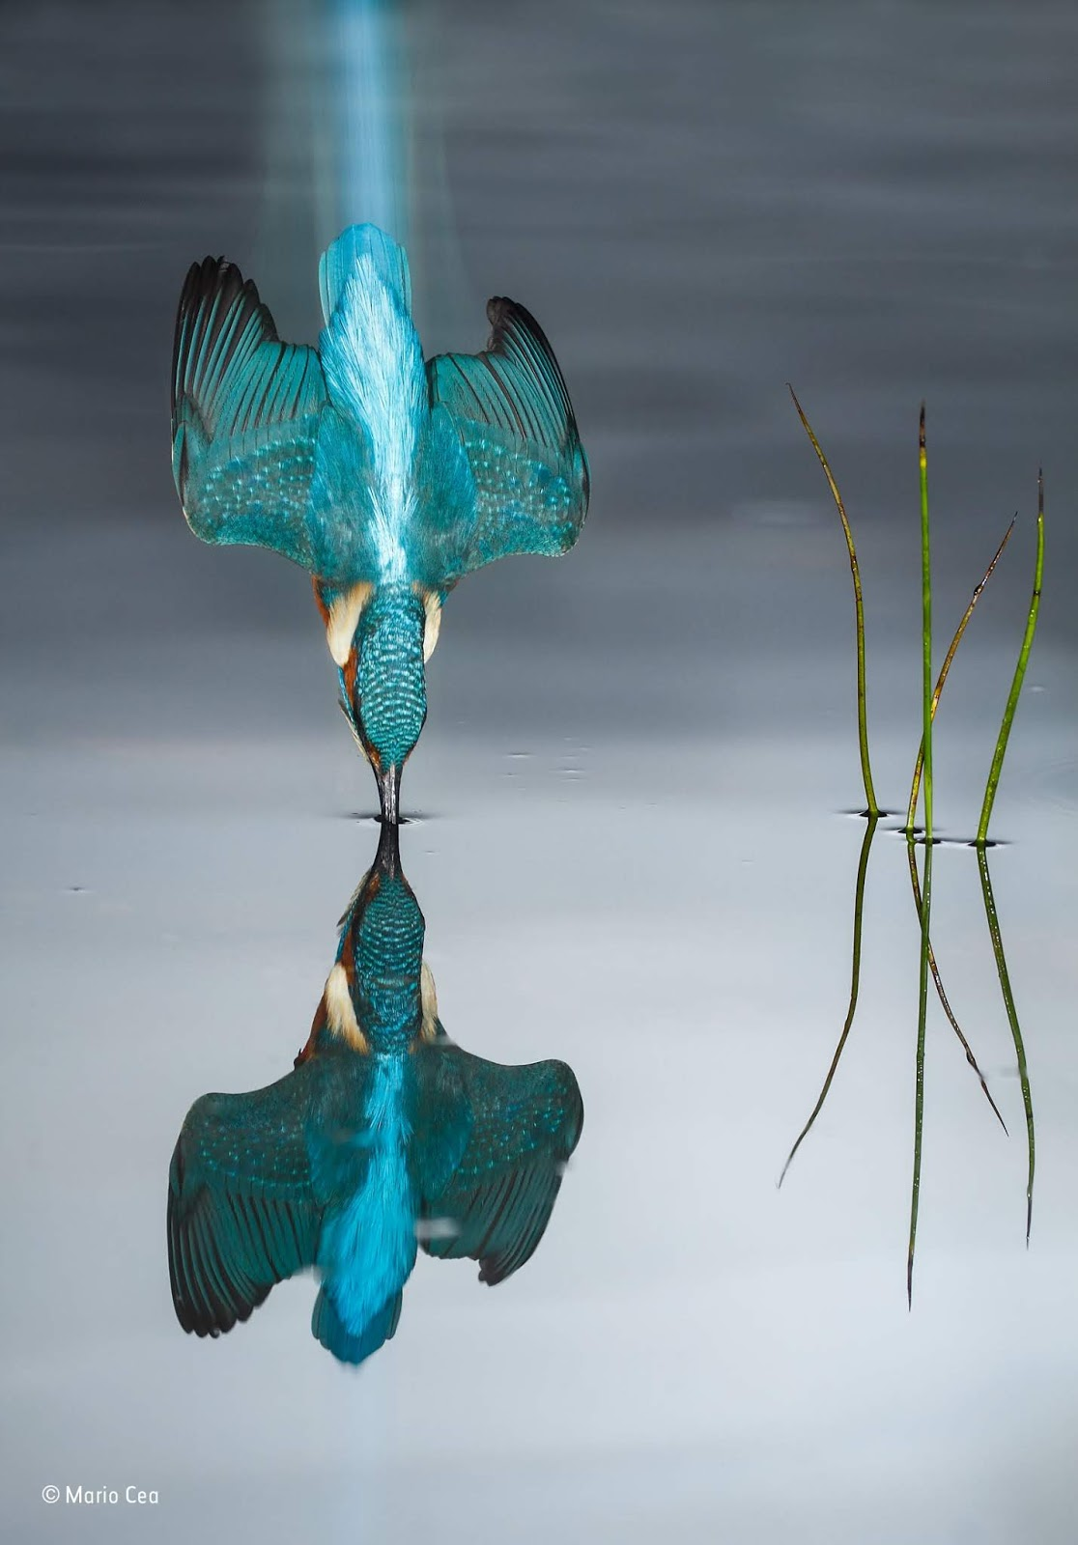
The Kingfisher
Kingfishers or Alcedinidae are a family of small to medium-sized, brightly colored birds in the order Coraciiformes. They have a cosmopolitan distribution, with most species found in the tropical regions of Africa, Asia, and Oceania. The family contains 114 species and is divided into three subfamilies and 19 genera. All kingfishers have large heads, long, sharp, pointed bills, short legs, and stubby tails.

Slide 5
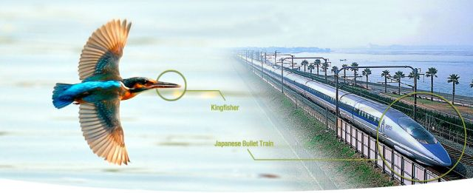
Why is Kingfisher useful at technology research?
Japan's famous bullet train used to make a loud boom when it travelled through tunnels. But, thanks to a spot of bird-watching, an engineer was able to fix the problem after he was inspired by a kingfisher.
https://www.bbc.com/news/av/science-environment-47673287/how-a-kingfisher-helped-reshape-japan-s-bullet-train

Slide 6
Thanks for listening,
hope you enjoyed it!

