Slide 1
BIOMIMICRY
WITH
WHALES
Quim Solé

Slide 2
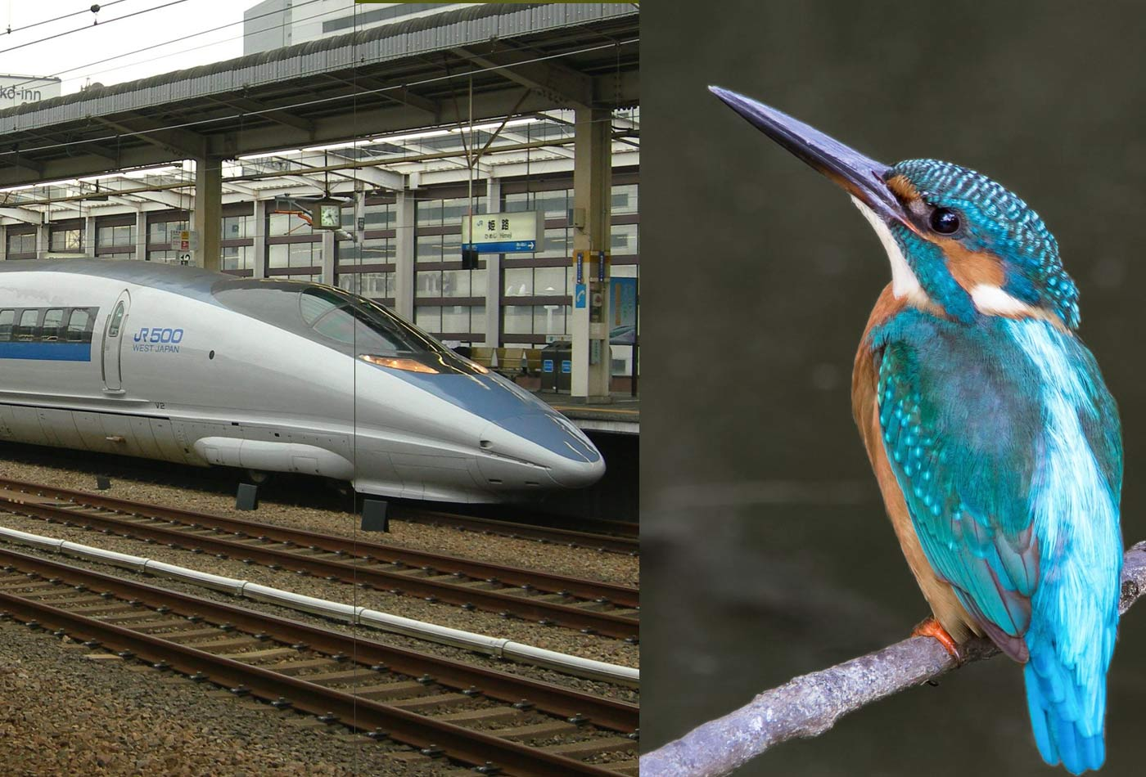
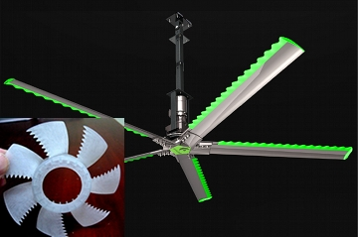
What is biomimicry?
It is the application of nature’s physics, chemistry, biology and technology to help us make more efficient scientific development.

Slide 3
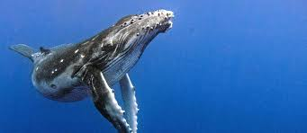
Why whales?
Whales are a big marine life form which need a lot of strength to move in water. Has it only to do with strength?

Slide 4
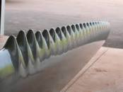
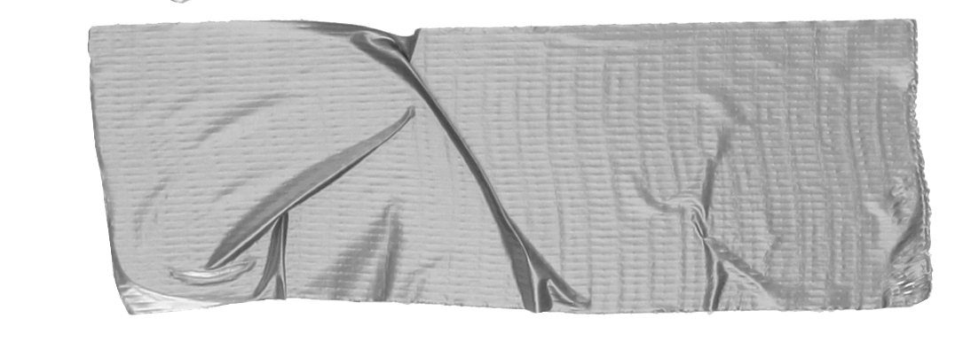
They use physics to help themselves and not use all the strength required
This was discovered by a man called Frank Fish, which after 30 years turned that physical process into technology

Slide 5
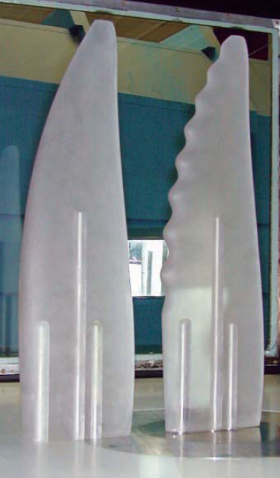
The whale flippers in a fan move 25% more air and require
25% less energy to move
at the same speed

Slide 6
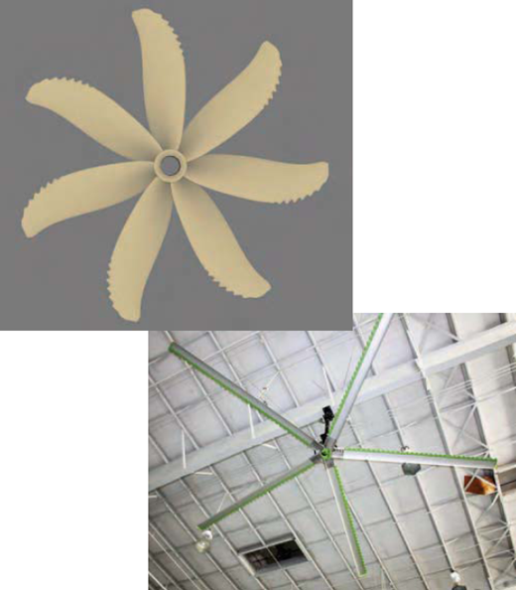
Their zigzag-shaped ending is the clue on the increased efficiency, and clearly will save lots of energy in the future

Slide 7
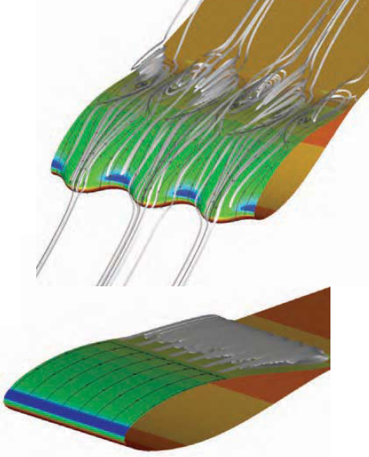
This image represents how does the air go through the flippers
Consejo
Si es posible, cuéntale el problema a la audiencia a través de la historia de una persona.

Slide 8
Webgraphy:
From whales to fans, Alan S. Brown, May 1, 2011, ASME Digital collection, April 16, 2020 https://asmedigitalcollection.asme.org/memagazineselect/article/133/05/24/442647/From-Whales-to-FansA-Second-Look-at-a-Piece-of

Slide 9
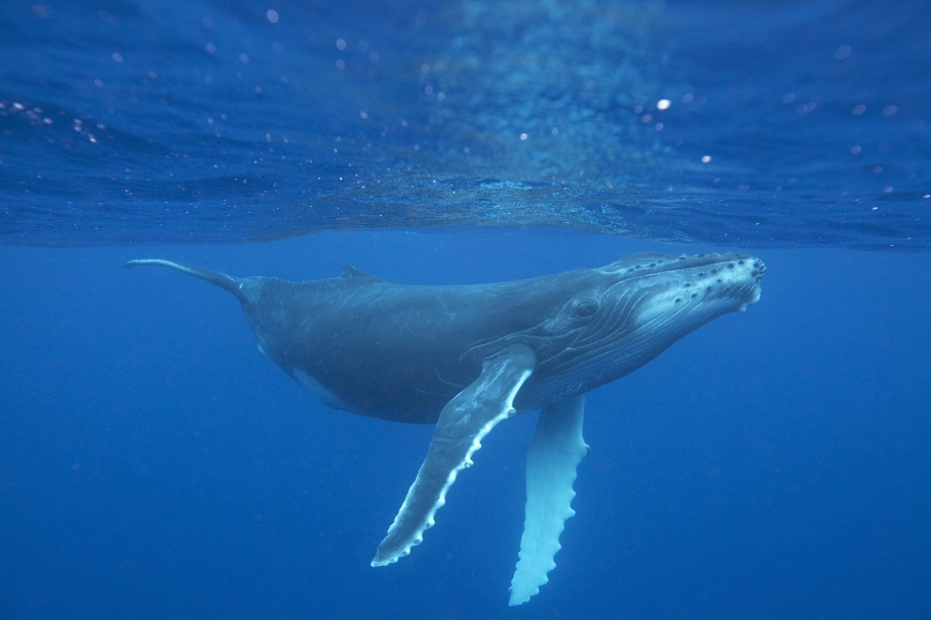
Thank you for your attention!
And thank whales for being awesome!

