Slide 1
the Game
Inspired by nanotechnology and Biomimicry

Slide 2
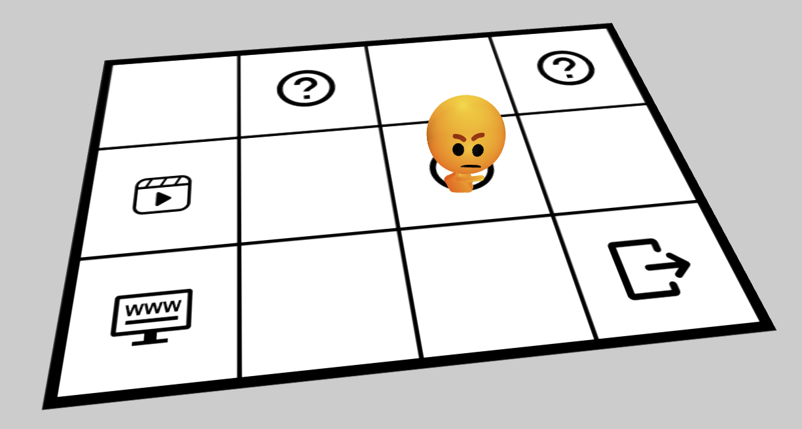
The aim
The aim is to escape from 4 rooms

Slide 3
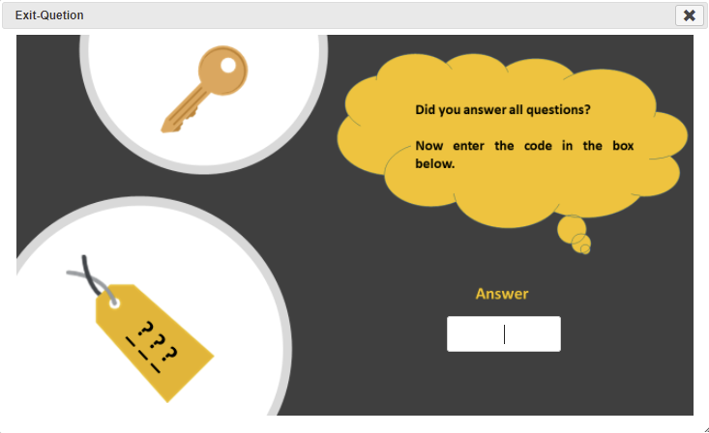
The code
In order to escape, you must enter the correct code at the end of each room

Slide 4
The code
Each code consists of 3 or 4 characters which you will find from the correct answer
If you have answered three questions and the correct answer from the first question is “c” from the second is “a” and from the third is “2” then the code will be “ca2”

Slide 5
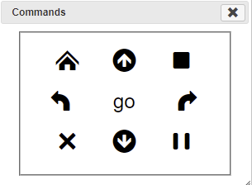
Moves explained
You can move the figures in the room using the keys
↑ One step forward
↓ One step back
↶ Left turn
↷ Right turn
GO Move

Slide 6
Icons explain
You can gather information and read questions.
Question
Video
Activity
Web page
Exit

Slide 7
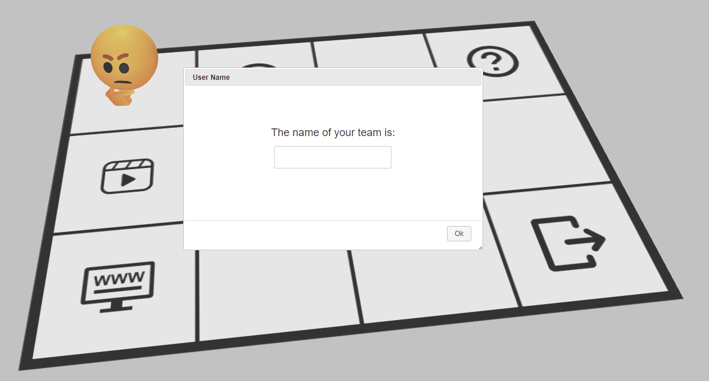
Login
First, write the name of your team
which will be visible to everyone (so please be careful!!!).

Slide 8
The address is
www.seilias.gr/erasmus/greece
Good Luck

