Slide 1
Torre Vicens School

Slide 2
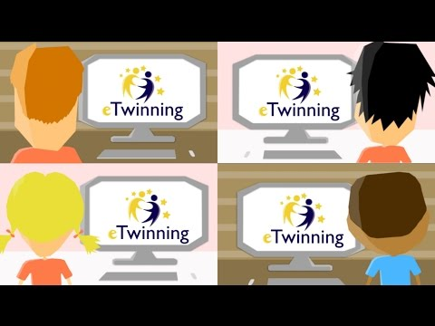
Let’s start an eTwinning

Slide 4
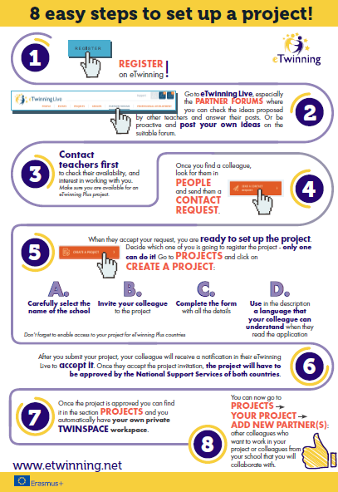

Slide 5
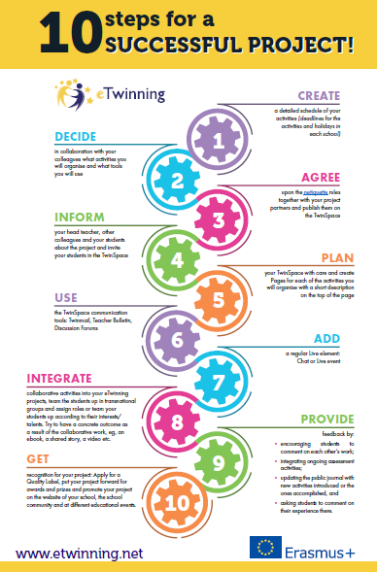

Slide 6
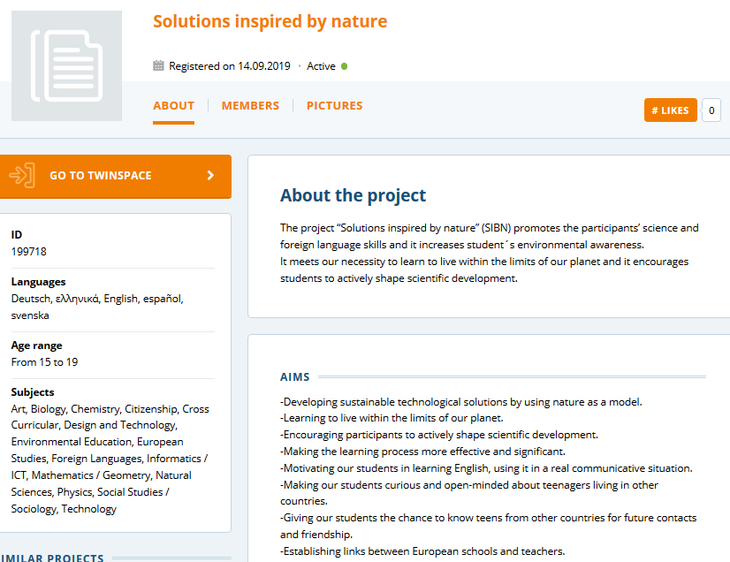
eTwinning
project:
ISBN (1)
Project
Aims

Slide 7
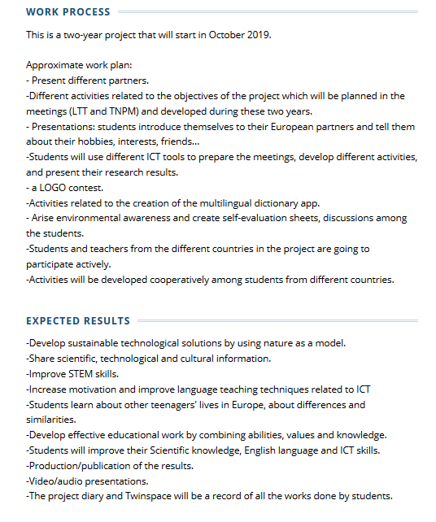
eTwinning
project:
ISBN (2)
Work and results

Slide 8
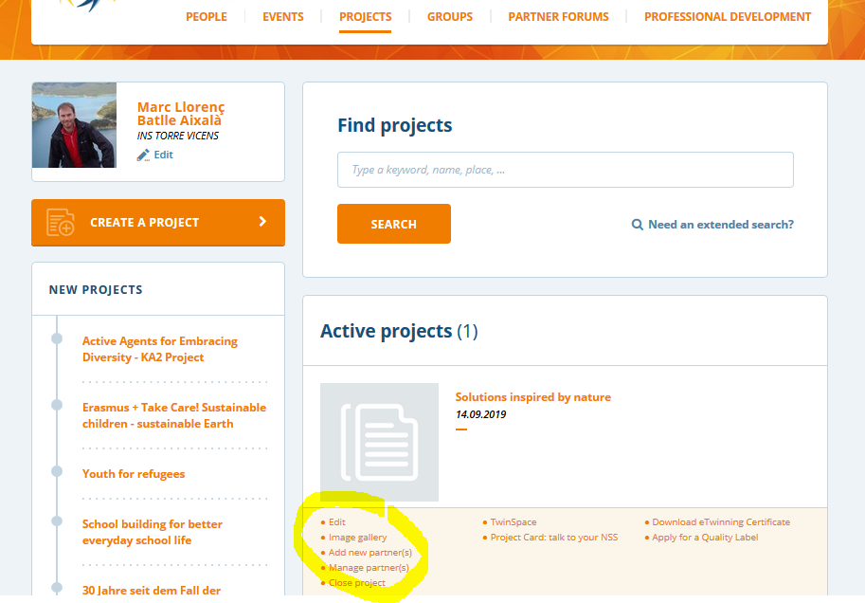
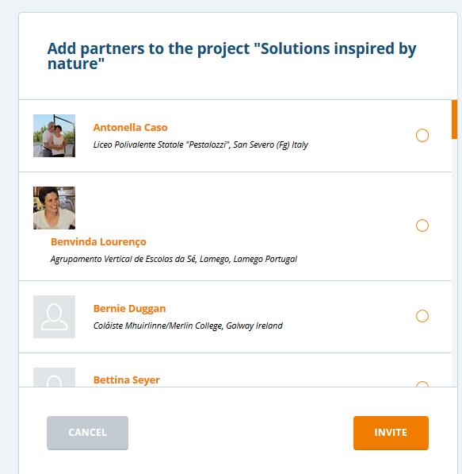
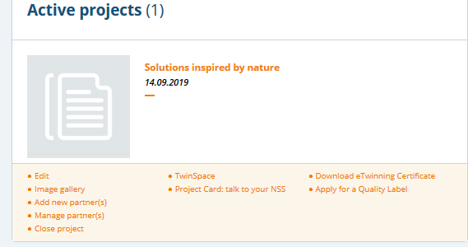
Firsts steps:
Be participant
Be friends in eTwinning
Add teachers participants

Slide 9
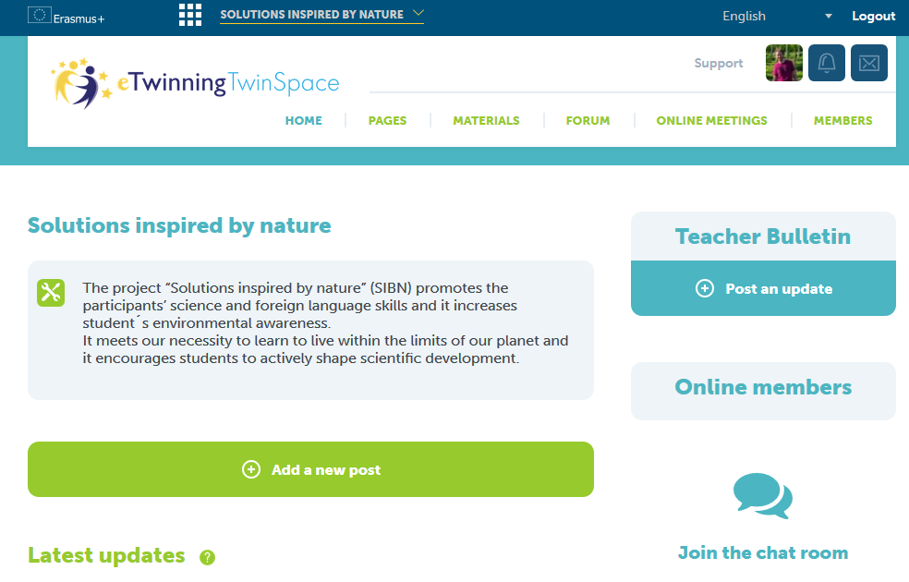
Twinspace Home

Slide 10
Twinspace
The design and organization of the TwinSpace correspond to the partners.
The TwinSpace is the place where all the materials (files, videos, documents) are housed; It is also the space in which the partners communicate (both teachers and students), through chat, videoconference, forum, profile, or other embedded external tools.
These communication tools facilitate the development of planned tasks and in particular the preparation and monitoring of teacher and / or student mobility if they are planned within the association. After mobility, they facilitate communication and interaction between partners.
The development of the tasks and the results achieved are stored in the activity pages.

Slide 11
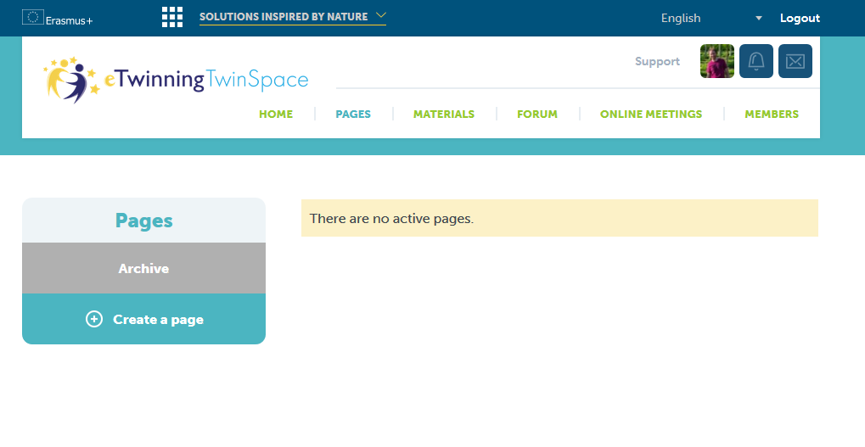
Twinspace Pages 1

Slide 12
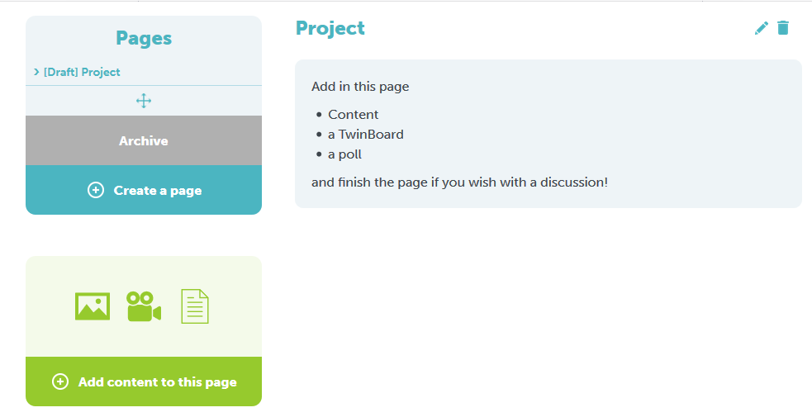
Twinspace : Pages 2 Project

Slide 13
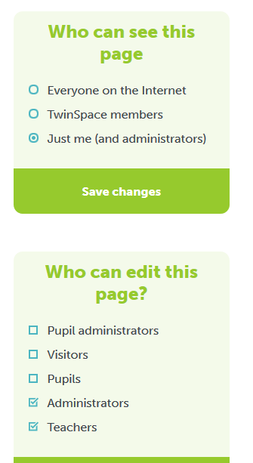
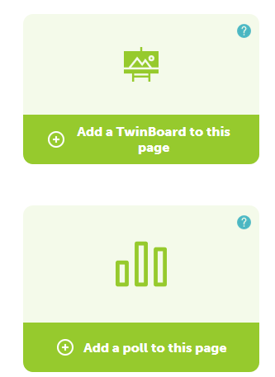
Twinspace : Pages 3

Slide 14
Twinspace page: Example before - during - after
Who we are? Schools, teachers, students, countries. Description, Map, Vokis, Photos
Timeline
Activities: Logos contest, learnings, instruction booklets, word dictionary, visits, projects, scientific research, presentation, instruction booklets, forums, discussion, surveys, games, videos, videoconference, etc.
Teacher Meetings
Student meetings
School projects online
Evaluation : rubrics, surveys, initial, intermediate, final, ...
Dissemination: news, social network sites, poster, contest, seminars, exhibition...

Slide 15
Activities
Orientation:
Concept maps: http://bubble.us, http://mindmeister.com, http://mindomo.com
Timeline: www.timetoaster.com
Forums: TwinSpace Forum
Comunication:
Debate: foros de TwinSpace, www.tricider.com, http://www.createdebate.com, www.voxopop.com
Line activity: Adobe Connect (available in TwinSpace)
Group work: http://backchannelchat.com/ https://palms.polyu.edu.hk:8448/
Cooperation:
Design logos
Cooperative work (history) http://meetingwords.com/
Learn new languages https://voicethread.com/
Evaluation
Kahoot, Quizz, Google forms, Corubrics
Follow-up
Diary, book, magazine online, videos https://piktochart.com

Slide 16
Participants images - DISSEMINATION
Use of participants images in photos and videos: school should sign an agreement where we indicate we could use their image in the etwinning platform and other activities related with the project.
How do we manage in the project?
Social network sites
Newspapers
School website
Visits in Companies / Townhall / University …
We should upload the permission of images
in platform.
eSAFETY
Country rules?

Slide 17
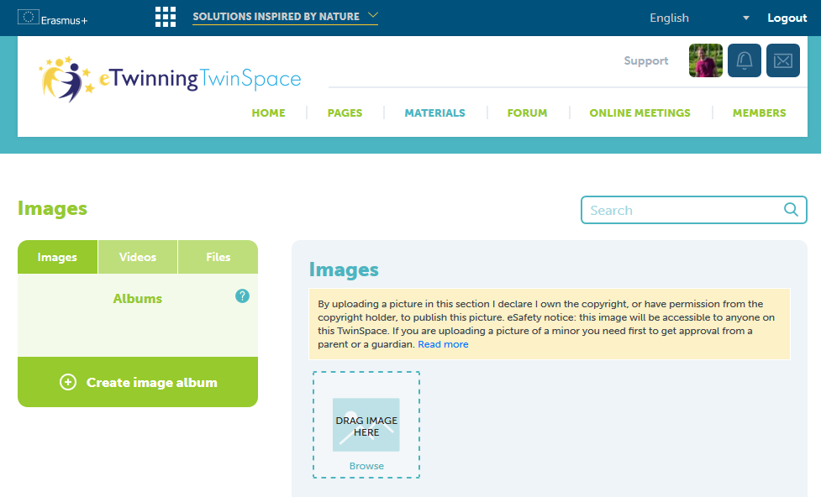
Images / videos / files

Slide 18
Creative commons
Where do we obtain free images / music / videos for our activities ?
Take by ourselves
https://ccsearch.creativecommons.org/ Images
pixabay.com
pexels.com
unsplash.com
flaticon.com (icon)
all-free-download.com
Music:
youtube library
aurionautix.com
jamendo.com

Slide 19
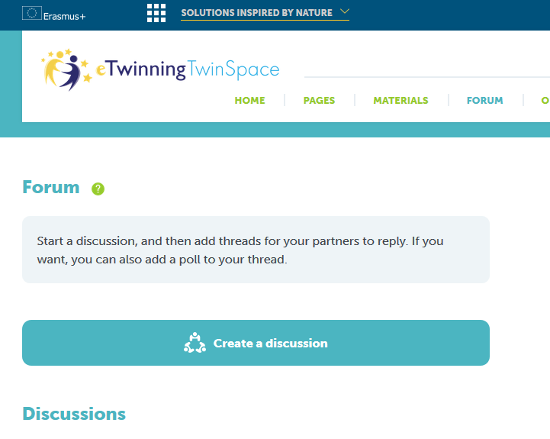
Forum
Discussions

Slide 20
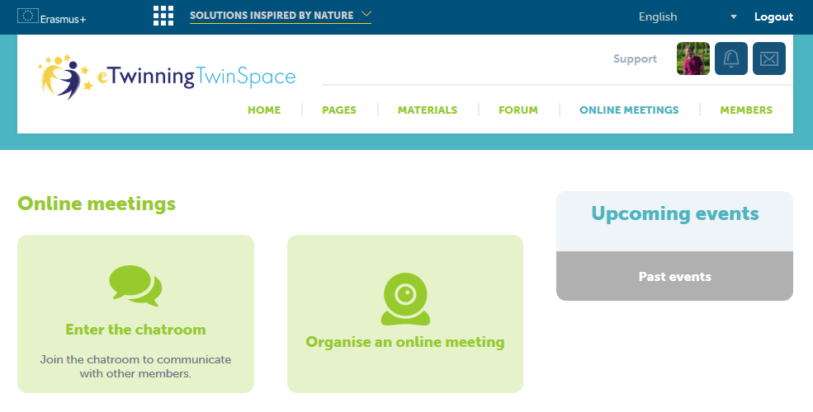
Online meetings

Slide 21
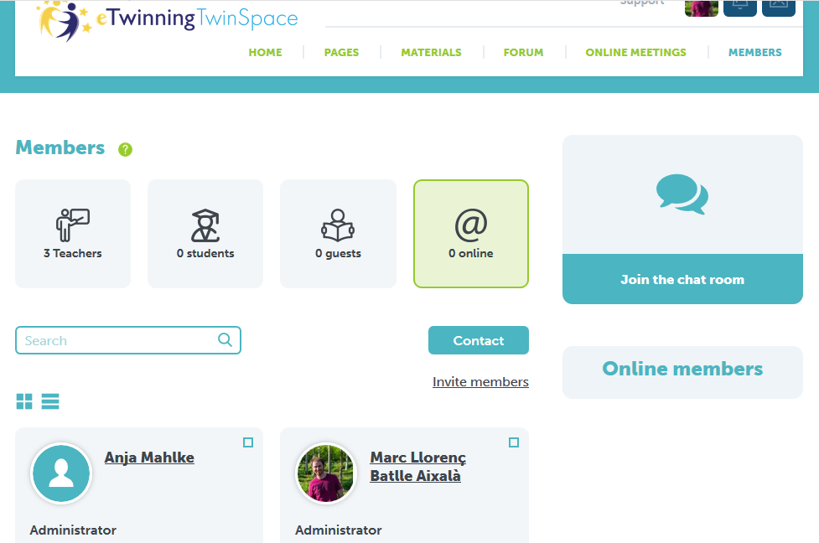
Members (1)

Slide 22
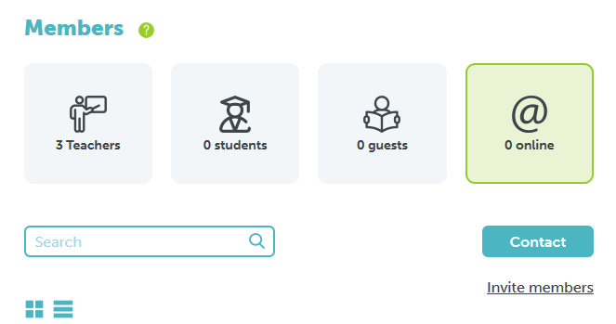
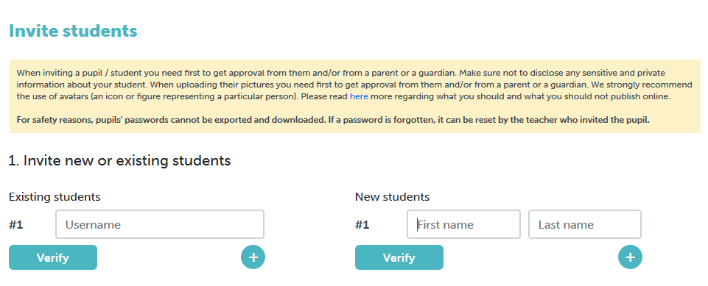
Members (2)

Slide 23
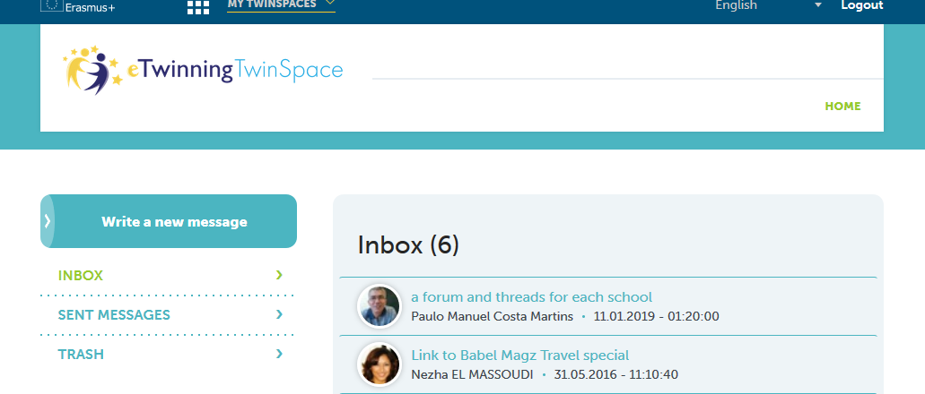
MESSAGES / NOTES

Slide 24
Thanks for your attention

