Slide 1
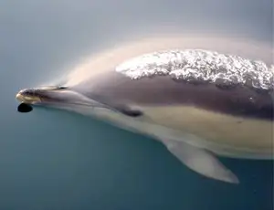
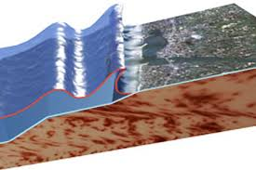
BIOMIMESIS
Name: MAMA DIABY
Class: 1 BATX A
Teacher:MARC BALLE

Slide 2
INDEX
*WHAT IS BIOMIMESIS?
DOLPHINS AND THEIR ECOLOCALITATION SYSTEM
TSUNAMIS SYSTEM
HOW THE EARTHQUAKE DETECTION SYSTEM WORKS
WEBGRAPHY

Slide 3
WHAT IS BIOMIMESIS?
Biomimesis is the science that studies nature as a way of inspiration for technology in this way we give the merits to nature as a generator of our knowledge and with that of current technology

Slide 4
DOLPHINES AND THEIR ECHOLOCATION SYSTEM
In my case, I will talk about dolphins. They are consider one of the smartest mammals in the animal species. They have an echolocation system that gives the ability to locate objects through the sound. They use to locate their prayers using their sounds echoes. These use low-frequency waves to communicate with each other, and high-frequency ones for echolocation. They have an special anatomy adapted to the emission and reception of certain sounds

Slide 5
TSUNAMIS SYSTEM
Researchers have been inspired by dolphins to design a tsunami alert system. Using the echolocation system, we can obtain the magnitude, the location and the depth of the earthquake.
This system is based on the Richter scale with a logarithmic scale, that helps to identify the intensity of earthquakes.
We should consider the location and the depth from the epicenter and the friction of geological fault and the composition of the earth when an earthquake is detected.

Slide 6
WEBGRAPHY
https://youtu.bqe/BKQsrbHRWNU.(autor :ECU911)
https://youtu.be/Csyl5RGhcdM (autor: BioEnsiclopedia)
https://youtu.be/AEdcRcEmZeU. (autor: Secretaría de Marina Armada de México)
https://youtu.be/J2Luc9LMamY. (autor: ACCIONA)
https://youtu.be/XSdrjoPImBs. (autor: Biomimeis Arquitectura)
https://youtu.be/JFF_dh0gwag. (autor:sustentAR TV)
https://youtu.be/qhxSVLCxupU. (autor :Amelia Belén Sánchez Rodríguez)
https://youtu.be/zW9aWjMSYOA .(auror: RPP Noticias)

