Slide 1
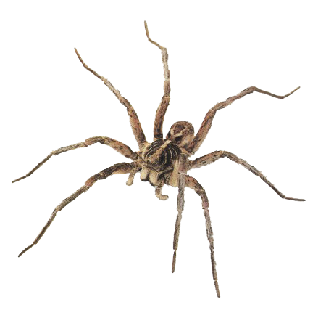
By:
Wiktoria Zawialow
Biomimesis With
Spiders

Slide 2
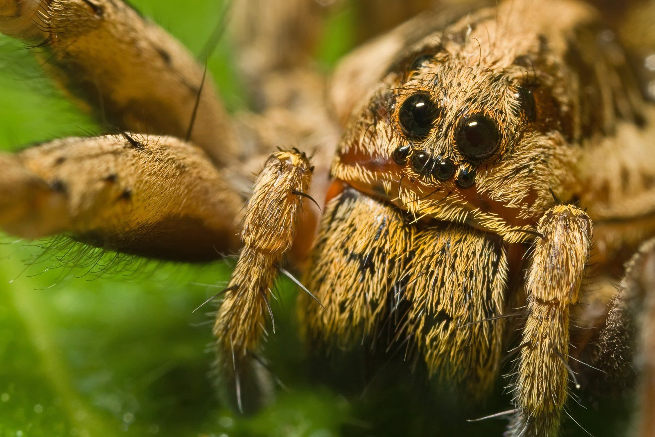
Seriously Spiders? Ew...
They might look a bit revolting, but don’t let their appearance fool you, spiders are really helpful and intelligent creatures.
sfs
Though they have four pairs of eyes, scientists have proven that spiders are almost blind. That’s why they have to recompense their nearly nonexistent sight with other senses.
They have the ability to recognise humans, learn from past experiences and even solve problems.

Slide 3
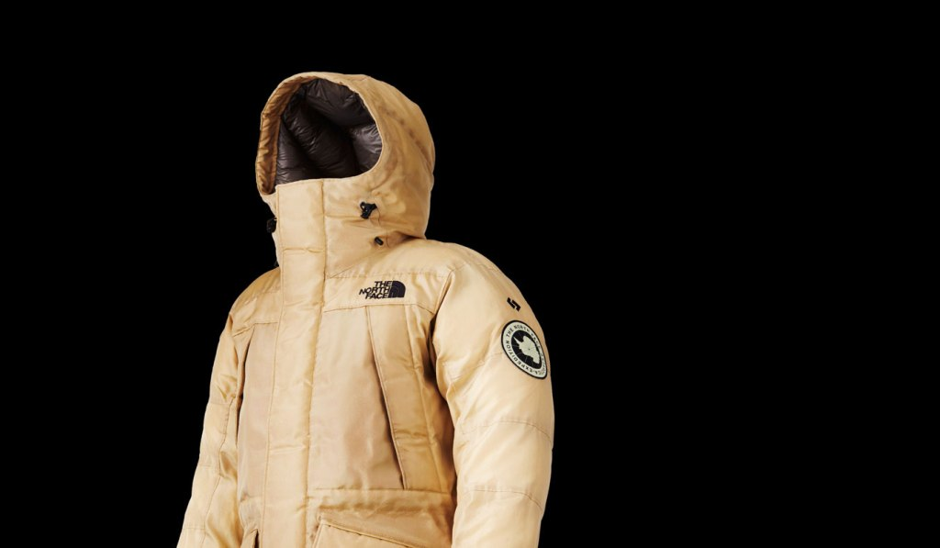
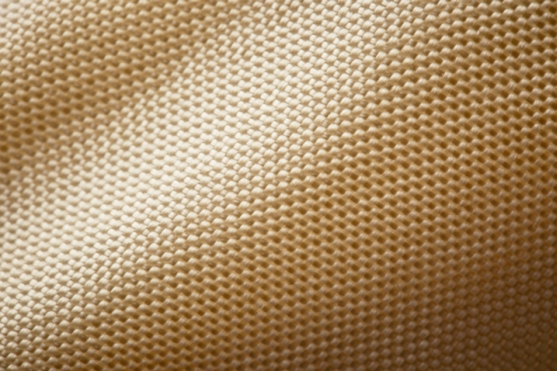
The Spider Silk
sfs
Spider silk is as strong as steel, lighter than carbon fibre, and tougher than Kevlar.
For those exact reasons, the North Face company decided to create a synthetic version of this material to help them design a jacket.

Slide 4
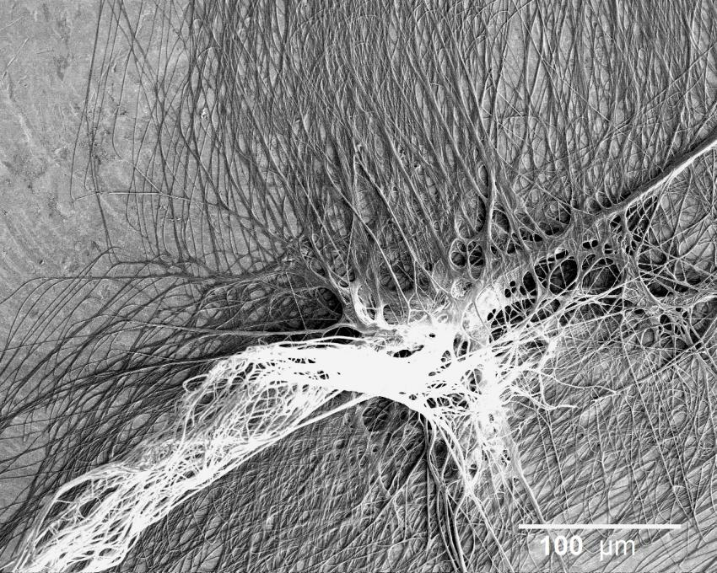
Let’s Help The Doctors Out!
Since spider silk is really sticky, researchers at the University of Akron are trying to figure out if they could use the synthetic version of the silk and use it to attach bones and tendons together during surgeries.
sfs

Slide 5
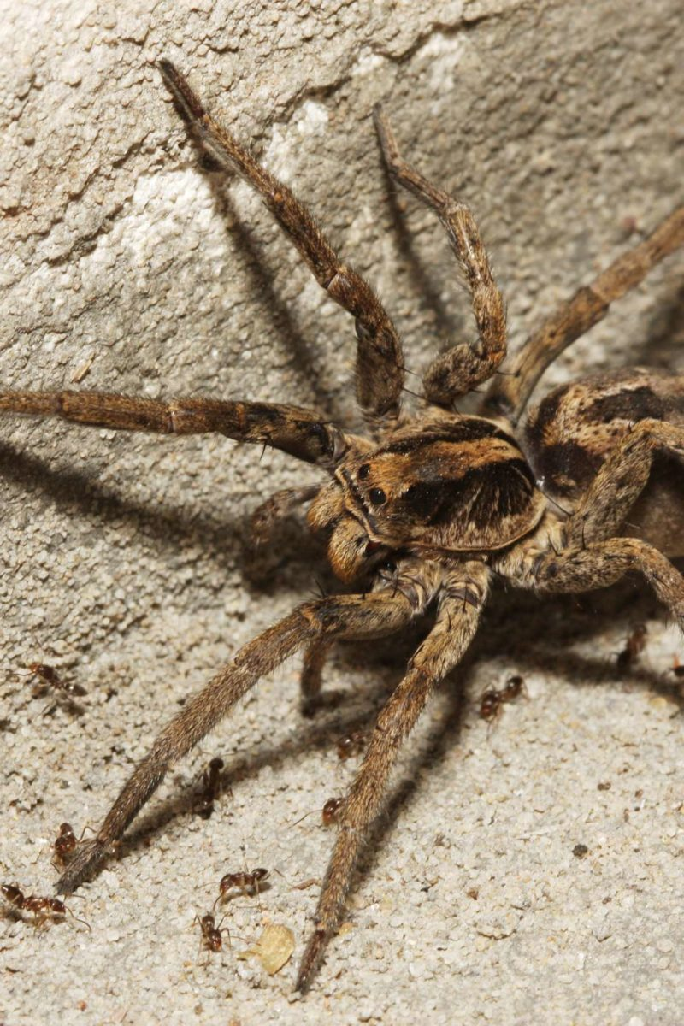
Spider Powers!
Spiders have one of the world’s most sensitive vibration detectors: they can pick up the slightest rustling of a leaf from several meters away.
Now, scientists have developed similar sensors that can detect simple human speech. The technology could lead to wearable electronics for speech recognition, health monitoring, and who knows what else.
sfs

Slide 6
Bibliography:
https://www.scoop.it/topic/biomimicry/?&tag=Spider
https://th.bing.com/th?id=OIP.0UdCvwqrjKQ-_F4suTGP2wHaEK&pid=Api&w=208&h=116
https://th.bing.com/th?id=OIP.1UD91tnpJZUtn_NRc3MUQQHaE1&pid=Api&w=204&h=133&dpr=1,25
https://scx2.b-cdn.net/gfx/news/hires/2014/spidersspinp.jpg
https://images.squarespace-cdn.com/content/v1/55cf0ab9e4b030e59df76c9f/1446802936354-6STV77IV1ORSQI0ELUQB/ke17ZwdGBToddI8pDm48kCKTt8a7LIDpOpilsEC_saVZw-zPPgdn4jUwVcJE1ZvWQUxwkmyExglNqGp0IvTJZUJFbgE-7XRK3dMEBRBhUpxFQeYc9AMcCGY71BmvEdhAIaaLAyxFvKUn9AKlVkDbDFq7WtuuMv1RCPXSlNxNJhc/image-asset.jpeg
https://i1.wp.com/www.muted.com/wp-content/uploads/2015/11/The-North-Face-x-Spiber-Moon-Parka-01.jpg?fit=1024%2C597&ssl=1
https://i.pinimg.com/originals/7e/93/12/7e931271ec2c13c20ce261441e042b63.png
https://i.pinimg.com/originals/bb/a1/64/bba1648e3e678180bf9b797e78bd0a63.jpg
https://encrypted-tbn0.gstatic.com/images?q=tbn%3AANd9GcQOsw3pbMF7_RaP0E8t1WtPsnt4Tu4YgquxVJOyJ2j6iRppQT3q&usqp=CAU
https://www.shutterstock.com/pl/video/clip-30787285-cobweb-covered-dew-drops-sparkling-moving-wind
sfs

Slide 7
sfs
END

