Slide 1
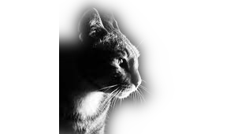
BIOMIMICRY : CAT
David Muñoz 1st Batx A, Ins Torrevicens

Slide 2
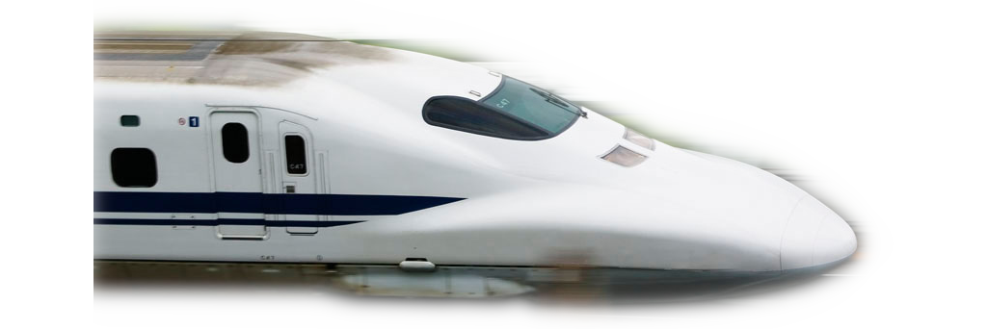
What’s biomimicry?
It is a practice that learns from and mimics the strategies used by species alive today. The goal is to create products, processes, and policies — new ways of living — that solve our greatest design challenges sustainably and in solidarity with all life on earth.

Slide 3
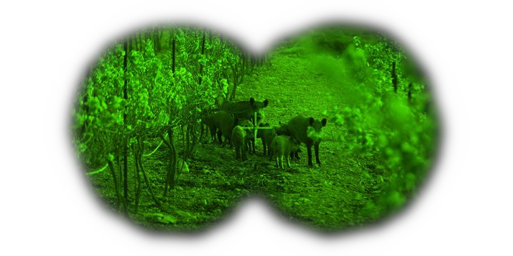
Cat’s night vision
Cats have the hability to see 8 times better than the human in dark spaces due to the high amount of photoreceptors in their eyes.
Due to this, the scientifics invented the night vision goggles

Slide 4
Night vision goggles
We cannot just increase the number of photoreceptors in our eyes, and the cats night vision isn’t as good as you think.
The vision that the goggles give to you is twenty-five thousand times more clear than the natural. They also incorporate an infrared light lamp, because the glasses are useless if there is no light in the room.

Slide 5
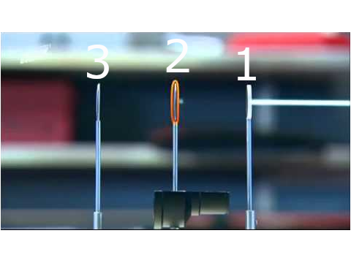
The concept that the currently night vision goggles use is pretty simple.
The system is made by three different lenses. In the point 1 the lens doesn’t allow the light to pass, only electrons can pass. In the point 2 the lens multiplies the number of electrons exponentially. Then, in the point 3, due to a special property that transforms the electrons into photons.
Finally the image is duplicated (one for each eye).

Slide 6
Webgraphy:
Image 1: Kitten Toob. Maria McCutchen. 2011 . 26 July 2018. https://kittentoob.com/
Image 2: Fourboxes. 11 December 2015. https://fourboxesgroup.com/
Image 3: Huffpost. Sascha Brodsky. 2005. 10 December 2017. https://www.huffpost.com/
Image 4 & How does the night goggle work: Discovery Max. Evelyne Dalby. 1 February 2018. https://youtu.be/iI0B1sPPNjc
Biomimicry: Biomimicry institute. 2006. Biomimicry institute. https://biomimicry.org/

