Slide 1
Biomimesis
“Hypodermic needles”
Roger Castells
1st Batx

Slide 2
What is biomimesis?
Biomimesis is the imitation of the models, systems, and elements of nature for the purpose of solving complex human problems.

Slide 3
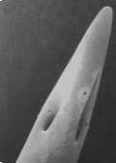
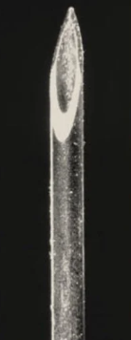
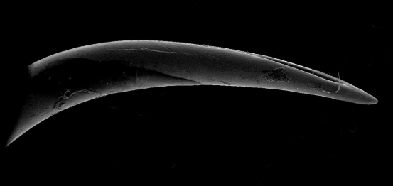
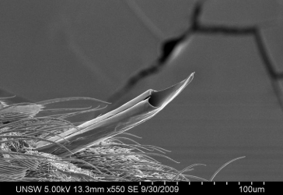
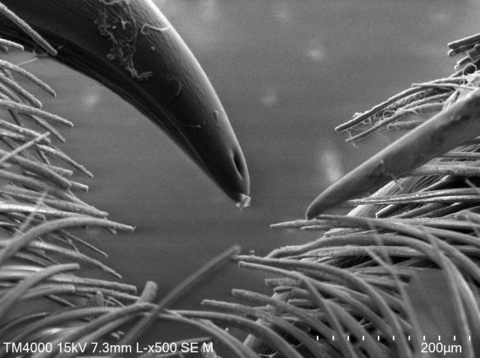
“CHALLENGE”
Only 5 images under a electron microscope…….

Slide 4
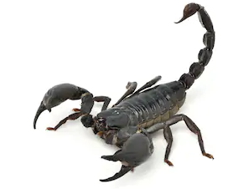
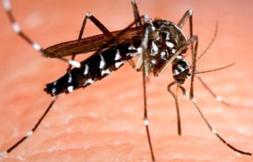
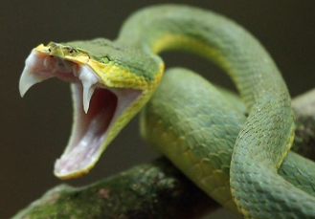
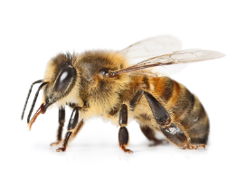
SOLUTION
Only one image was a needle, the others were only fangs and stingers.

Slide 5
WHY?
“Conclusions”
Well, the purpose of this fangs and stingers are to inject the maximum liquid in a given time with least resistance.
So, if we compare this characteristic of this animals with the hypodermic needles that are used in sanitary fields, we could say that this invention was based in this type of animals.

Slide 6
WEBGRAFY
Naukas. Entomoblog. 25 novembre de 2011. 25 abril 2020. https://naukas.com/2011/11/25/veneno-escorpiones/
Illinois News Bureau. Diana Yates. 16 abril 2019. News Bureau. 26 abril 2020 https://news.illinois.edu/view/6367/775344
Wikipedia. 17 april 2020. Wikipedia. 25 abril 2020 https://en.wikipedia.org/wiki/Biomimetics
Kirrawee High School. 26 abril 2020 https://kirraweehigh.school/learning/scanning-electron-microscope/
AskNature Team. 14 setembre 2016. 26 abril 2020 https://asknature.org/strategy/needle-like-structure-inserts-painlessly/
Reddit. Pontmaster. 1 year ago. Reddit. 25 abril 2020 https://www.reddit.com/r/natureismetal/comments/8hdcdu/a_hypodermic_needle_b_viper_fang_c_spider_fang_d/

