Slide 1
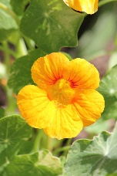
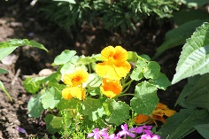
Ποτέ μην χάνετε την ελπίδα γιατί τα θαύματα συμβαίνουν καθημερινά
Giving hope in difficult times
We all know that times are tough because of the Corona virus pandemic. So we- an international group of students from Sweden, Spain, Greece and Germany- want to do
a project to help people around the world.
Our idea aims at elderly people because
they are most vulnerable. We want to make your days more colorful and give you hope. The only thing you have to do is to take care of a plant, more specifically
nasturtium (Tropaeolum Majus ). We choose this plant because it flourishes in many different places around the world. Have fun with it!
We look forward to hearing from you:
Nunca pierdas la esperanza porque los milagros ocurren todos los días
Verliere nie die Hoffnung denn jeden Tag geschehen Wunder
Solutions inspired by Nature;
….. Please fill in your school‘s name and address.
Förlora aldrig hopp eftersom mirakel händer varje da

Slide 2
This is nasturtium Tropaeolum majus (nasturtium, Indian cress or monk cress) is a flower plant that has its origin from the north of Bolivia to Colombia. The leaves are disc-shaped and they have bright orange or red flowers. In addition all of the over ground plant parts are edible.
The fruit is 2 cm wide, divided into three parts and each segment has its own seed of a length from 1–1.5 cm.
This is how nasturtium makes your room or balcony more colorful Plant the seeds in a pot with seed soil in a sunny place and keep it always moist. Use little or no fertilizer, otherwise it will develop more leaves than flowers. When you water it, you can observe the special water-repellent feature of the leaves.
Nasturtium makes the food more colorful
The petals of the flower can be used as an especially decorative salad ingredient. It has a light peppery taste, which is like watercress, and it´s also used in stir fries.

