Slide 1
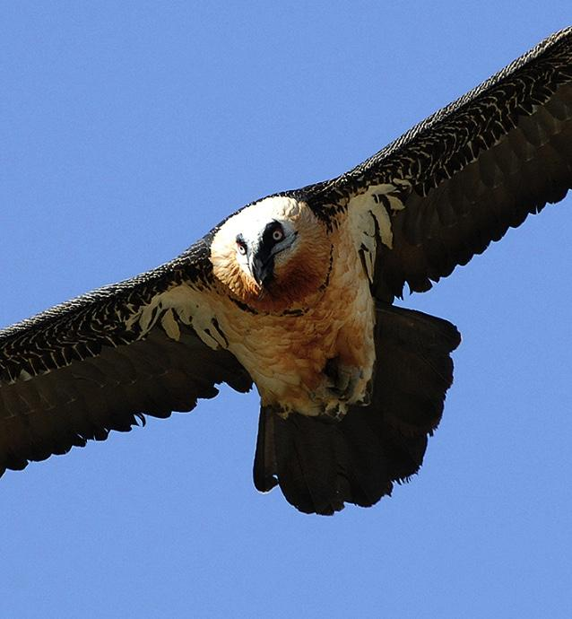
The Lammergeier
(Spain)
“Birds have to fly!”
Our national bird
Latvia, 26th-29th November 2019

Slide 2
The Lammergeier
Its scientific name Gypaetus barbatus refers to its body aspect (from the Greek “Gyps”: vulture and “aetos”: eagle and the Latin “barbatus”, referring to the beard that protrudes below its beak).
Its eyes are surrounded by a red sclerotic ring, which becomes more visible when the individual is aggressive or nervous. A black mask extends from the eyes to the base of the beak, where fine feathers (forming the beard) appear. On the top of the head there are black feathers that form a hood. The tail has a wedge or rhombus shape and the tarsi are covered with feathers.

Slide 3
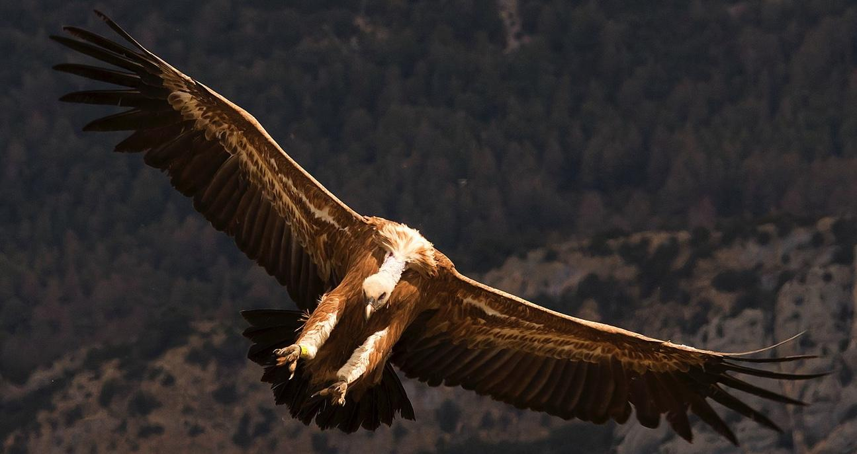
General information
Length: 94–125 cm long
Wingspan: 2.31–2.83 m
Weight 4.5–7.8 kg
Life expectancy: 20 years (more than 40 in captivity).

Slide 4
Habitat
It is a species that is present in mountainous zones, preferably those where there are open spaces and areas with steep walls. Their presence coincides with the existence of populations of wild ungulates and domestic livestock, which are their main source of food.

Slide 5
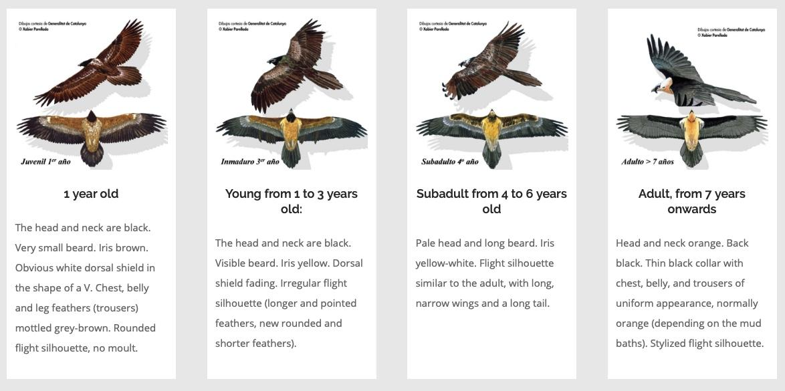
Plumage stages (feathers)

Slide 6
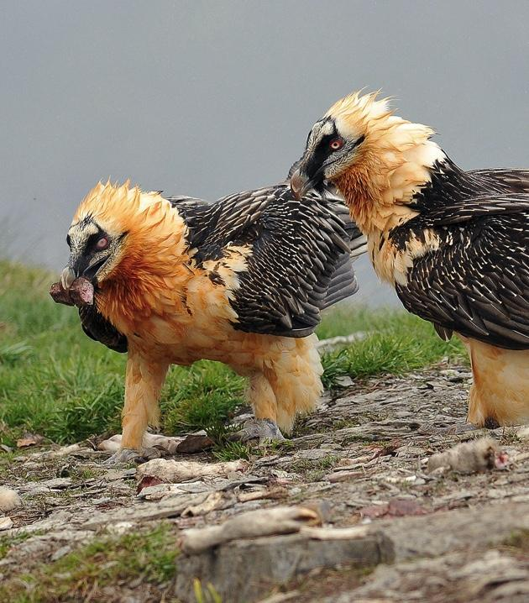
Nutrition
The Lammergeier is a scavenger bird, which specialises in feeding on bones. Its wide gape and the possession of a large number of acid-secreting cells facilitate the digestion of bones.
The bird´s common name in Spanish,”Quebrantahuesos”, comes from the particular technique it uses to ingest food. This consists of breaking large bones, which cannot be swallowed whole, into pieces of adequate size. The species achieves this by throwing the bones from the air onto rocky areas that are called “breakers”.

Slide 7
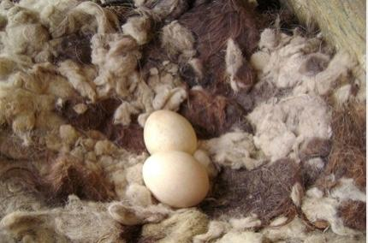
Reproduction
The Lammergeier has a long reproductive cycle, divided into several stages:
-pre-laying (September-November) -incubation (December-February) -breeding (March-August) -emancipation of chicks (January). During the pre-laying stage the species carries out activities related to the construction of the nest (preferably in caves), and territorial defence.The nests are composed mainly of branches and wool, this one fundamental for maintaining the temperature of the nest during incubation.

Slide 8
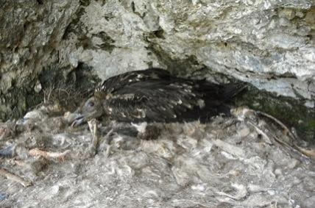
The species forms pairs at an average age of seven years and they make the first attempt to lay at between 8-10 years of age. Both males and females take part in incubation.
The average incubation period after laying is 53 days.
If two chicks are born the first chick has been observed to be aggressive towards the second one, which results in starvation of the younger chick, hence contributing to a reduction in the number of progeny.
The average age at which the chick leaves the nest is 120 days.

Slide 9
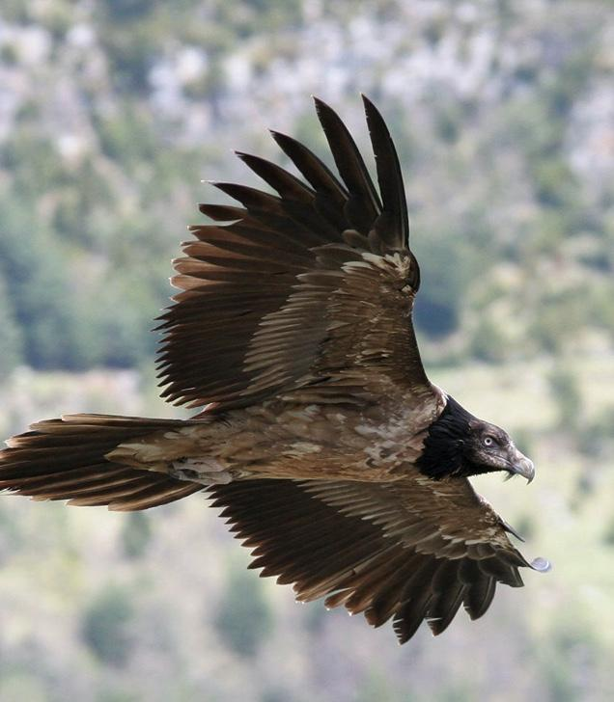
Juvenile dispersion
The pre-adults perform dispersive movements both within the Pyrenees and towards other mountain ranges: Picos de Europa, Sistema Ibérico etc. Possibly one of the most critical stages in the bird´s life cycle is juvenile dispersion.In most raptors, juveniles are more likely to make longer journeys, since a significant proportion of adults are territorial. The pre-adult birds tend to concentrate on the southern slopes of the Pyrenees (January-April).

Slide 10
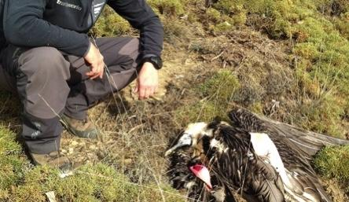
Threats
Factors that negatively affect the conservation of the species are unnatural mortality (poisoning and electrical lines), loss of habitat, reduction of food resources and failure of reproduction due to human disturbance (beatings during hunts, sports activities etc.).

Slide 11
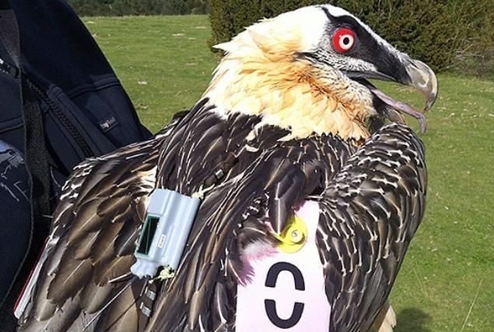
Satellite tracking
It is carried out by attaching satellite GPS (Global Position System) transmitters to the birds, which gives information about the exact position of the individuals, their hunting areas and their movements.

Slide 12
Information from: www.quebrantahuesos.org

