Slide 1
Miroslav Krleža
Bianca Malita, Jakub Pawlikowski, Alexandros Tsilikas, Vjeran Svečnjak, Fran Uljarević

Slide 2
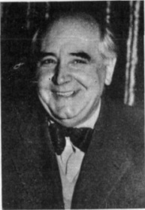
Miroslav Krleža- ( born 7 July 1893 – died 29 December 1981)was a Yugoslav and Croatian writer and a prominent figure in cultural life of both Yugoslav states, the Kingdom and the socijalist republic. He has often been proclaimed the greatest Croatian writer of the 20th century and beyond.

Slide 3
Biography
Miroslav Krleža was born in Zagreb. He enrolled in a preparatory military school in Pécs. At that time. Subsequently, he attended the Ludoviceum military academy at Budapest. In the post-World War I period Krleža established himself both as a major Modernist writer and politically controversial figure in Yugoslavia.
Krleža was the driving force behind leftist literary and political reviews. He was a member of the Communist Party of Yugoslavia from 1918, expelled in 1939 because of his unorthodox views on art, his defense of artistic freedom against Socialist realist doctrine. After the long polemic, pursued by Krleža with virtually every important writer in the Kingdom of Yugoslavia, in the period between the two World Wars. The Party commissar sent to mediate between Krleža and other leftist and party journals was Josip Broz Tito.
After the establishment of the Nazi puppet Independent State of Croatia under Ante Paveli, Krleža refused to join the Partisans now headed by Tito. Following a brief period of social stigmatization after 1945 – during which he nevertheless became a very influential vice-president of the Yugoslav Academy of Science and Arts in Zagreb. Supported by Tito, in 1950 Krleža founded the Yugoslav Institute for Lexicography, holding the position as its head until his death. The institute would be posthumously named after him, and is now called the Miroslav Krleža Institute of Lexicography.
From 1950 on, Krleža led a life of the high-profile writer and intellectual, often closely connected to Tito. He also briefly held the post of president of the Yugoslav writers' union between 1958 and 1961. In 1962 he received the for the novel Zastave, and in 1968 the Herder Prize.
Following the deaths of Tito in May 1980, and Bela Krleža in April 1981, Krleža spent most of his last years of his life in ill health. He was awarded the Laureate Of The International Botev Prize in 1981. He died in his villa Gvozd in Zagreb, on 29 December 1981 and was given a state funeral in Zagreb on 4 January 1982.

Slide 4
Work- Krleža's formative influences include Scandinavian drama, French symbolism and Austrian and German expressionism and modernism, with key authors like Ibsen, Strindberg, Nietzsche, Karl Kraus, Rilke, and Proust.
Krleža's opus can be divided into the following categories.
Poetry: "Balade Petrice Kerempuha", "Till Eulenspiegel".
Novels: "Povratak Filipa Latinovicza", "Banket u Blitvi", "War and Peace".
Short stories and novellas: "Hrvatski bog Mars".
Plays: " Gospoda Glembajevi".
Diaries and memoirs: "Notes from Tržič".

Slide 5
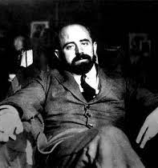
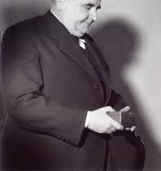

Slide 6
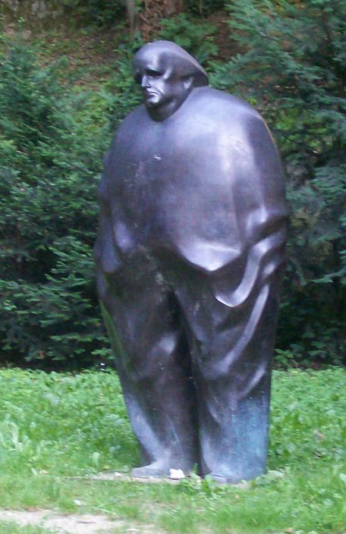
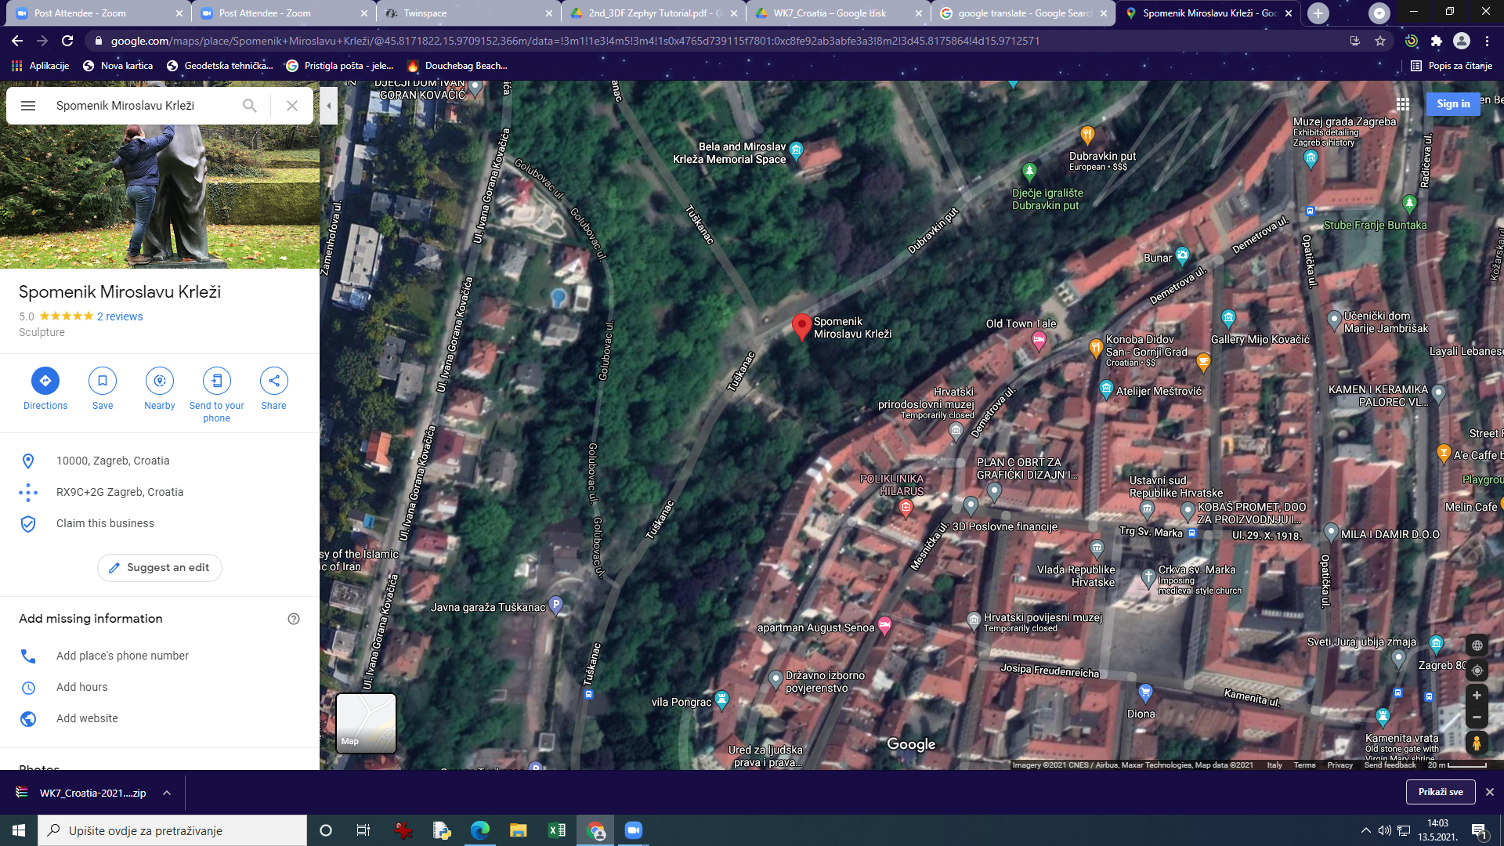
Miroslav Krleža monument
You can see the Krleža's monument in Zagreb near Dubravkin put.

Slide 7
Link for 3d model on youtube
https://www.youtube.com/watch?v=93EH2g0i3No

