Slide 1
Erasmus: strengthens european heritage
Workgroup 4

Slide 2
Members:
Konstantina Pavlidou
Aleksandra Lasota
Sven Redzepagic
Eva Panagiotidou
Aida Sabater
Leader: Samuel Silva

Slide 3
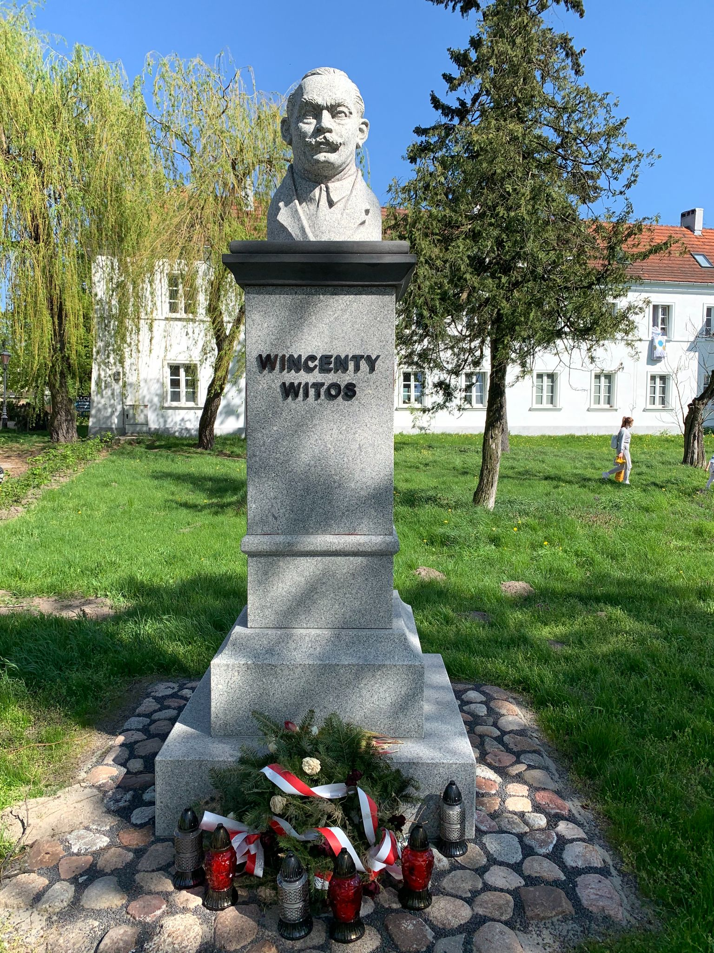
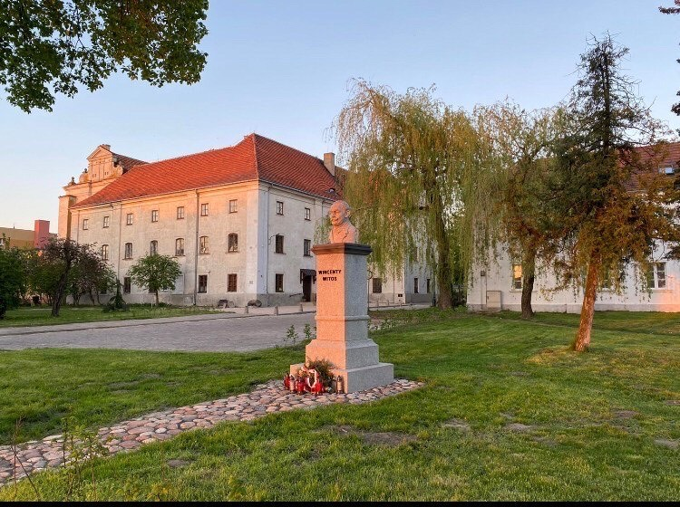
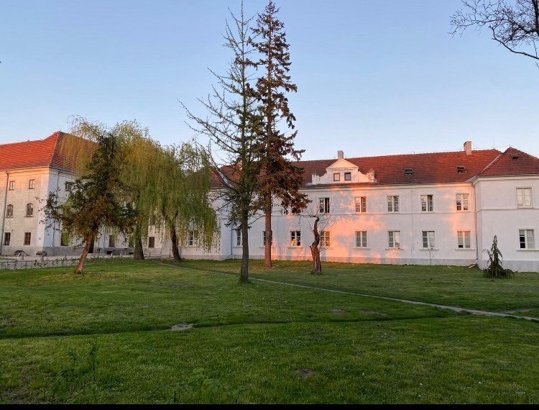
I. STATUE DESCRIPTION

Slide 4
STATUE DESCRIPTION
This monument is located at Stanisława Stanisławskiego Street in Łowicz. All passers-by can see it.
It was created on the initiative of members of the "Dom Ludowy" Society in Łowicz.
The statue has a realistic style and we think it’s very cool.

Slide 5
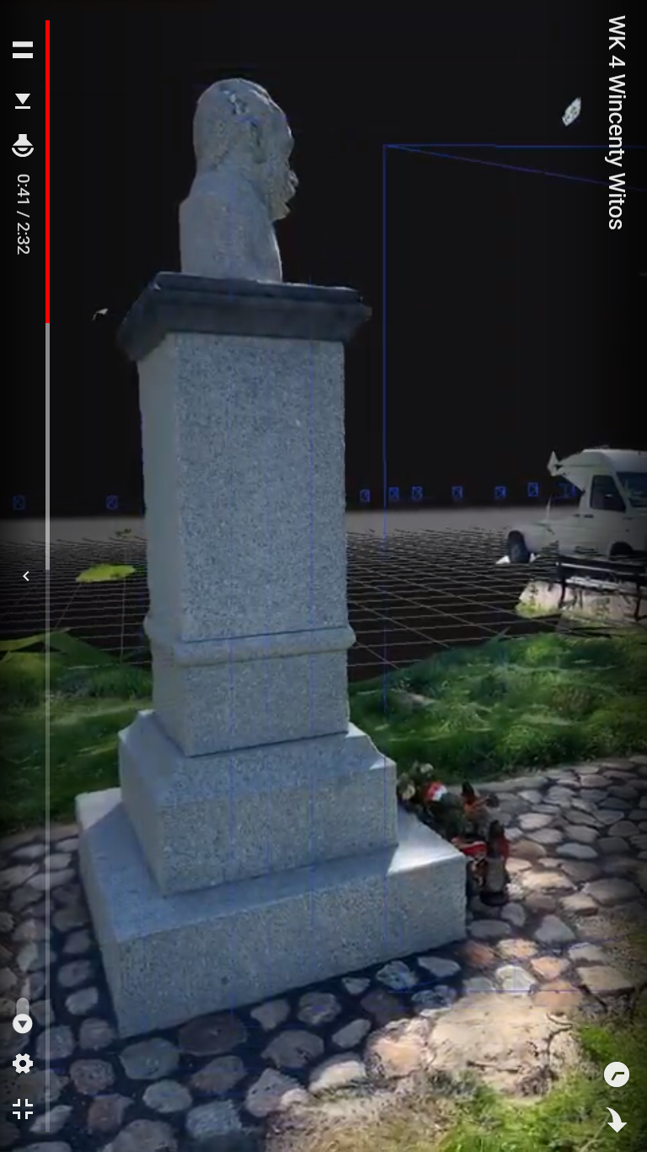
II. 3D MODELS OF THE STATUE
https://youtu.be/BXXGpi-_OpY
We tried to use 45 photos to make this 3D model, but in the end we only used 44.
The surface of the 3D model is completely closed.

Slide 6
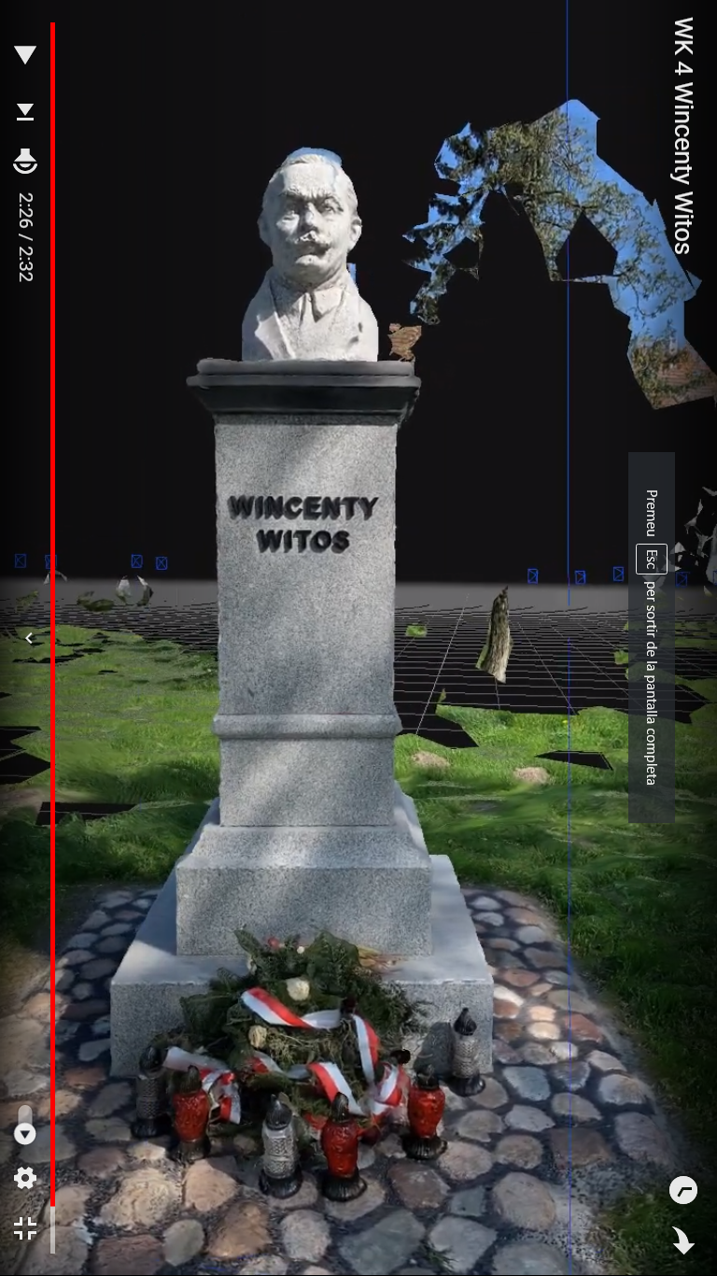
II. 3D MODEL OF THE STATUE
We didn’t have any problems makis the 3D model.
Sven did it with his computer and it turned on well.
The software was really user friendly.

Slide 7
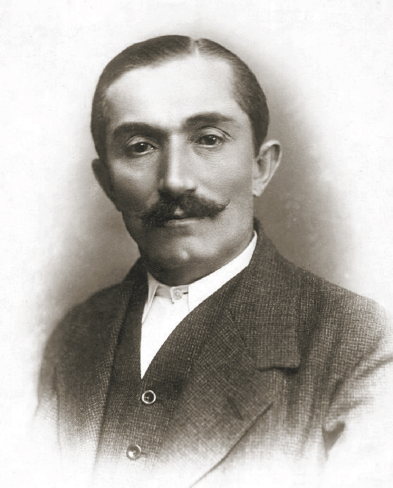
III. DESCRIBING THE PORTRAYED PERSON
This statue is dedicated to Wincenty Witos
He lived between 1874 and 1945.
He was form a polish family from
Wierzchosławice.

Slide 8
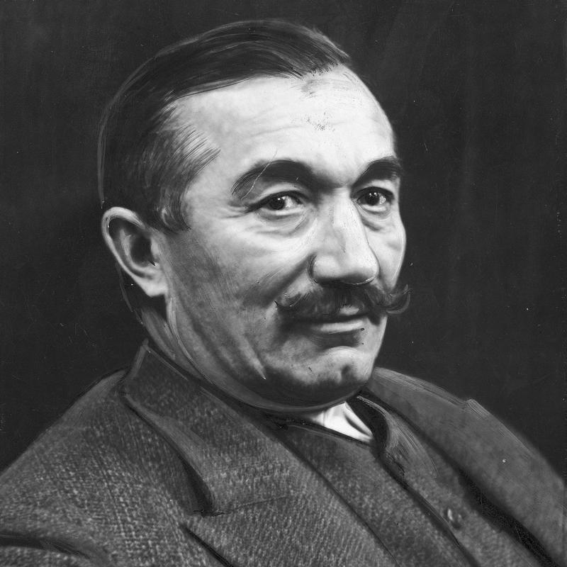
III. DESCRIBING THE PORTRAYED PERSON
Wincenty was an important polish politician.
He was member of the Polish People Party and served as the premier of Poland three times.
He was already recognised during his lifetime.

Slide 9
III. DESCRIBING THE PORTRAYED PERSON
The statue was erected to commemorate his job for Poland and his help during the time of the Bolshevik offensive to the country.
His work is very inspiring as an example of defending democracy and freedom.

