Slide 1
WK 3
JAN PAWEL II STATUE

Slide 2
GROUP LEADER:
- Zuzanna Kucińska - Poland
GROUP MEMBERS:
Fábio Correia – Portugal
Athina Topalidou – Greece
Elena Andreou – Cyprus
Mireia Vilar – Spain
Nikola Bićanić – Croatia
Iva Požarić - Croatia

Slide 3
How we worked?
And this is the finished product :
https://www.youtube.com/watch?v=O5MOdTzfprc

Slide 4
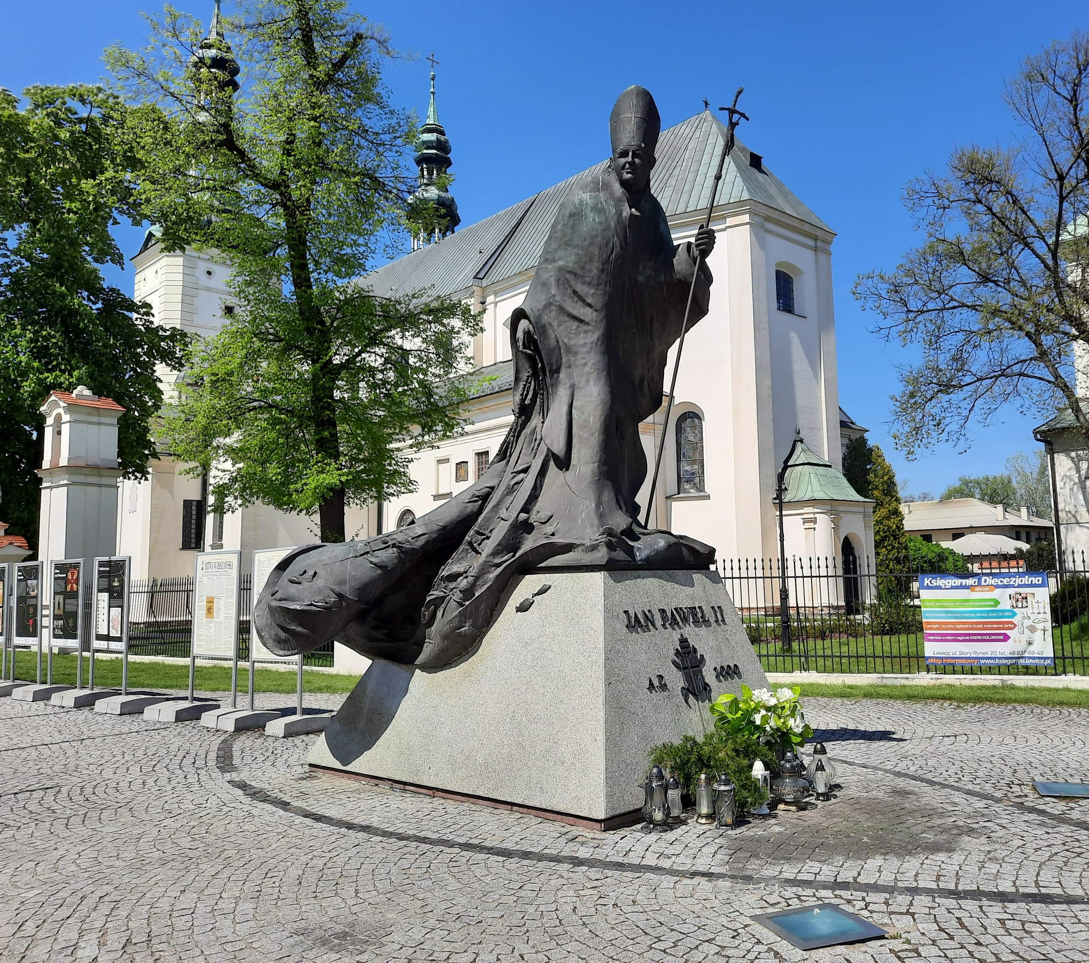
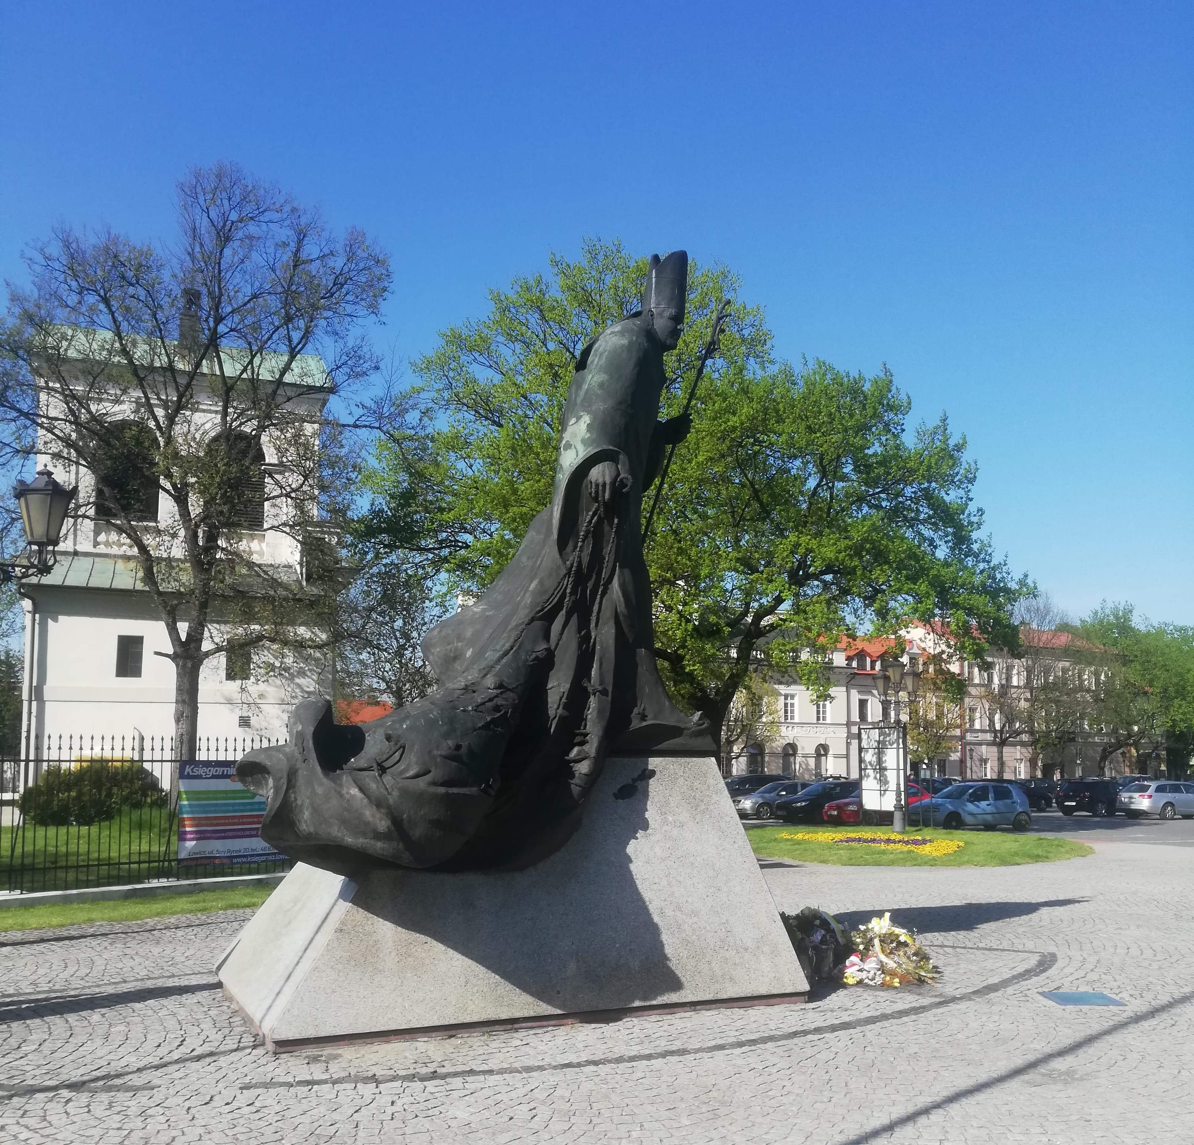

Slide 5
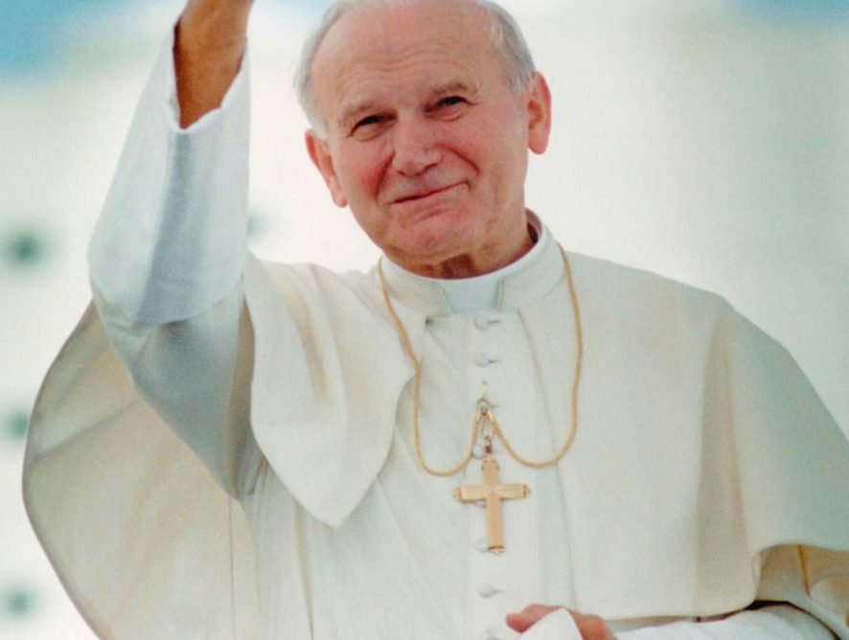
Jan Pawel II
Who was Jan Pawel II
Jan Paweł II recognition

Slide 6
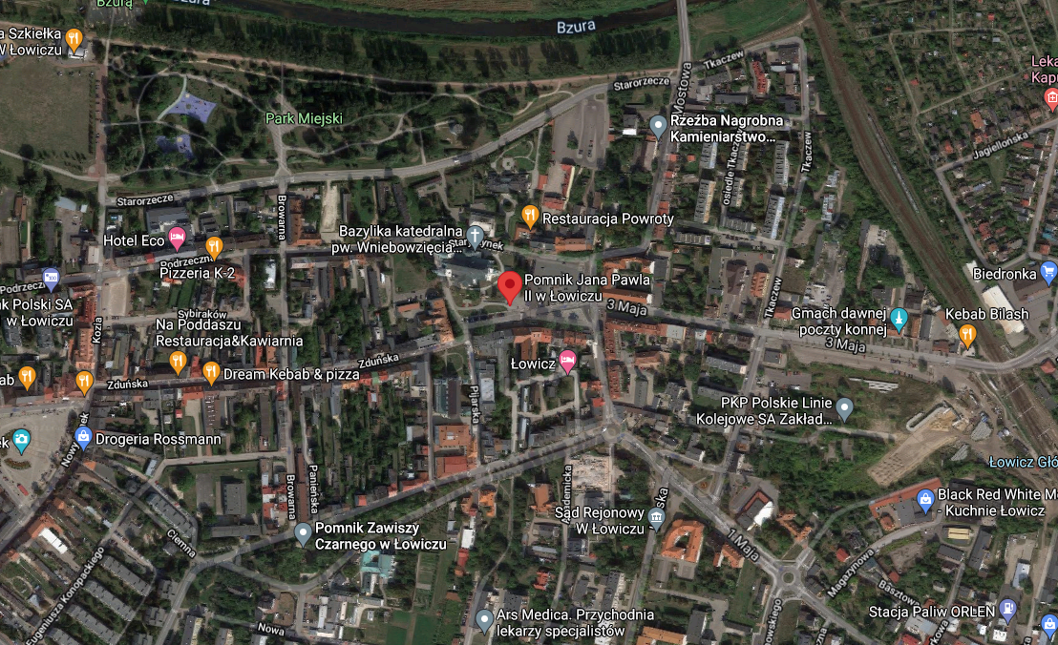
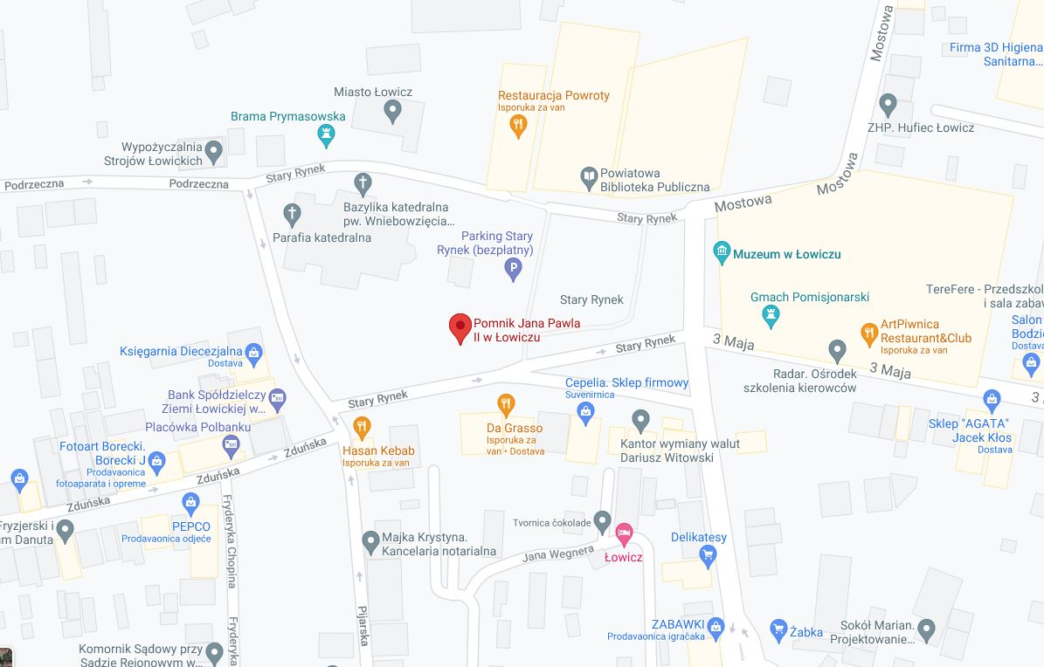

Slide 7
REFERENCES
https://en.wikipedia.org/wiki/Pope_John_Paul_II
http://international.amu.edu.pl/team/john-paul-ii/

