Slide 1
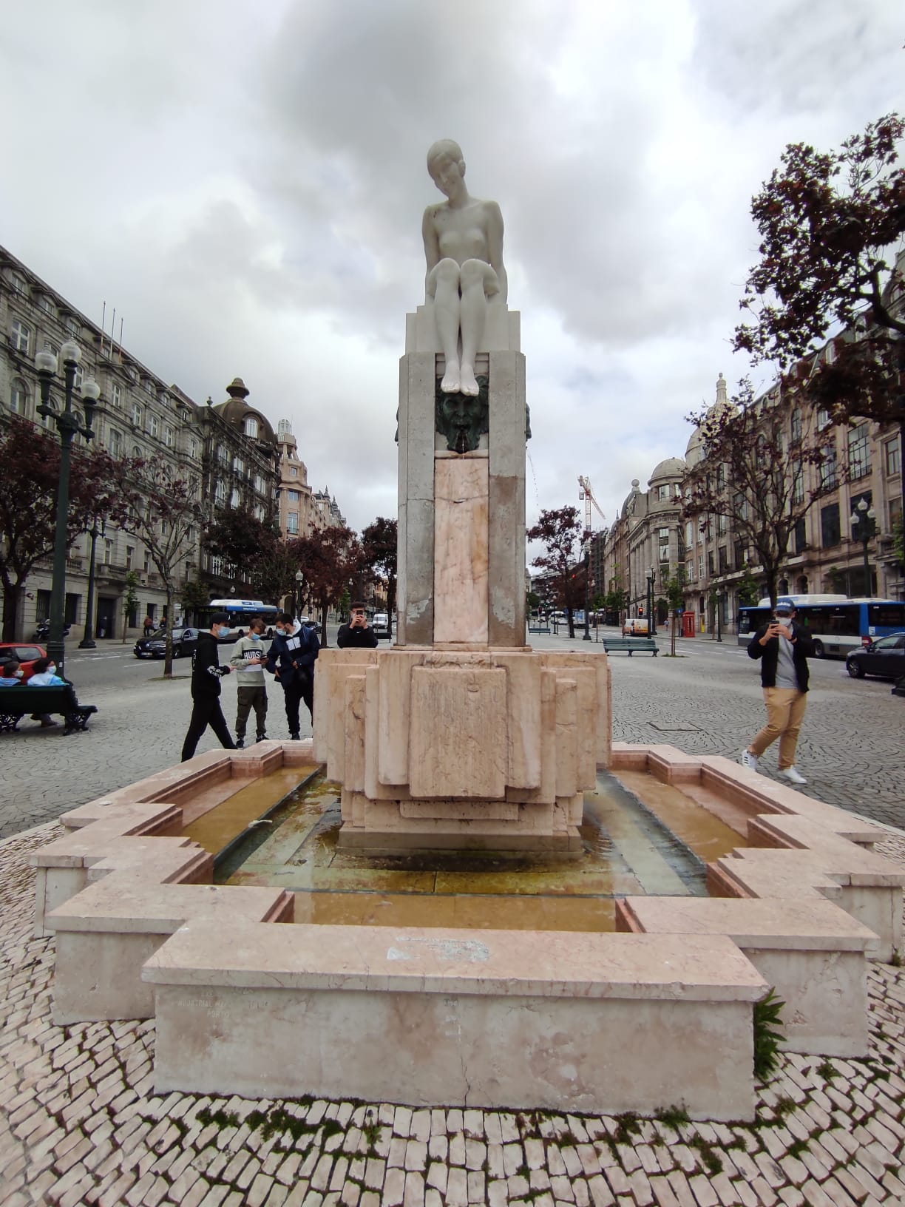
Fonte da Juventude Menina Nua
WorkGroup 5
Paolo Barać
Bartosz Dzięgielewski
Sotiris Roustemis
André Vieira
Mihael Folnegović
Lisa Vertikhina
Constantina Plastira
Team Leader : Bartosz Dzięgielewski
Team Name : Cereal Killers

Slide 2
How we worked
We downloaded the pictures ( Twinspace → Computer )
We made the 3D model ( Computer → Zephyr )
Uploaded to YT ( Zephyr → YouTube )
We made the PP Presentation ( Google Presentation → Shared the link )

Slide 3
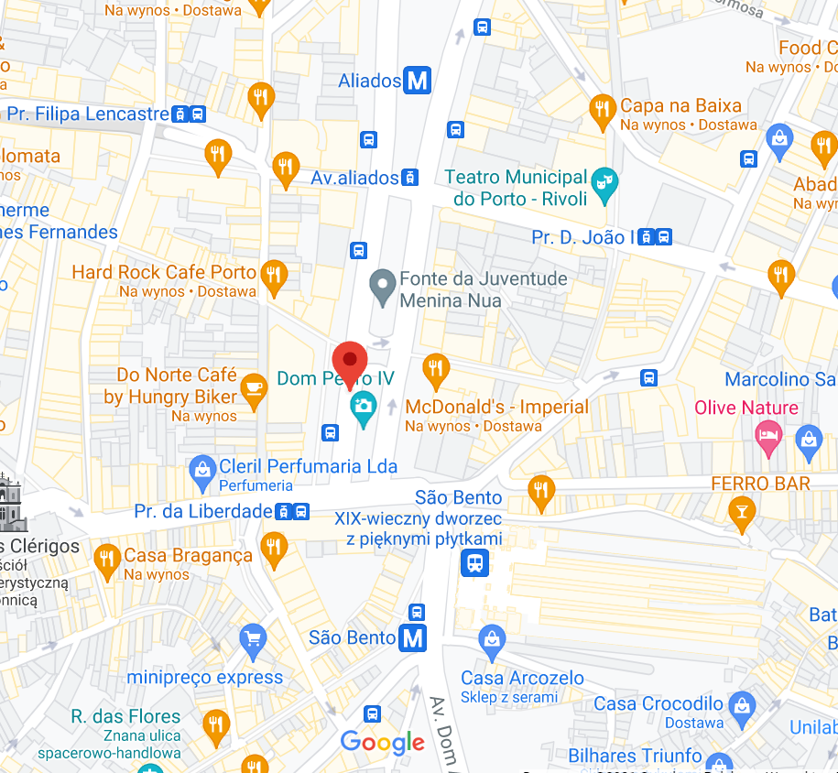
Location of the statue.
Location: Liberdade Square, Porto, Portugal

Slide 4
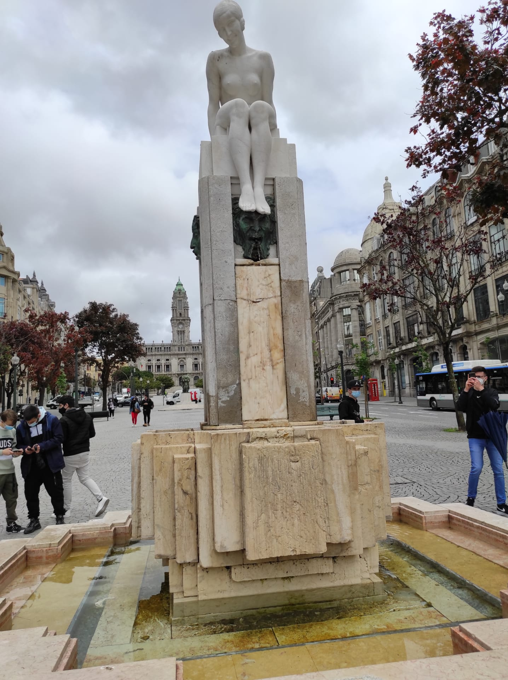
Name of Statue: Menina nua,
The Fountian of Youth (eng.”Naked Girl”)

Slide 5
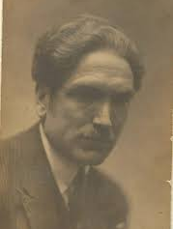
Author of Statue and the time.
Henrique Moreira
Portuguese sculptor
Finished in 1929

Slide 6
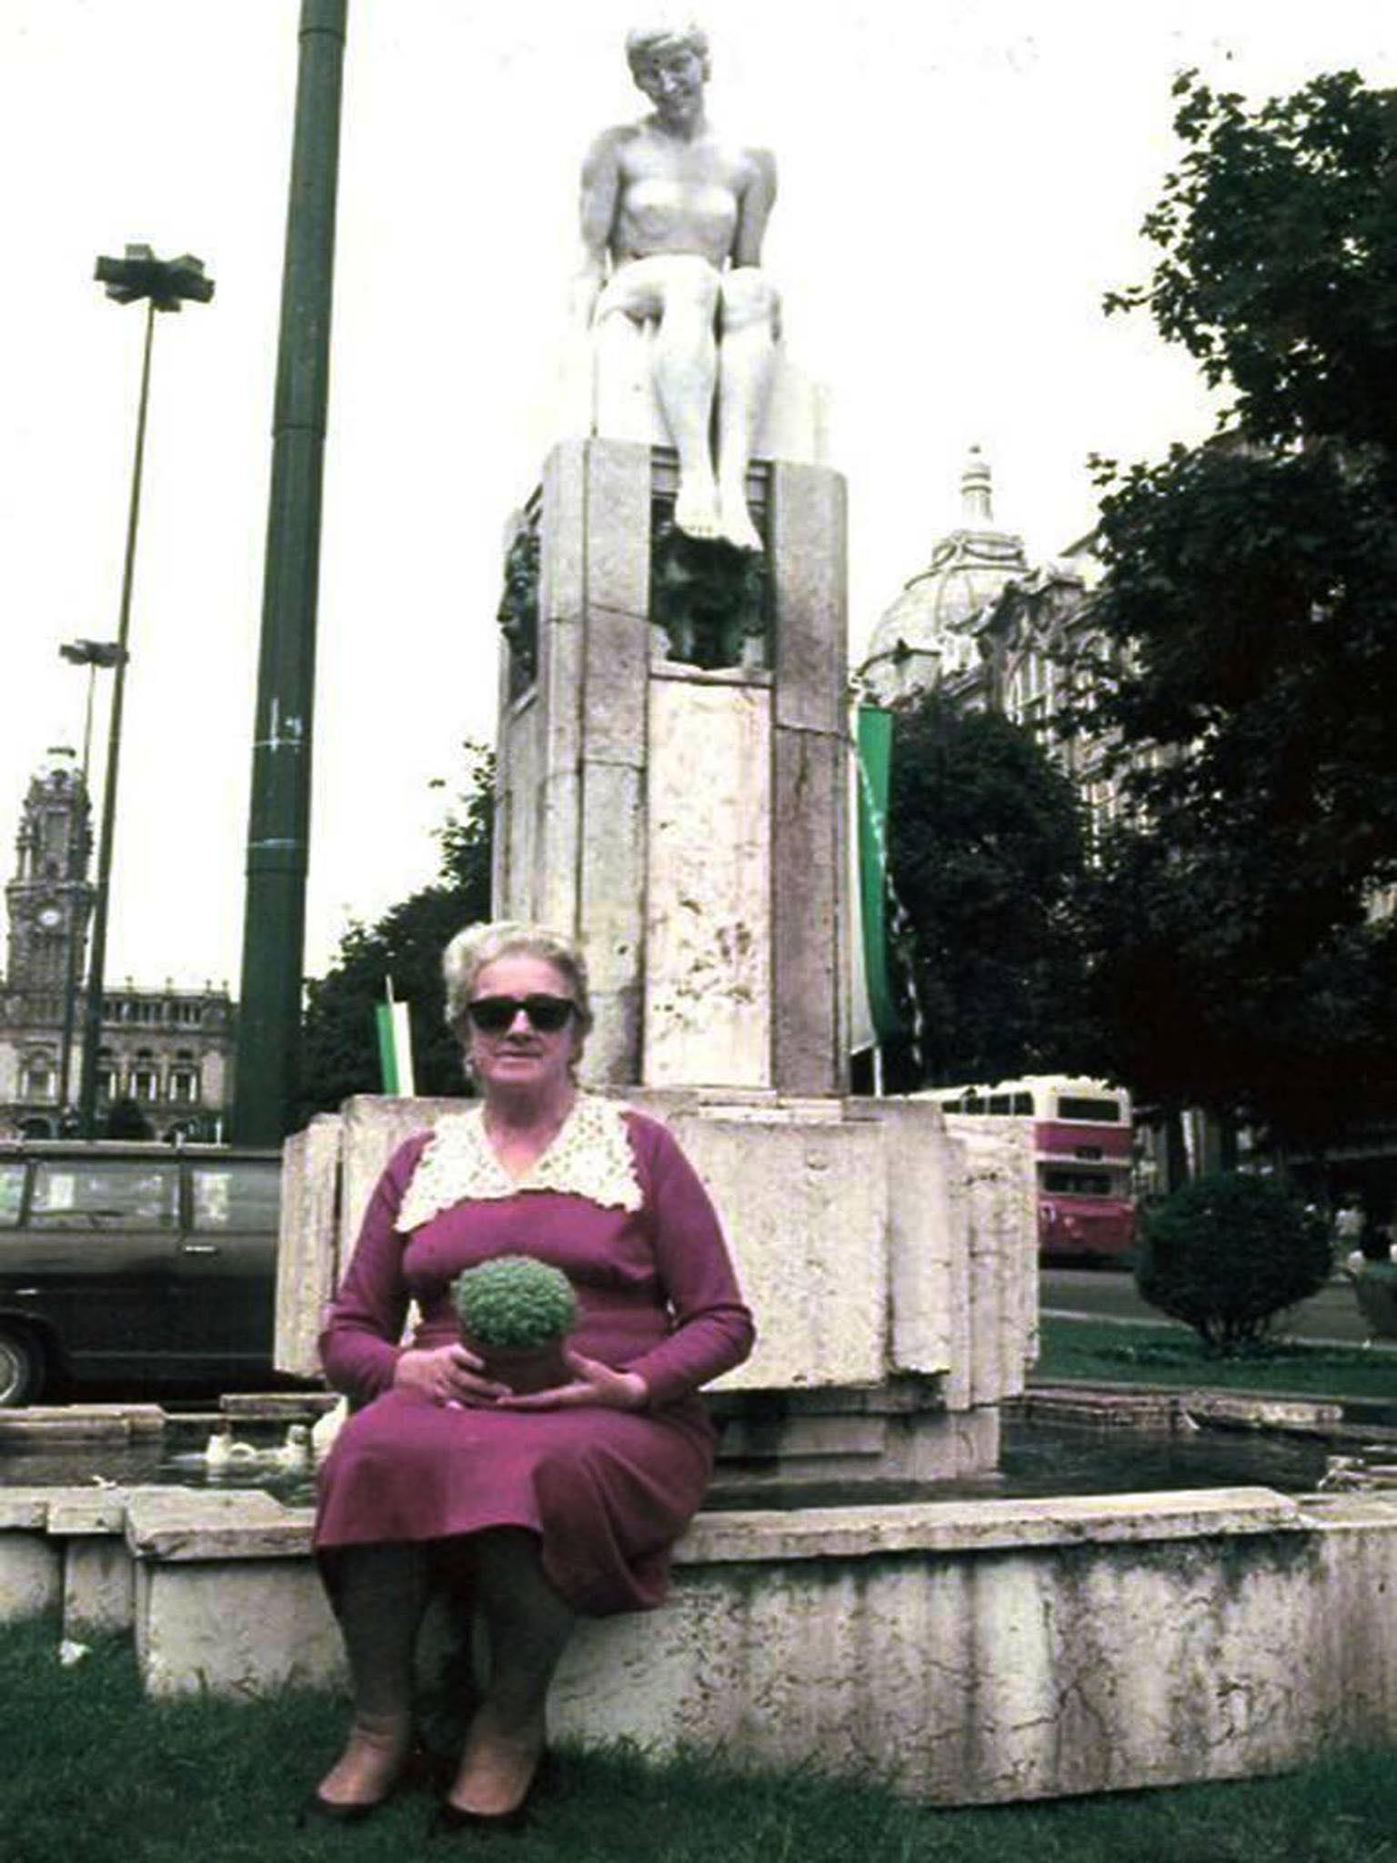
Model
- Born 4.12.1910
- At age of 19 she was the model of the statue.
- Her name was Aurélia Magalhães Monteiro
- One of the most appreciated and
coveted women of her time

Slide 7
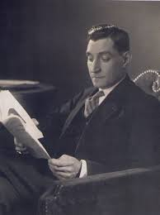
Time Portuguese Dictator
It was made under Salazar dictatorship
During strong church power

Slide 8
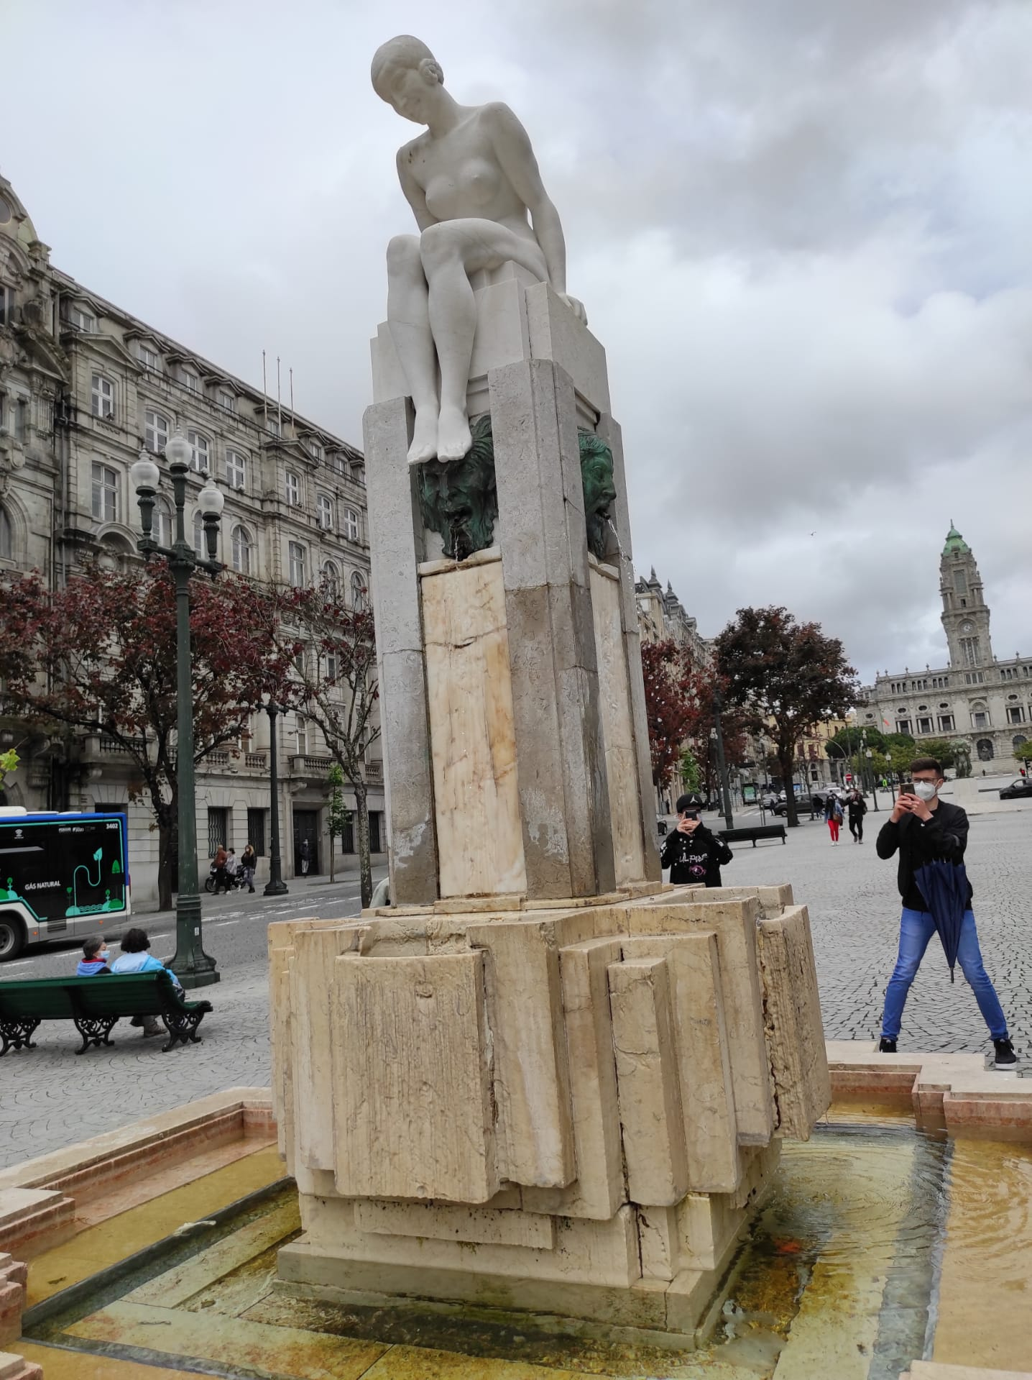
Link to the 3D model
https://www.youtube.com/watch?v=qj-3QZ1TKh0

Slide 9
Bibliography
https://pl.tripadvisor.com/Attraction_Review-g189180-d13809213-Reviews-Fonte_da_Juventude_Menina_Nua-Porto_Porto_District_Northern_Portugal.html
https://www.correiodoporto.pt/do-porto/aurelia-magalhaes-monteiro-ou-a-menina-nua

