Slide 1
WK 2 ARISTOTELES
Andre Soares, Konstantina Karagianni, Sara Soliva, Goncalo Soares, Sara Komeštik

Slide 2
Something about Aristoteles:
Greek Aristoteles, was born at 384.
He was born in Chalcidice
He died 322.
He was Philosopher and scientist
He is one of the greatest intellectual figures of Western history

Slide 3
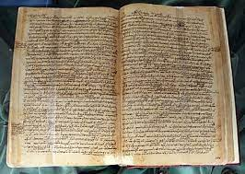
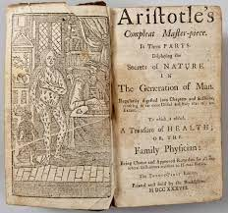
NOTABLE WORKS
“Sophistical Refutations”
“Posterior Analytics”
“History of Animals”
“Eudemian Ethics”
“On Generation and Corruption”
“Protrepticus”
“Categories”
“Physics”
“Nicomachean Ethics”
“On the Generation of Animals”

Slide 4
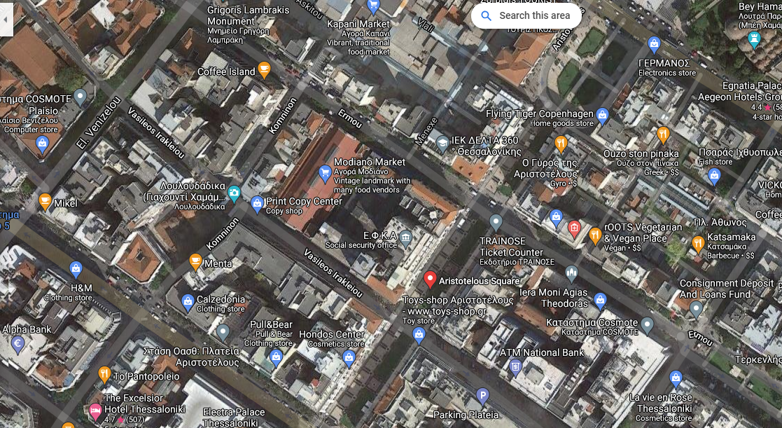
Position of the statue
Every person who passes through the Aristoteles square can see the statue
The author of the statue is
Ernest Hebrard

Slide 5
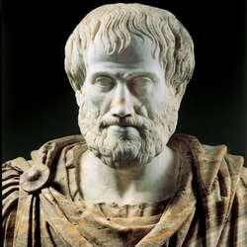
3D model of the statue
3DF Aristoteles – link
The surface is completely closed

