Slide 1
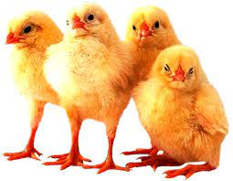
Interview with Alicia by Alina
-How do you feel about the project?
-I like it a lot, because I am meeting new people and I am practicing my English and learning many new things from other countries.
-How much free time do you usually have a week?
-Weekends, holidays and days when I don't have class, because I go to the blended institute.
-Do you spend your time in a creative way? If so, how?
-Yes, I like to do new things with clothes that I no longer wear or do crafts.
-Do you take part in any extra currucilar activities? Name them.
-I don't do anything after school.
-Do you have any hobbies? Tell me something about them.
-I like spending time with my animals, I have chickens, pigeons and three dogs. I also like to walk with my dogs and I like to watch football when my team plays. I also read.
-What are your household duties?
-I clean up my room and tidy up my closet, which I share with my sister but she doesn't usually pick up, so I have to do it myself, I make the food when my mother is not there and I always make dinner, mine and my sister's and of course I make him eat my dogs and my father the chickens.
-What's the most favourite free time activity in your country? Use some real data if possible.
-Meet friends to go out to party or drink some beers with tapas (tapas is as we say in Spain, but it is like an aperitif).
-Choose the best free time activity among these three: listening to music, watching Netflix, playing computer games. Justify your opinion.
-Listen to music, because while I listen to music I can do other things.
-What profession is popular in your country?
-Teacher either for young children or for adolescents, also police, teacher of physical education and all branches of sport.
-What is the weather in your city now?
-It is cloudy and windy, but here in the Campo de Gibraltar area it is common for it to be windy.

