Slide 1
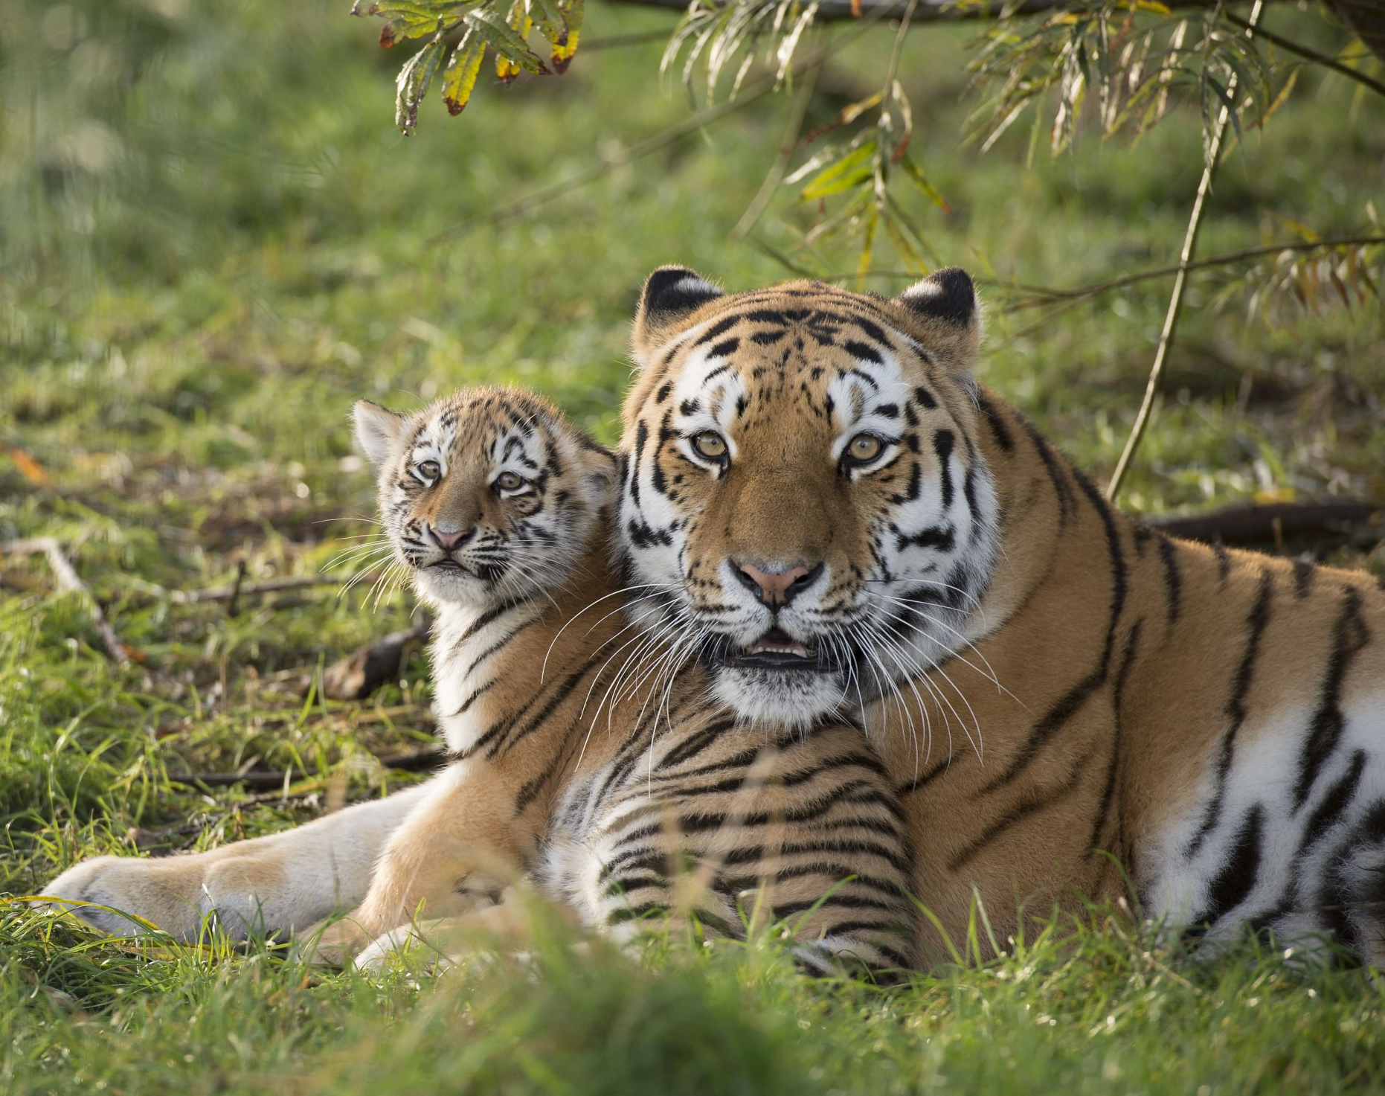
Working with animals

Slide 2
Many people casually dream of working with animals training dolphins, doing veterinary work, grooming pets, or opening an animal-related service business. But, how can you determine whether an animal-related career will be a good fit for you? The best way to begin is to fully research your options, realistically evaluate your skills and talents, and gain hands-on experience and education in the field.
Is a Career Working With Animals Right for You?

Slide 3
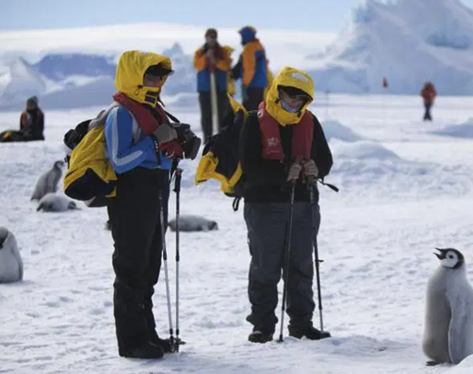
Penguin flipper
Penguin flipper is one of the rarest professions. It so happens that the penguins fall on their backs and can no longer roll over. Then they are saved by the penguin flipper. He gently puts them on their feet so that they can move on. This profession does not have a large number of employees. The flippers themselves must get along well with the animals, be prepared for their duties.

Slide 4
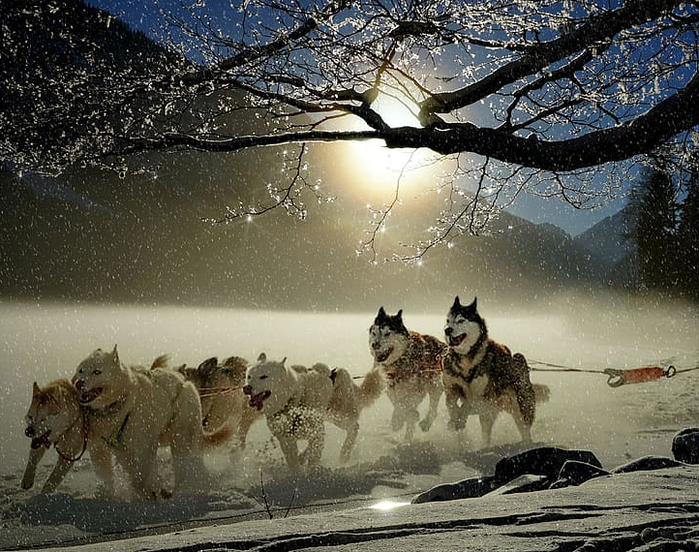
Sled Dog Racing
Dogsled racing, also called sled dog racing, sport of racing sleds pulled by dogs, usually over snow-covered cross-country courses. In warmer climates, wheeled carts are substituted for the sleds. Dogsledding was developed from a principal Eskimo method of transportation. In ancient times it was used for freight transport or mail delivery. But now used for entertainment. About 6 or 7 dogs are attached to the sleds. If there is no snow in the environment, roller sledges are used.
The best known sled dog race is the Iditarod Trail Sled Dog Race sled dog racing is one of the most popular sports in Canada's Yukon Territory.

Slide 5
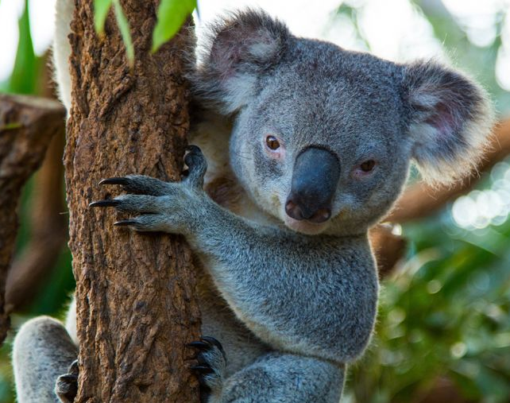
Zoos
A zoo is a place where wild animals are kept for viewing and studying. The zoo has its good things like education for the people but unfortunately has many problems. One of the biggest problems is that they use animals for fun without any precautions for the animals safety. They feed animals with a bad diet, even in some zoos animals are beaten. A reform of the zoos has to be made in order to make it easier for the lives of the animals

Slide 6
Horse riding
Horse riding is a great sport! Anyone can ride a horse!From toddlers to older people and it is very developing. It helps us focus, makes us more responsible and even open to new friendships. Even though it is a bit of a dangerous sport, in my opinion everyone should try it at least once!

Slide 7
Created by
Kinga O. from Poland
Nadia K. from poland
Jelena Ž. from Serbia
Vigran A. from Ukraine
Duccio T. from Italy
Tomaso from Italy
Zeynep B. from Turkey

