Slide 1
Playing video games
Team: International Bimba

Slide 2
Popularity
3 billion people play video games, which is about 40% of the world's population. This conclusion was reached by experts after a study conducted by DFC Intelligence in July 2020.

Slide 3
Gaming in Ukraine
Due to the specifics of 2020 related to the coronavirus pandemic in Ukraine and the world, the dynamics of the horizontal coverage of Ukrainian Internet users involved in gaming is increasing to 4-5 million people out of 44 million inhabitants.

Slide 4
Gaming in Poland
The well-known firm Newzoo has shared the results of a study of the Polish gaming market. According to her, there are 12 million gamers in a country of 38 million inhabitants.

Slide 5
Gaming in Turkey
The number of gamers in Turkey has grown from 30 million in 2018 to 32 million in 2019, with 57% of players being male and 43% female out of 82 million inhabitants.

Slide 6
Gaming in Italy
According to Newzoo data for 2017, the number of gamers in Italy was 25 million out of 60 million inhabitants.

Slide 7
Popularity games
Genshin Impact is an open world action / RPG computer game developed by the Chinese company miHoYo Limited.

Slide 8
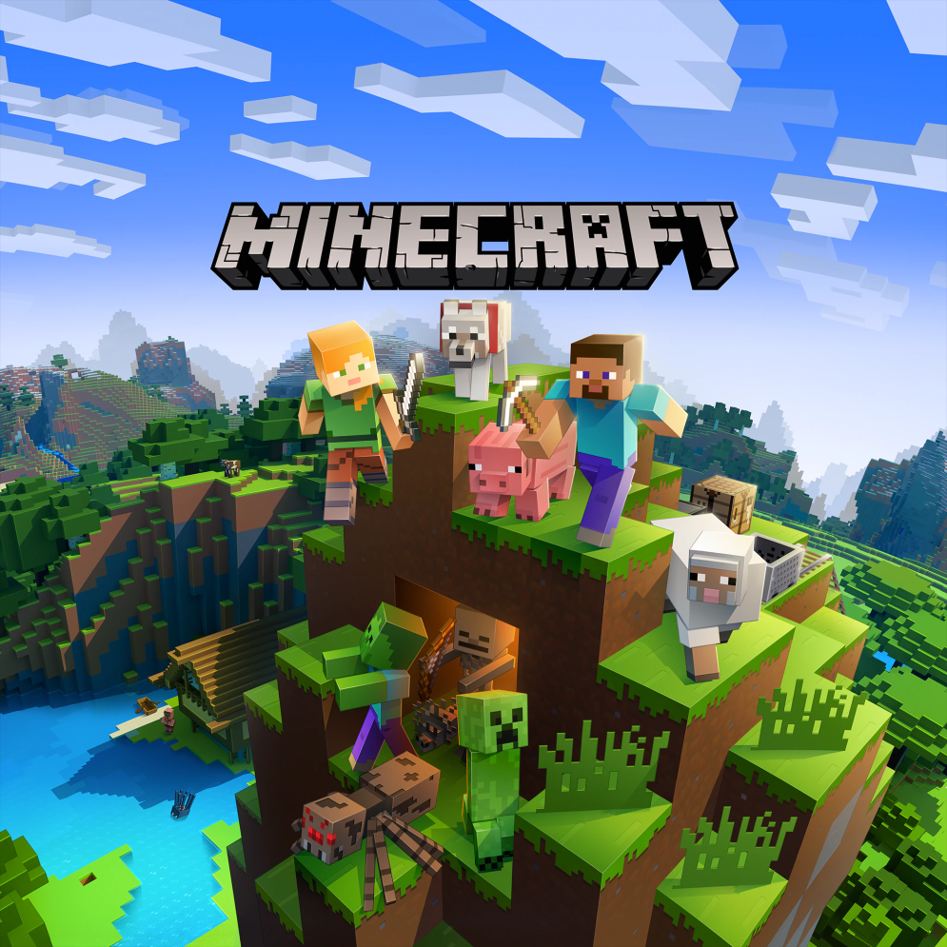
Popularity games
Minecraft is an indie sandbox computer game originally created by Swedish programmer Markus Persson and published by his company Mojang AB.

Slide 9
Popularity games
League of Legends, or LoL for short, is a real-time strategy RPG video game developed and released by Riot Games on October 27, 2009.

Slide 10
Popularity games
The Sims is a series of computer games in the life simulation genre developed by game designer Will Wright and Maxis and The Sims Studio and published by Electronic Arts.

Slide 11
Created by
International bimba:
Kostya from Ukraine Tais from Ukraine Galina from Ukraine Albina from Ukraine Liza from Ukraine Ola from Poland Emilia from Poland Vlad from Ukraine

Slide 12
Resources: 1. https://ru.wikipedia.org/wiki/%D0%9A%D0%BE%D0%BC%D0%BF%D1%8C%D1%8E%D1%82%D0%B5%D1%80%D0%BD%D0%B0%D1%8F_%D0%B8%D0%B3%D1%80%D0%B0 2. https://allcorrectgames.ru/insights/mobile-game-market-index/italy/#:~:text=%D0%A1%D0%BE%D0%B3%D0%BB%D0%B0%D1%81%D0%BD%D0%BE%20%D0%B4%D0%B0%D0%BD%D0%BD%D1%8B%D0%BC%20Newzoo%20%D0%B7%D0%B0%202017,%2C%2049%25%20%E2%80%94%20%D0%B6%D0%B5%D0%BD%D1%89%D0%B8%D0%BD%D1%8B). 3. https://www.ukrinform.ru/rubric-society/3174846-v-ukraine-za-god-cislo-gejmerov-vyroslo-do-5-millionov-ekspert.html#:~:text=%D0%9E%D0%BD%20%D0%BE%D1%82%D0%BC%D0%B5%D1%82%D0%B8%D0%BB%2C%20%D1%87%D1%82%D0%BE%20%D0%B2%202019,%D0%B2%D0%BE%D0%B7%D1%80%D0%B0%D1%81%D1%82%D0%B0%D0%B5%D1%82%20%D0%BD%D0%B0%2015%2D20%25.

