Slide 1
Netflix

Slide 2
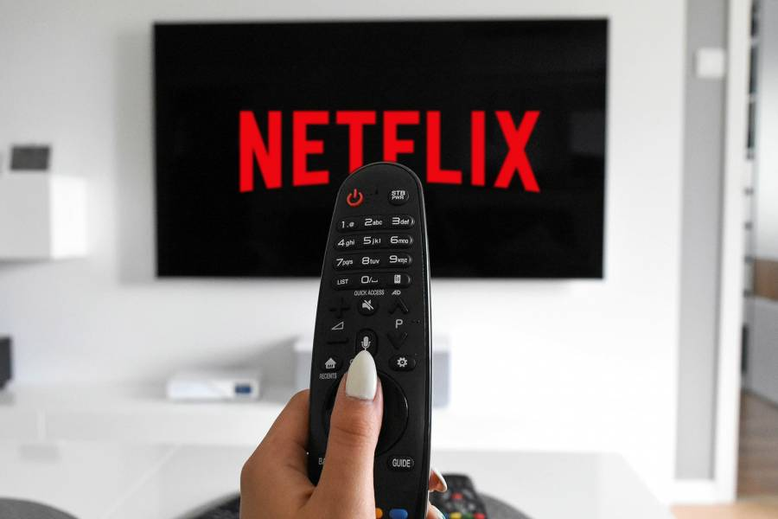
What is Netflix?
Netflix is ​​a US company operating in the internet distribution of movies, television series and other paid entertainment content. In 2013, Netflix expanded its film and television production and online distribution. It is based in California.
Who?
most of us teenagers in our free time love to watch TV series or movies on Netflix ... it's one of the most used platforms, and very easy to use.

Slide 3
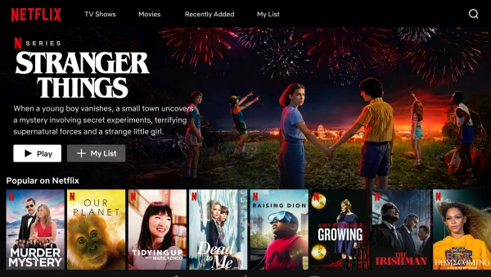
What can you find?
On Netflix, you can find many different types of movies and TV series, like Drama movies, horror movies, love movie, adventure movies, comic movies and many others.
About the TV series, those too are many, and of many different kinds.
In our free time
we often watch TV series in our free time, when the weather is bad outside and we can't go out, or in the evening before going to sleep.

Slide 4
Netflix in Poland
At the end of 2019, Netflix in Poland had approximately 775 thousand. subscribers. Currently, the number is estimated at 879,000 people paying for the subscription.The best series on Netlix for Poles
Queen's gambit-
To the lake-
The Ranch-
Unorthodox-
Norsemen-
Orange Is The New Black-
The Beginning Of Life-
One Day At A Time
Poles spend 49 minutes a day watching video on the Internet, which is still shorter than the global average - Internet users around the globe take 67 minutes a day, which is 11 minutes more than in 2017

Slide 5
Netflix in Turkey
Turkey Statistics Institute (TSI), according to the television to watch the Time Use Survey, published in 2015, which makes up 94 percent of the activities we perform when working in power.
WE HAVE THE RECORD WITH 330 MINUTES A DAY Turkey, with 330 minutes per day watching television proportion holding the world record holder. Saying that television has an important place in our lives by looking at these numbers, Union Istanbul's Agency President Mehmet Erkmen says that the Turkish people spend most of their day and therefore their life in front of TV.MOST CONTEST, MARRIAGE-DINING PROGRAM, SERIES AND MATCHES ARE WATCHED. Turkey is one of the best countries in the world watch television. The disclosed data also confirms this information. According to the data; Turkey's average daily spend 5-6 hours watching TV. This technological box, which covers 94 percent of the activities we carry out outside of working time, also appears as the driving force of the industry.AVERAGE 3 HOURS OF TV WATCHED IN EUROPEOn the other hand the European average of 3 hours, 2.5 hours and kept in mind if Japan within 3 hours of TV viewing statistics in China, has become a very real handy in many ways the television in Turkey.Citizens of the day looking at these figures in Turkey Erkmen thus indicating that spent most of her life in front of TV, said that today's television is still the driving force of the sector due to high access.

Slide 6
- AVAILABILITY of this free time activity?
Men spent more time in leisure activities (5.5 hours) than women (4.9 hours). Watching TV was the most time consuming leisure activity, accounting for just over half of all free time on average. Men watch TV for 3 hours a day, women spend 2.6 hours a day.
The turkey is usually monitored television at home in your spare time. If it happens in the family, they will watch Neflix TV series at home. Television can be watched everywhere.
- YOUR OWN INTERPRETATION ?
I like watching TV, I like comedies and action movies but frankly I watch a lot of TV series and movies :) and I can spend 3 hours. But I don't watch TV for more than 2 hours. The pleasure of watching the series is going out with family and friends, it is more fun at the bidet pjama party, definitely don't watch it alone :)

Slide 7
This presentation was created by:
Martina Perrino from Italy
Sema Atmaca from Turkey
Vhins Caburnay From Italy
Martyna Filus from Poland
Esra Tutuncu from Turkey
Giorgia Molesti From Italy
Emine Sahin from Turkey
Julia Smolka from Poland
Our source of research is: https://it.wikipedia.org/wiki/Netflix
thank you very much for reading our presentation.

