Slide 1
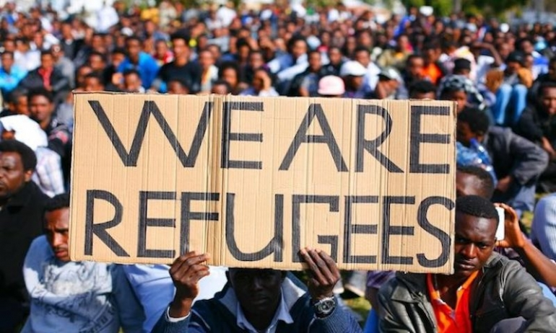

Slide 2
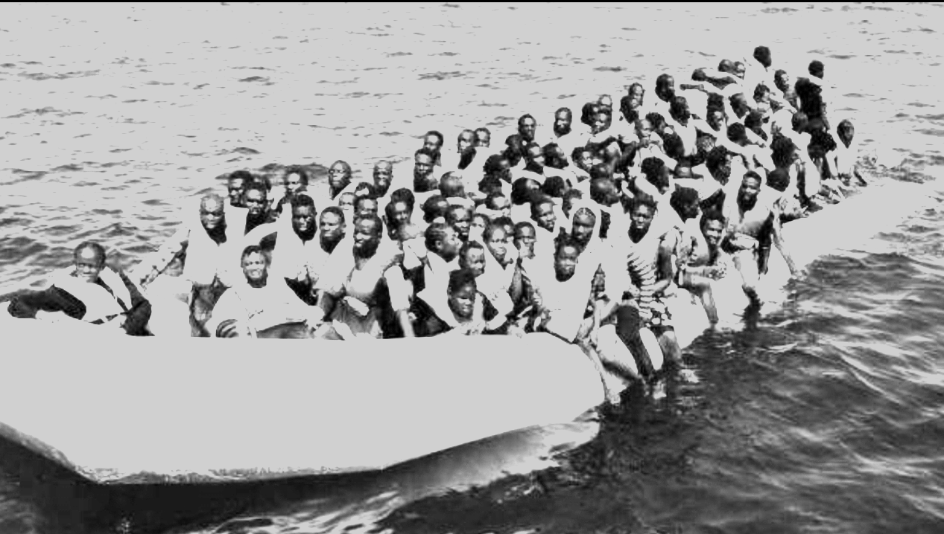
There are about two thousand people who risk their lives every day by crossing the Mediterranean Sea

Slide 3
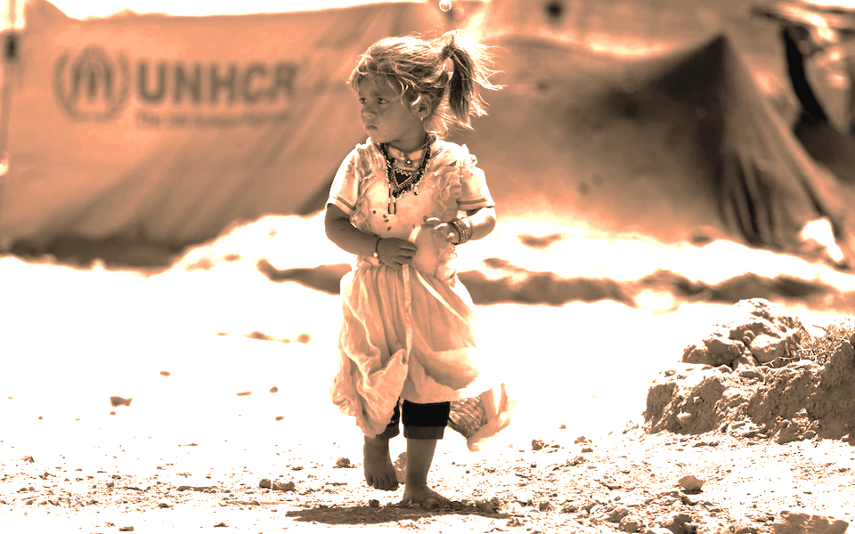
Why do people flee their own countries?
They are FORCED to flee their homes because of war and persecution

Slide 4
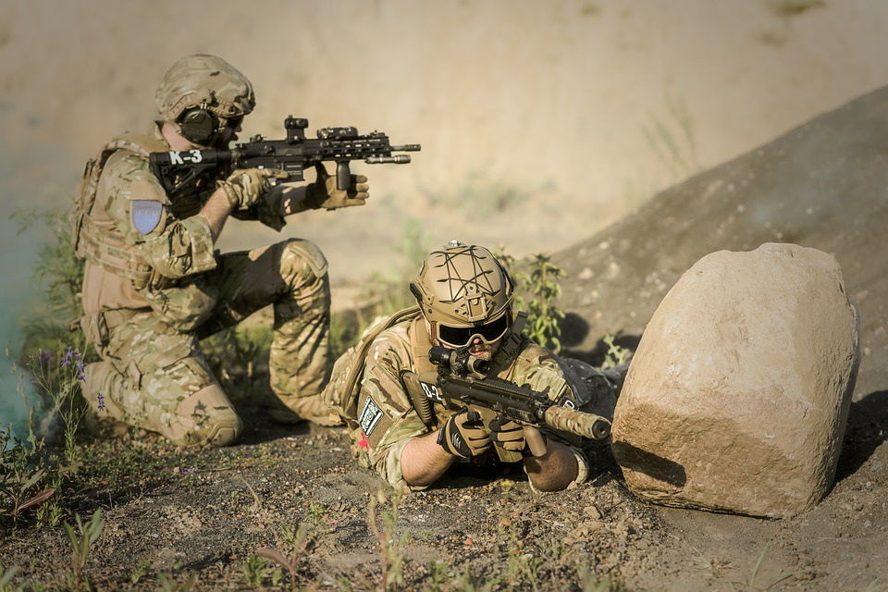
ARMED CONFLICTS
Thousands of civilians are suffering in armed conflicts all over the world.
The victims are for the most part the citizens and poor people which are forced to escape…

Slide 5
For example ……. in most of the African countries
WARS ARE CAUSED BY:
- terrorism
- contrast between breeders and agricultural activities
- Claims for independence - POLITICAL REASONS
- Rebel groups fighting the naming of mining companies - ECONOMIC REASONS

Slide 6
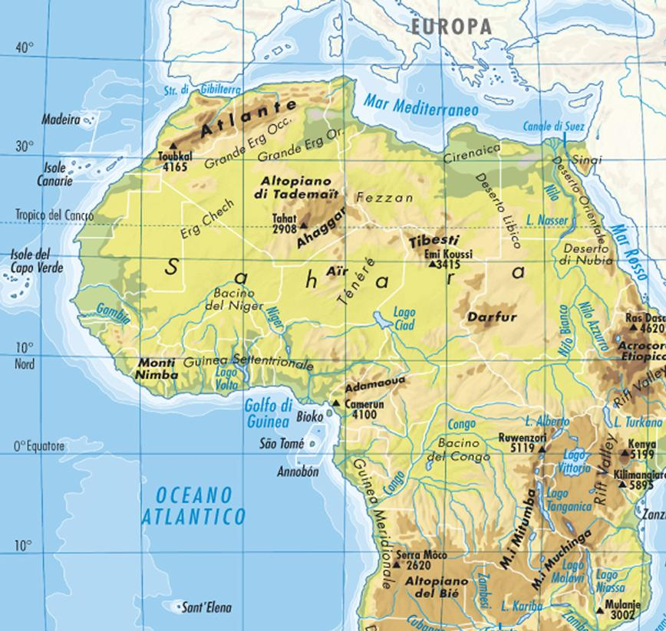
This is the migration route to Italy: a real obstacle race
Italy
Malta
DESERT
EXTREME TEMPERATURES
WILD ANIMALS
LACK OF WATER
CONFLICTS AT THE BORDERS
In general

Slide 7
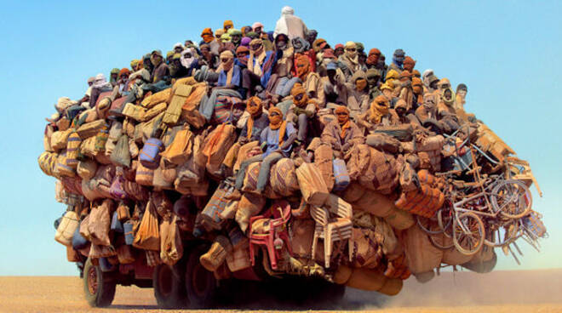
“Lot of people don’t know what facing adversity means because they have never been forced to migrate”

Slide 8
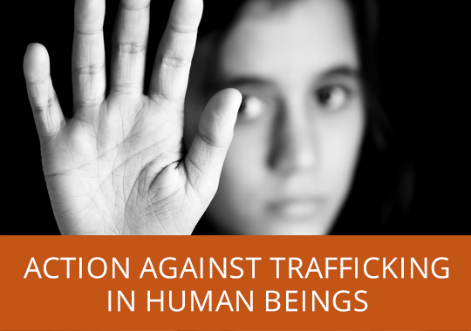
The control upon the regional routes of drug and guns trafficking and the trafficking in human beings (migrants) as well, are also important causes leading to conflicts.

Slide 9
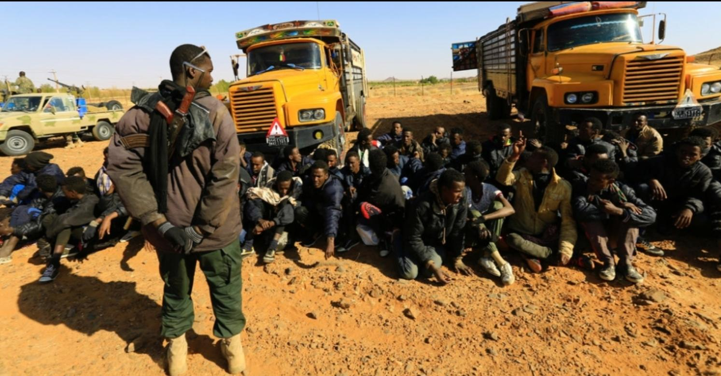
WHAT’S THE TRAFFICKING IN HUMAN BEINGS?
Human trafficking is a serious crime that abuses people’s fundamental rights and dignity. It involves the criminal exploitation of vulnerable people for the sole purpose of economic gain. Human trafficking is a modern form of slavery. It is often transnational in character and its victims are of both genders and all ages.

Slide 10
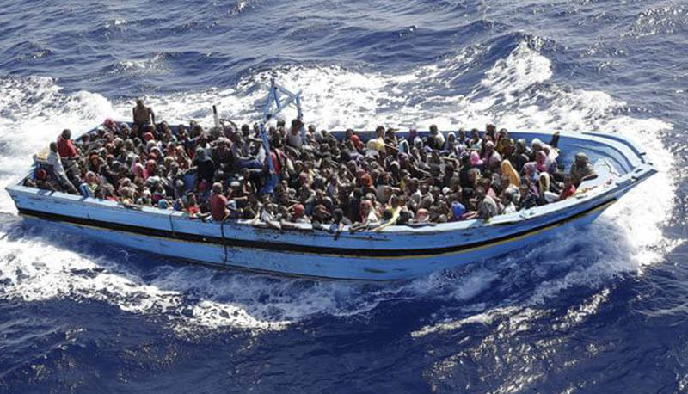
WHO ARE THE BOAT-PEOPLE?
PEOPLE WHO HAVE LEFT THEIR COUNTRY BY BOAT, USUALLY HOPING TO FINDING SAFETY IN ANOTHER PLACE.
BOAT PEOPLE= REFUGEES TRAVELLING BY SEA

Slide 11
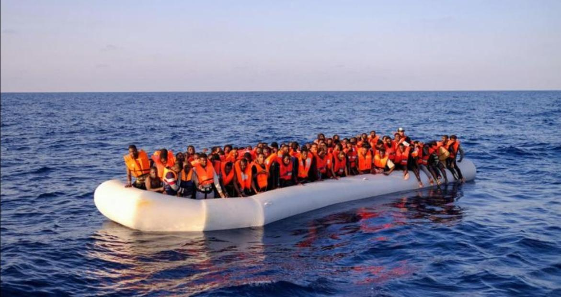

Slide 12
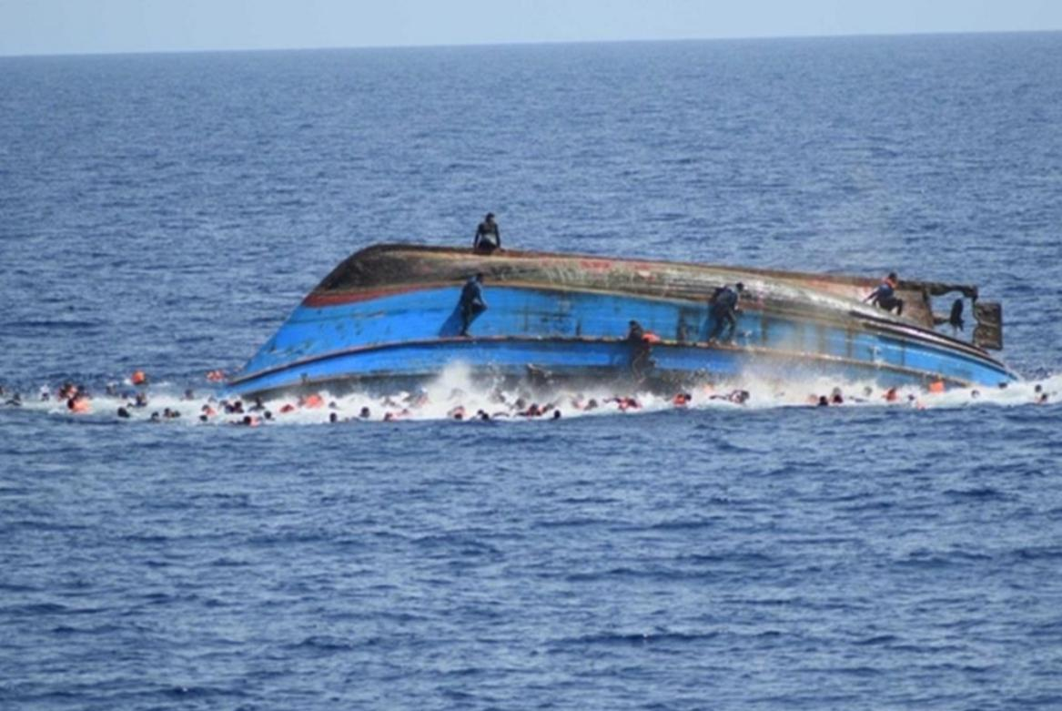

Slide 13
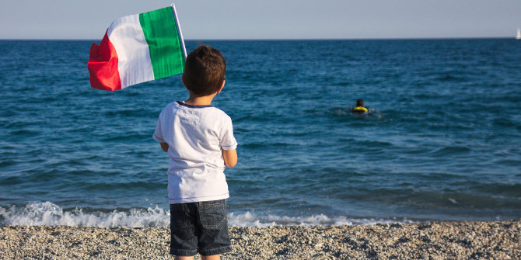

Slide 14
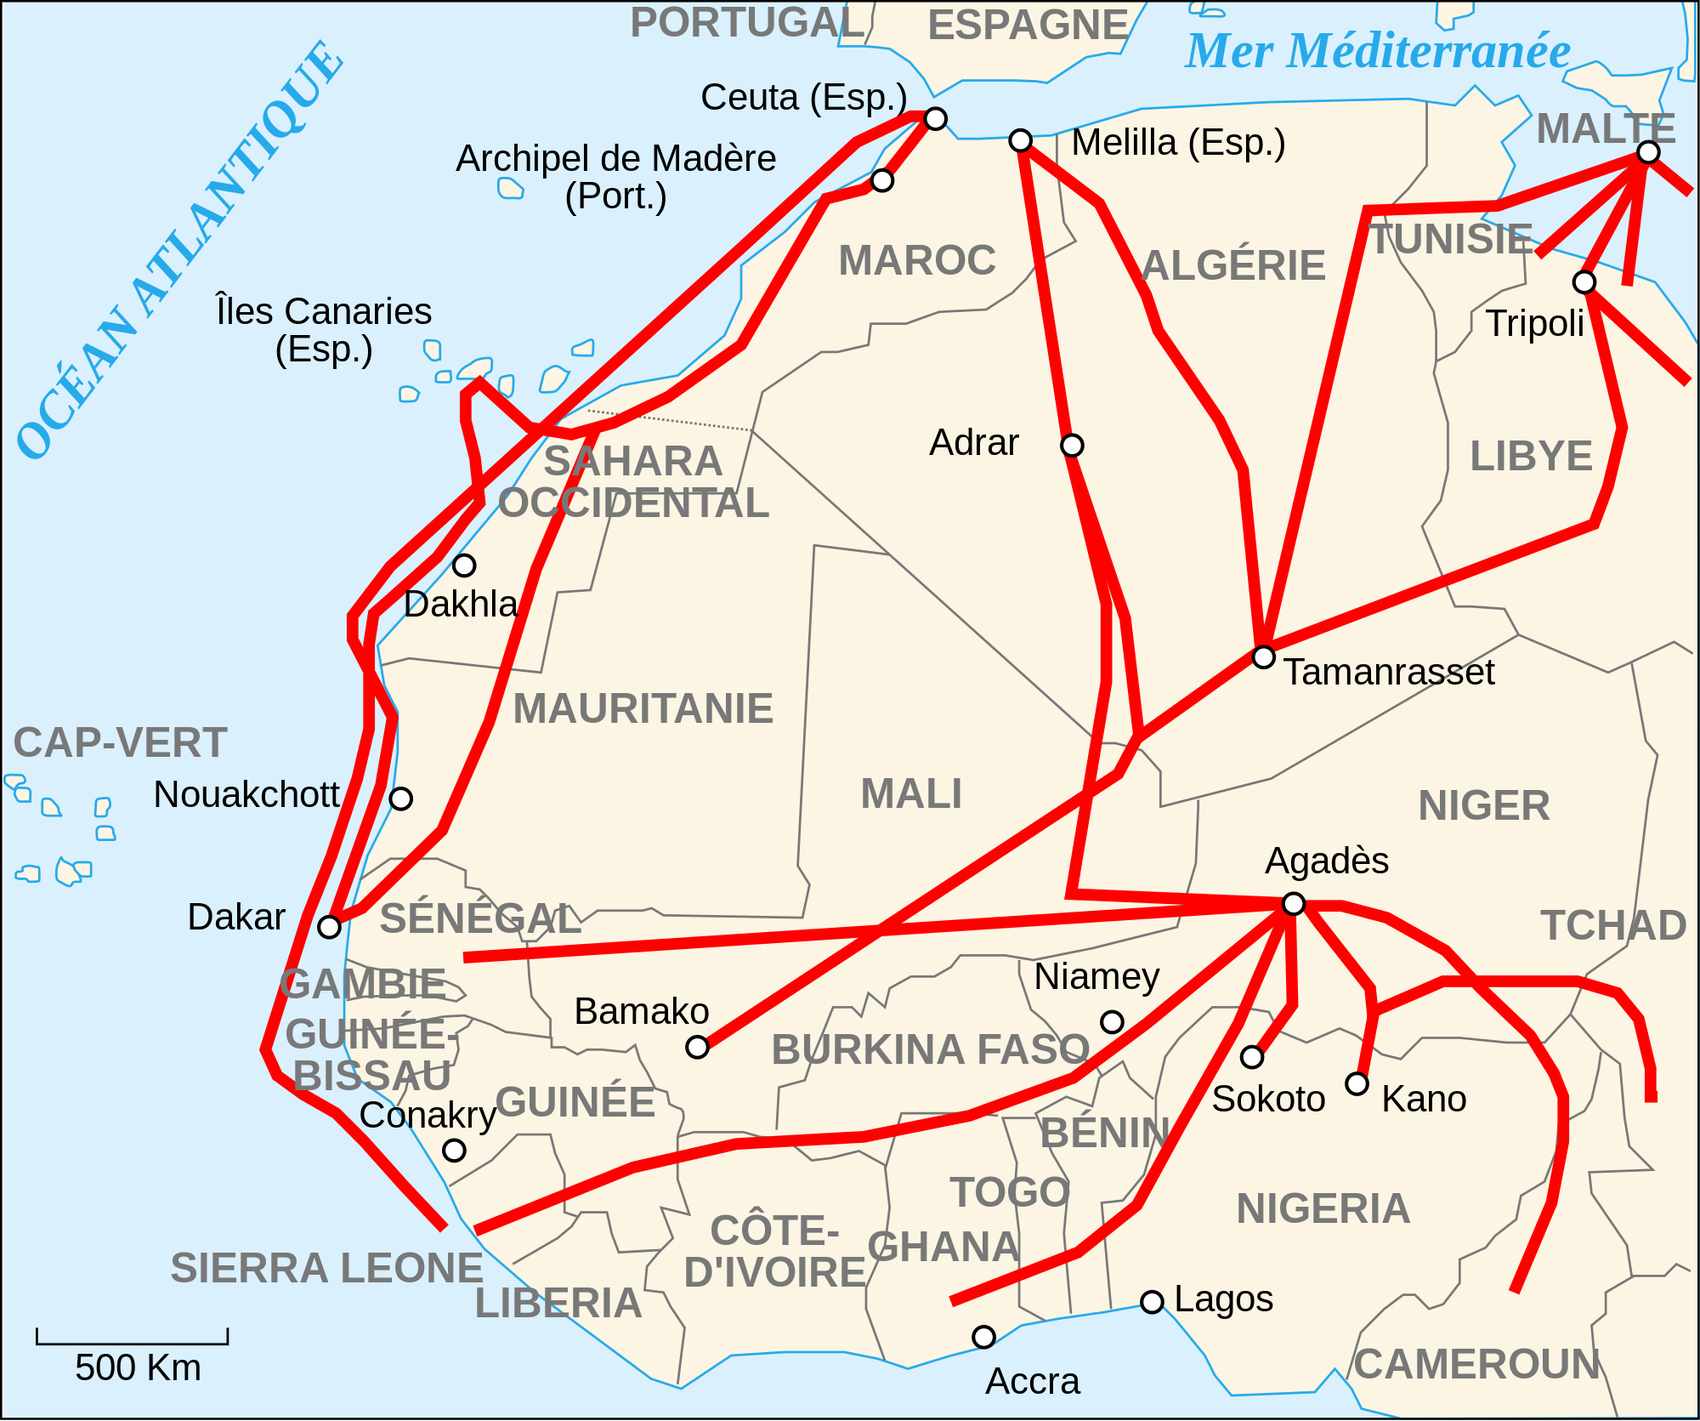
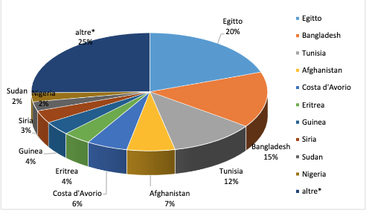
Where do BOAT PEOPLE come from?

Slide 15
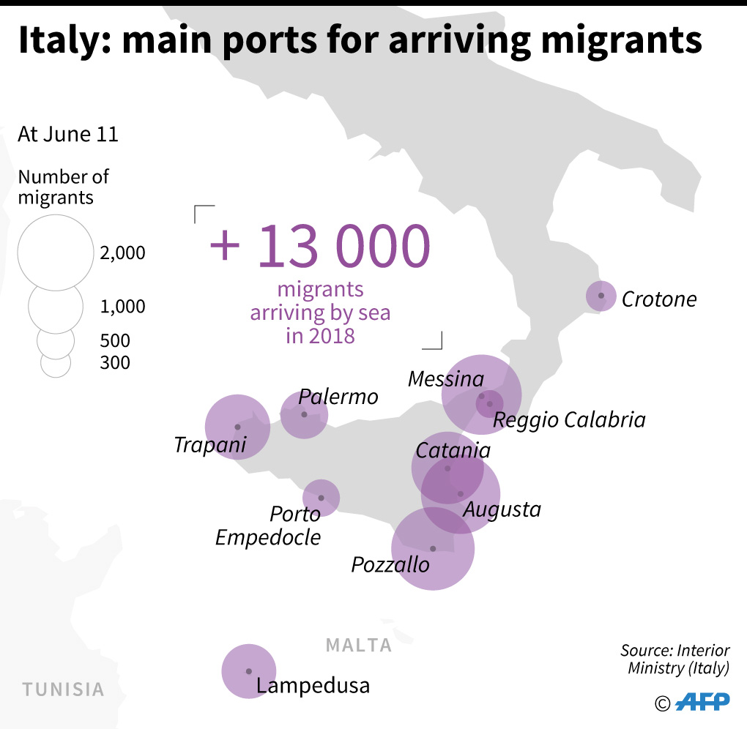
Immigration in Italy: a look at the numbers
According to Istat data, the foreign population present in Italy as of January 1. 2021 represents 8.7% of the resident population.
To these, a number of irregular foreigners must be added, estimated around 519,000.
Lombardy is the region with the largest number of foreigners, followed by Lazio and Emilia Romagna.

Slide 16
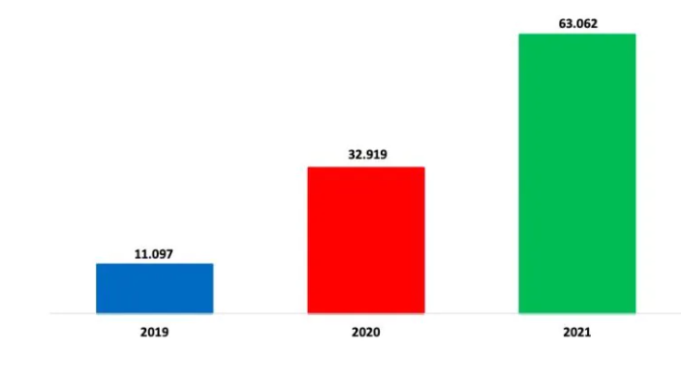
This chart represents the number of people immigrated in Italy in the years 2019-2020-2021

Slide 17
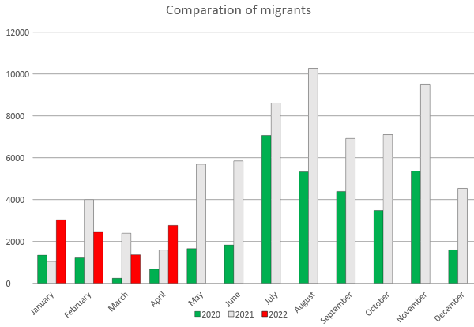
Since the beginning of 2022, there are also 100,754 Ukrainian refugees arriving at Italian borders.
The cities of destination declared by the Ukrainians upon entry into Italy are above all Milan, Rome, Naples and Bologna.

Slide 18
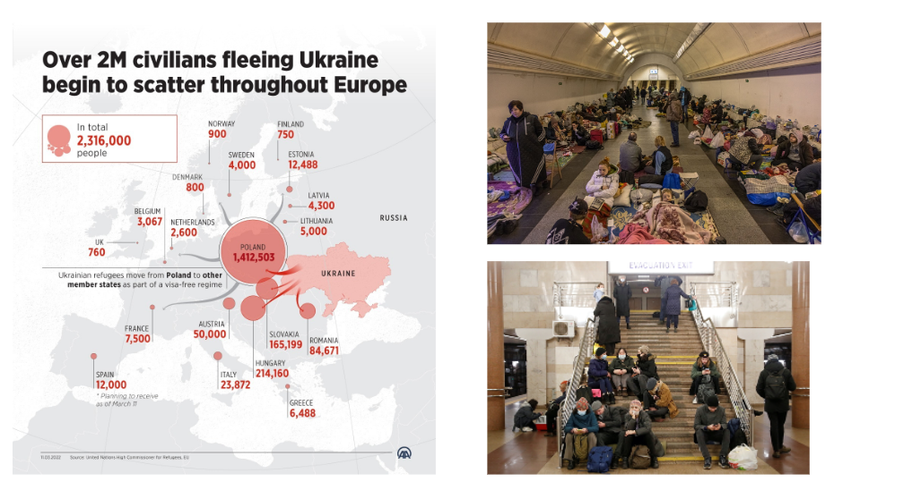

Slide 19
THE reception system
in Italy

Slide 20
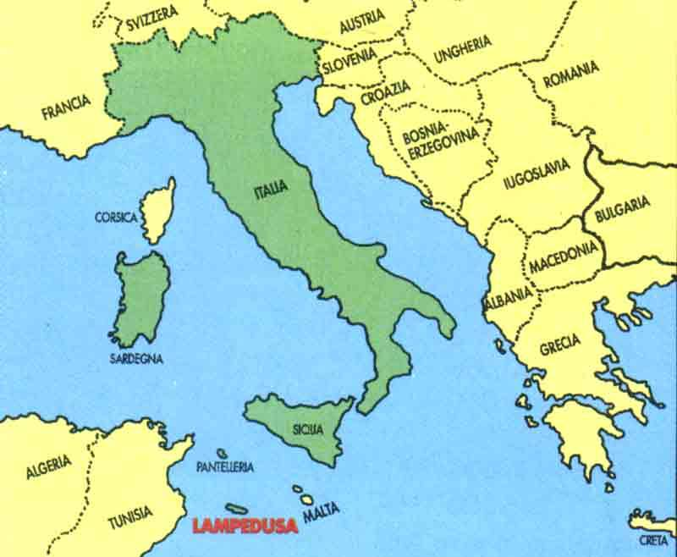
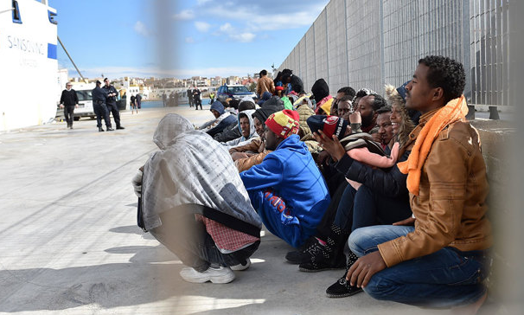
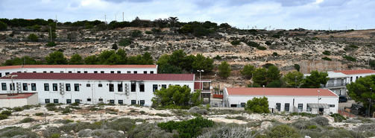
In Lampedusa the refugees are welcomed in centers called HOTSPOTS where immigrants can stay until they found an accommodation
immigrants leave Africa and arrive in Lampedusa

Slide 21
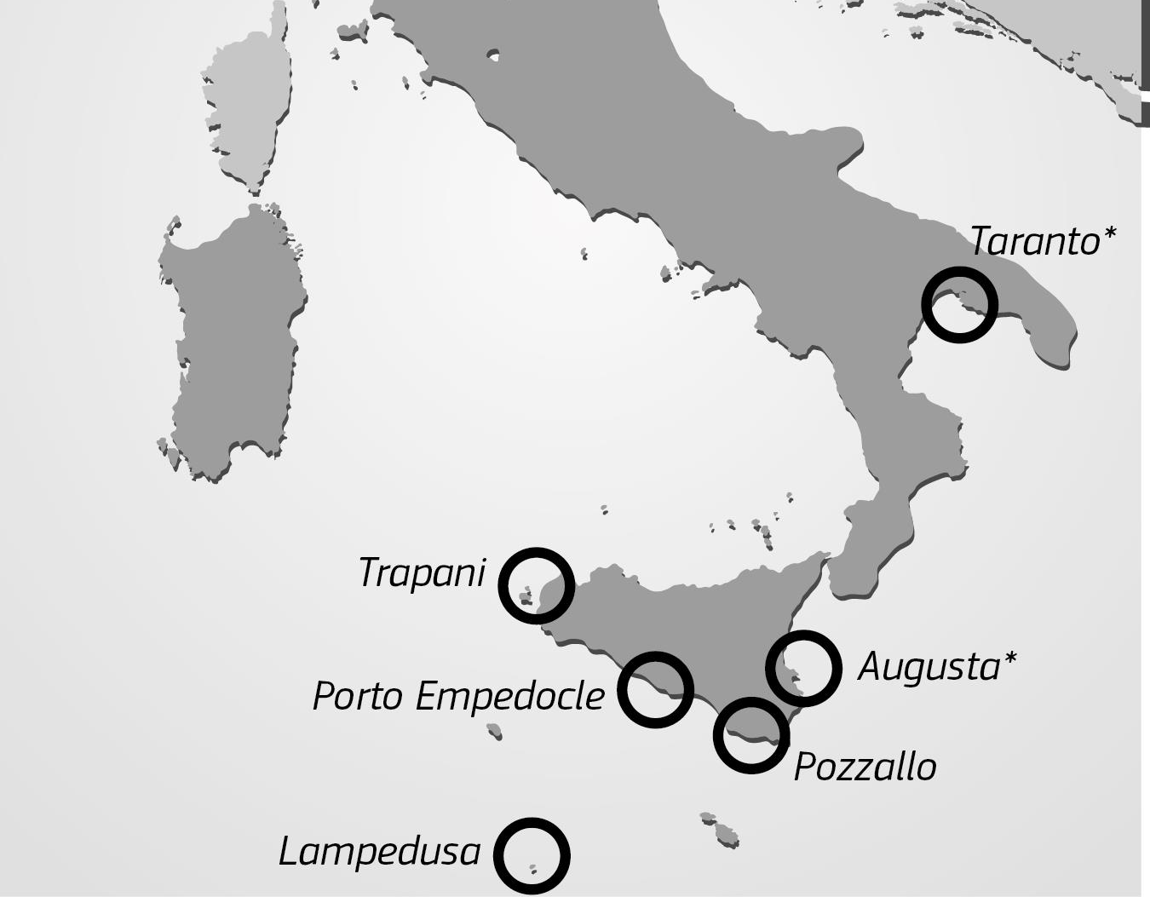
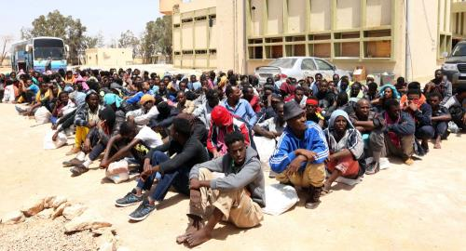
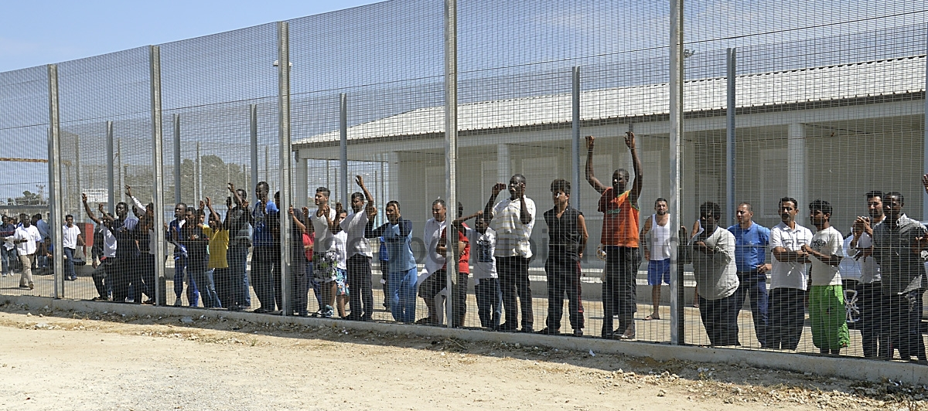
HOTSPOT
The personal data of newly disembarked foreign citizens will be registered in the hotspot centers.

Slide 22
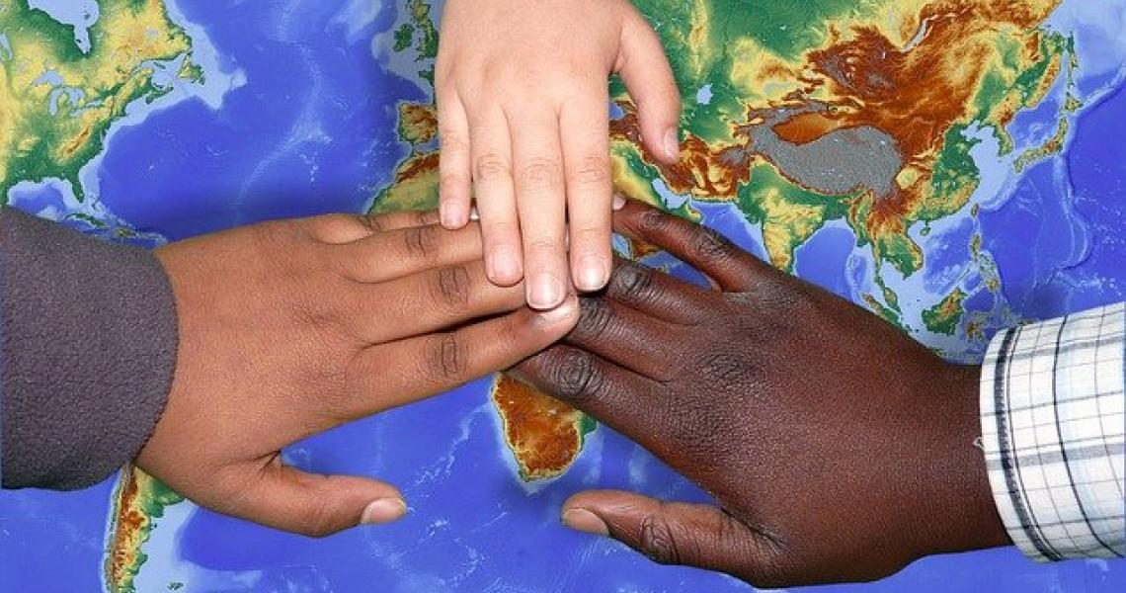
SAI = NATIONAL ASYLUM PROGRAMME
SAI aims to welcome, protect and integrate refugees .
It gives them protection and asylum.
Immigrants have legal, health and linguistic assistance.
SAI helps them to find a work.

Slide 23
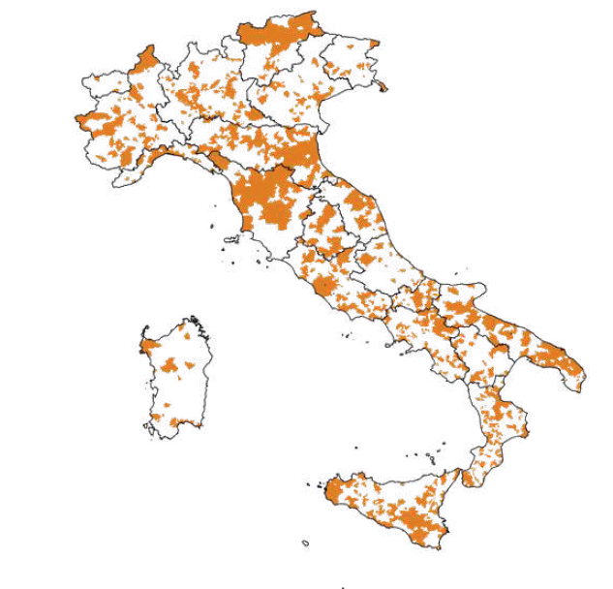
This is the map of SAI centres in Italy

Slide 24
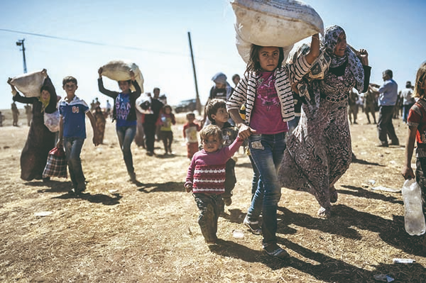
What do asylum seekers have to do when they arrive in Italy?
After submitting the application for international protection, asylum seekers will be summoned for an interview where they will be asked for information on:
• identity (origins, family, culture, studies, work and religion, political ideas)
• reasons for leaving the country of origin
• fears of returning to the country of origin and risks

Slide 25
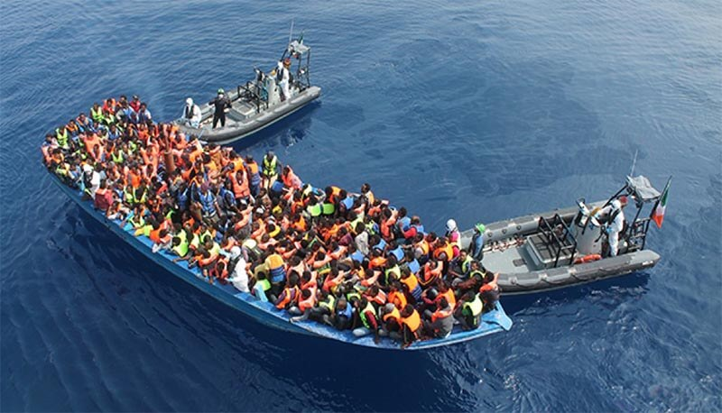
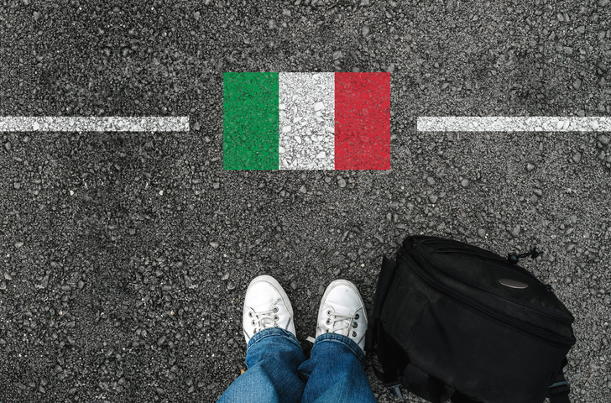
Immigration
Two stories about…

Slide 26
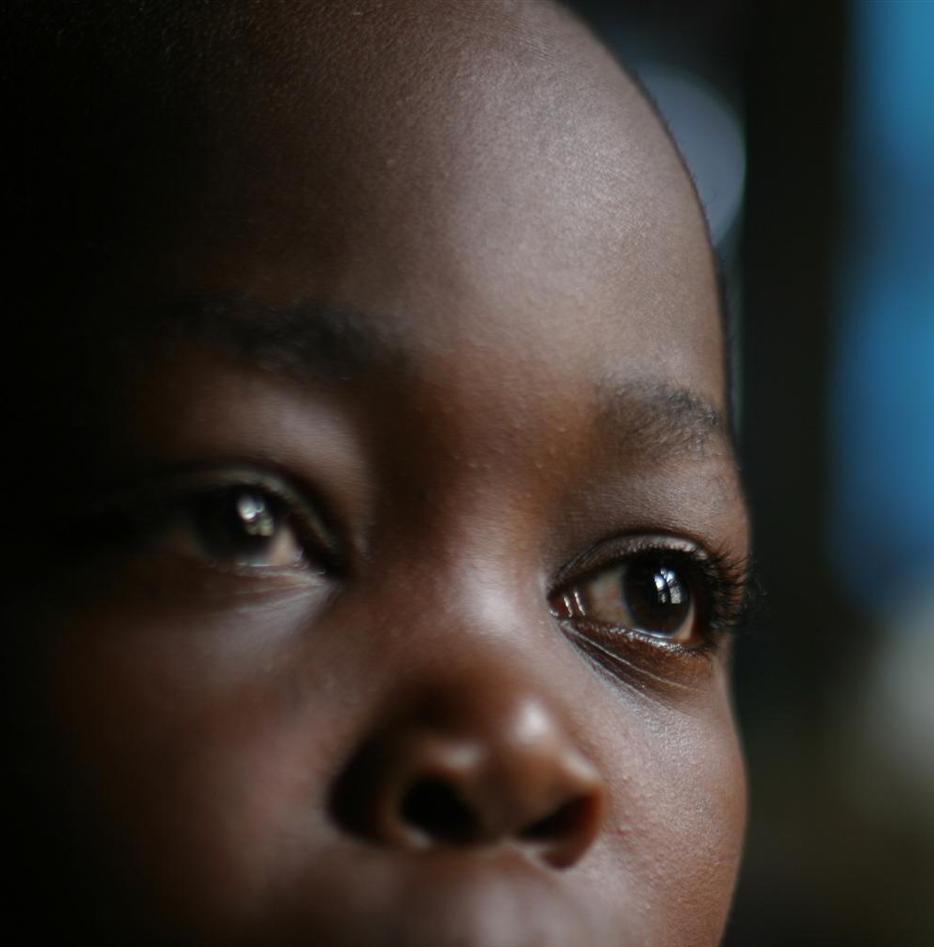
THE STORY OF MOHAMED
Mohamed knew that crossing the Mediterranean sea could be dangerous….
He had no fear , since the day his parents died because of a bomb.
Mohamed was alone, so he decided to flee the war in the country where he lived.
He gave ALL THE MONEY HE HAD to human traffickers who brought him in Libya. When the journey began, the human traffickers treated him inhumanly. Maybe life in Italy will be better, HE THOUGHT…
After a long trip he arrived in Malta.The authorities brought him in a refugees camp where they treated him like a prisoner. Every day he wished to escape from that horrible refugees camp.

Slide 27
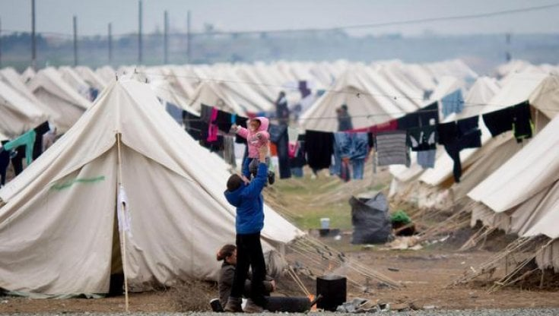

Slide 28
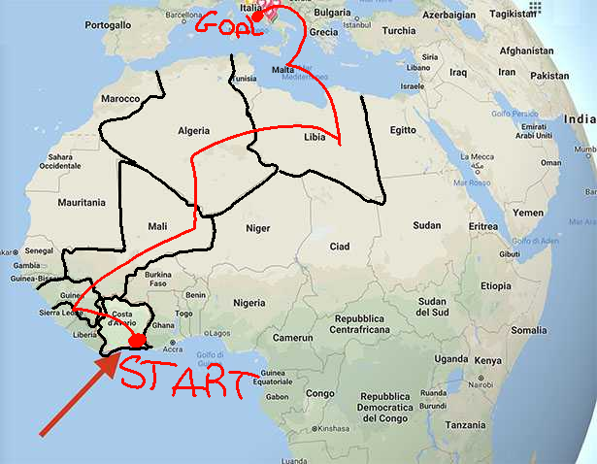

Slide 29
Six month later, after Mohammed had saved a sum of money, he could afford the journey to Italy .
When he arrived in Italy, he didn’t know where he was.
Then the authorities brought him in a host camp where he learnt Italian and he took a course to become a hotel receptionist.
Now he’s working in a hotel and he is a famous photographer known all over the world.

Slide 30
THE SYRIAN HOUSE, A TAKE AWAY RESTAURANT IN BRESCIA
Another happy ending story

Slide 31
comic BY PIETRO SOTGIU 2^C

Slide 32
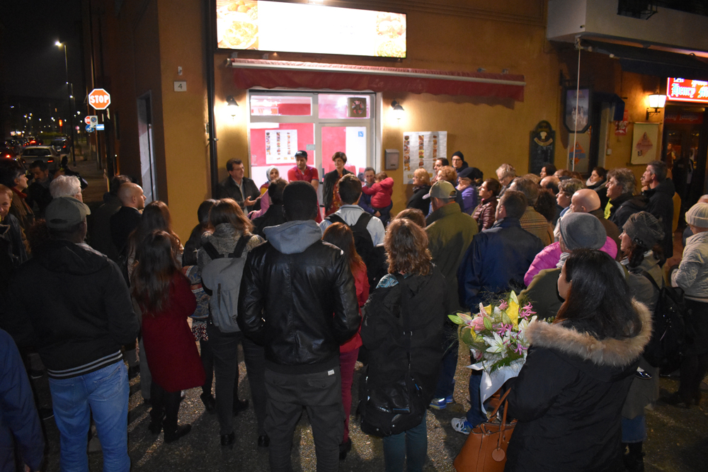
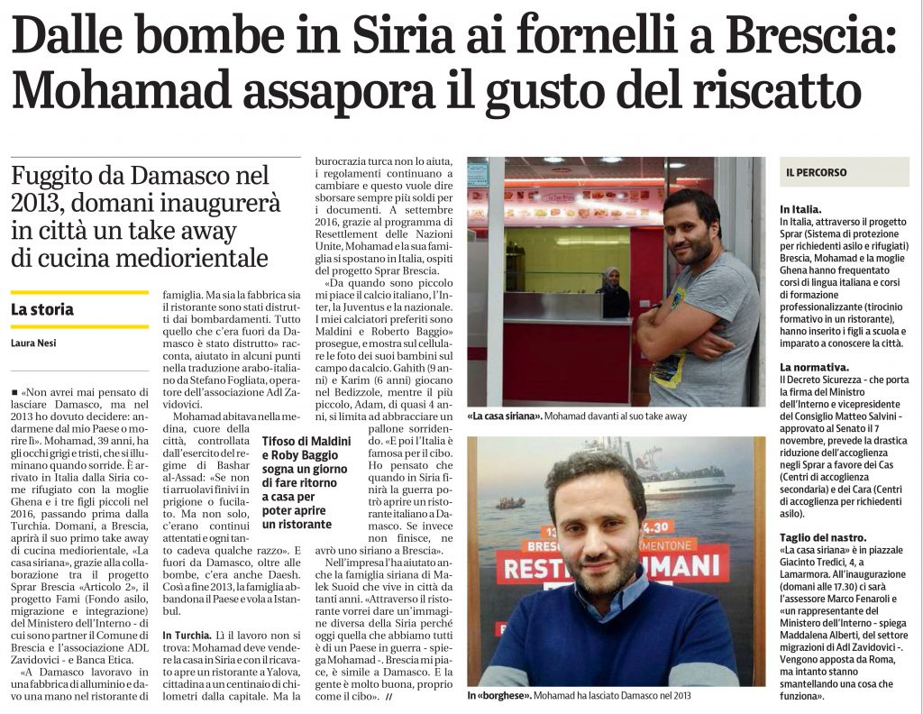
FROM THE SYRIAN BOMBS TO THE STOVE IN BRESCIA: MOHAMAD TAKES HIS REVENGE

Slide 33
THANK YOU FOR PAYING ATTENTION!
ERASMUS+ ITALY team

