Slide 1
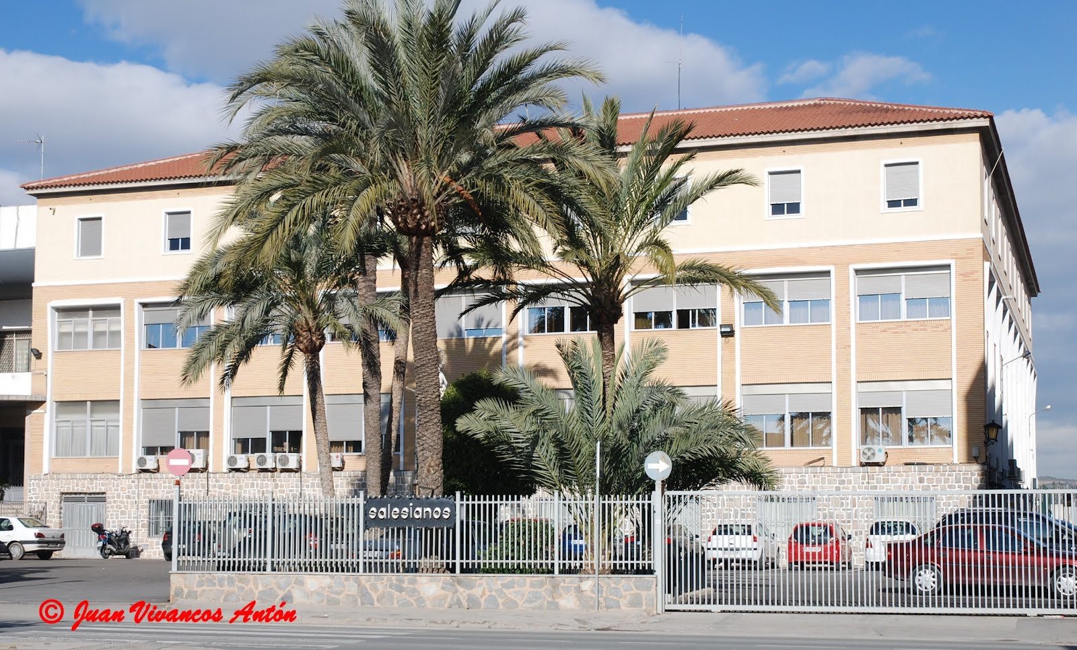
SALESIANOS DON BOSCO SCHOOL,
SPAIN

Slide 2
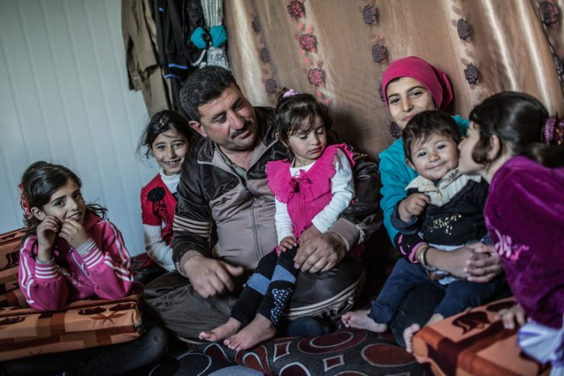
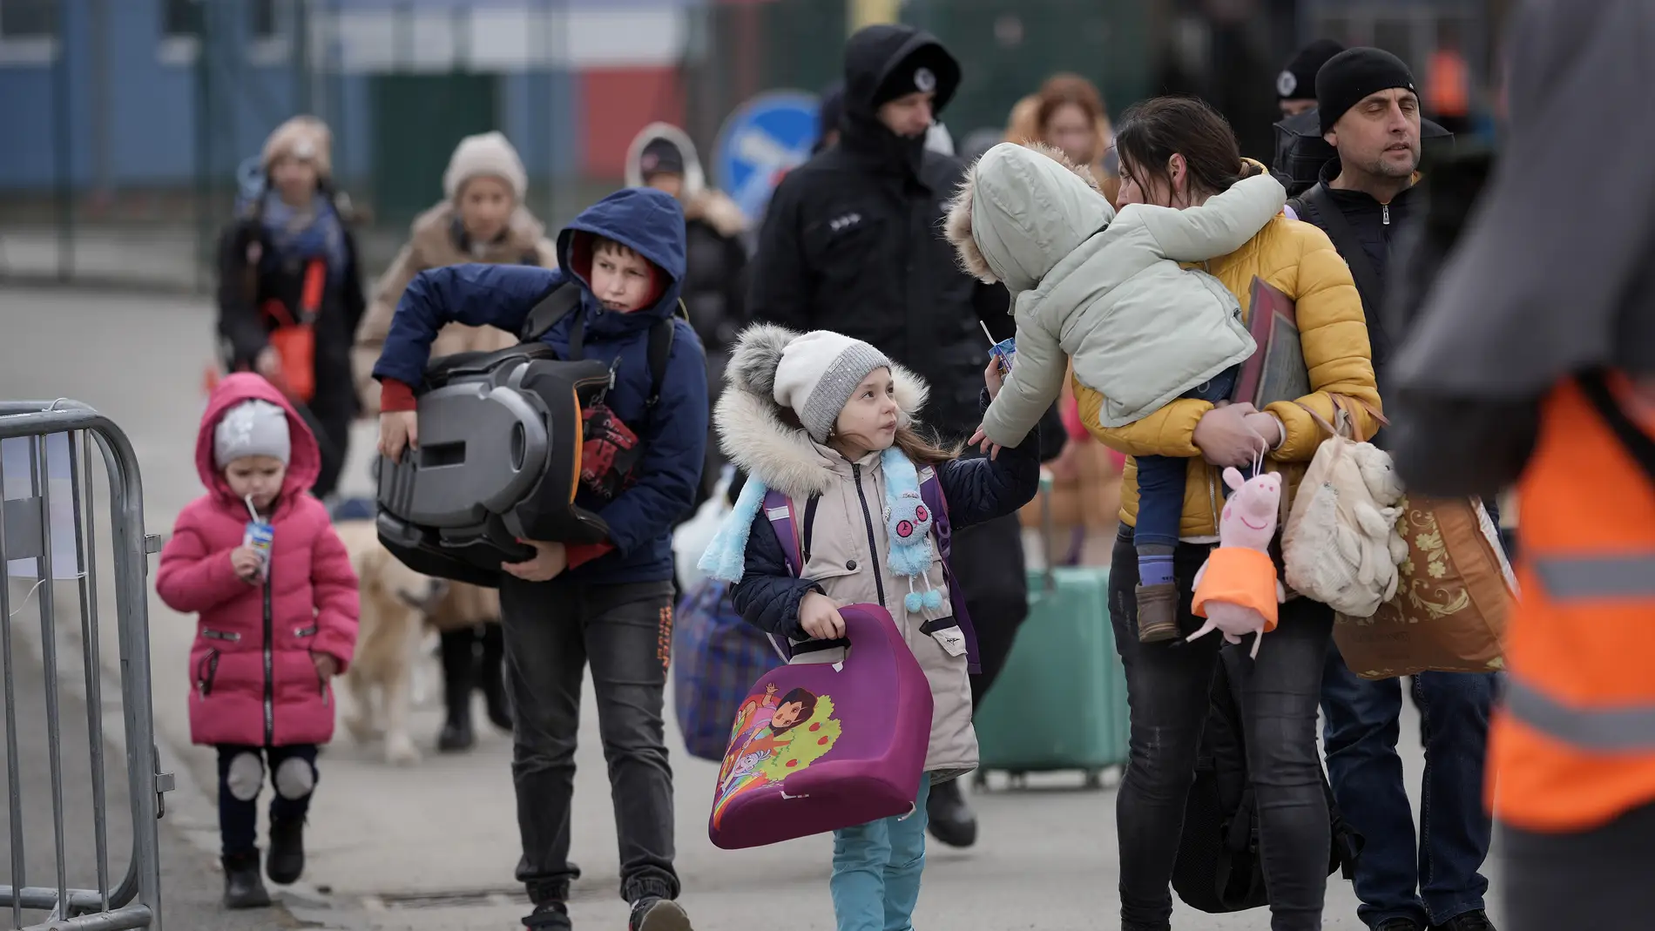
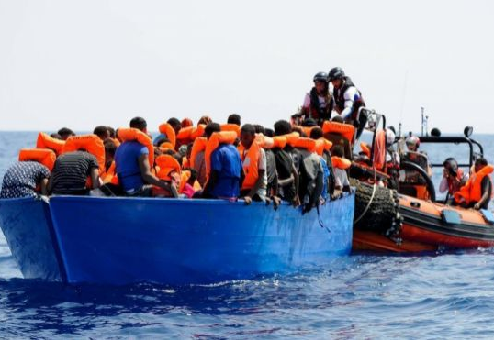
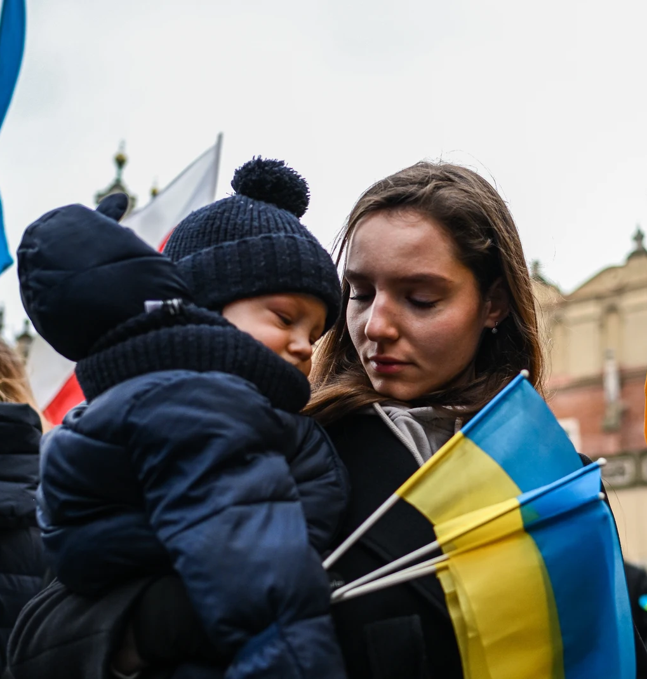
“THE REFUGEES' SITUATION IN SPAIN”
-This project is made by:
Ángela Gaspar
María Marín
Guillem Aparicio
Claudia Cevasco
Paloma Molina
Alba García

Slide 3
OUR PROJECT INDEX
1. What countries do the refugees come from?
2. What kind of people are the majority of the
refugees that arrive in Spain?
3. In which places do they stay?
4. How can people help them?
5. How their future ends?

Slide 4
1.What countries do the refugees come from?
Syria
Venezuela
Afghanistan
Morocco
Burma
Ukraine

Slide 5
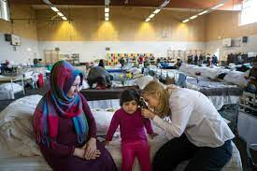
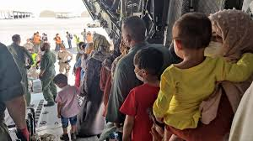
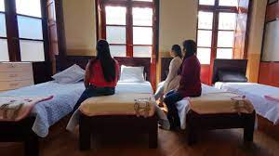
3. In which places do the refugees stay?
They usually stay in :
Asylums
Shelters
Houses of reception

Slide 6
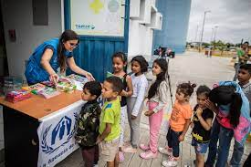
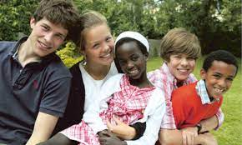
4. How can people help them?
Donations
Host them
Draw attention to the problem

Slide 7
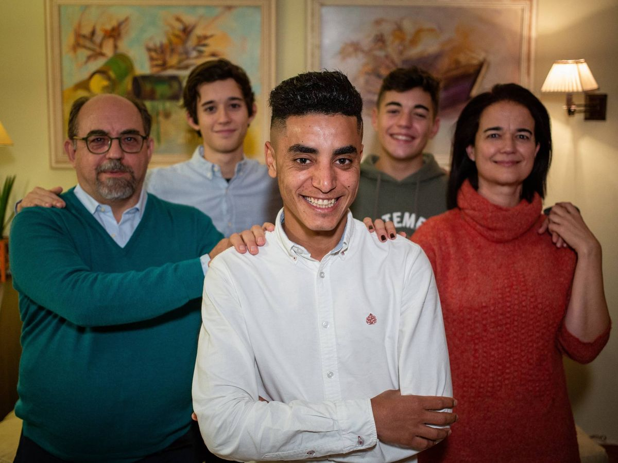
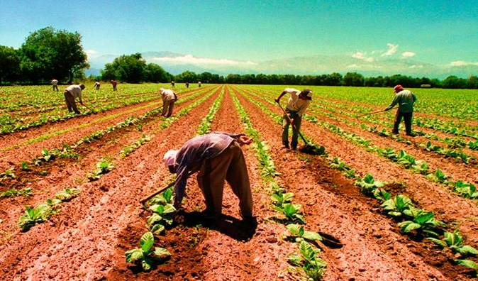
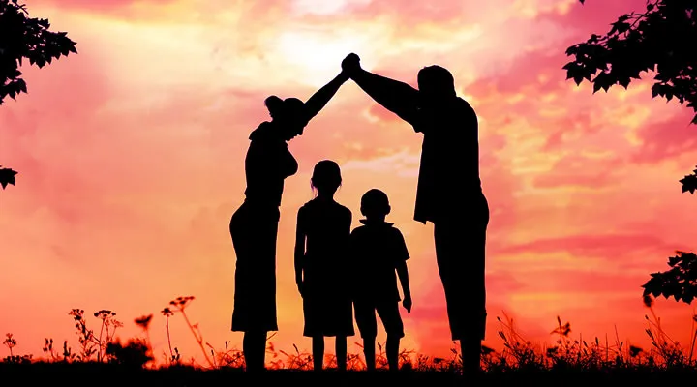
5. How their future ends?
The families can receive refugees
They can get a job
They can form their own family

