Slide 1
REFUGEES IN TURKEY
Where we came from, and where we're going

Slide 2
While the number of people forcibly displaced due to conflict, violence and persecution reached record levels globally; Turkey continued to be the country hosting the largest number of refugees in the world.

Slide 3
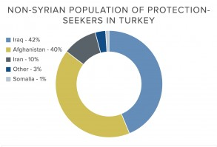
Percentages of refugees in
Turkey
Turkey hosts refugees from many countries.October 2017 there are approximately 3.2 million Syrian refugees in Turkey.urkey also maintains a significant non-Syrian population. As of October 2017, of the non-Syrian population of protection- seekers in Turkey: about 44% are from Afghanistan, 42% are from Iraq, and 10% are from Iran. The remainder are from other countries around the world.

Slide 4
Refugees crisis in Turkey
Turkey have high expenses on refugee care (housing, employment, education, and health), including the medical expenses (no discount from western medicine companies), with minimal support from other countries. Refugees impact on economic and social issues: increases in food and house prices and property rents.

