Slide 1
FIT FOR THE EUROPEAN JOB MARKET THROUGH APPLICATION, TRAINING AND INTERNSHIP

Slide 2
PROJECT OBJECTIVES
Offer students a realistic perspective for their future
Students become more aware about how they could put their individual skills and abilities into practice
Students build a personal profile which will help them to write up a CV and letter of application

Slide 3
MOBILITIES
November 2018 – Sicily – Comparison of diverse concepts
May 2019 - Malta
Autumn 2019 - Portugal
Spring 2020 - Germany

Slide 4
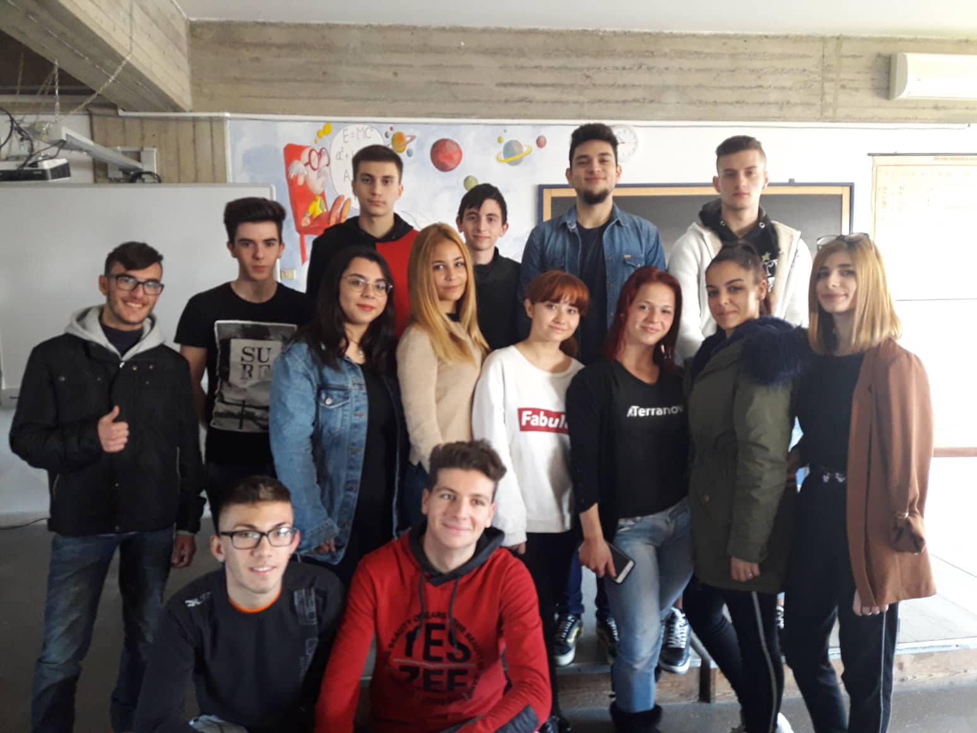
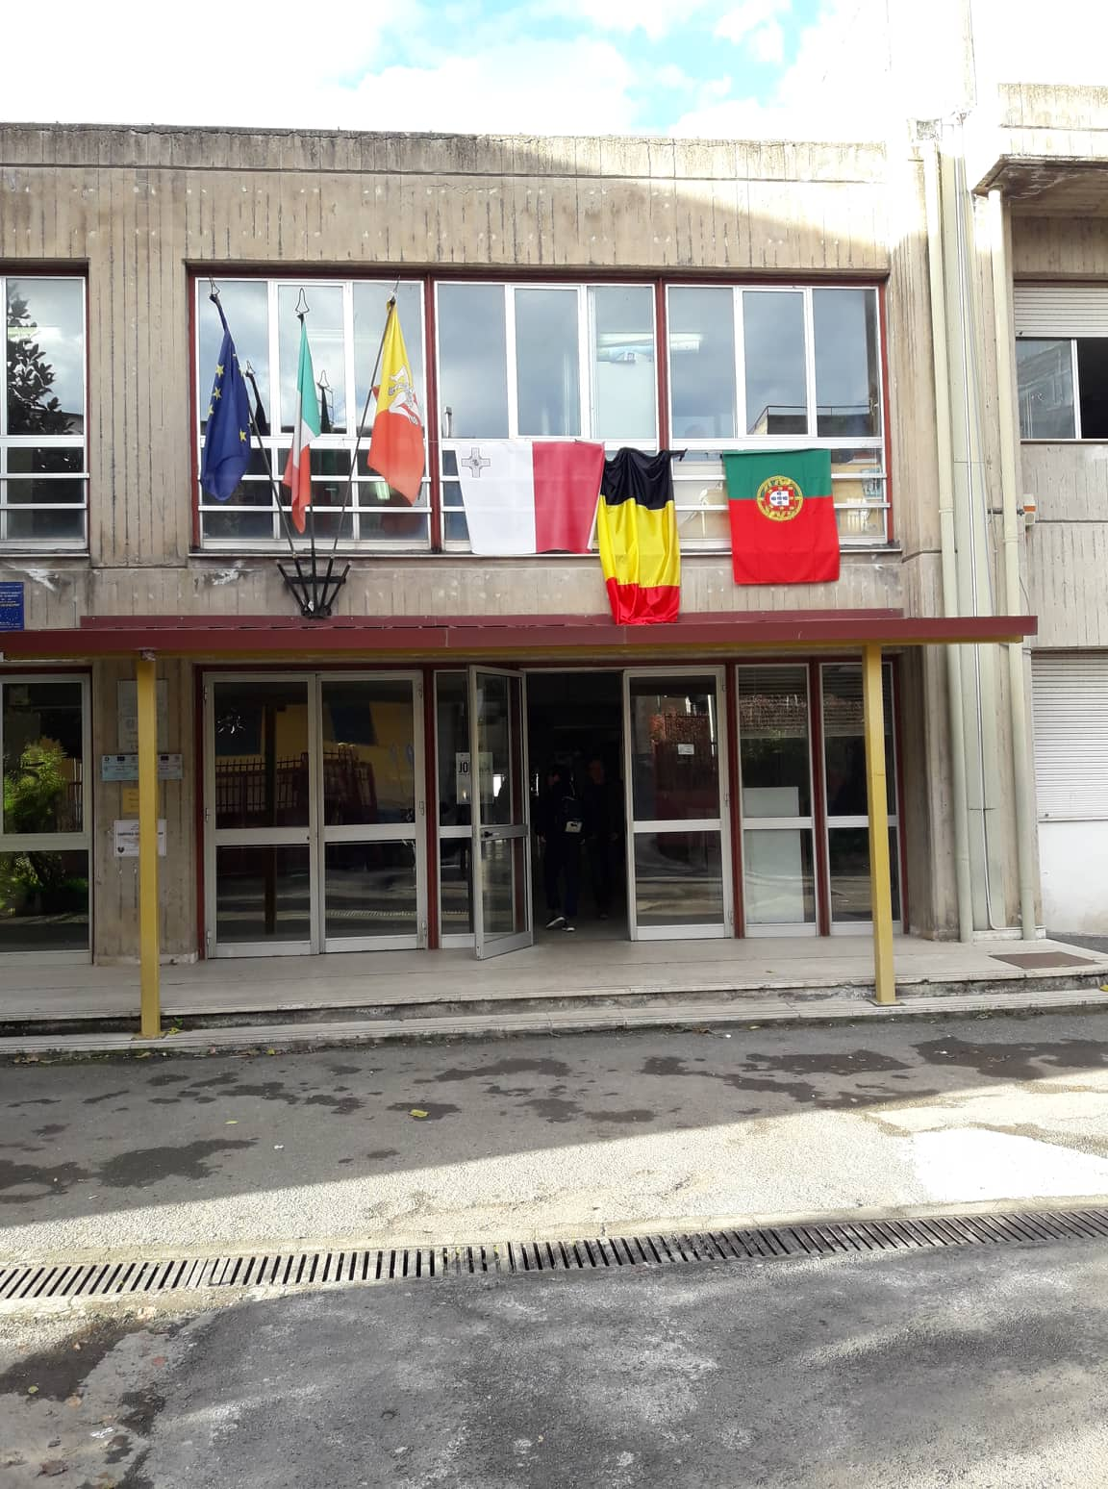
GETTING ACQUAINTED WITH A NEW ENVIRONMENT
Meeting the host families
Spending time in the Sicilian classrooms
Ice-breaking – unfortunately difficult to break boundaries with Germans

Slide 5
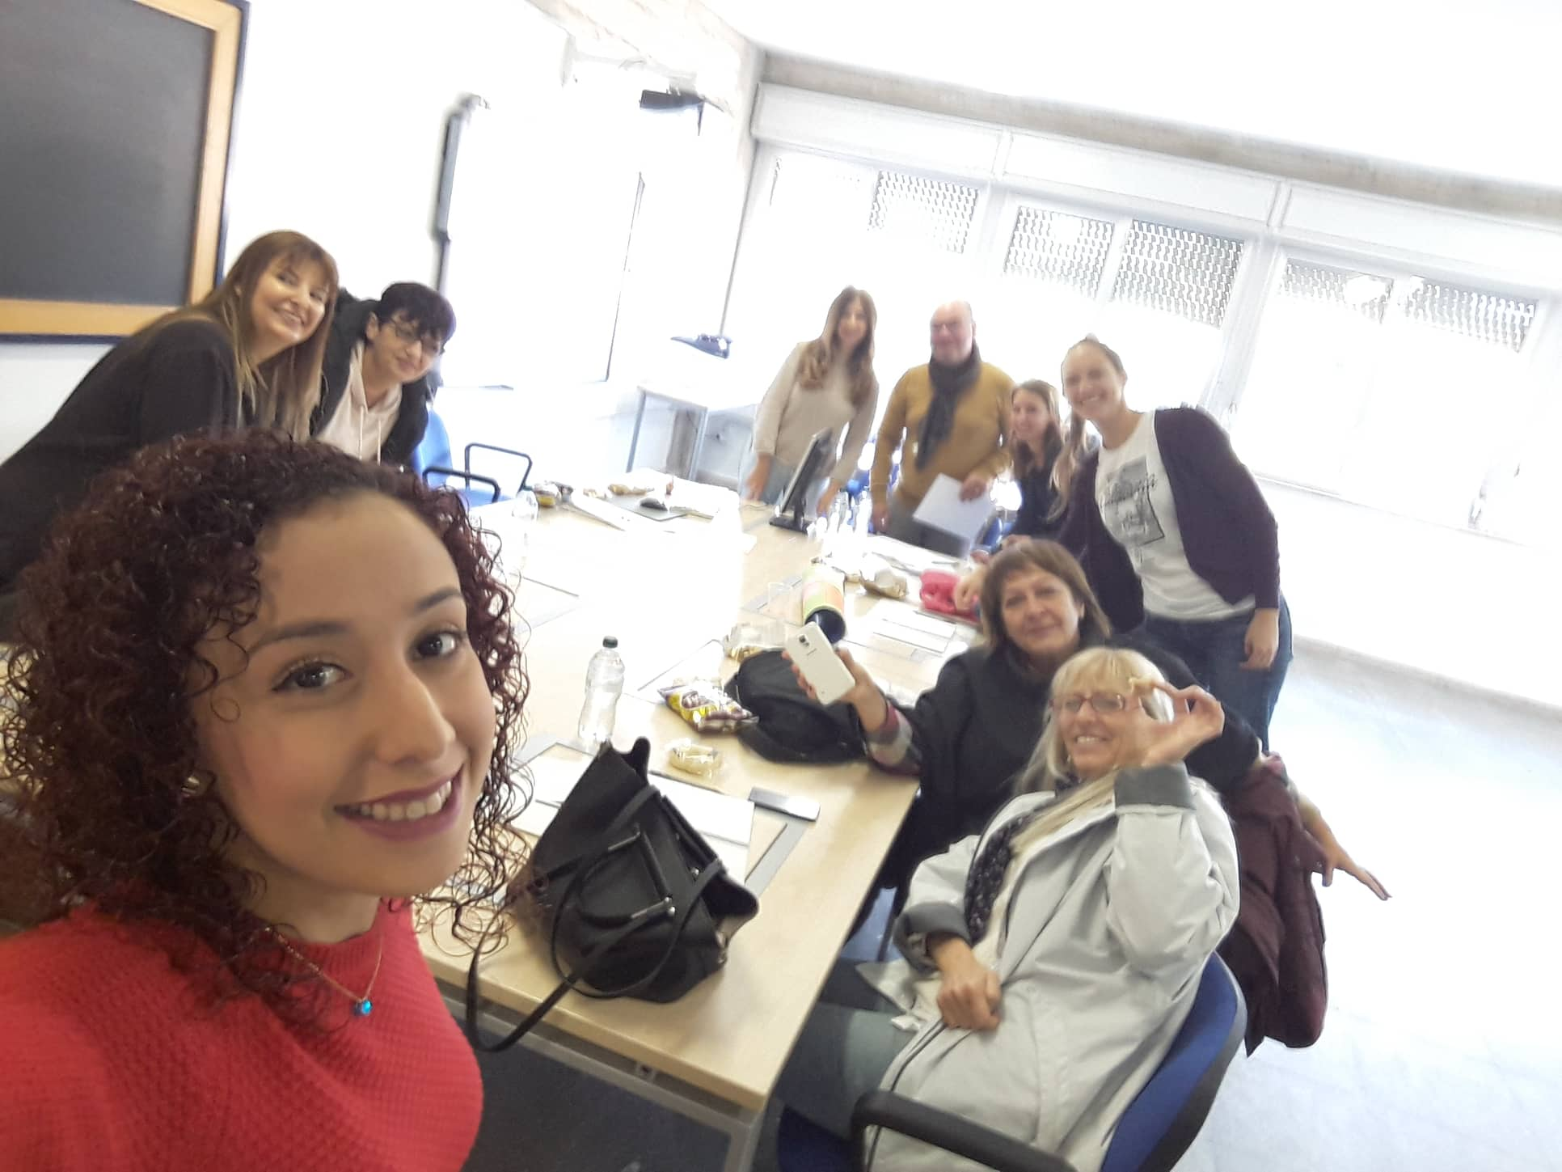
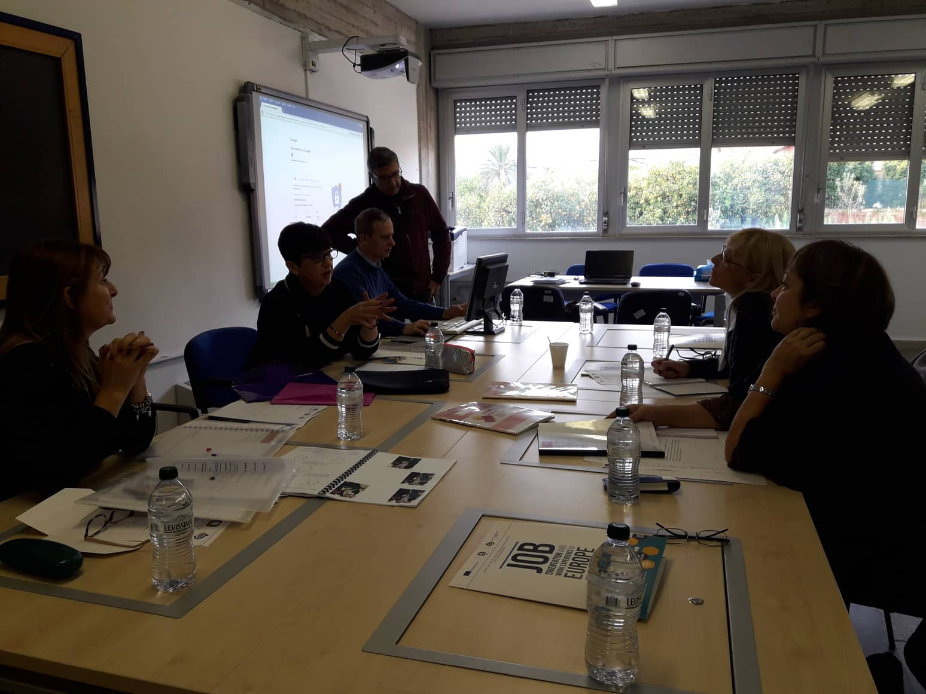
TEACHERS’ MEETING
Discussion about the transition from school to the workplace in our country – portfolios and ACEE
Our school was the best equipped for assisting students with this transition
Discussions directed at how our ideologies could potentially be adapted for the other countries were carried out

Slide 6
WORKING ON THE OUTCOMES OF THE PROJECT
Logo produced by students
Students discussed their subject preferences – use of different languages including non-verbal communication
Individual student portfolio

Slide 7
POTENTIAL JOB OPPORTUNITIES
Kore University – library, earthquakes simulation, airplane simulation
Oranfrizer – considering all jobs as important
Research Centre for the Citrus crops
Honey – Zaffarena

Slide 8
CULTURAL VISITS
Procession in Scordia
Etna - snow experience for the first time
Town Hall in Catania
Piazza Elefante and Castello Ursino
Taormina – cable cars

Slide 9
STUDENT REMARKS ABOUT THEIR EXPERIENCE
“It was my first experience abroad and it was the best week and his family treated me like their son”
“The first experience of snow. It was really cold but really nice”
“I really learnt a lot from this journey and the types of culture they have”
“I started to feel like one of them. I already miss Federico’s family”
“Doqna larinġa li minn ġewwa kienet roża”

