Slide 1
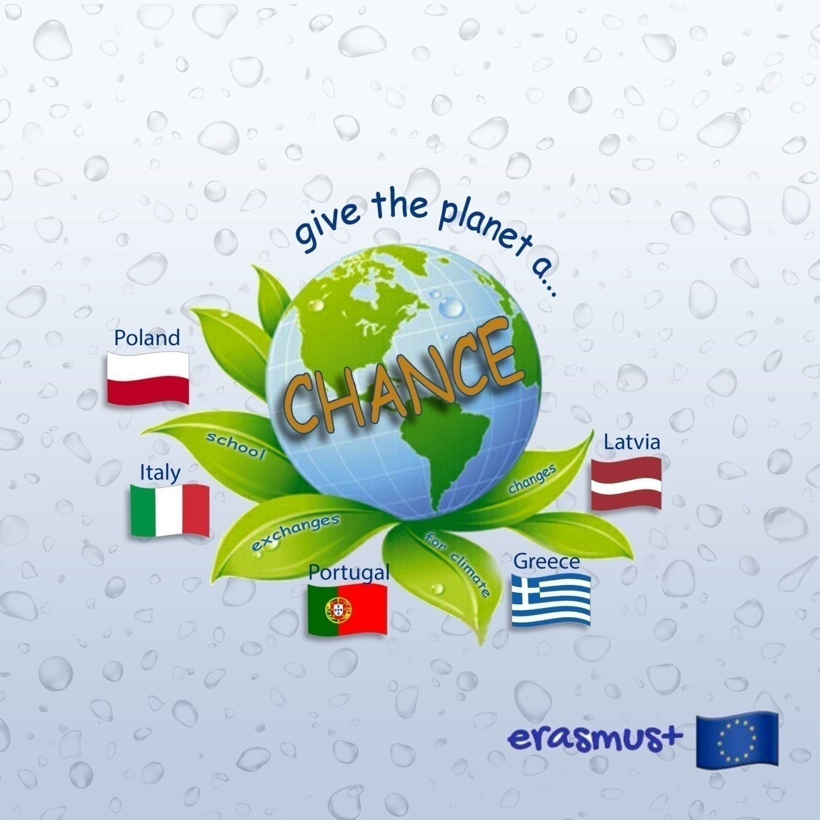

Slide 2
Greece Our region Thessaly

Slide 3
Our Region
Name: Thessaly
Largest city: Larissa
River: Pinios
Mountains: Olympus, Kissavos
Lakes: Carla
Seas: Aegean Sea

Slide 4
Thessaly
Thessaly is a traditional geographic and modern administrative region of Greece, comprising most of the ancient region of the same name. Before the Dark Ages, Thessaly was known as Aeolia and appears in Homer’ s Odyssey.
Thessaly lies in central Greece and borders the regions of Macedonia on the north, Epirus on the west, Central Greece on the south and the Aegean Sea on the east.

Slide 5
Larissa city The ancient Theatre

Slide 6
Larisa city Alkazar park

Slide 7
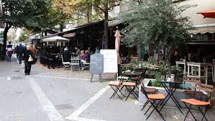
Larisa city
Pinios river
The city of coffe

Slide 8
Pinios river
Across the city
And flows out into Aegean Sea

Slide 9
Olympus Mountain
Is the highest mountain in Greece.
It is located in the Olympus range on the border between Thessaly and Macedonia. Mount Olympus has 52 peaks, deep gorges, and exceptional biodiversity.
The highest peak, Mytikas, meaning “nose”, rises to 2.918 meters.
Olympus was notable in Greek mythology as the home of the Greek gods, on Mytikas peak.

Slide 10
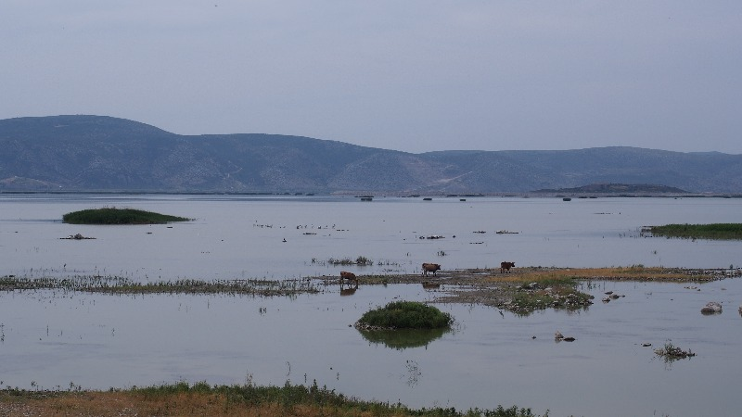
Carla Lake
Carla is a former lake that sits in 60 to 80 m above the sea level making it the only one in the plain of Thessaly. The lake is located at the nothern end of the Magnesia regional unit in the Pinios basin…

Slide 11
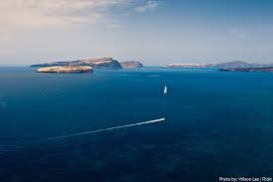
Aegean Sea
Aegean is an elongated embayment of the Mediterranean sea located between the Greek and Anatolian peninsulas and the mainlands of Greece and Turkey.
The Aegean islands are within the sea and some bound it on its southern region including Crete and Rhodes.

Slide 12
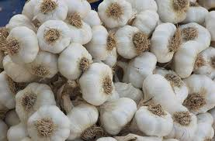
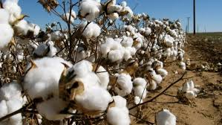
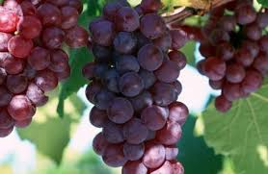
cultivations
Wheat
Garlic
Cotton
grapes

Slide 13
Thank you for your attention Katerina Tounda Ntinos Ntafoulis Athena Papahatzi Argiro Papanagiotou Vasiliki Koutsaftouli Gymnasium Of Platykampos Larissa Greece

