Slide 1
HUNGARY, LITHUANIA AND SPAIN Holidays

Slide 2
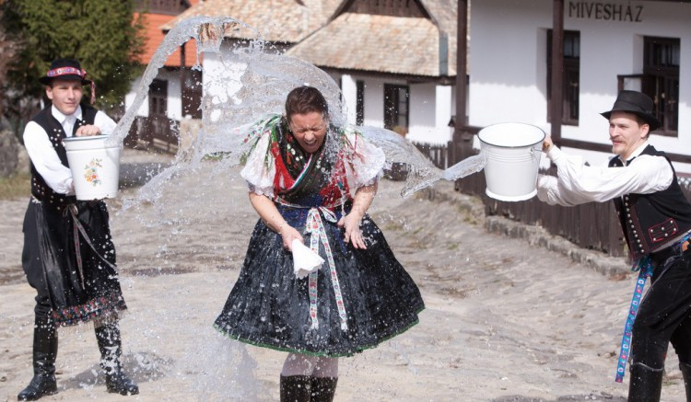
Easter in Hungary :
The day still has special significance for unmarried women and girls. They wear pretty clothes and await the unannounced arrival of their admirers. Girls take a pride in attracting many visitors and “waterers.” After the boy has carried out his ritual role, he is offered gaily painted eggs, home-baked cookies, and an alcoholic drink. He is then free to go on to the next girl. The sprinkling with water and the gift of Easter eggs is a pre-Christian fertility symbol far older than the celebration of Easter.

Slide 3
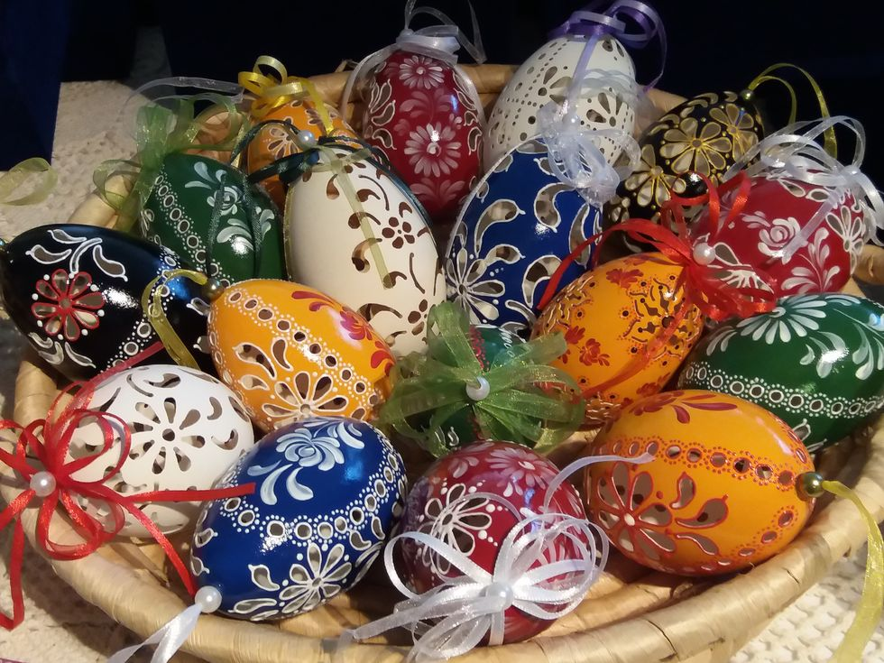
Hungarian easter eggs :
Within the Christian tradition, the custom of dyeing eggs red goes back a thousand years. Red symbolizes the blood of Christ; the egg, eternal life. Other colors began to be used only three hundred years ago. Hungarian Easter eggs are decorated with simple geometric shapes or ornamented with swirls of plants and flowers.

Slide 4
HOGUERAS

Slide 5
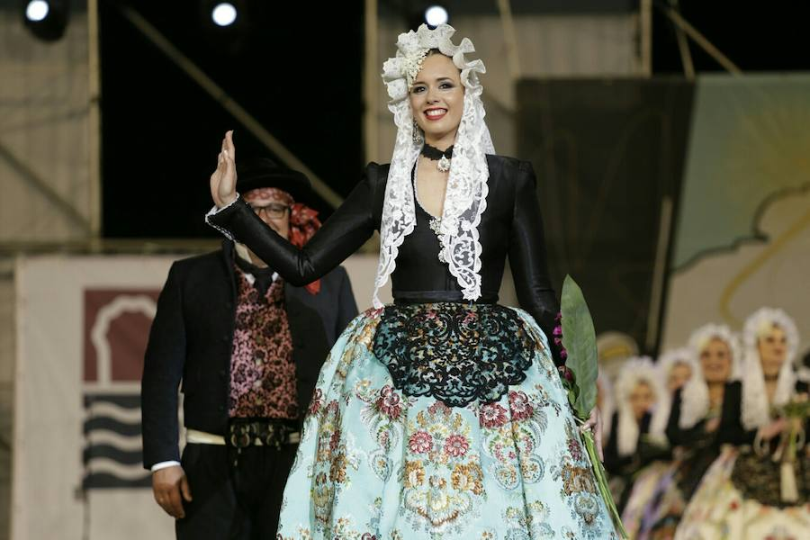
Belleas del foc :

Slide 6
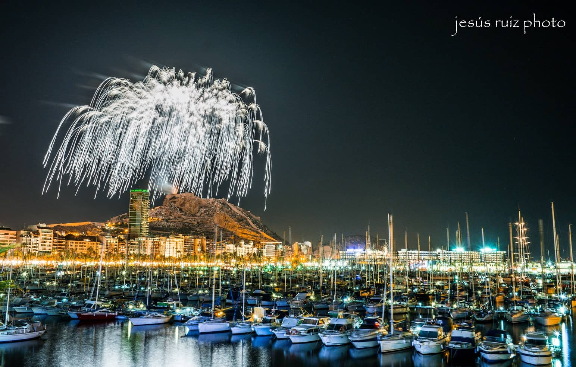
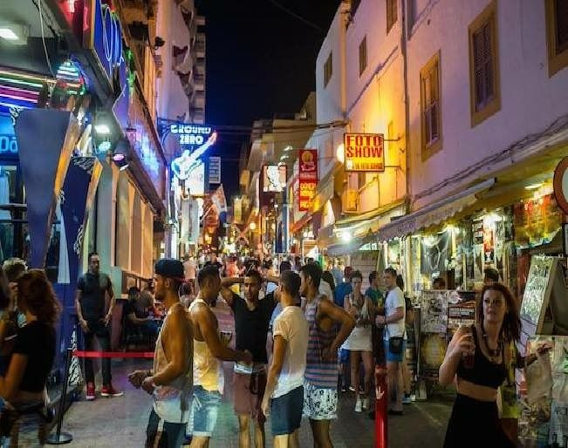
Barracas and celebrations :

Slide 7
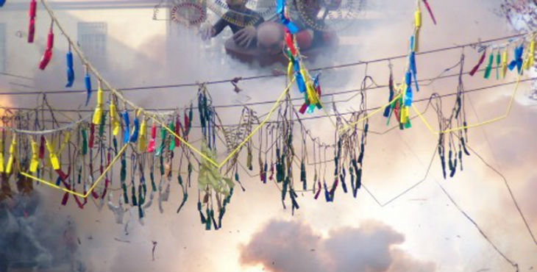
La mascletá :

Slide 8
LITHUANIAN NATIONAL HOLIDAY
SAINT JONAS' FESTIVAL

Slide 9
Saint Jonas ' Festival, also known as Rasa (Dew Holiday), Joninės, Kupolė, Midsummer Day or Saint John ' s Day) is a midsummer folk festival celebrated on 24 June all around Lithuania

Slide 10
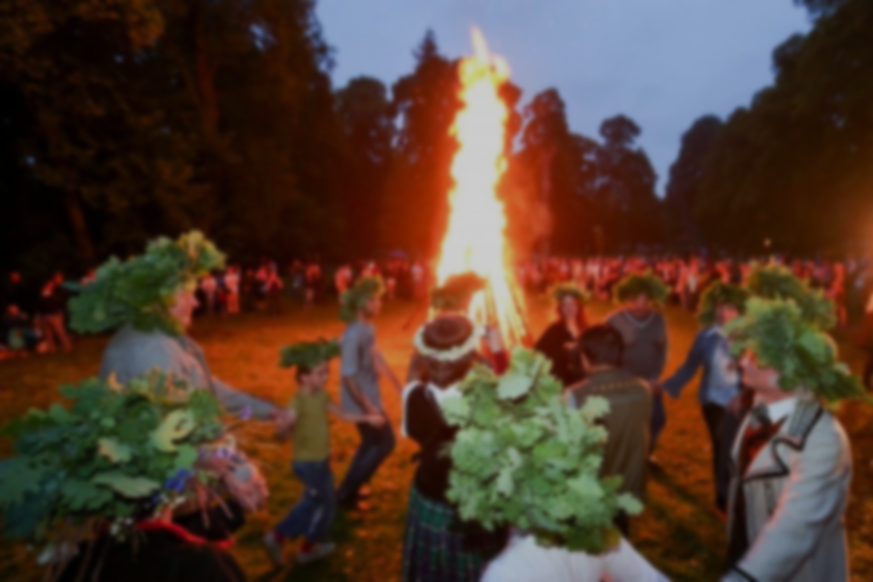
While midsummer day is celebrated throughout Europe, many Lithuanians have a particularly lively agenda on this day. The traditions include singing songs and dancing until the sun sets, telling tales, searching to find the magic fern blossom at midnight, jumping over bonfires, greeting the rising midsummer sun and washing the face with a morning dew, young girls float flower wreaths on the water of river or lake.

Slide 11
For thousands of years, Balts, the ancestors of the Lithuanians, have celebrated the summer solstice (Rasa to the Lithuanians) by offering sacrifices to the pagan gods, and priestesses light the altar fire. This tradition still continues to this day. The ritual is usually performed by members of Romuva (religion)

Slide 12
When Christianity came to Lithuania, it brought with it the celebration of Saint John ' s Day and while Christians celebrate Joninės (St. John ' s) in the local language, Christians, Romuviai, and those with other beliefs all celebrate Rasa together. Lithuanians with the names Jonas, Jonė, Janina receive many greetings from their family, relatives and friends

