Slide 1
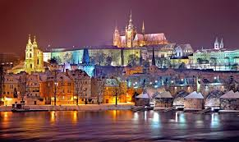
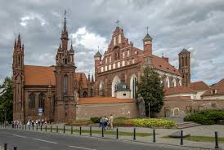
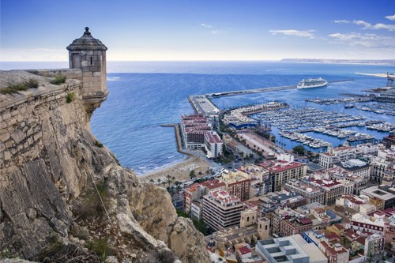
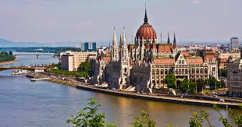
HERITAGE PRESERVATION DEBATE

Slide 2
The spokesman of each country makes a speech on the topic for 2 -3 min.
The countries participants Put forward their arguments to support or reject the topic. (1-2 min per country)

Slide 3
CZECH
Three reasons why students should be taught the value of cultural heritage.

Slide 4
LITHUANIA
glass buildings beautify/destroy the historic value of a city. Give arguments for/ against.

Slide 5
HUNGARY
Cultural Heritage and tourism development. PROS AND CONS.

Slide 6
SPAIN
Three reasons why we should SAFEGUARD AND ENHANCE INTANGIBLE HERITAGE.

Slide 7
in 15 min time students should agree on the statement:
Why is it important to preserve cultural heritage?
What actions should be taken to preserve cultural heritage?

Slide 8
the main spokesperson:
will ask the students from four countries to present their topics;
will ask the students from four countries to make arguments for and against;
will follow the time;
will make the conclusion of the debates and will be responsible for writing a FINAL statement four countriesparticipants agree on.
Edgaras will take pictures and shoot the debates.

