Slide 1
Vilnius Gabija Gymnasium

Slide 2
Introduction
Vilnius Gabija Gymnasium is a gymnasium in Vilnius, the capital city of Lithuania.
Our gymnasium hosts three schools under one roof: primary, secondary and gymnasium.

Slide 3
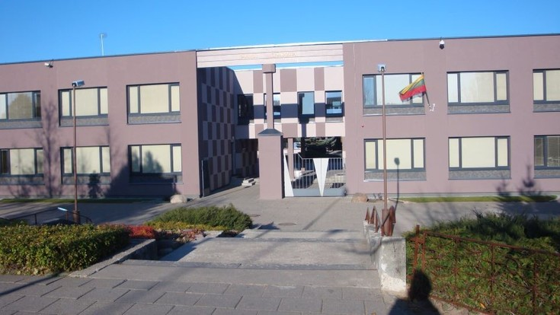

Slide 4
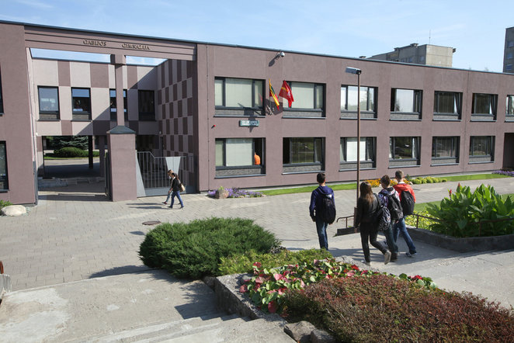

Slide 5
History
Vilnius Gabija Gymnasium has been working since 1989.
The official birthday of the school is 20th October – the day when the very first students opened the door of their new school.

Slide 6
History
In 1993 the title of Gabija was bestowed on gymnasium.
Gabija was a goddess of fire in paganism – the old religion of ancient Baltic tribes – therefore Gabija is a symbol of creativity and wisdom.

Slide 7
Gymnasium’s attributes
Flag
Logo

Slide 8
Virtues of gymnasium:
Creativity,
Empathy,
Tolerance,
Professionalism,
Wisdom.

Slide 9
Misions:
To educate innovative, creative, tolerant and responsible youth.
To assure students they will receive highly qualified education.
To allow students to express themselves through art, sport or academic contests and projects.

Slide 10
Statistics:
Up to 1600 students.
124 teachers.
62 forms.
64 classrooms.

Slide 11
Traditions
Our gymnasium has quite a lot of celebrations, starting from the first day of new school year (1st September) and school birthday, to national holidays and festivals.

Slide 12
Traditions
Also we have a wide variety of academic, artistic and sport competitions such as public speaking in Lithuanian or English, the election of most literate student, volleyball tournament ...

Slide 13
A few moments from our celebrations

Slide 14
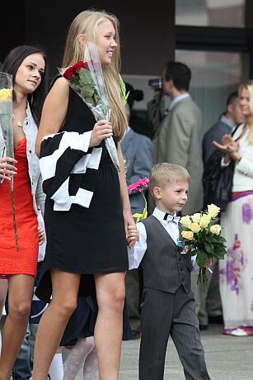
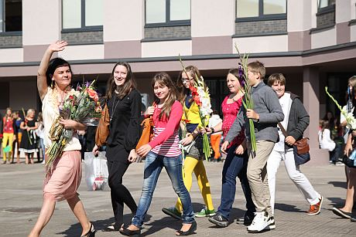
New School Year

Slide 15
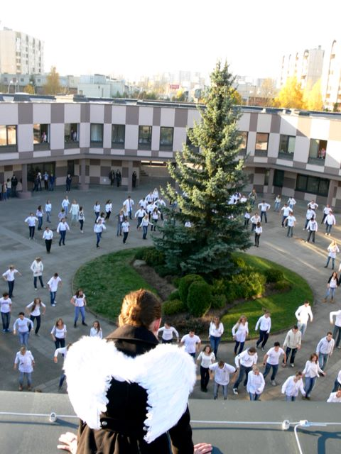
Gabija’s birthday flashmob

Slide 16
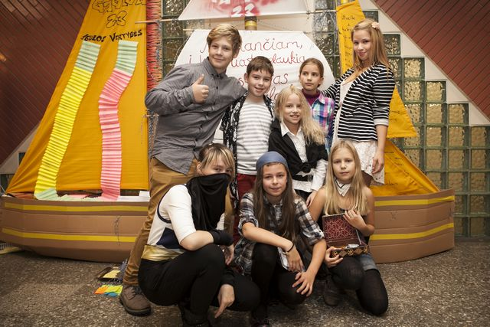
Gabija’s birthday

Slide 17
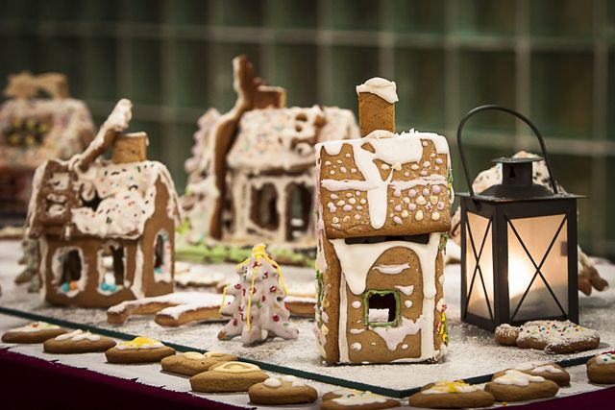
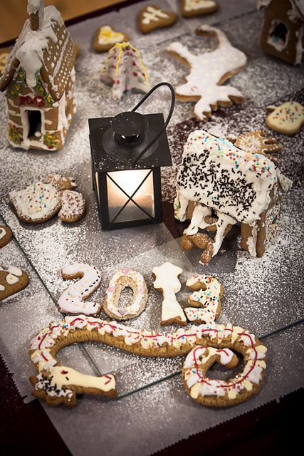
Christmas baked goods fair

Slide 18
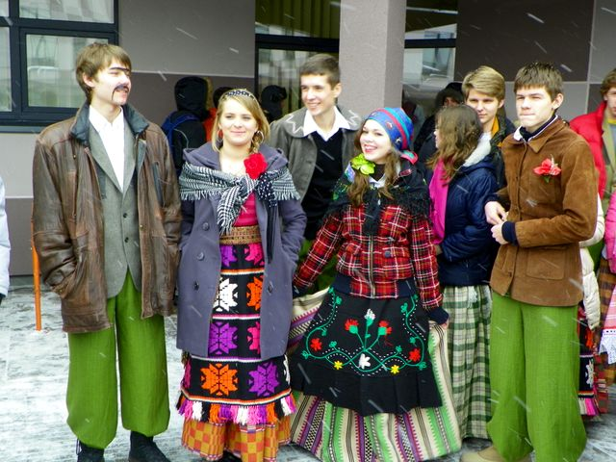
End of winter festival (‘Uzgavenes’)

Slide 19
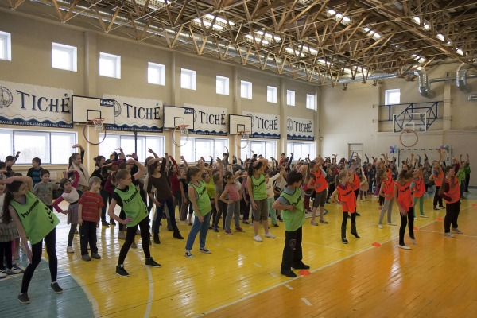
Day of aerobics

Slide 20
