Slide 1
LETENYEY LAJOS HIGH SCHOOL, TECHNICAL HIGH SCHOOL AND VOCATIONAL SCHOOL OF FELCSÚT
Founded in 2011, originally as a secondary educational institute
of the Puskás Ferenc Football Academy in Felcsút

Slide 2
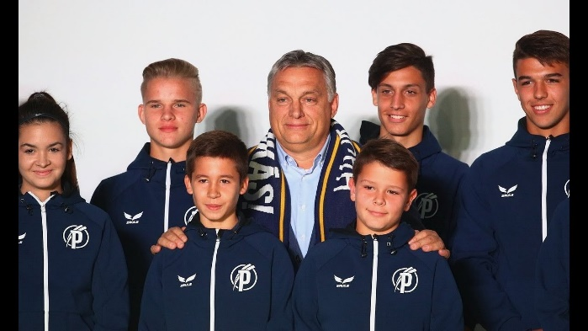
PANCHO ARENA FELCSÚT
Felcsút is the home town of our Prime Minister, Viktor Orbán,
who is a great supporter of football and of vocational education.

Slide 3
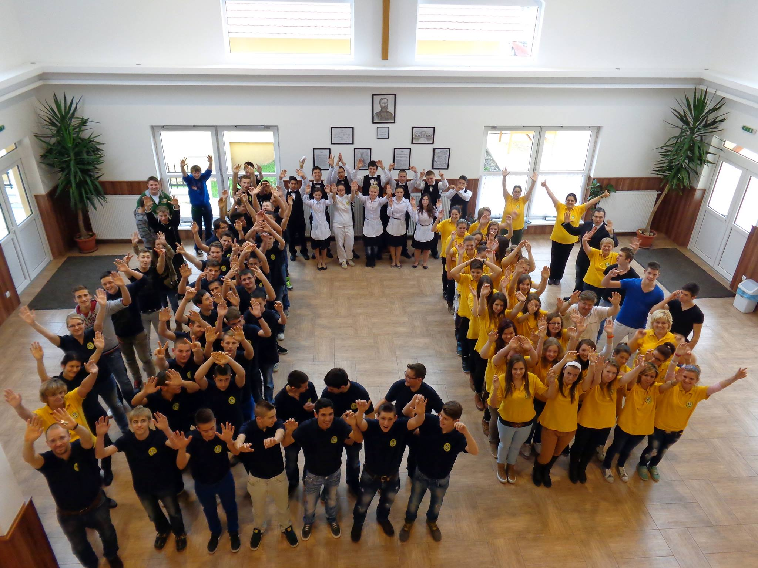

Slide 4
Our school provides education at a wide range of vocations and levels:
3 YEARS - VOCATIONAL SCHOOL FOR COOKS, PASTRY COOKS, WAITERS AND FARMERS
4 YEARS - GENERAL HIGH SCHOOL, PREPARING STUDENTS FOR HIGHER EDUCATION/UNIVERSITY
5 YEARS - TECHNICAL SCHOOL –MANAGEMENT SKILLS IN FOOTBALL COACHING, GASTRONOMY AND AGRICULTURE

Slide 5
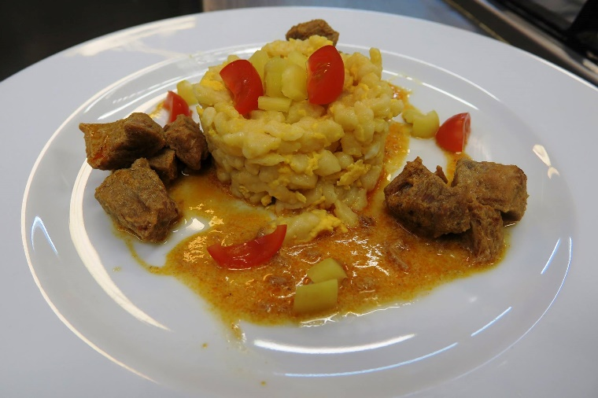
COOKS AND CHEFS

Slide 6
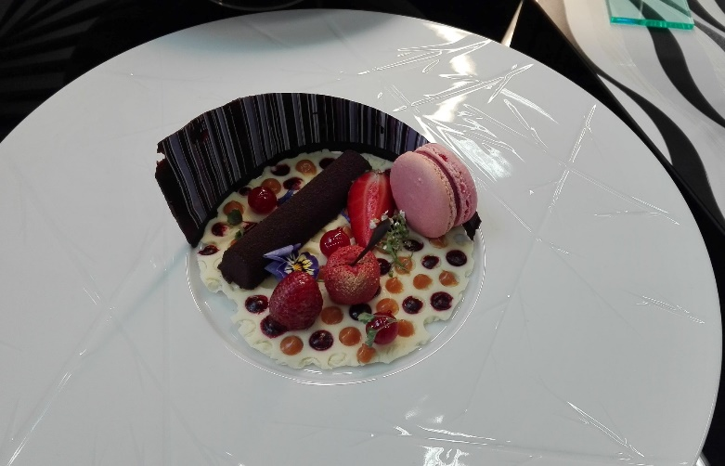
PASTRY COOKS

Slide 7
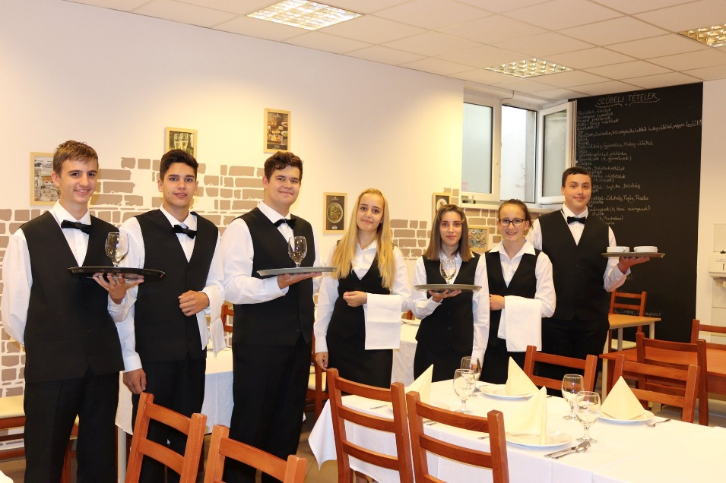
WAITERS AND WAITRESSES

Slide 8
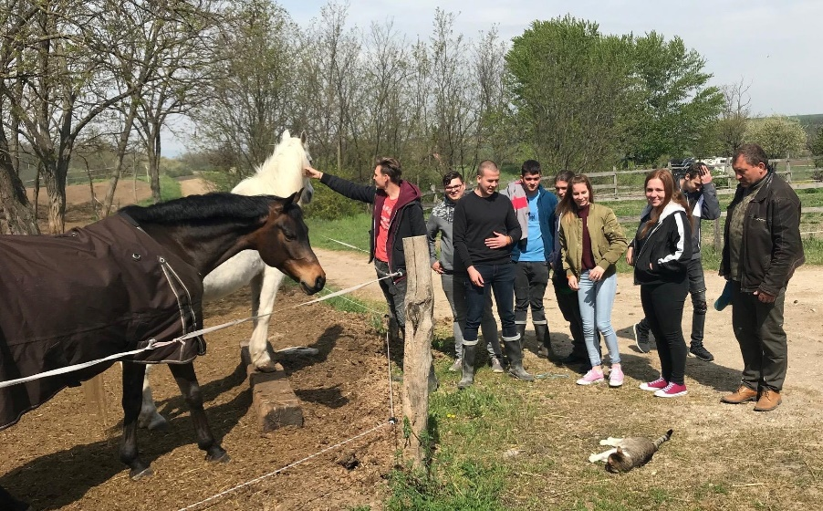
FARMERS AND AGRICULTURAL WORKERS

Slide 9
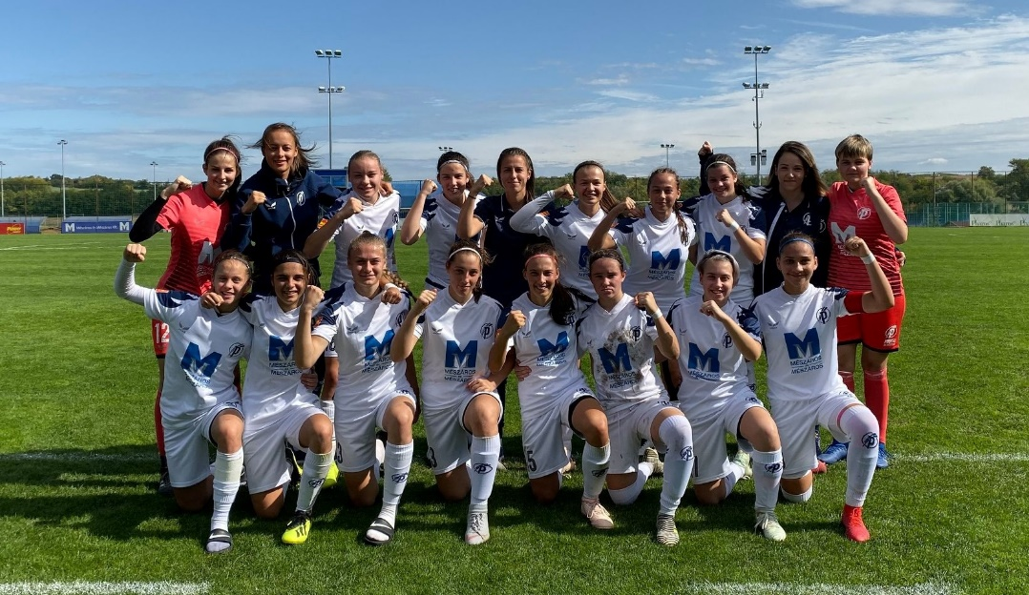
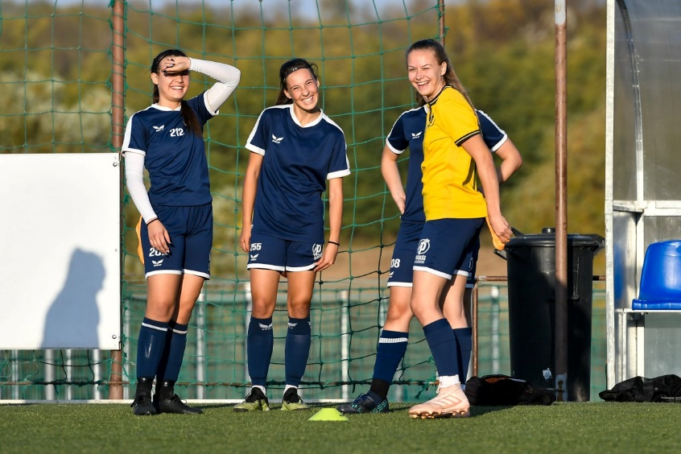
FOOTBALL PLAYERS

Slide 10
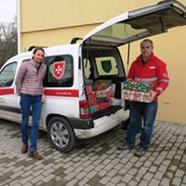
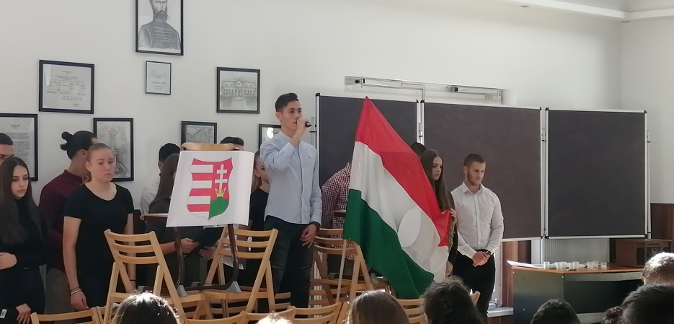
EVENTS, HOLIDAYS, COMMUNITY
ADVENT
CHRISTMAS
NATIONAL HOLIDAYS

Slide 11
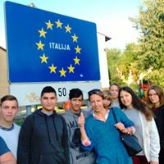
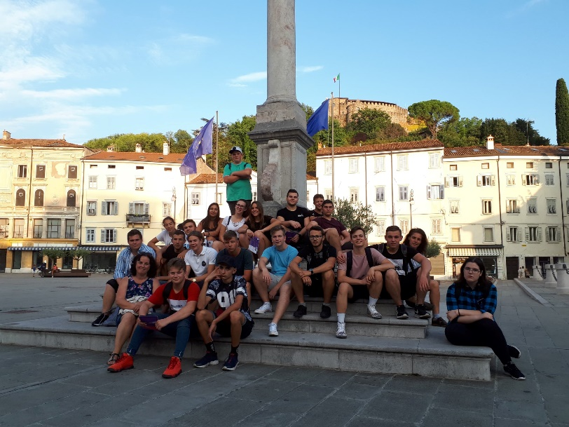
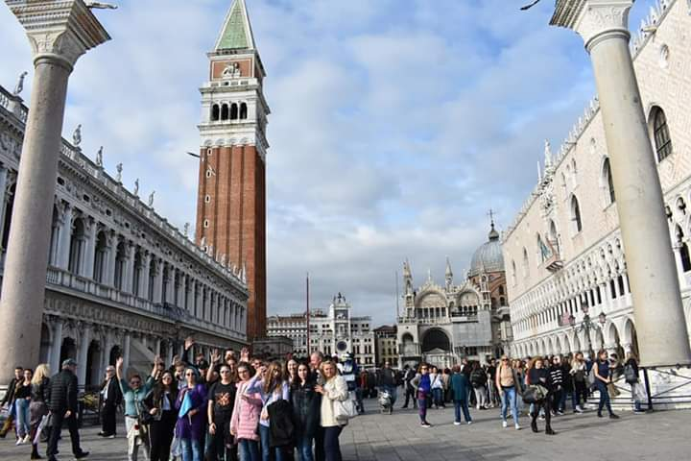
ERASMUS PARTNERSHIP IN SLOVENIA
NOVA GORICA 2018,
2019

Slide 12
THANK YOU FOR YOUR ATTENTION!
Compiled by Judit szabadhegy

