Slide 1
E-TWINNING PROJECT 2018/19
«SHALL WE MEET AT THE HARBOUR ?»

Slide 2
COOPERATIVE WORK
GREECE ,ITALY AND ARZEBAIJAN
The story of the lighthouse

Slide 3
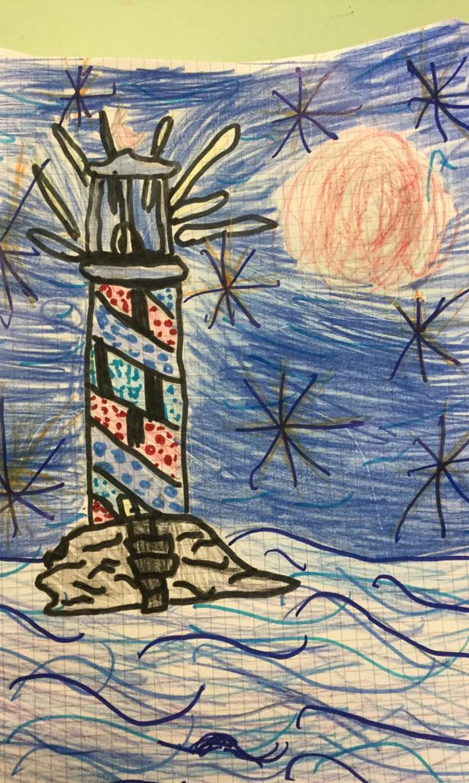
Once upon a time there was a lighthouse with a strange light.(Kyriaki Gr)

Slide 4
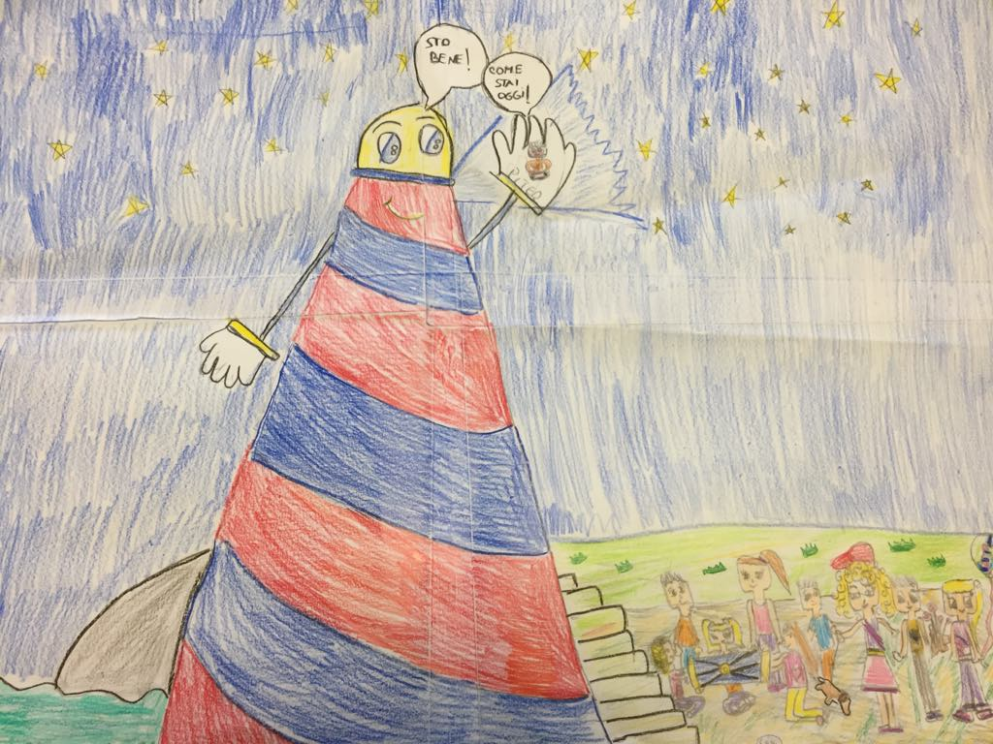
The lighthouse had a mouth,eyes,and he could give a blue light and it could speak to people(George Gr)

Slide 5
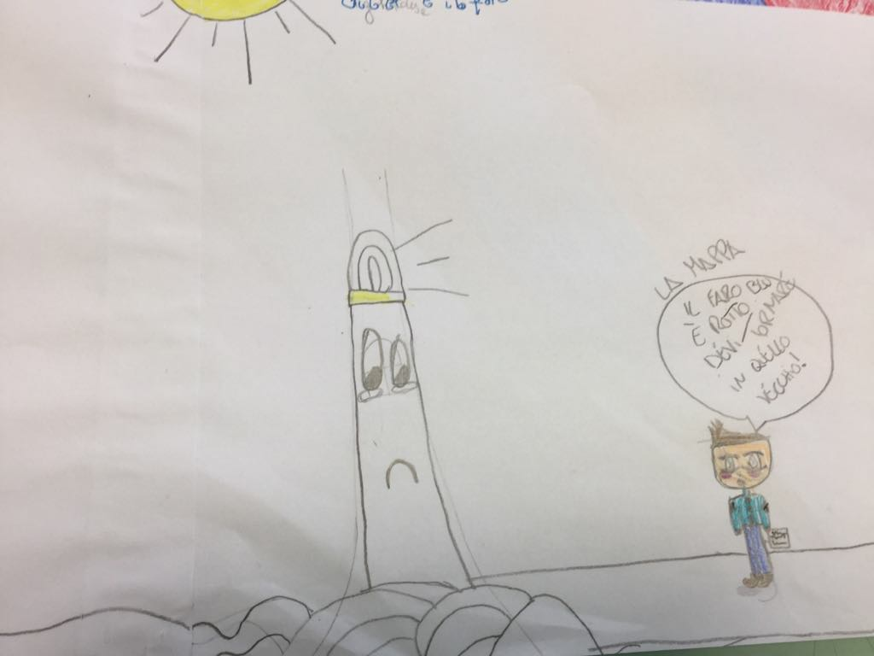
One day came there a human.His name was Peter.He was a lighthouse keeper

Slide 6
He was living in another lighthouse.Peter met the lighthouse and became good friends.(Faidra Gr.)

Slide 7
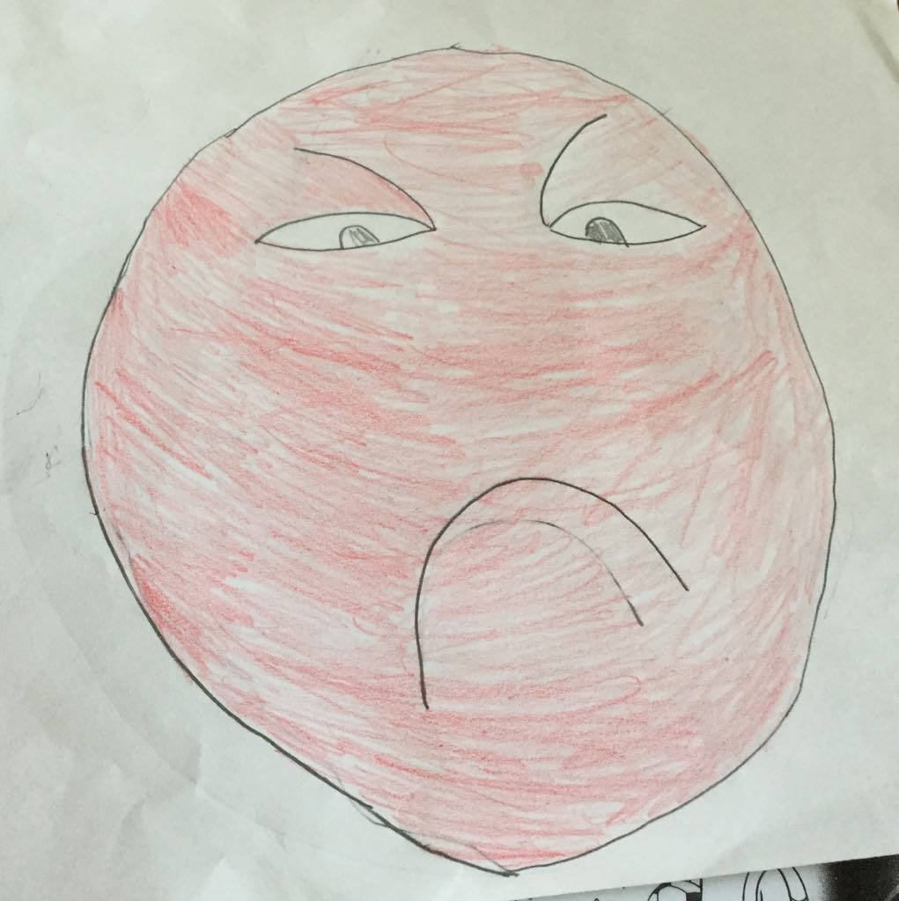
Peter was sad…

Slide 8
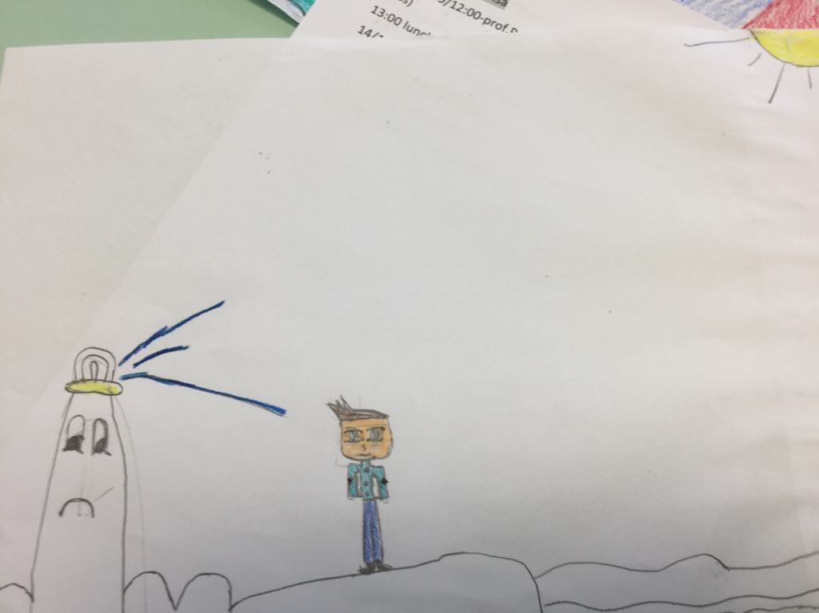
One day Peter took a letter that was asking to return to the old lighthouse (Louis Gr.)

Slide 9
…and after…
Because he loved his new lighthouse and he didn’t want to leave his new friend.(A. Nazhrin AZ)
He tried to find ways in order to stay there and didn’t break up with new friends(Arzum AZ)
Peter said that the lighthouse was broken (Kyriaki Gr.).

Slide 10
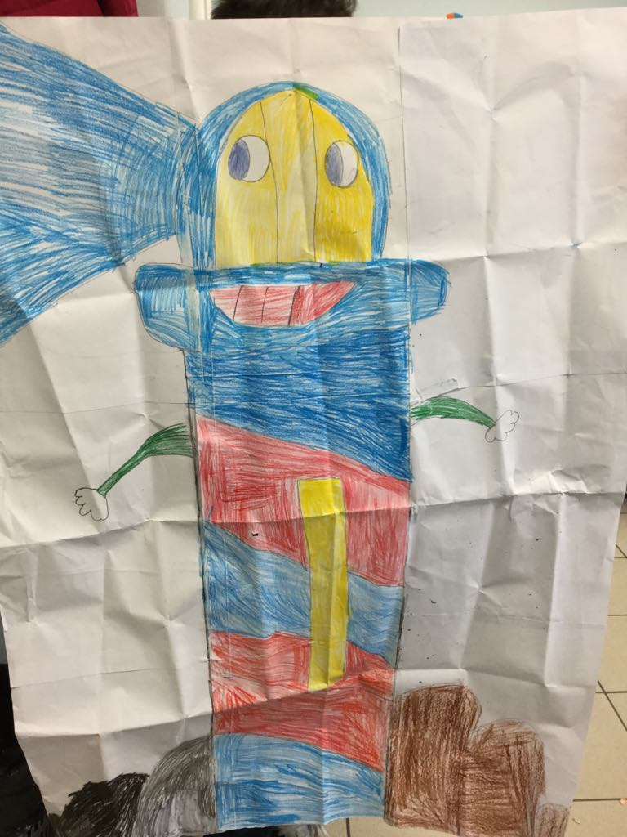
So Peter said that it is time to fix and must stay there,with his best friend! (Faidra Gr.).

Slide 11
Transnational groups
Illustrations and presentation by students from I.C.S. «FALCONE»-Italy
Story Writers by students from Greece and Arzebaijan
Thanks for watching

