Slide 1
The school system in Italy works liKe this:
-PRIMARY SCHOOL : three-five years of age
-ELEMENTARY SCHOOL : six to ten
-MIDDLE SCHOOL: eleven to thirteen
-HIGH SCHOOL: fourteen to eighteen

Slide 2
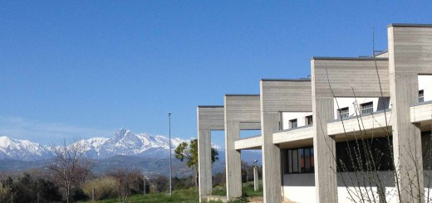
We are in high school, precisely we chose, after middle school ,to attend a Technical Institute in Accountancy. Last year, we had to choose whether to continue in the specialization in Accountancy or take another route : the specialization in Informatics. We chose the latter. We are in third year and in two years we’ll take our high school diploma.

Slide 3
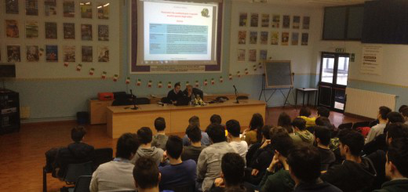
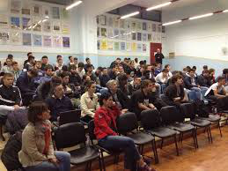
After the high school diploma if you want , you can go to university to get a university degree. In Italy without a high school
diploma it is difficult to find work ,so to do high school is important.
This is our Lecture Hall.

Slide 4
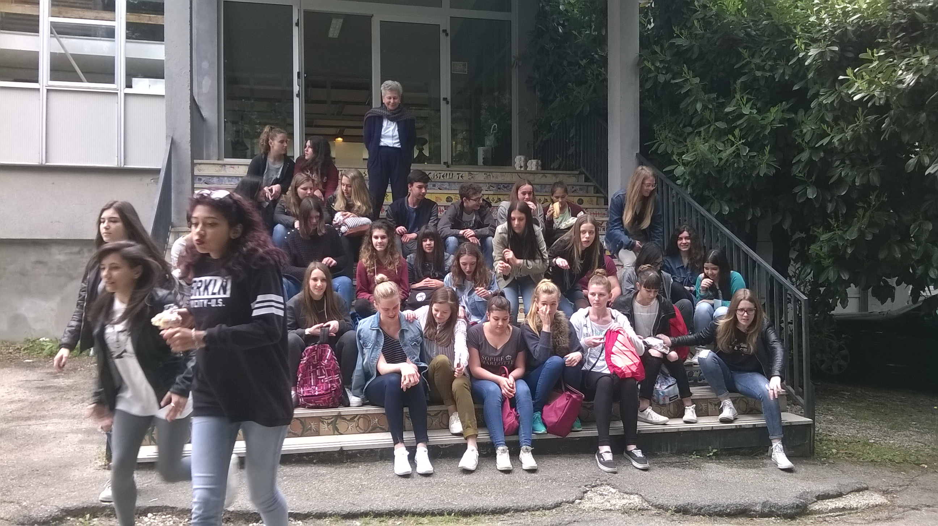
OUR SCHOOL EXCHANGE WITH KOBLENZ GERMANY: MAY, 2016. Our school organizes many trips and exchanges. Here we are at the Ceramic school of Castelli with our German Friends.

Slide 5
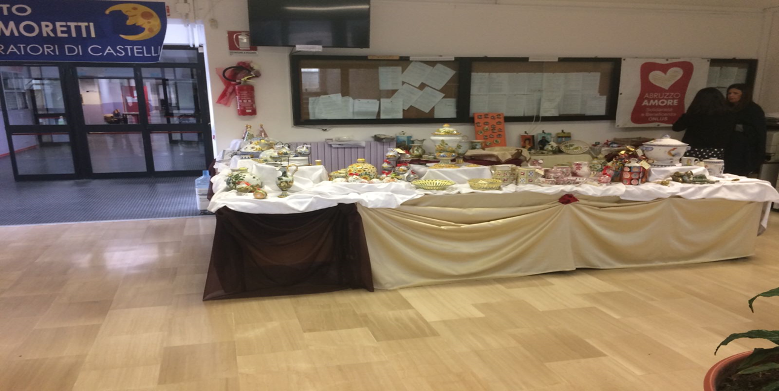
CHARITY AND SPECIAL EVENTS
In this picture we are selling the ceramics for Castelli , hit by an earthquake in October. It was a wonderful thing for all of us because we collected thousands of euros for them.

Slide 6
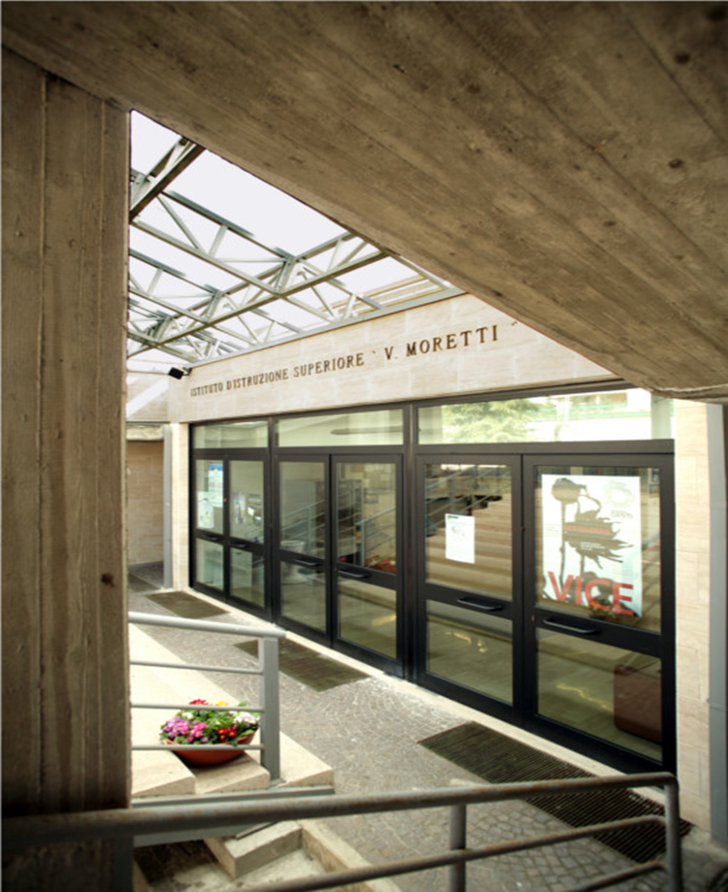
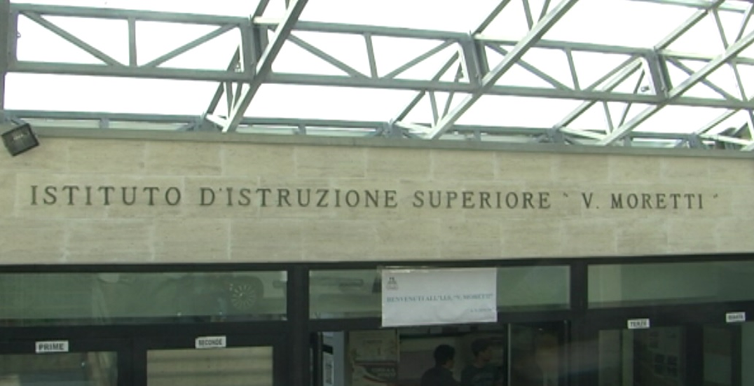
SCHOOL ENTRANCE

Slide 7
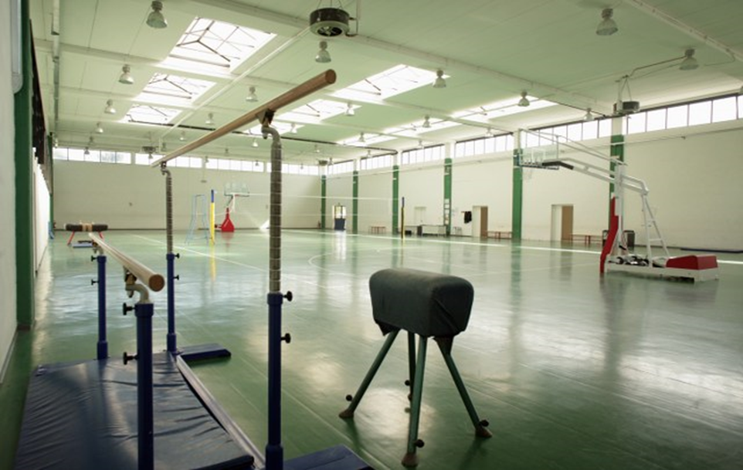
the GYM

Slide 8
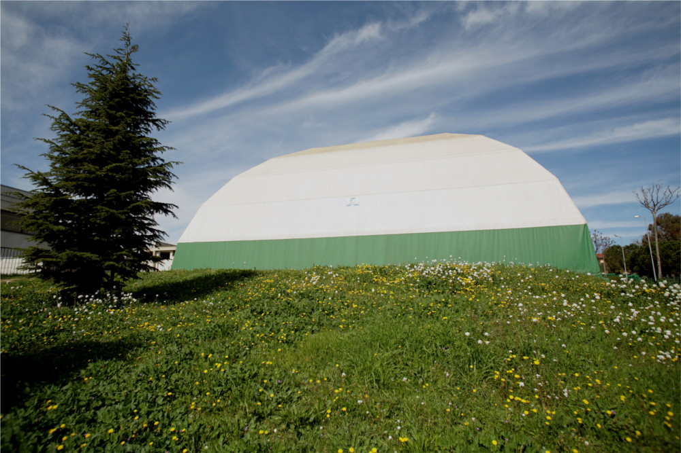
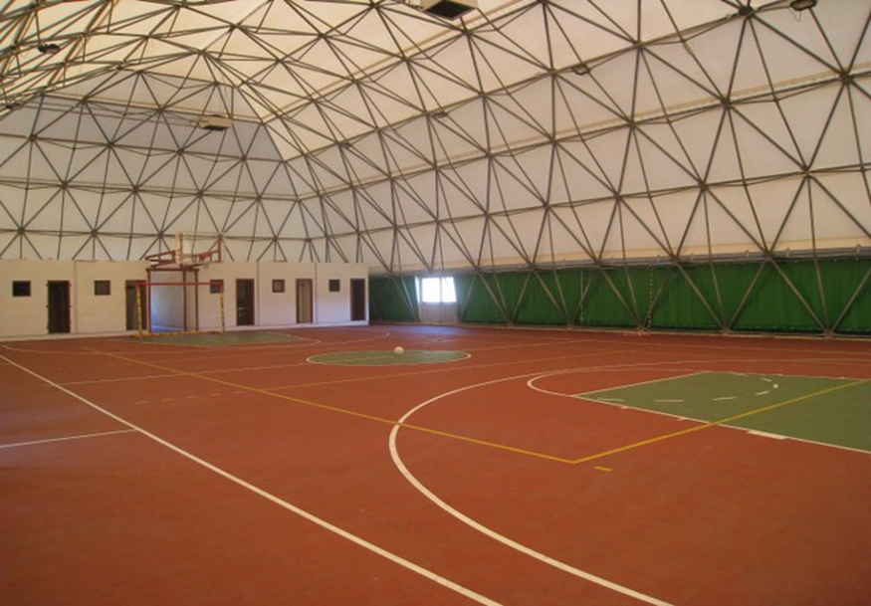
The second gym

Slide 9
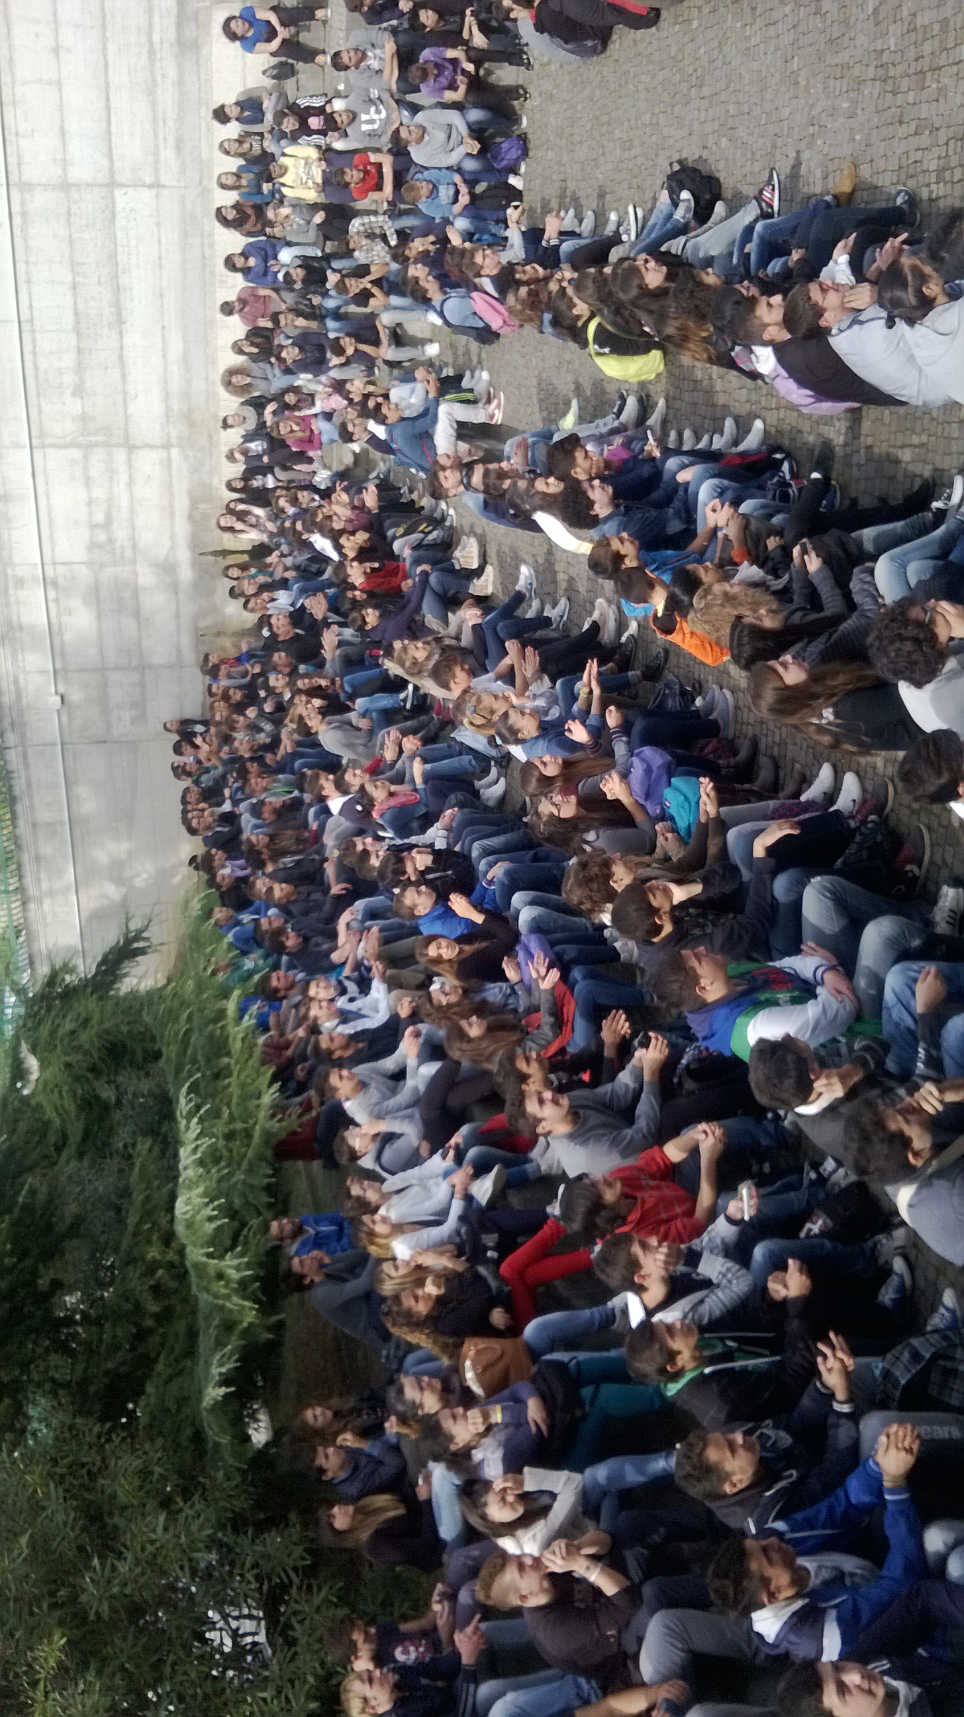
A student assembly

Slide 10
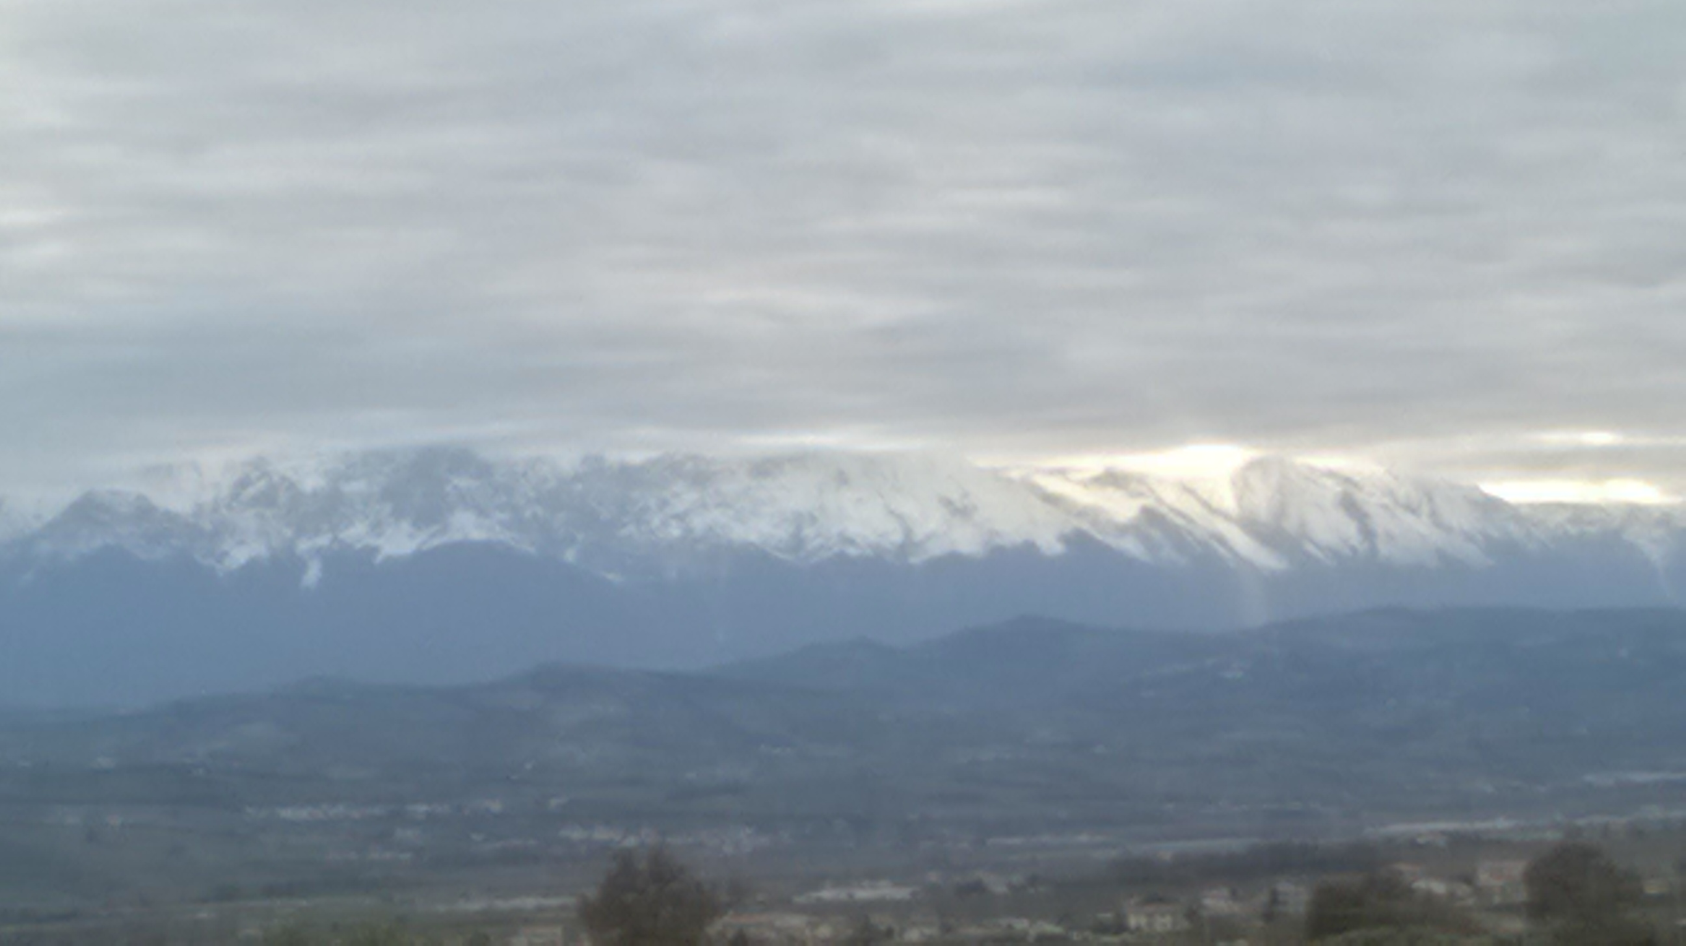
The View from our school

Slide 11
the end by Marica Marozzi

