Slide 1
Student‘s Day

Slide 2
Breakfast time…

Slide 3
Usual transport to school…

Slide 4
school entrance…

Slide 5
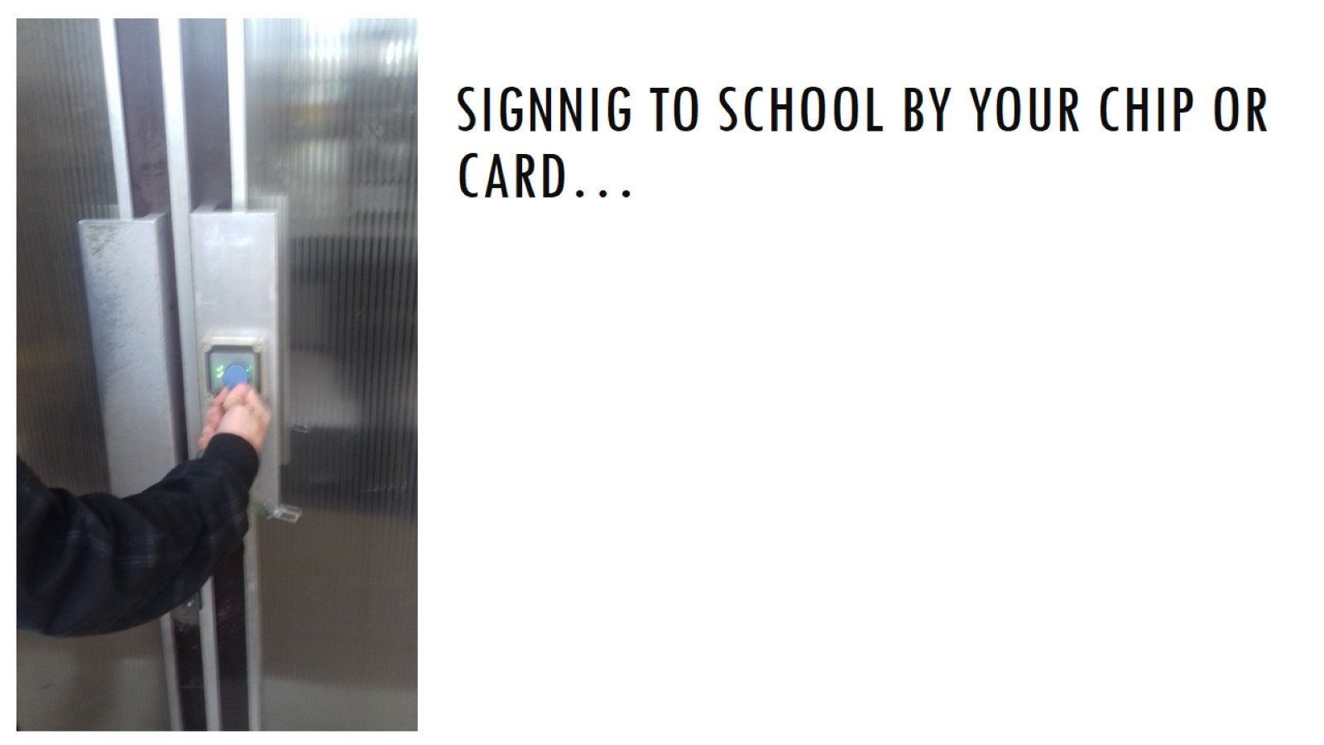
signnig to school by your chip or card…

Slide 6
Morning… school locker room

Slide 7
Let‘s start our lessons…

Slide 8
Maths and Electronics are our dayli routine…

Slide 9
Usual break and snack…

Slide 10
It and english lessons…

Slide 11
Lunch time !!!

Slide 12
chill out after lunch…

Slide 13
Table tennis room gym football field P.E. lessons

Slide 14
Let‘s go home…

Slide 15
Don‘t forget to log out …

Slide 16
nice way home by public transport or by a train…

Slide 17
difficult homework…

Slide 18
Nice Meal made by your father…

Slide 19
THE End

