Slide 1
Best CLASS in the world

Slide 2
Hi everyone !
My name’s Filip. Im 16 years old. Today i wanna present my class with my friend - Paweł

Slide 3
We’re like brothers …
Mateusz
2nd Daniel
Piotr and Jarosław
Daniel
Dominik
Hubert
Patryk
2nd Patryk
Maciek
and Maciek
ME
Paweł

Slide 4
… But Who we’are ?
We are students of technical information in the best school in Poland

Slide 5
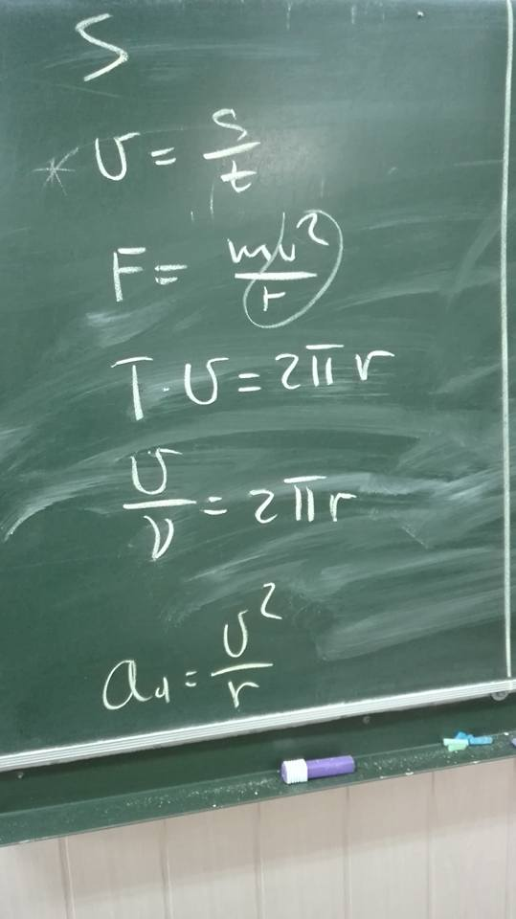
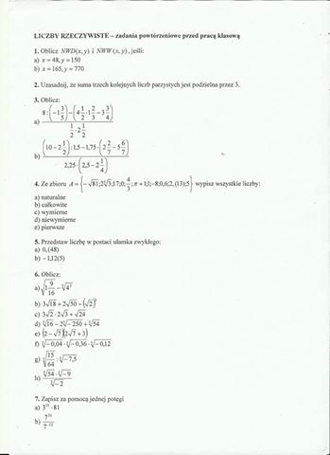
We must study …

Slide 6
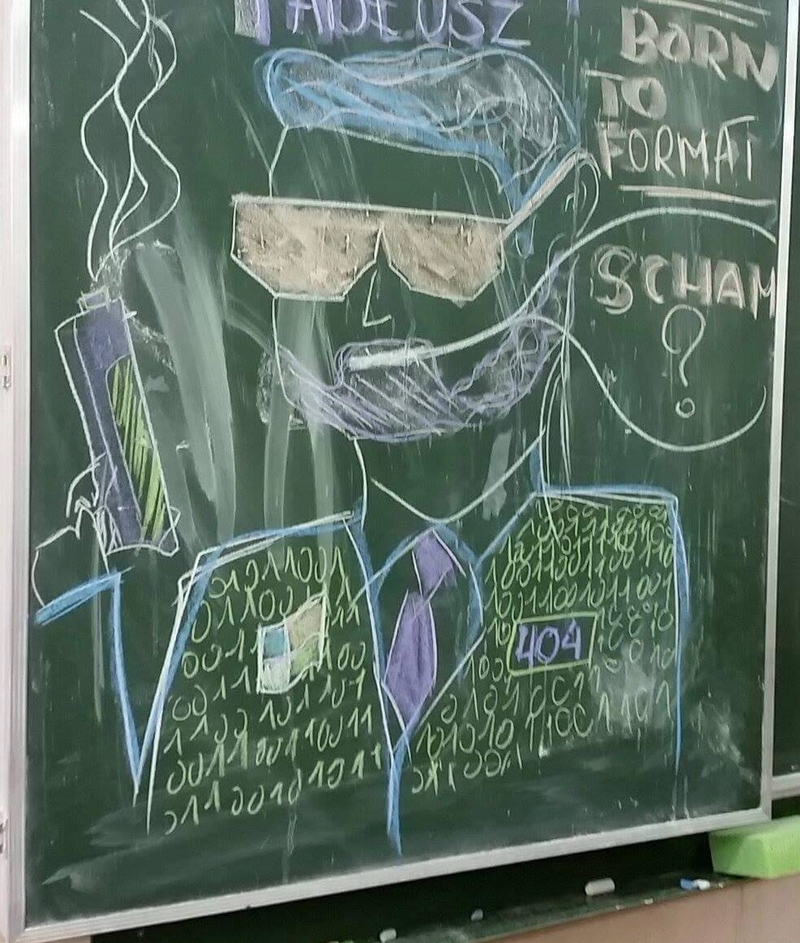
… but we like also fun

Slide 7
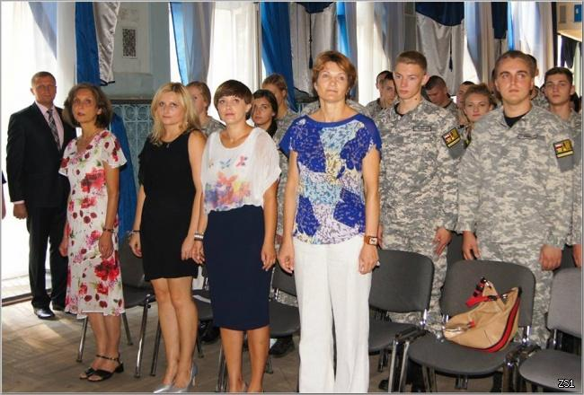
We got the best teachers

Slide 8
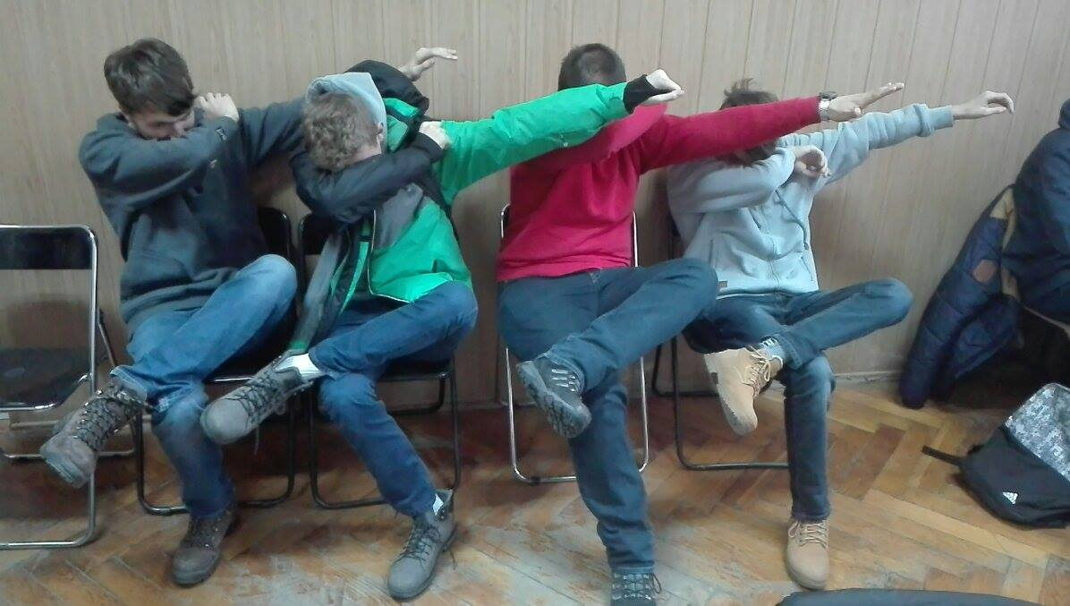
Join, and enjoy with us !

