Slide 1
SPŠE v Úžlabině

Slide 2
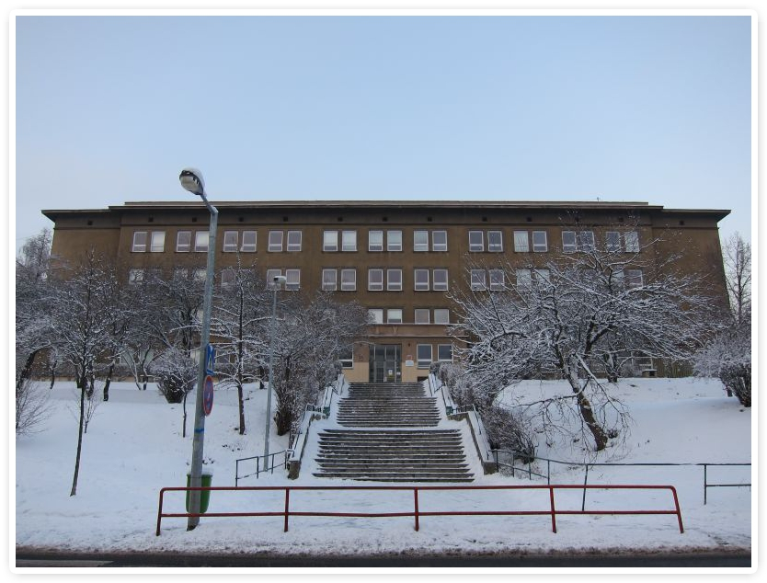
Our school building

Slide 3
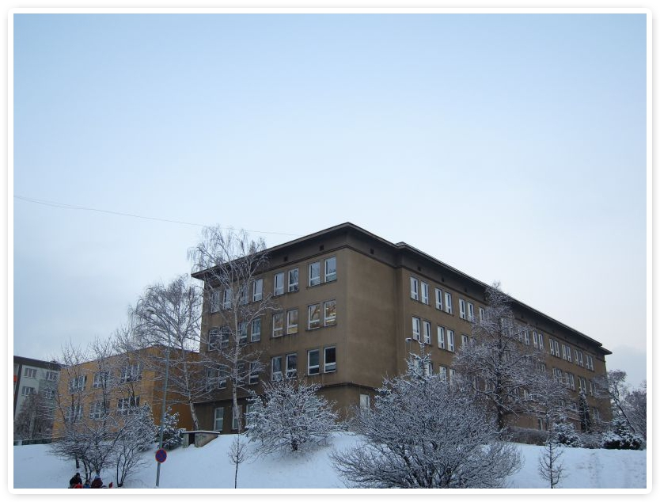
Lovely school

Slide 4
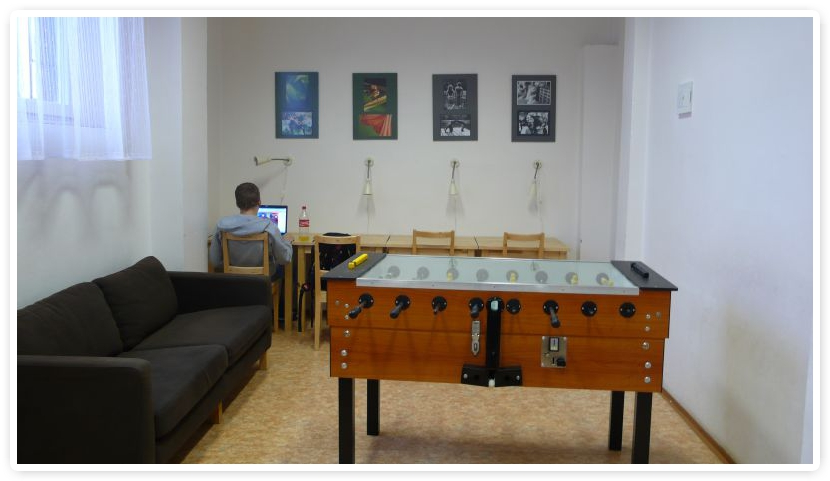
School club

Slide 5
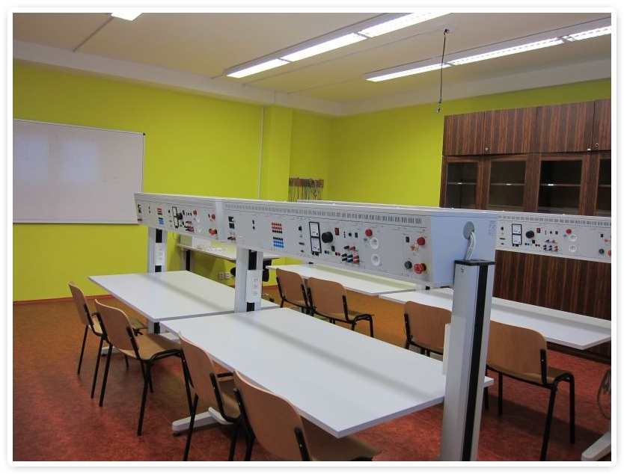
Laboratory of Electronic Measurement

Slide 6
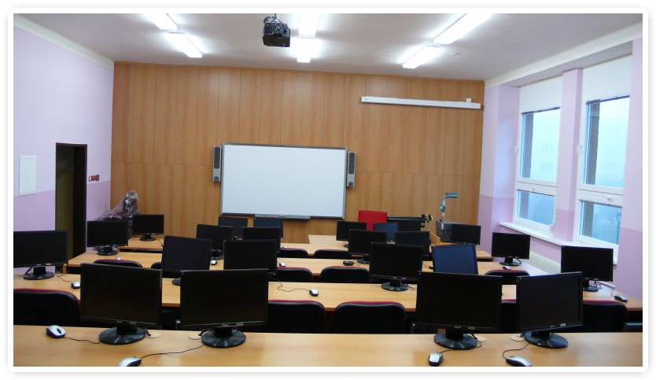
Informatic laboratory

Slide 7
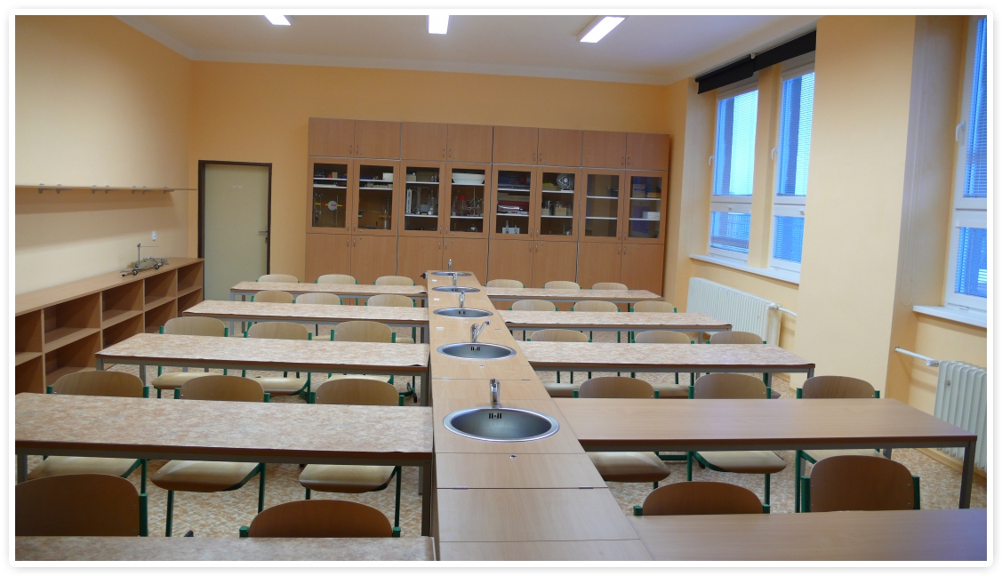
Chemistry laboratory

Slide 8
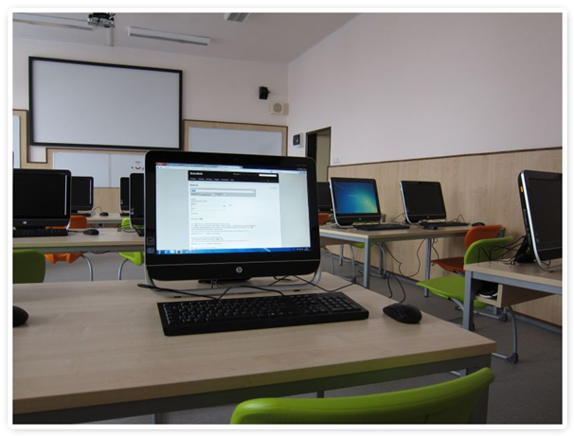
Language laboratory

Slide 9
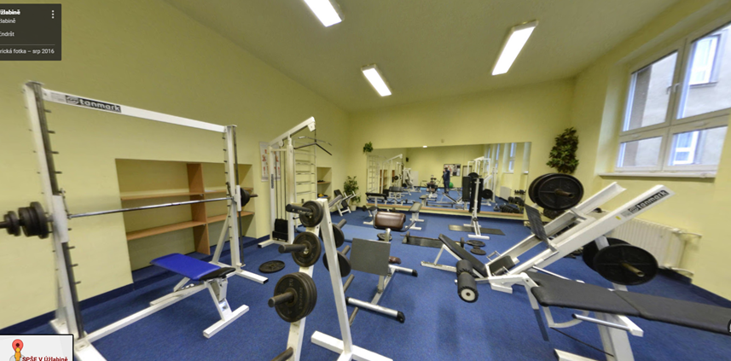
Gym

Slide 10
Chemistry laboratory

