Slide 1
NON SCHOOL ACTIVITIES
Michal Lenc, E2.A

Slide 2
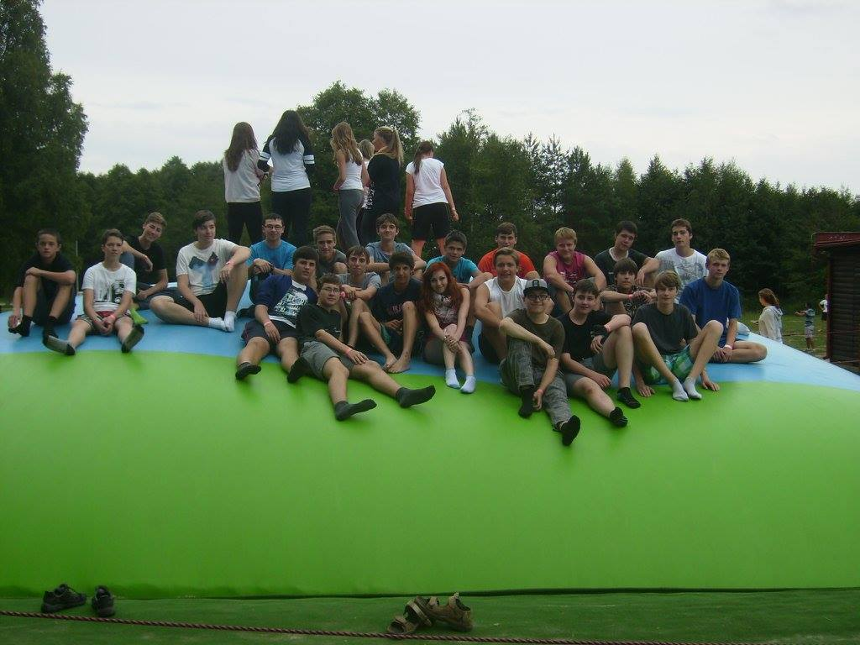
Adaptation course
First September week we were in Poslův Mlýn on an adaptation course. The target was clear. Meet our new classmates and work like a team.
I think we did it very well, cos we were better than other classes and we won the most of games.
We played a lot of funny and interesting games, like building a ferry and ferrying our teacher on the next shore.

Slide 3
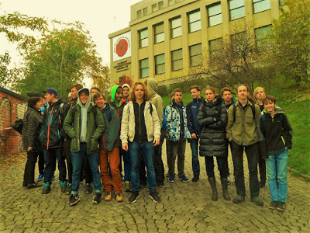
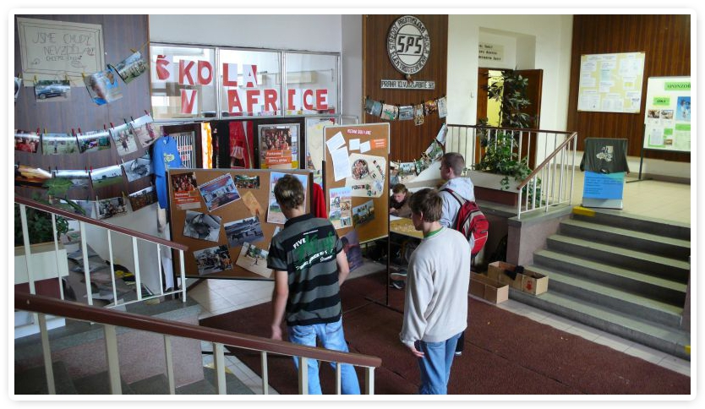
Let´s build a school in Africa and Remembrance day
We have some charity events, too. We collect money for a school in Africa and we celebrate Remembrance day, which is a day dedicated to soldiers in war.

Slide 4
English theater
In Autumn we usually visit some theatre drama in English. This year (2016) we were in Salesiánské theatre and saw a play called The Winter´s Tale which was written by William Shakespeare
We go to Czech theater before Christmas holidays too. We often visit some plays which is important to us to past our school leaving exam.

Slide 5
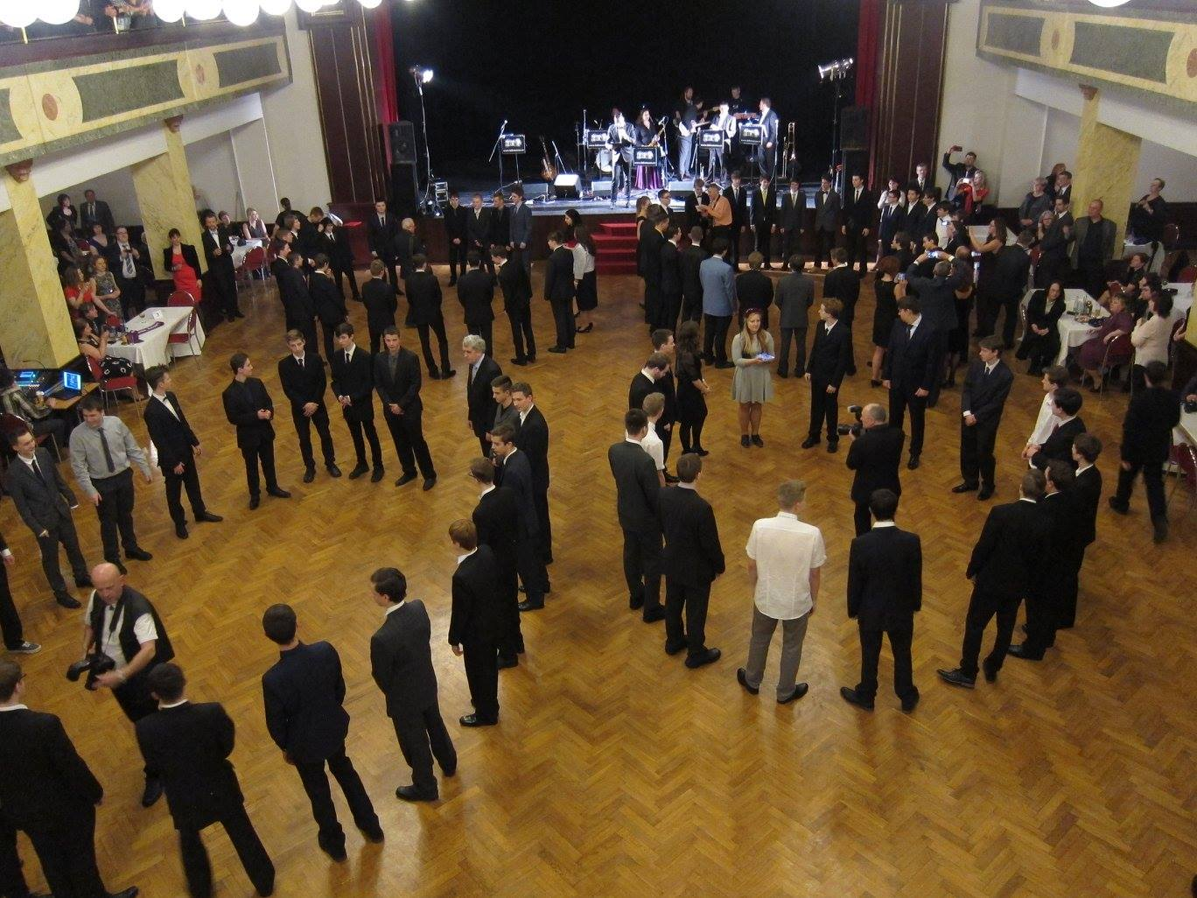
Matriculation ball
In February we were attending matriculation ball. We were in Prague in Radiopalác.
Each of us got his own blue ribbon which symbolised following four years on Úžlabina.

Slide 6
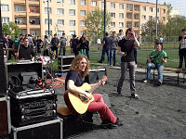
The Last Ringing
Every year, at the end of school year we have The Last Ringing which is for fourth classes something like the final goodbye to school (farewell party) teachers and their classmates. During that, we have a football tournament and we enjoy a free day speaking together and having fun.

