Slide 1
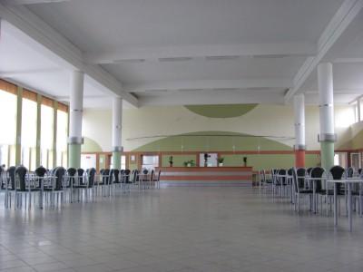
Our canteen
It’s a place where we eat and spend time .

Slide 2
MEnu
We have a new menu every week.
It’s one of them.

Slide 3
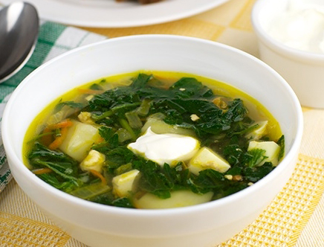
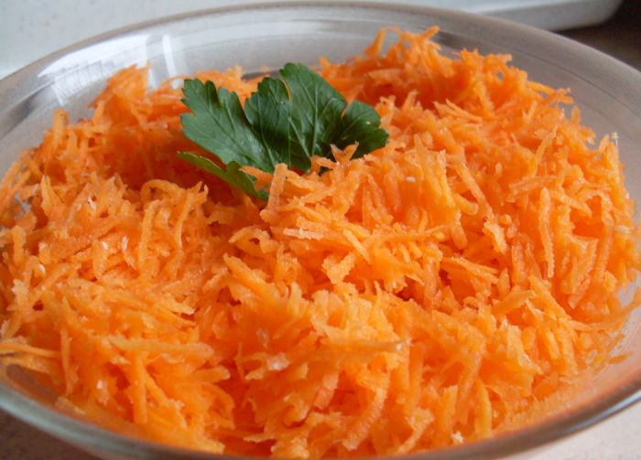
Monday
Breakfast:
- Sausage, ham, butter, pepper, bread, tea, milk soup, apple
Lunch:
Sorrel soup, potatoes, chicken steak, carrot salad, compote, fruit
Dinner:
Hot sausaes, butter, cheese, tomato, bread, tea

Slide 4
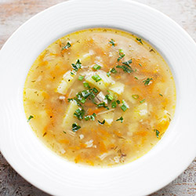
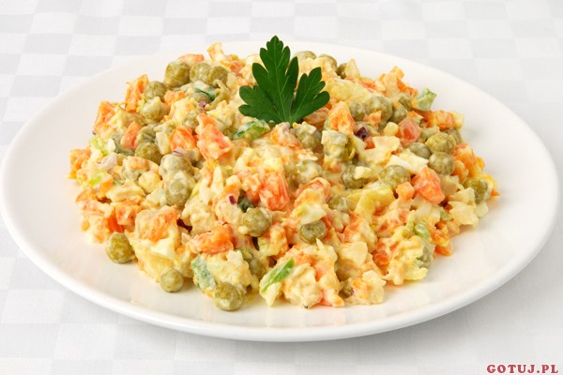
Tuesday
Breakfast:
Pork fillet, am, butter, pickled cucumber, bun, bread, tea, cocoa, orange
Lunch:
Krupnik soup, potatoes, Gypsy chicken, vegetable salad, compote, doughnut
Dinner:
- Scrammbled eggs, butter, luncheon meat, yoghurt, salad with tomatoes, bread, tea

Slide 5
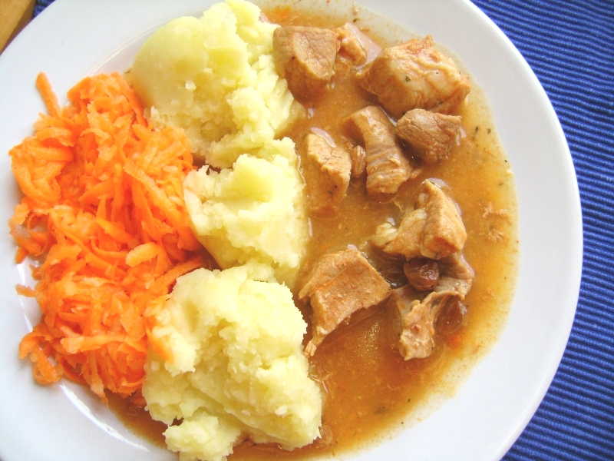
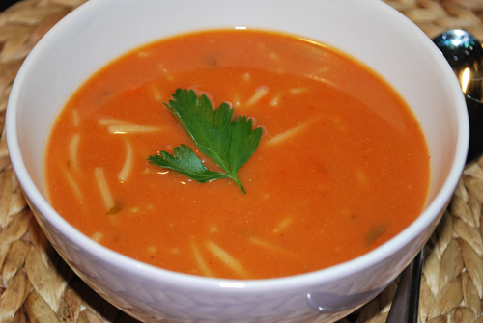
Wednesday
Breakfast:
Honey fillet, butter, ham, canned peppers, bun, bread, tea, milk soup, apple
Lunch:
Tomato soup, potatoes, pork stew with vegetables, compote, fruit
Dinner:
- cheese, butter, salad with ham, bread tea

Slide 6
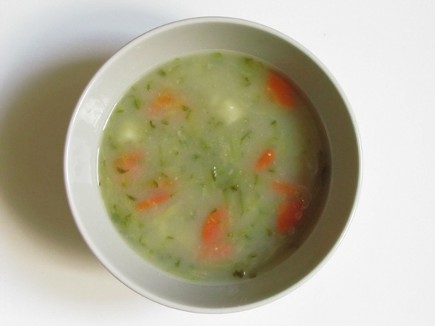
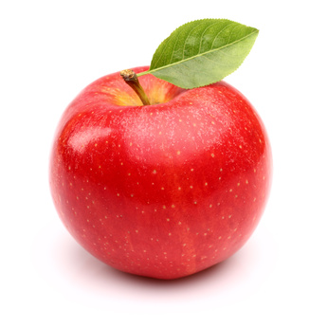
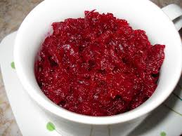
Thursday
Breakfast:
Sausage, butter, ham, pickled cucumber, bun, bread, tea, white coffee, fruit
Lunch:
Cucumber soup, pork roast, cooked beetroot, compote, apple
Dinner:
- Beef tripe, cottage cheese, tea, fruit

Slide 7
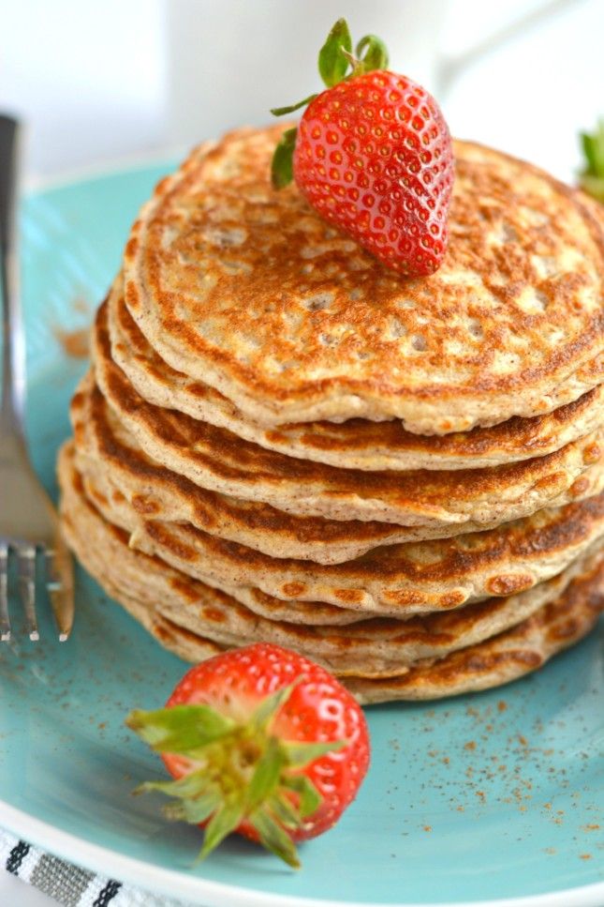
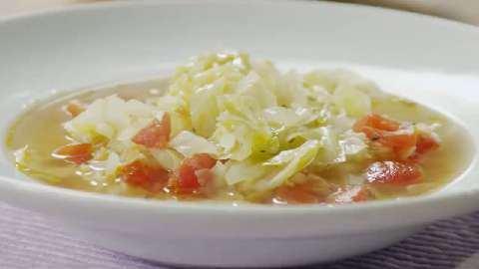
Friday
Breakfast:
Cheese, tuna, butter, Swedish salad, bun, bread, tea, fruit
Lunch:
Cabbage soup, pancakes with cottage cheese and strawberry, compote
Dinner:
- Bun, yoghurt, fruit

Slide 8
Created by Hubert Ruta from I inf a

