Slide 1
ARTICLE 10
Everyone is entitled in full equality to a fair and public hearing by an independent and impartial tribunal, in the determination of his rights and obligations and of any criminal charge against him.

Slide 2
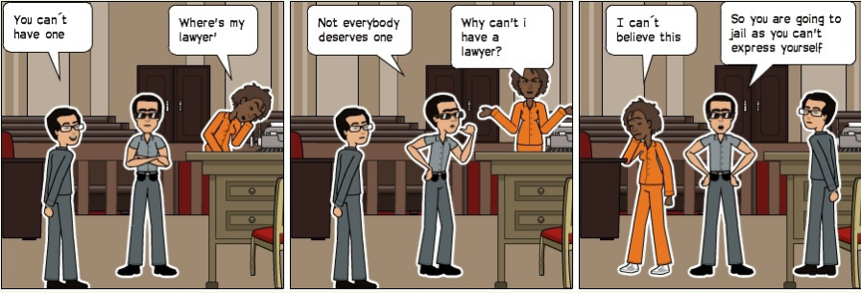
From Juan

Slide 3
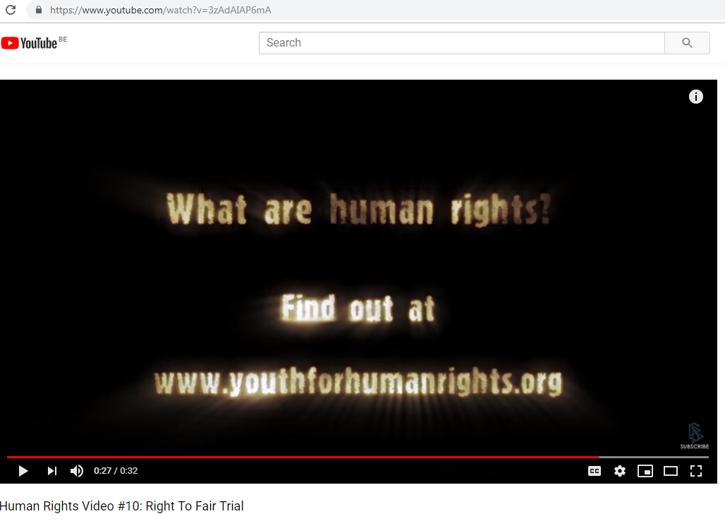
Human Rights Video #10: Right To Fair Trial-- https://www.youtube.com/watch?v=3zAdAIAP6mA from Juan

Slide 4
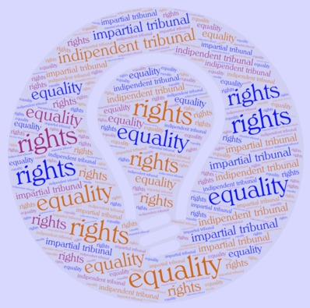
From Chiara

Slide 5
These realisations were done by team 4 about articles 10, 11 and 12
For more information,
Go to the posted works in Forums on our twinspace.
Mrs Sabine Callens

Slide 6
From Beyza
Everyone should be judged according to the law,should be decided objectively,no one should be removed without a necessity of the private property.

Slide 7
Article 11
(1) Everyone charged with a penal offence has the right to be presumed innocent until proved guilty according to law in a public trial at which he has had all the guarantees necessary for his defence.
(2) No one shall be held guilty of any penal offence on account of any act or omission which did not constitute a penal offence, under national or international law, at the time when it was committed. Nor shall a heavier penalty be imposed than the one that was applicable at the time the penal offence was committed.

Slide 8
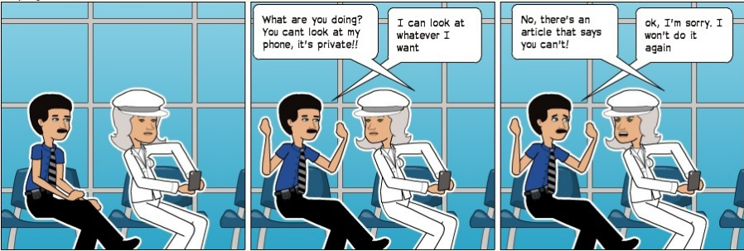
From Juan

Slide 9
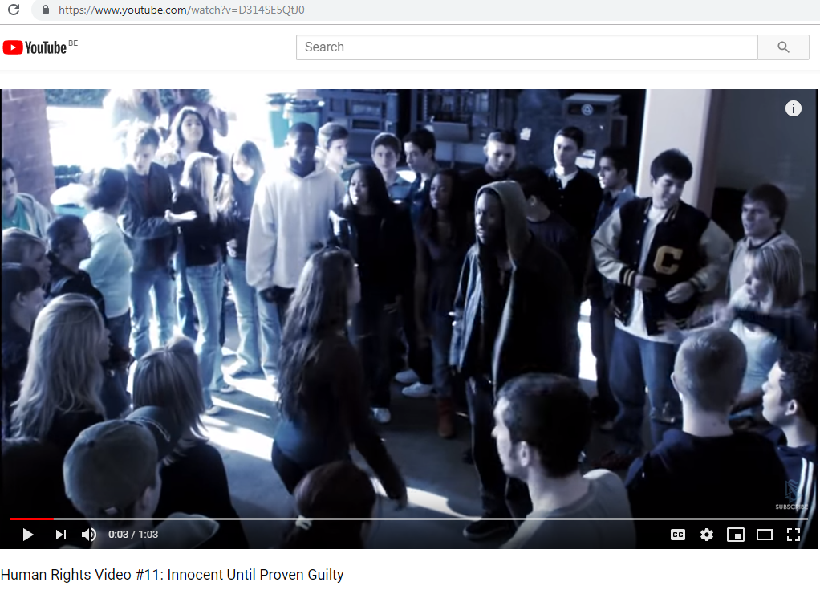
Human Rights Video #11: Innocent Until Proven Guilty-- https://www.youtube.com/watch?v=D314SE5QtJ0 from Juan

Slide 10
Article 12
No one shall be subjected to arbitrary interference with his privacy, family, home or correspondence, nor to attacks upon his honour and reputation. Everyone has the right to the protection of the law against such interference or attacks.

Slide 11
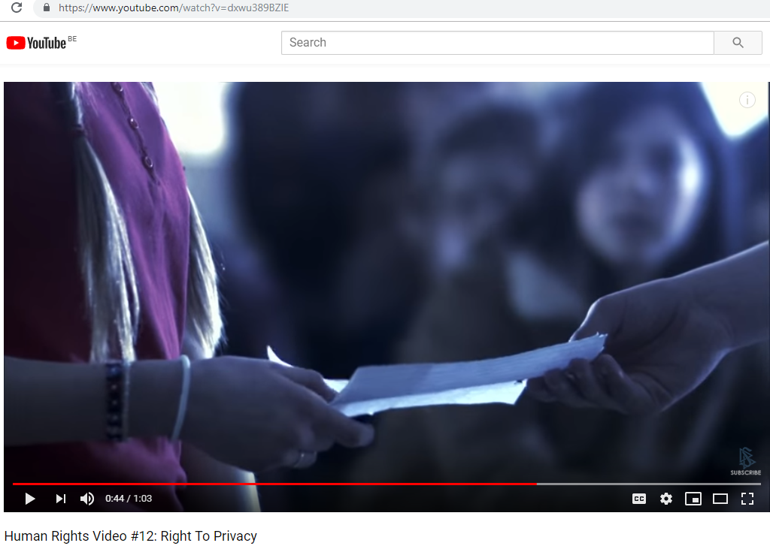
Human Rights Video #12: Right To Privacy-- https://www.youtube.com/watch?v=dxwu389BZlE from Juan

Slide 12
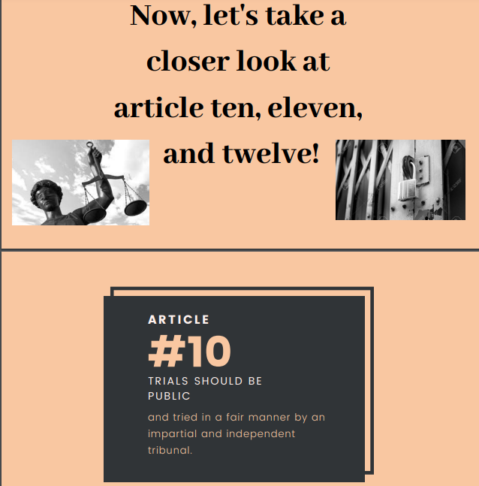
A powerpoint by Cathalina and Tommaso

Slide 13
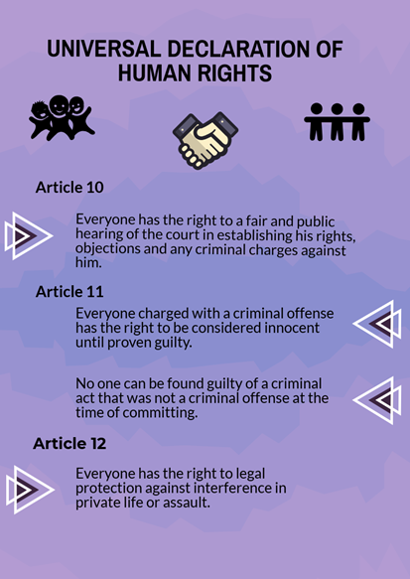
From Natali

Slide 14
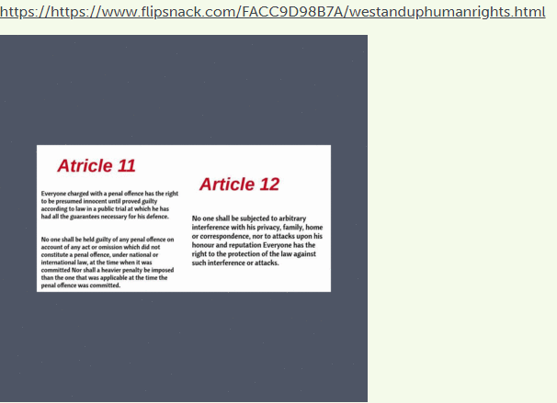
fromEbrar

Slide 15
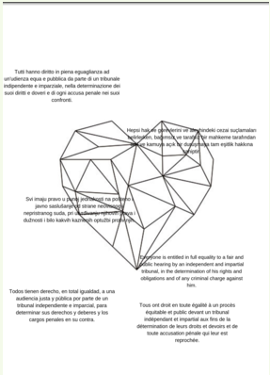
From Giuseppe

Slide 16
Some comments
From this project I have learned that we have to strive to provide all people with their rights.
Natali
Hello my name is Ines,in this project i have learned that all people deserve equal human rights,without judging them by there skin color or nationality.
Everyone should be judged according to the law,should be decided objectively,no one should be removed without a necessity of the private property. Beyza

