Slide 1
The Declaration consists of 30 articles but we have selected the ones we think are more relevant to us as young people!

Slide 2
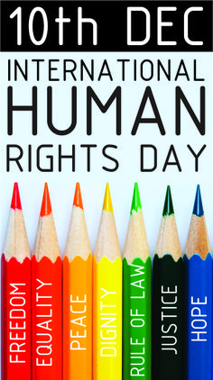
Article N°1
All human rights are born free and equal in dignity and rights.
They are endowed with reason and conscience and should act towards one another in a spirit of brotherhood

Slide 3
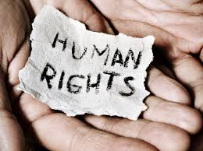
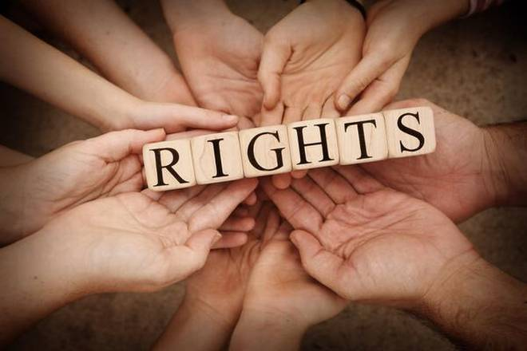
Article N°3
Everyone has the right to life, liberty and security person

Slide 4
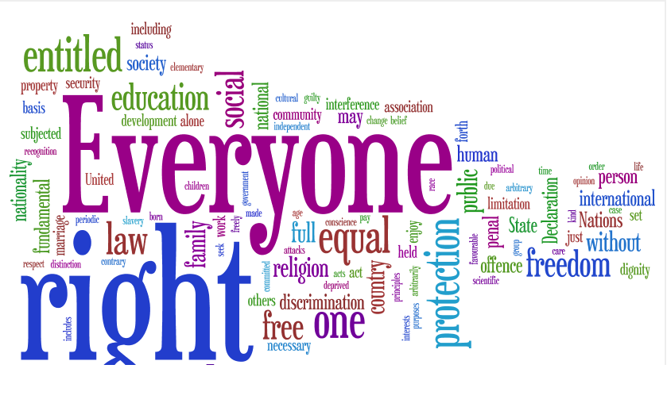
Article N°7
All are equal before the law and are entitled without any discrimination to equal protection of the law.
All are entitled to equal protection against any discrimination in violation of this Declaration and against any incitement to such discrimination

Slide 5
Article N°19
Everyone has the right to freedom of opinion and expression; this right includes freedom to hold opinions without interference

Slide 6
Article N°23
Everyone has the right to work, to free choice of employment, to just and favourable conditions of work and protection against unemployment

Slide 7
Article N°26
(1)Everyone has the right to education. Education shall be free, at least in the elementary and fundamental stages.
(2)Education shall be directed to the full development of the human personality and to the strengthening of respect for human rights and fundamental freedoms. It shall promote understanding, tolerance and friendship among all nations, racial or religious groups, and shall further the activities of the United Nations for the maintenance of peace.

