Slide 1
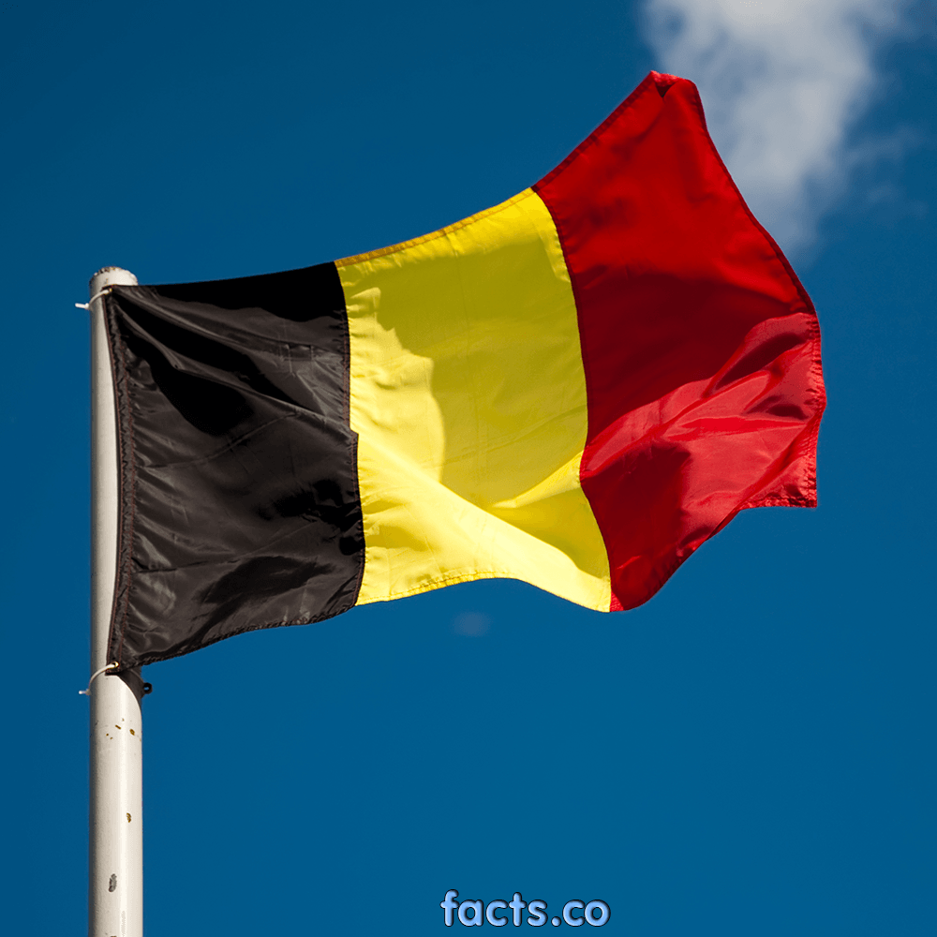
Belgium
Belgien
België
Belgique

Slide 2
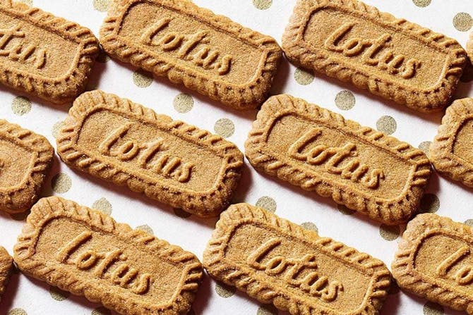
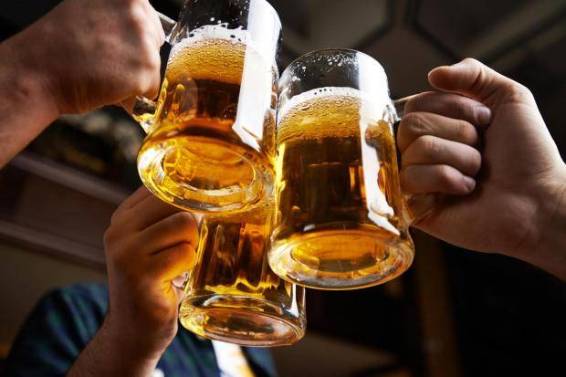
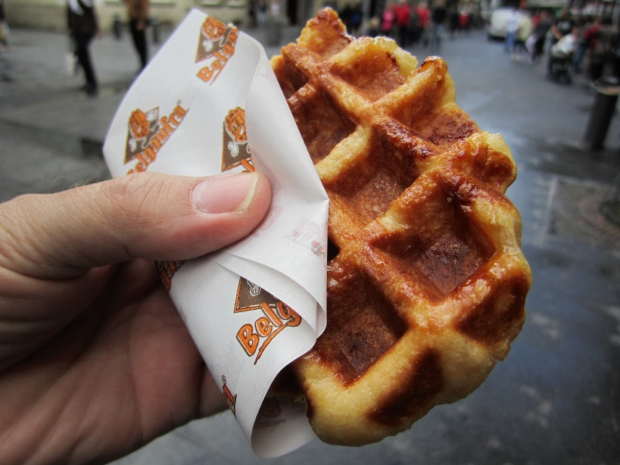
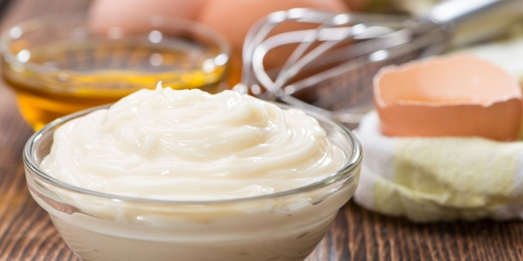
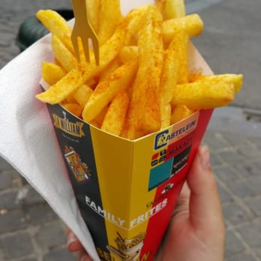
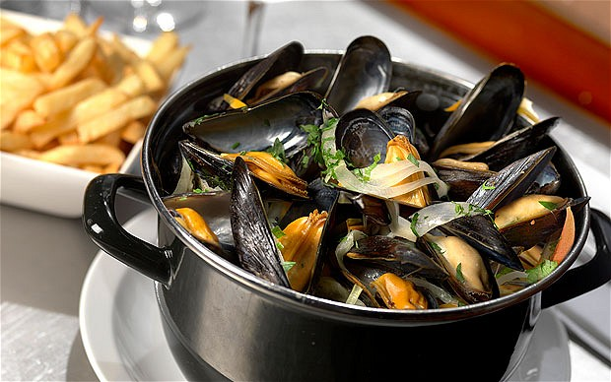
Food
Chocolate
Chips (Belgian fries)
Waffles
Mayonnaise
Mussels
Speculoos
Beer

Slide 3
Brussels
Manneken Pis
Atomium
‘Grand place’
Cinquantenaire
Royal Palace
Opera house / Place de la Monnaie

Slide 6
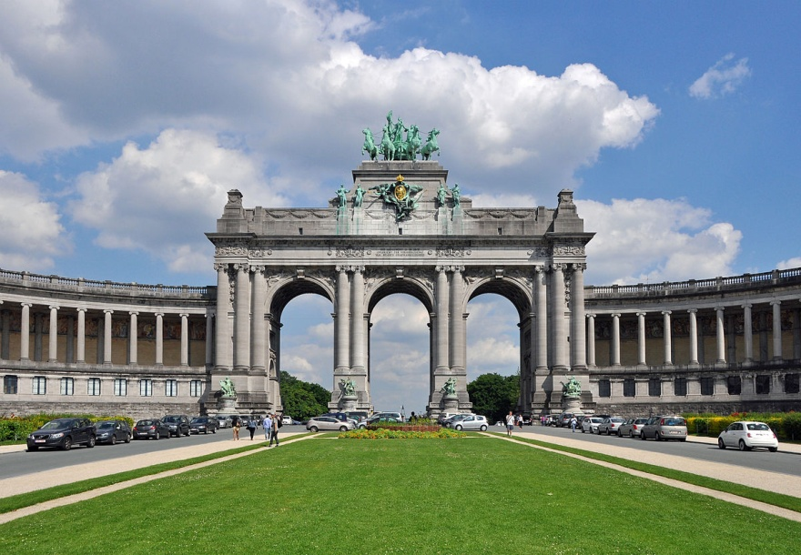
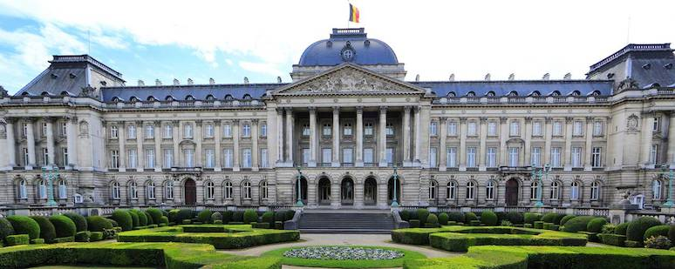
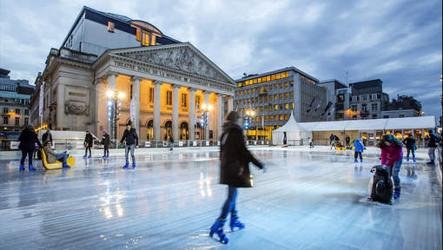

Slide 7
Flanders
Gravensteen in Gent
Medieval center in Brugge
Harbour in Antwerpen
The sea in Knokke

Slide 10
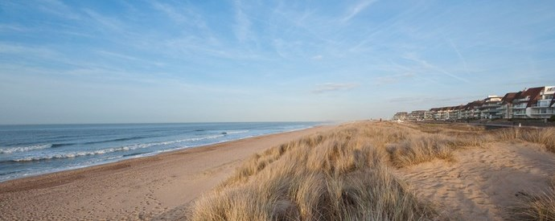

Slide 11
Wallonia
The Ardennes
Namur Citadelle
Castle of Bouillon
Tournai
Binche Carnival

Slide 12
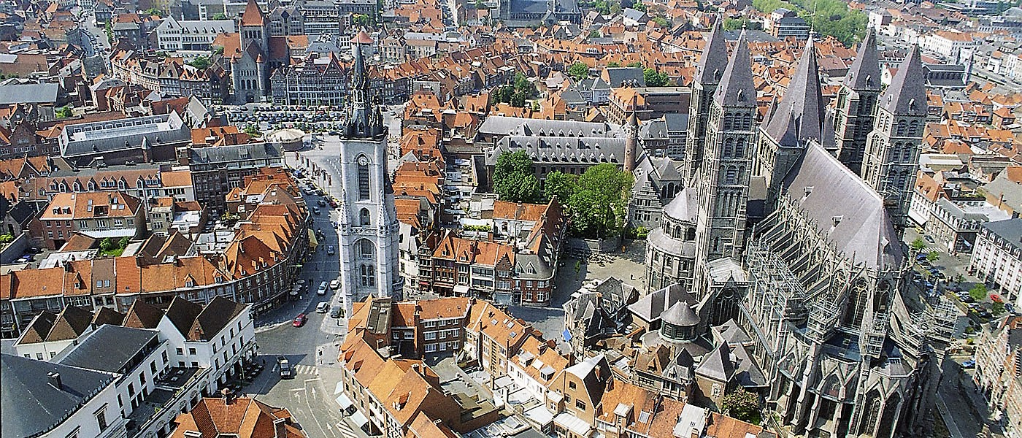

Slide 13
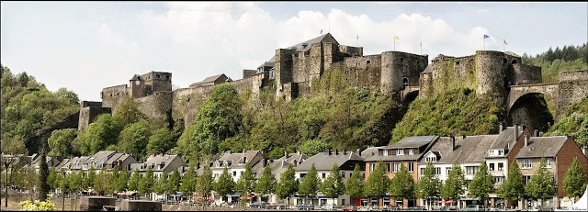

Slide 15
Artists
Stromae
Jacques Brel
René Magritte
Hergé
Philippe Geluck
Netsky
Dimitri Vegas and Like Mike
Selah Sue

Slide 16
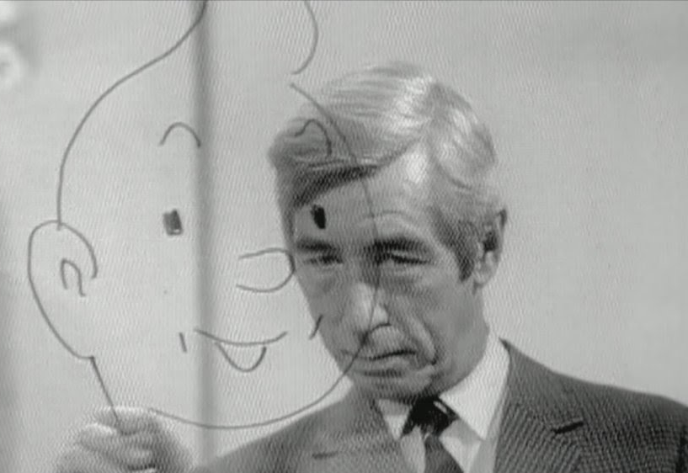
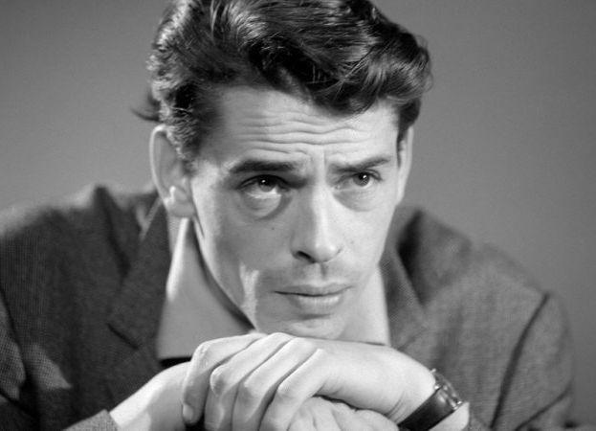

Slide 17
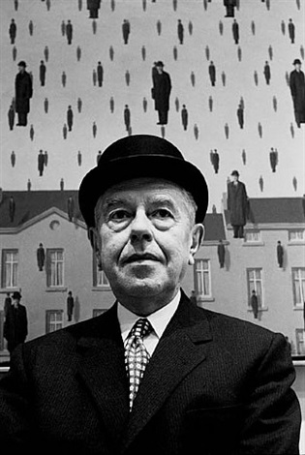
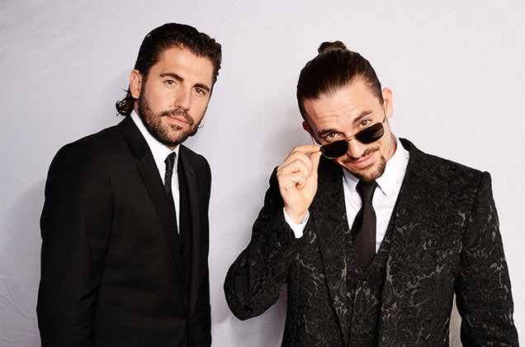
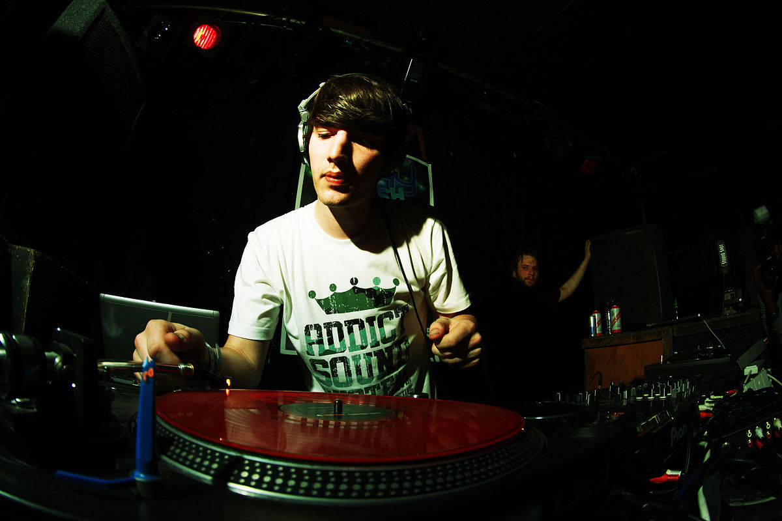

Slide 18
Festivals
Tommorowland
Laundry day
Pukkelpop
Gentse feesten
Les Ardentes
Dour festival (in this area)
Les Francofolies

Slide 20
Athletes
David Goffin
Justine Henin
Brothers Borlée
The Red Devils
Eddy Merckx

Slide 21
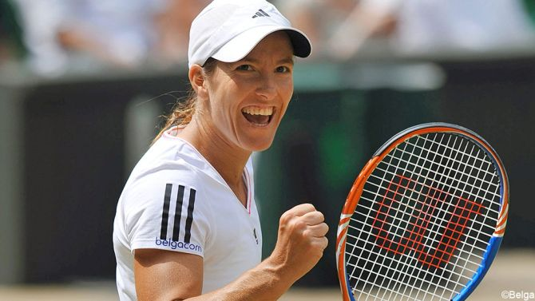
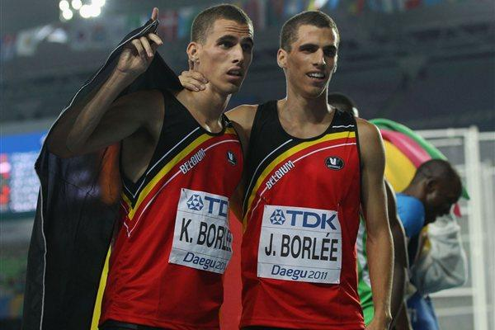
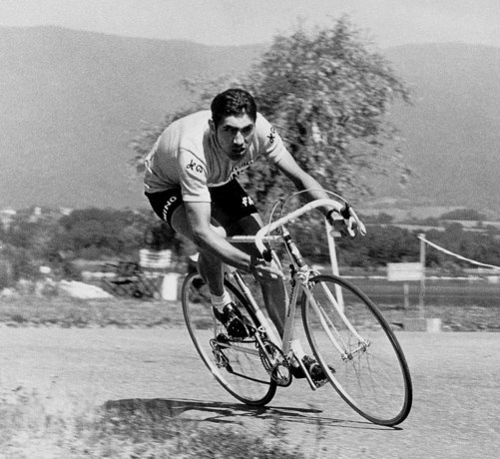

Slide 22
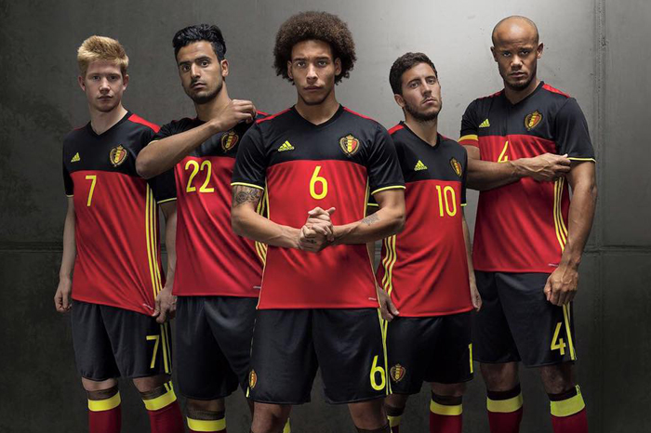

Slide 23
Belgian inventions
Spa
Saxophone
Billiard balls
Medieval Tapestries

Slide 24
