Slide 1
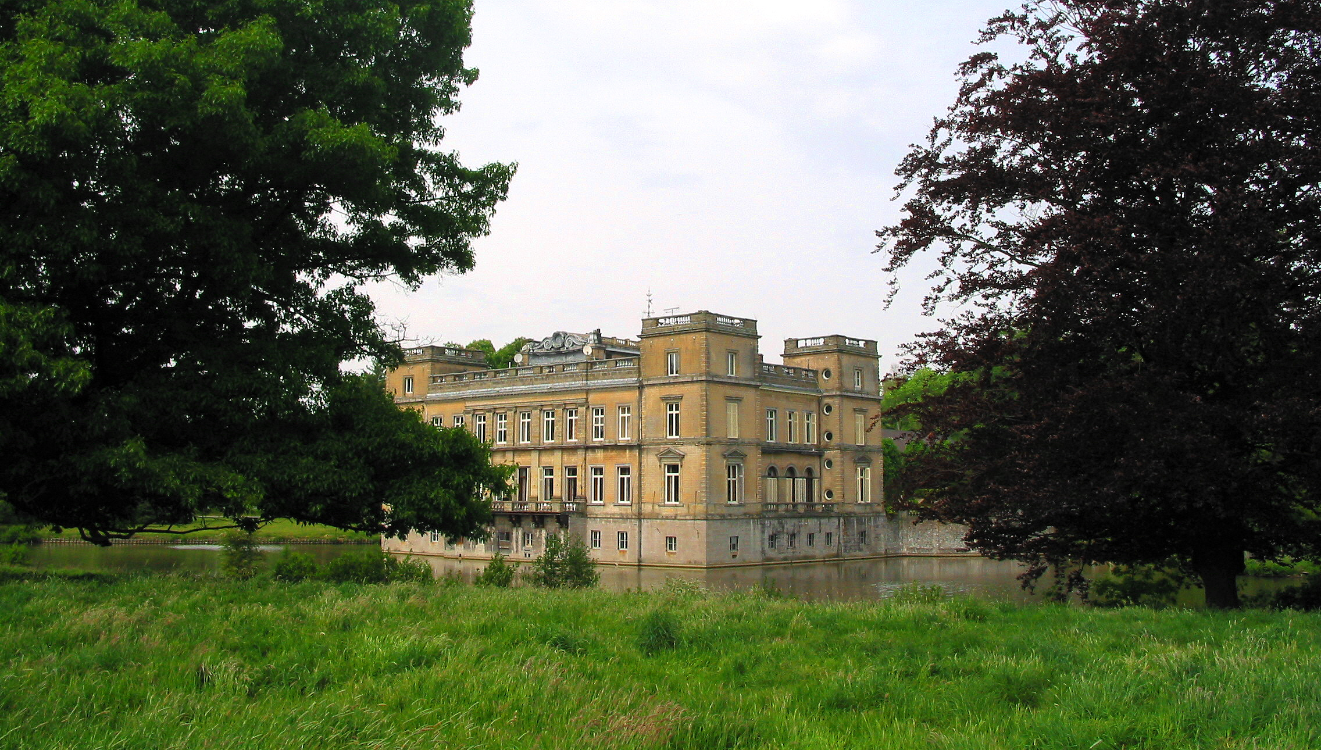

La Berlière

Slide 2
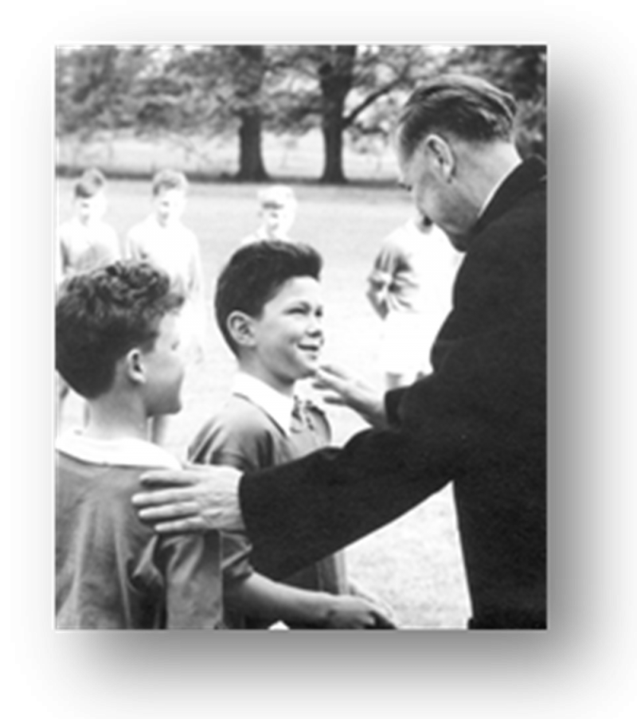
Little history of the school
The school founded at the end of WW II (1946) by Josephite Fathers
In the beginning there were only boys and boarders
Starting from 1996 the school was associated with l’institut de la Visitation
The school became mixed from then on,
The boarding school has been mixed
since September 2017.

Slide 3
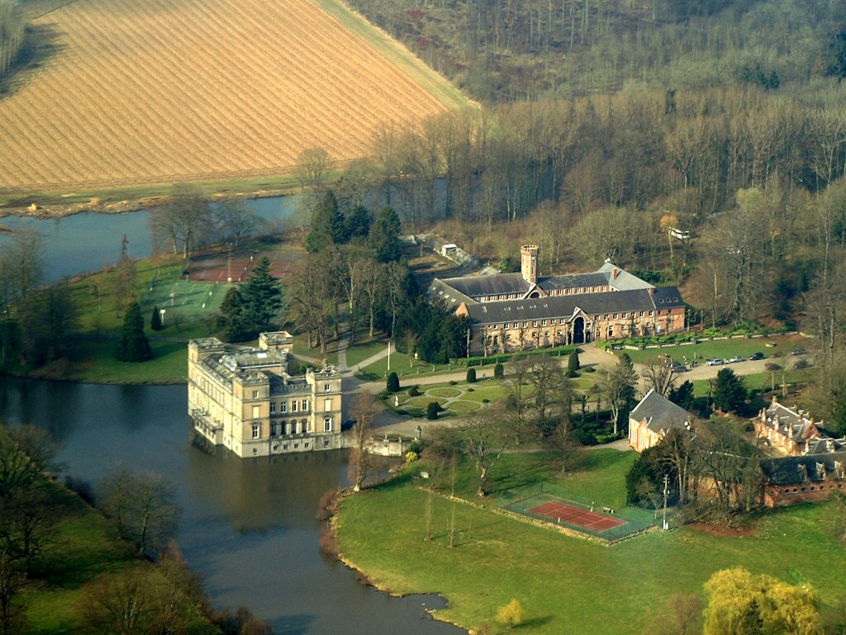
Boarding school

Slide 4
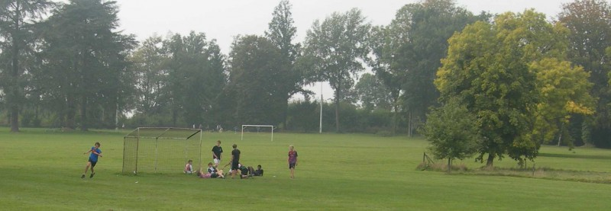
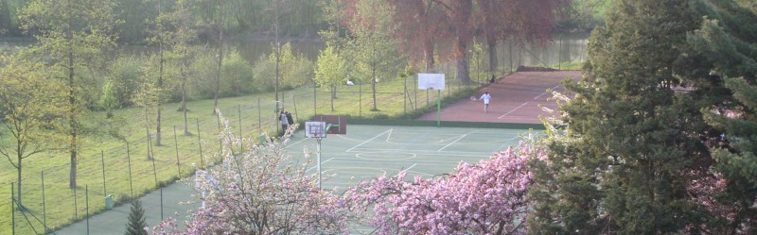
The boarding school
Activities:

Slide 5
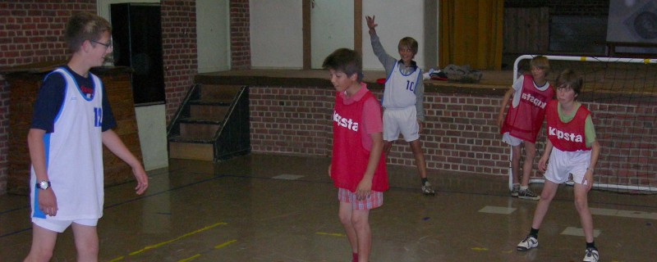
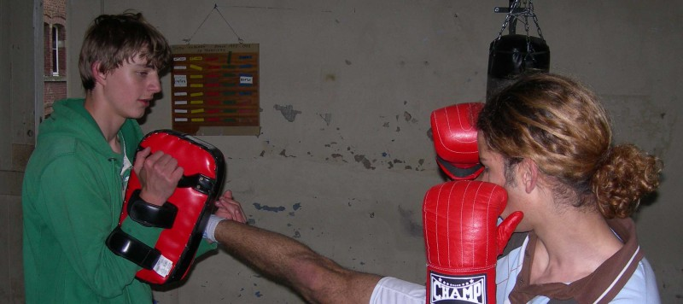

Slide 6
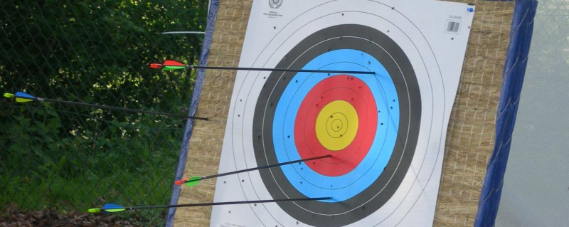
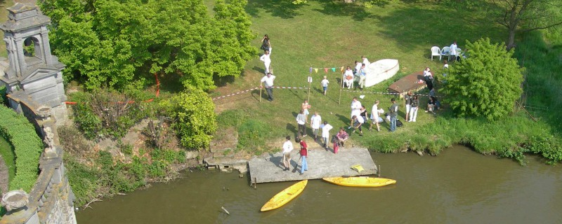

Slide 7
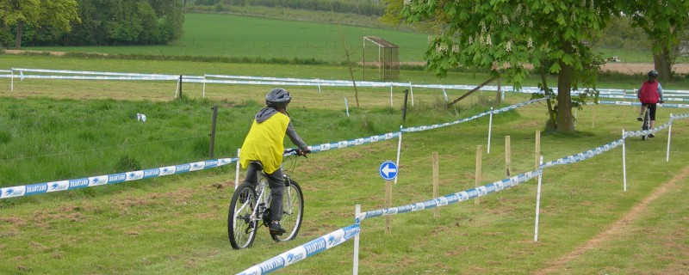

Slide 8
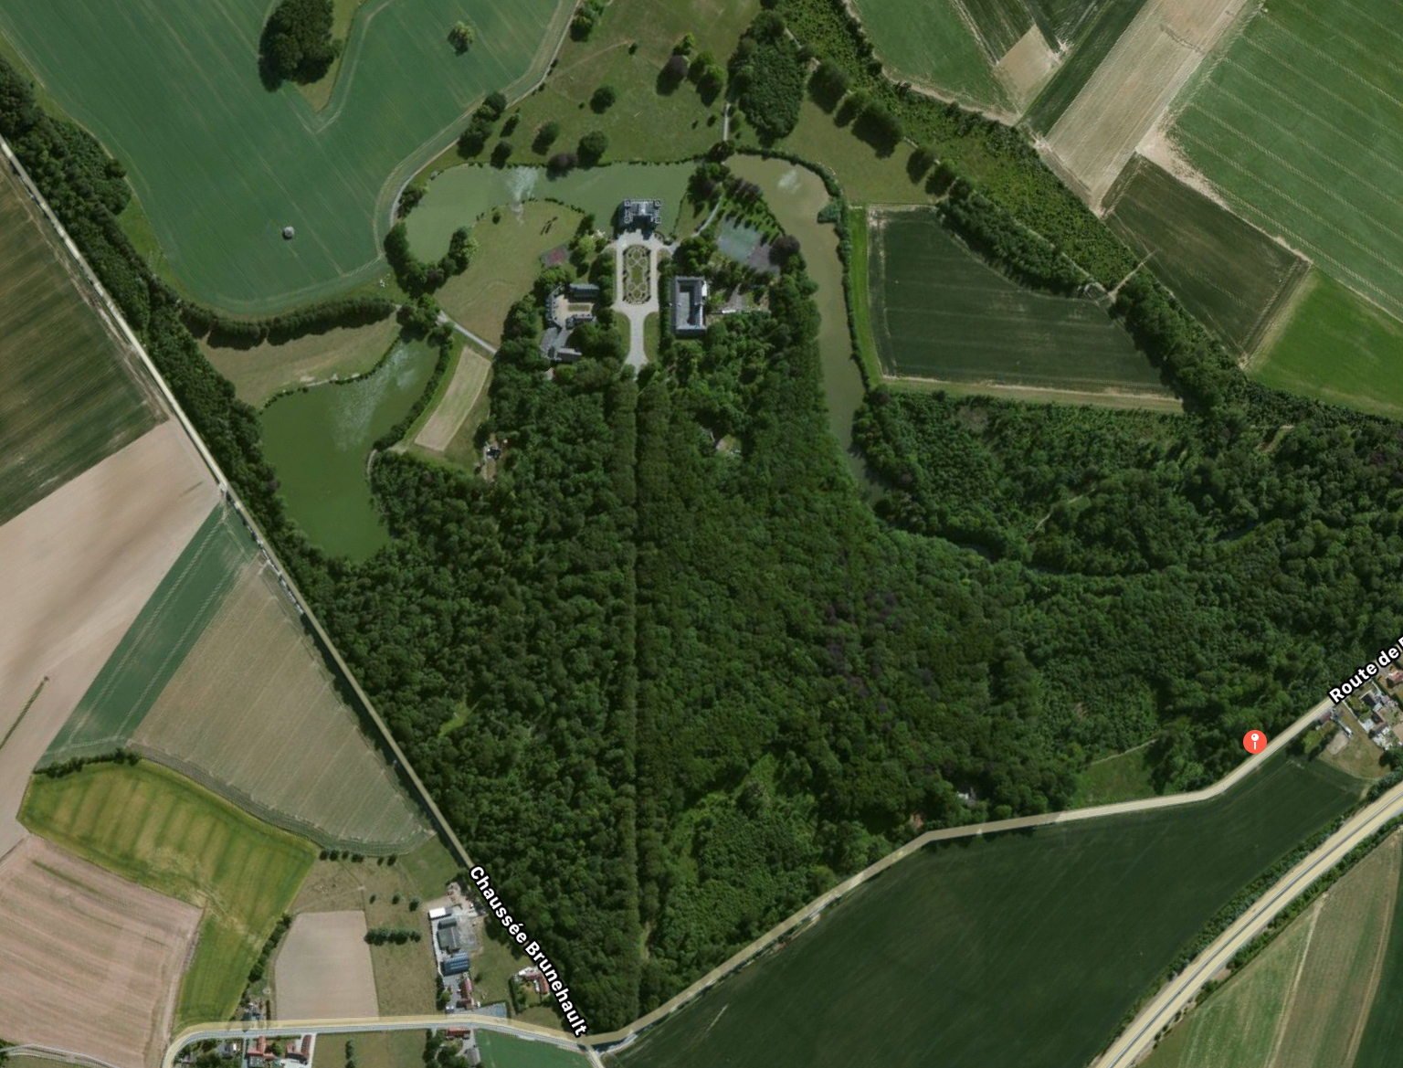
The area

Slide 9
School system in Belgium
School is compulsory from the age of 6 till 18
Three years of kindergarden (3 – 6)
Six years of primary school
Six years of secondary school ( decision in third year: general or vocational studies)
University or high school

