Slide 1
Safety road education
Second lesson

Slide 2
CHUNKS OF LANGUAGE Be careful: stai attento
Cross the road: attraversa la strada
Give way: dai la precedenza
Watch out: fai attenzione
Look at your right/left: guarda a destra/sinistra
Warn us: ci avvisa
Inform us: ci informa
Force us: ci costringe
Oblige us: ci obbliga
Don’t…: non…

Slide 3
Discuss about the following signs’ shapes.
What do they say?What colour are they?

Slide 4
And now discover the truth…

Slide 5
Triangles are always red and warn us of a danger.
Red circles tell what we must not do. Blue circles tell us what we must do.
Blue rectangles give information.
Green rectangles are used for directions on primary roads, white rectangles give us directions on non-primary roads.
Read it and try to understand. Work in group

Slide 6
Prepare a list of DO and DON’T. Work in group.
If necessary explain your list accompanying it with signs.
Example
DO
DON’T
-Cross the street
using the
zebra crossing
-…….
-Don’t cross the street
while running
-………

Slide 7
Prepare a SLOGAN about safety road education.
Example: “Do not text on your mobile while driving”

Slide 8
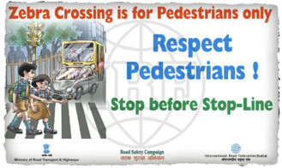
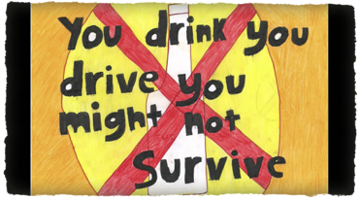
Create a poster with all the groups’ slogans
and stick it on the class’ wall.

