Slide 1
CLIL: EMOTIONS

Slide 2
HOW ARE YOU FEELING?

Slide 3
HOW IS SHE FEELING?
SHE IS….
(GUESS THE FEELINGS)
https://youtu.be/dOkyKyVFnSs

Slide 4
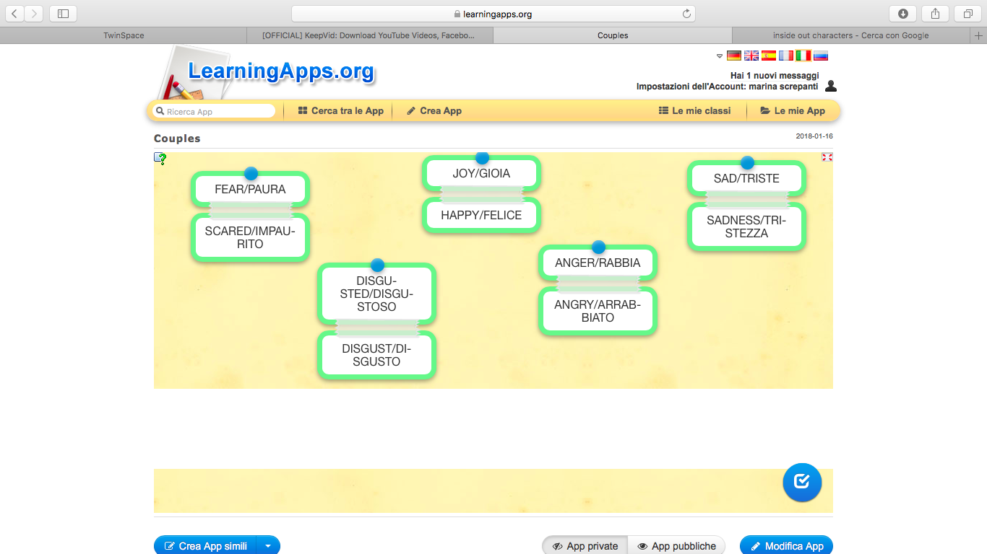
Now you play: transform the adjectives into nouns
https://learningapps.org/display?v=pcqww0wfn18

Slide 5
Now you play:
mime one of the feelings
and help your friends
guess
YOU ARE FEELING…

Slide 6
VANISHING WORDS: READ THE
WORDS ALOUD THEN…
Hi, I’m Brenda. Today I’m feeling sad
because I have got too many homework.
How are you feeling Mark? I’m feeling
disgusted.
I eat fish and I don’t like it.

Slide 7
READ THE TEXT AGAIN COMPLETING IT WITH THE
MISSING WORDS
Hi, I’m Brenda. Today I’m …………… sad
because I have got too many …………..…
How are you feeling, Mark?
I’m ………… disgusted.
I eat fish and I don’t …………. it.

Slide 8
READ THE TEXT AGAIN COMPLETING IT WITH THE
MISSING WORDS
Hi, ………Brenda.
Today I’m …………… sad because I
have got too many …………..…
How are you …………………, Mark?
I’m ………… disgusted.
I ……….. fish and I don’t …………. it.

Slide 9
READ THE TEXT AGAIN COMPLETING IT WITH THE
MISSING WORDS
Hi, …… …………
Today I’m …………… sad …………….. I
have got too many …………..…
How are you …………………, ……….?
I’m ………… disgusted.
I ……….. fish and I don’t …………. it.

Slide 10
CREATE A DOMINO (at least 6 PAPER cards)
WITH EMOTICONS AND FEELINGS
WORK IN GROUP, PLEASE
START
HAPPY
SAD
WORRIED

