Slide 1
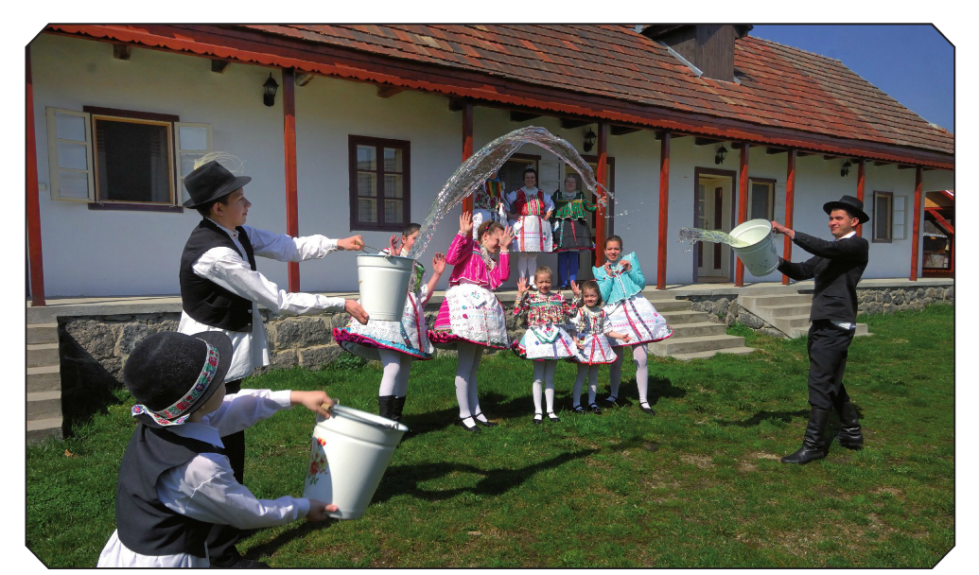
Easter in Hungary
Húsvét

Slide 2
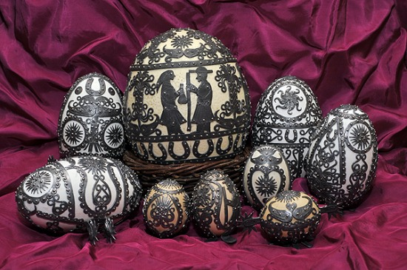
EASTER
Easter is a Christian tradition that celebrates Jesus rising from the dead. It’s a roving event that follows the Lenten fasting period, and in Hungary the various celebrations and traditions have links to Christian traditions, pagan rituals and modern chocolatey fun.

Slide 3
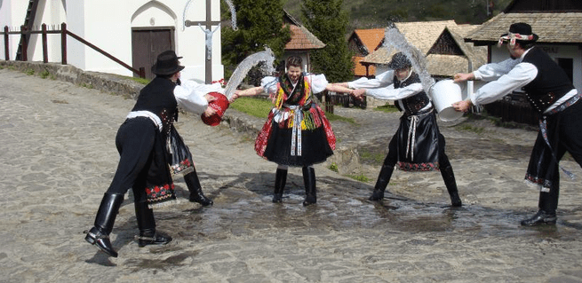
TRADITIONS
“Locsolkodás”
On Easter Monday, this tradition called “locsolkodás” involves boys and men reciting a poem to women and girls and then “sprinkling” them with perfume. In extreme cases this can also be achieved with a bucket of cold water! Originally it was young women of marriage-age who would be the victims but now the act (which has links to earlier pagan fertility rituals) has expanded to women of all ages – even relatives and colleagues. In the past it was a form of courtship and young women would be happy to be “sprinkled” by many potential suitors, nowadays it’s something which leaves women smelling of various cheap perfumes by day’s end.

Slide 4
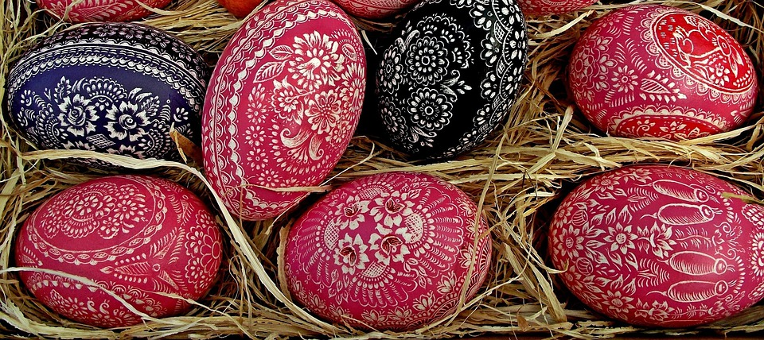
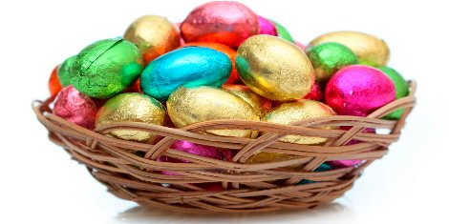
RETURNING
In return for each “sprinkling” the ladies give the men chocolate Easter eggs, specially decorated painted eggs, home made cakes and/or a shot of pálinka (a potent Hungarian fruit brandy). So on Easter Monday in Hungary boys and men go from house to house visiting family, friends, and sometimes colleagues spritzing a little Eau de Cologne on the female’s hair, picking up all kinds of treats along the way.

Slide 5
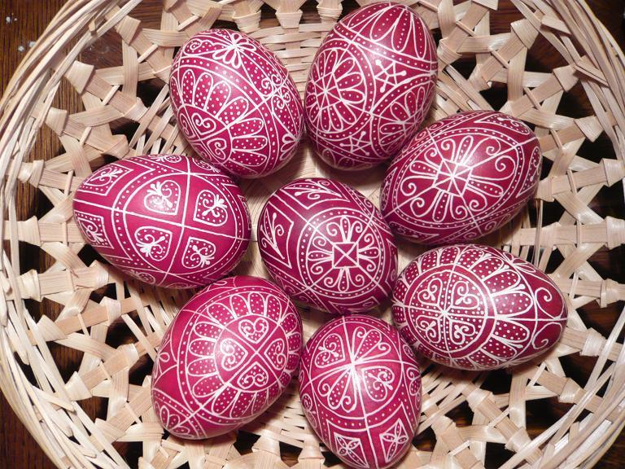
PAINTED EGGS
Painted eggs are part of a prominent Easter tradition in Hungary. Within the Christian tradition eggs were painted red (to symbolize Jesus’ blood), but in recent centuries this has changed to eggs being dyed many varied colors. The flower motifs that are often incorporated in the decoration reflect the embroidery and motifs found on Hungarian heritage folk costumes.

Slide 6
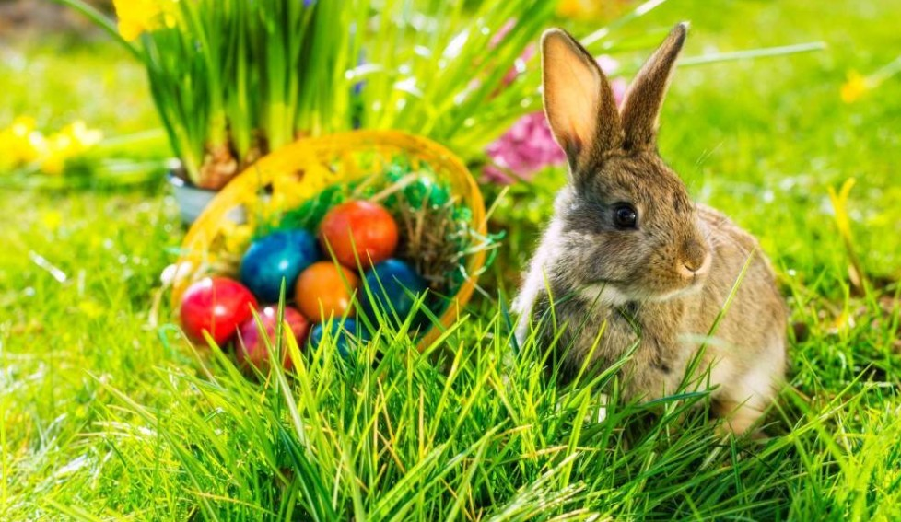
THE EASTER BUNNY
In modern Hungary the Easter Bunny brings chocolate eggs for young children and these are sometimes hidden in the house or garden, before they are found after an extensive Easter Egg Hunt. This usually takes place on Easter Sunday or Easter Monday in Hungary.

Slide 7
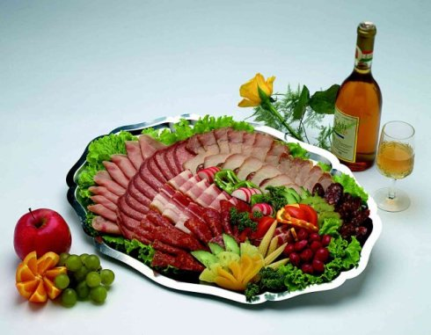
FOOD
For those following Christian traditions, on Good Friday it’s customary to eat fish, while on Easter Sunday meat dishes are eaten. Typically Hungarians eat ham served with horseradish and boiled eggs on Easter Sunday while “kalács” (a kind of braided Milk Loaf) is also served at Easter in Hungary. Of course chocolate eggs are also a huge part of the Easter diet, although this is a more modern element of the celebration.
Source: https://welovebudapest.com/en/2015/04/03/easter-in-hungary-traditions-and-events/

Slide 8
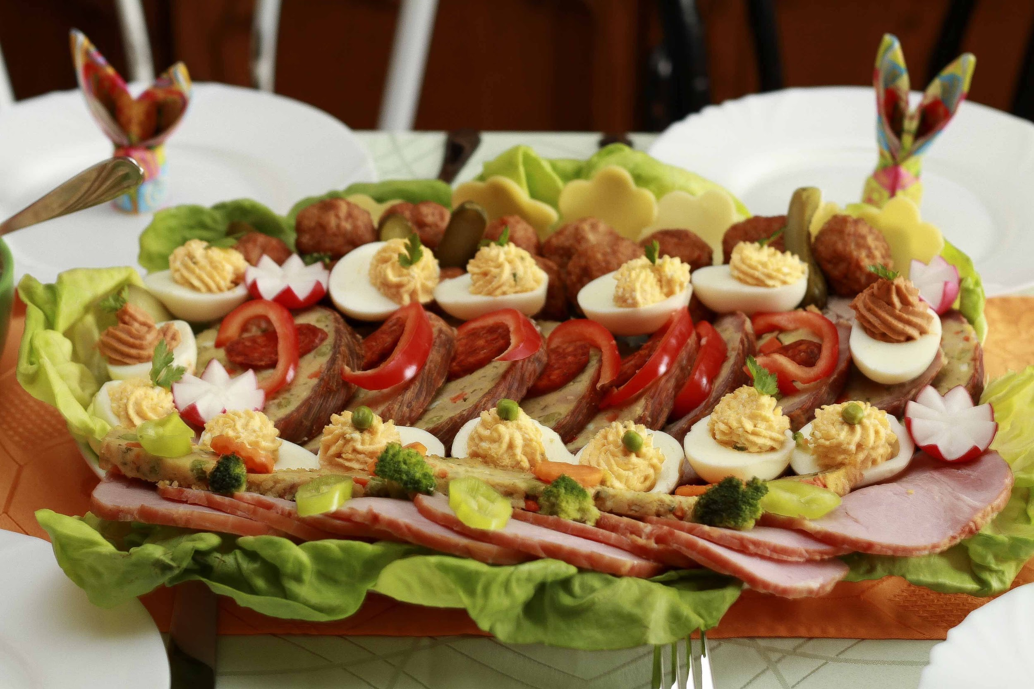
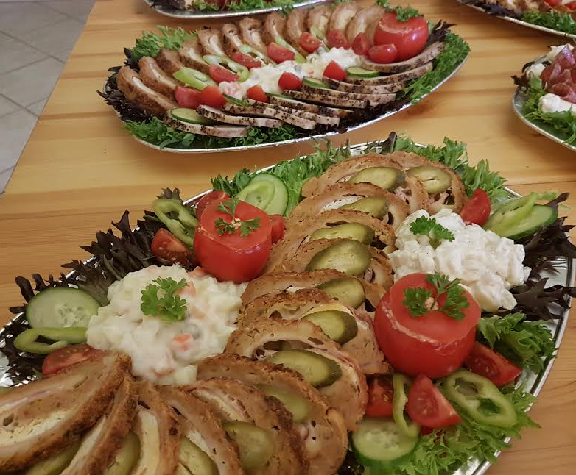
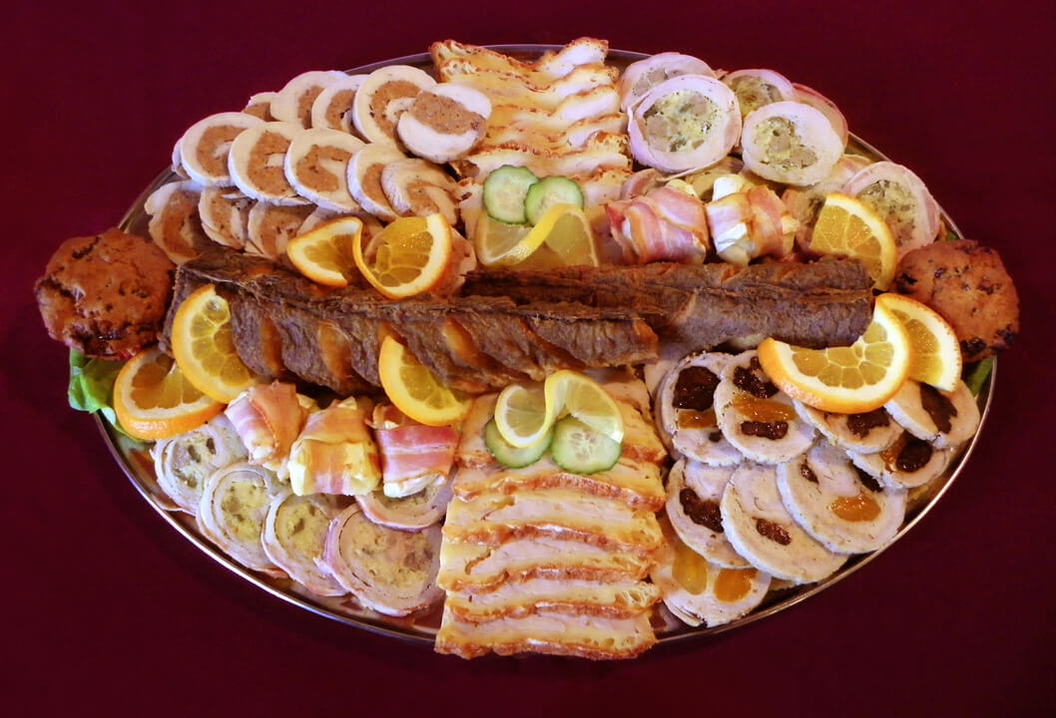

Slide 9
