Slide 1
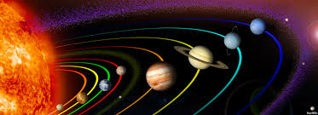
THE SOLAR SYSTEM
School of Palekastro

Slide 2
In our Solar System nine planets orbit around The Sun
Mercury, Venus, Earth, Mars, Jupiter, Saturn, Uranus, Neptune and Pluto
The Sun is in the centre of the Solar System and the planets orbit around it

Slide 3
THE SUN
It is in the centre of the Solar System
It is a star
It is about 1million times bigger than the Earth

Slide 4
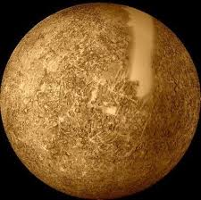
MERCURY
It is the closest planet to the Sun
It’s a rocky planet

Slide 5
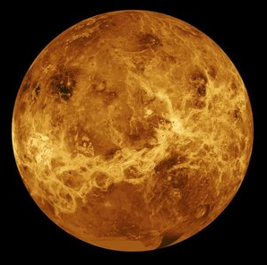
VENUS
It is is the second planet closest to the Sun
It’s the hottest planet in the Solar System
It is a rocky planet

Slide 6
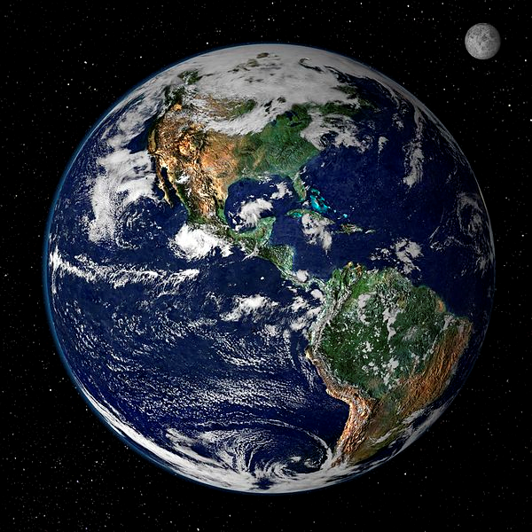
EARTH
We live on this planet
It’s the third planet closest to the Sun
The Earth is a rocky planet and ¾ parts of it
is covered by water
It has a satellite: The Moon

Slide 7
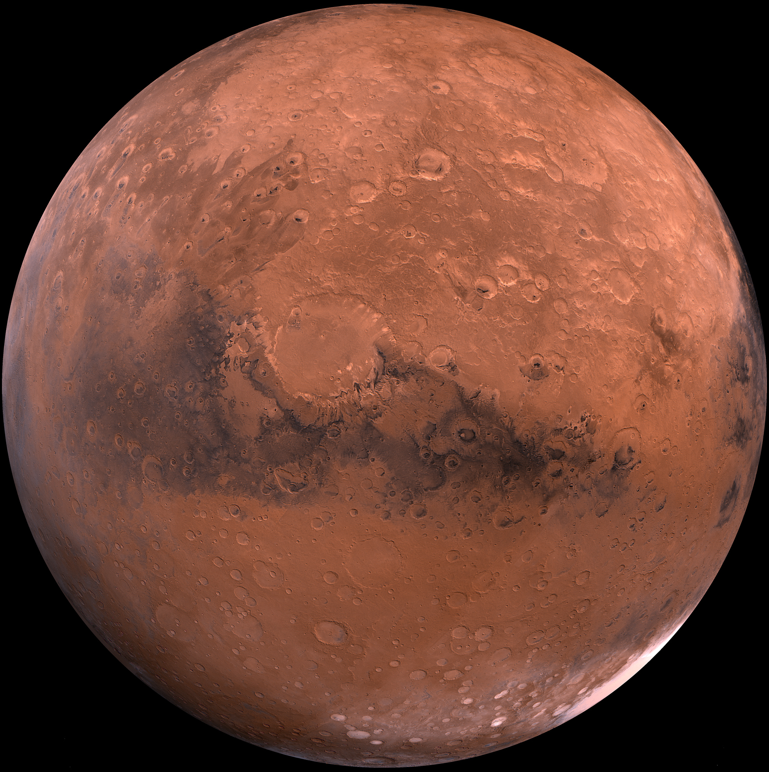
MARS
Mars is the fourth planet closest to the Sun
It’s a rocky planet
It is called the red planet

Slide 8
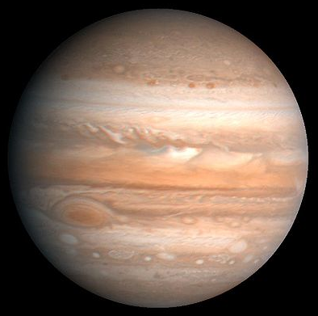
JUPITER
Jupiter is the fifth planet closest to the Sun
It’s made of gas
It’s the biggest planet in the Solar System
It’s called the giant gas planet

Slide 9
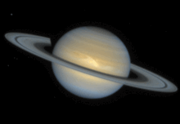
SATURN
Saturn is the sixth planet in the Solar System
Saturn is the second largest planet in the Solar System
It’s made of gas
It ‘s well-known for its rings

Slide 10
URANUS
It is the seventh planet closest to the Sun
It’s an extremely cold planet
It’s made of gas

Slide 11
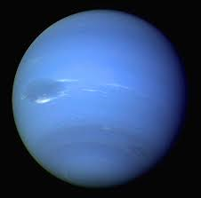
NEPTUNE
It is the eighth planet from the Sun
It’s a very windy planet
It has very strong winds

