Slide 1
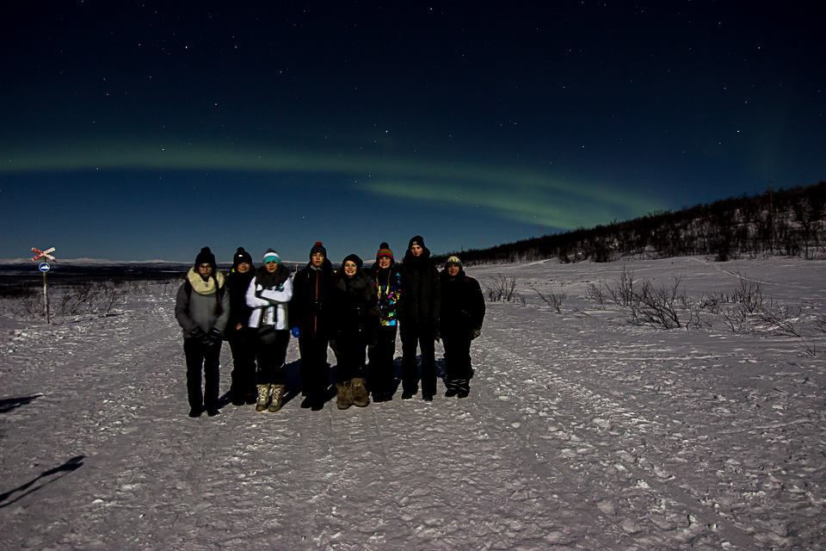
Swedish adventure in Kiruna
Made by Liwia Misztal

Slide 2
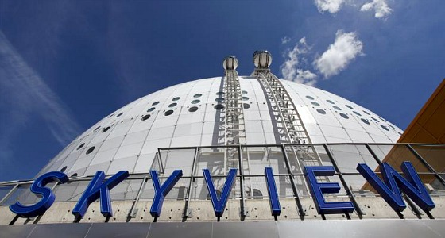
The beginning
The whole Polish team arrived to Stockholm on Saturday morning (4th of February 2017). We were supposed to go for dinner and then visit the city. We visited the Old Town and we had an occasion to go for a short walk in front of the King Palace. We could take a look at the whole city from something called "Skyview". It's a famous viewpoint located on a big arena called Globen. Globen is the second largest arena in Stockholm and is located in Johanneshov.

Slide 3
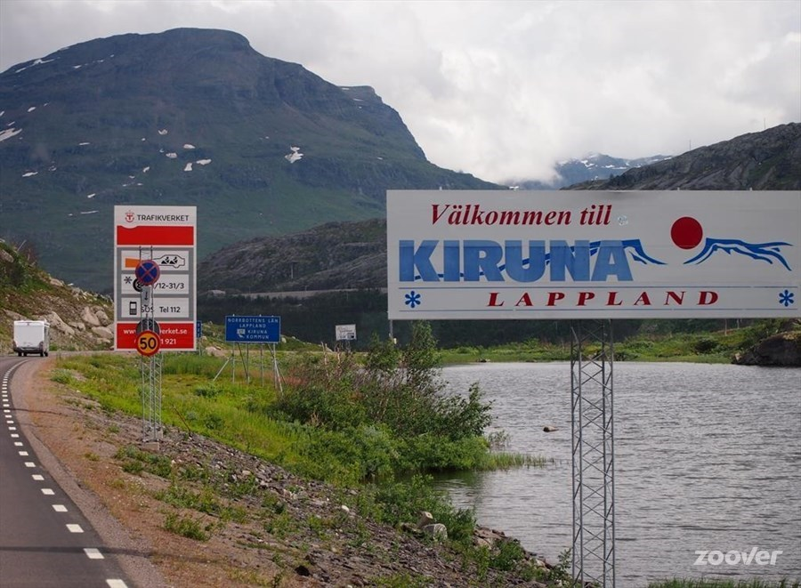
Arrival to Kiruna
We reached the final destination of our trip on Sunday afternoon. We were the first group that arrived (except Swedes, who greeted us very well). After a short break we had a photography workshops with one of the Swedish teachers. Afterwards, we were waiting for the groups from other countries to arrive.

Slide 4
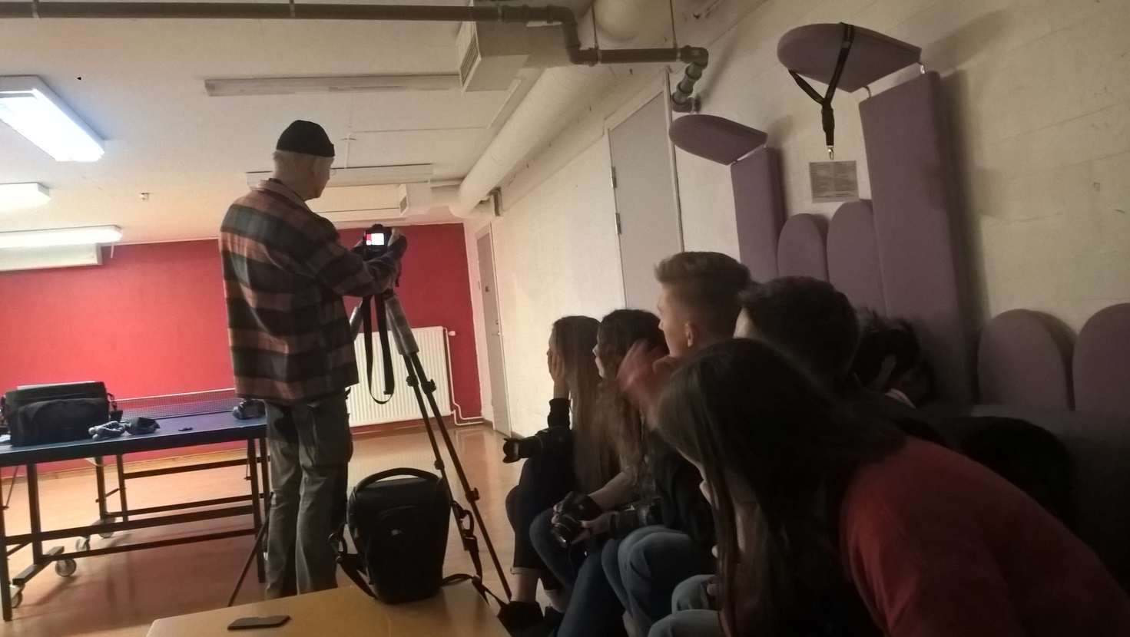
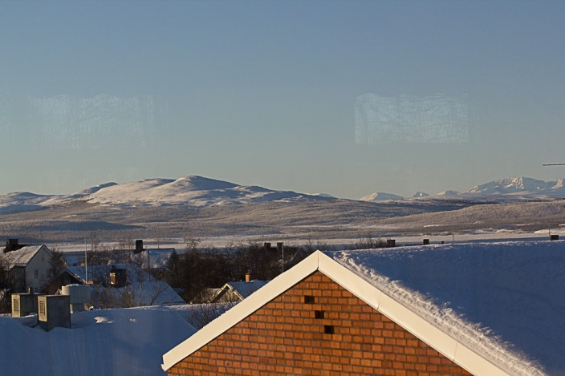

Slide 5
Monday
On Monday morning we had a Kick-Off. The Swedish teachers told us about the schedule and we saw a presentation about their school. Afterwards, we went to the "IRF" (Swedish Institute of Space Physics). They showed us some presentations about the Aurora Borealis ("Northern Lights") and "EISCAT" (European Incoherent Scatter Scientific Association). When we came back to the hotel, we had some free time for integration. In the evening Swedish team took us to the restaurant in the city centre in order to eat dinner.

Slide 6
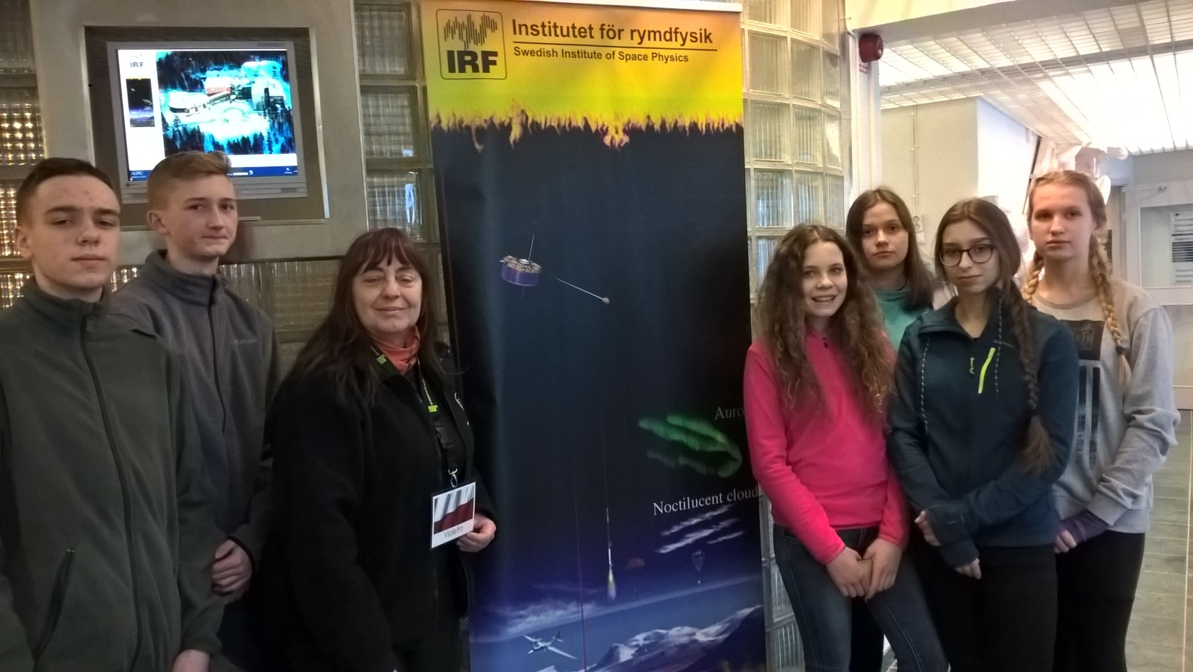
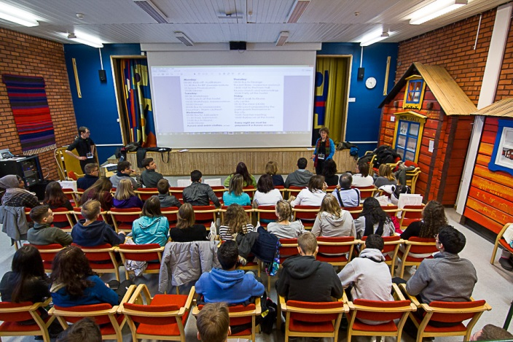

Slide 7
Tuesday
In the morning we had workshops in astronomy/astrophysics led by students from Sweden. We have learned how to make a compass or how to measure the height of Aurora Borealis. After lunch, when teachers were during the project meeting, we had a time for sports activities like skiing or sledding. Afterwards, we had some free time until the dinner. At 9 p.m we went to Luossavaara mountain in order to take photos of the Northern Lights. It was amazing experience, because for most of us it was the first time when we could see it. We had an opportunity to take photos, and some of them were really good.

Slide 8
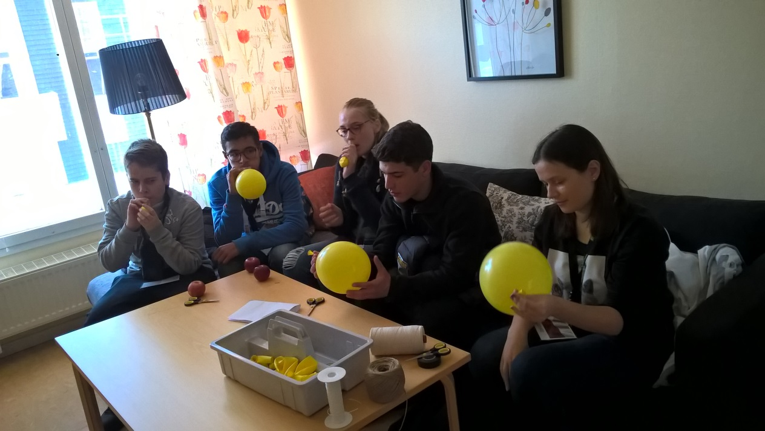
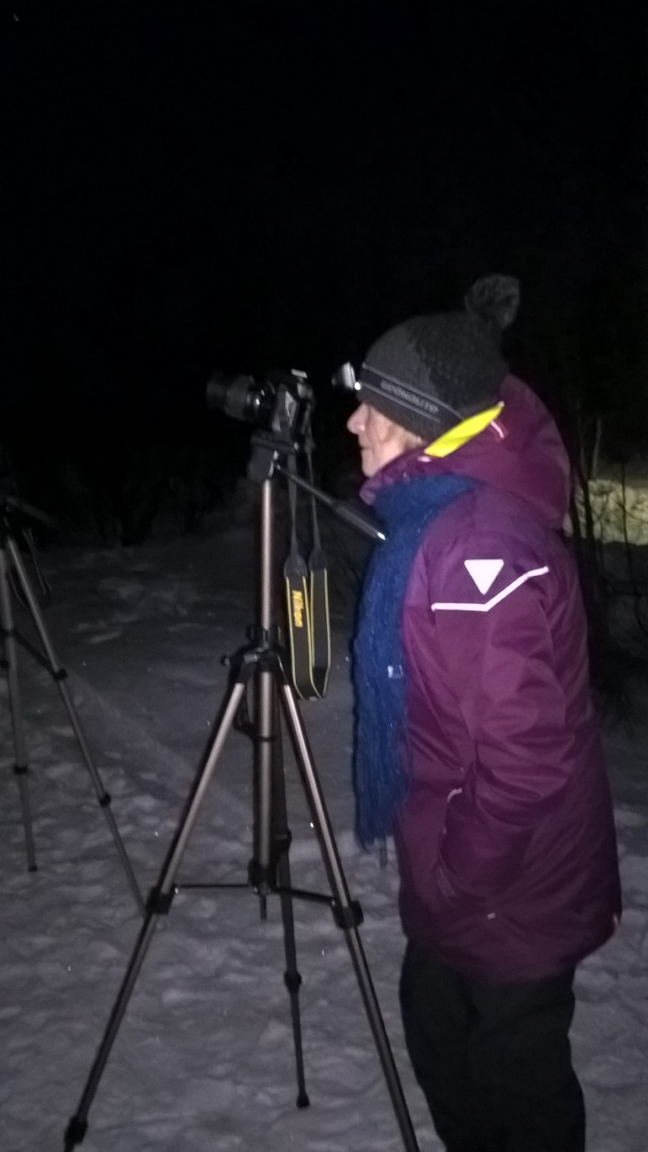
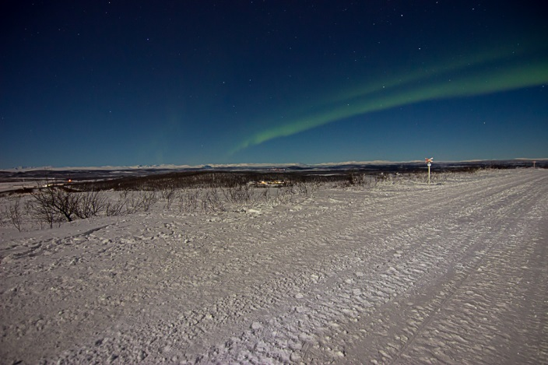

Slide 9
Wednesday
On Wednesday we were transportated to Jukkasjarvi village. The first destination of our trip was the Ice Hotel - a hotel and art exhibition made of ice from the river Torne, each year reincarnated in a brand new design. After the guided tour in that amazing place, we went to Sami village, where we had an opportunity to eat a traditional Sami lunch (including reindeer's meat). During the lunch, a Sami host told us about myths and legends linked to their culture. Afterwards, there was one of the most exiting parts of our trip - petting and feeding reindeers. It was such a fun, especially for these ones, who have seen that animal for the first time. Later we visited the church of Jukkasjarvi. The wooden church is the oldest building in the village (built around 1607/1608) and is well known for its wooden carved altar piece triptych by Bror Hjorth. When we came back to Kiruna, everybody was very cold, but it was worth it.

Slide 10
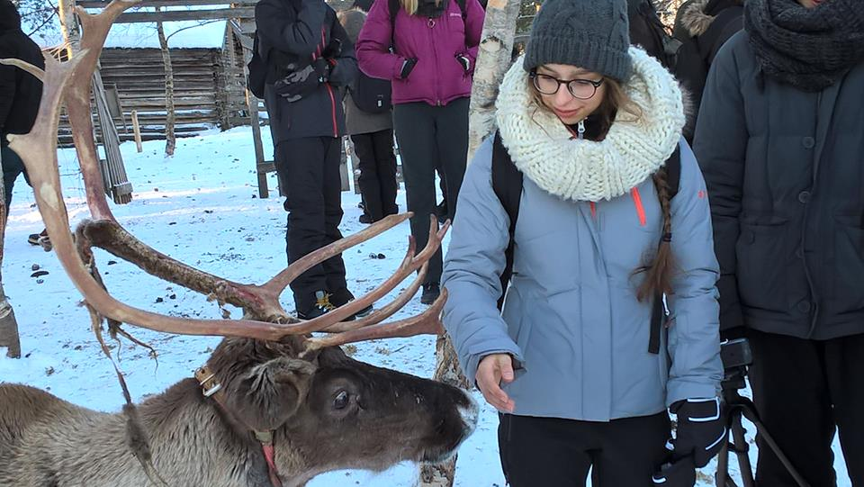
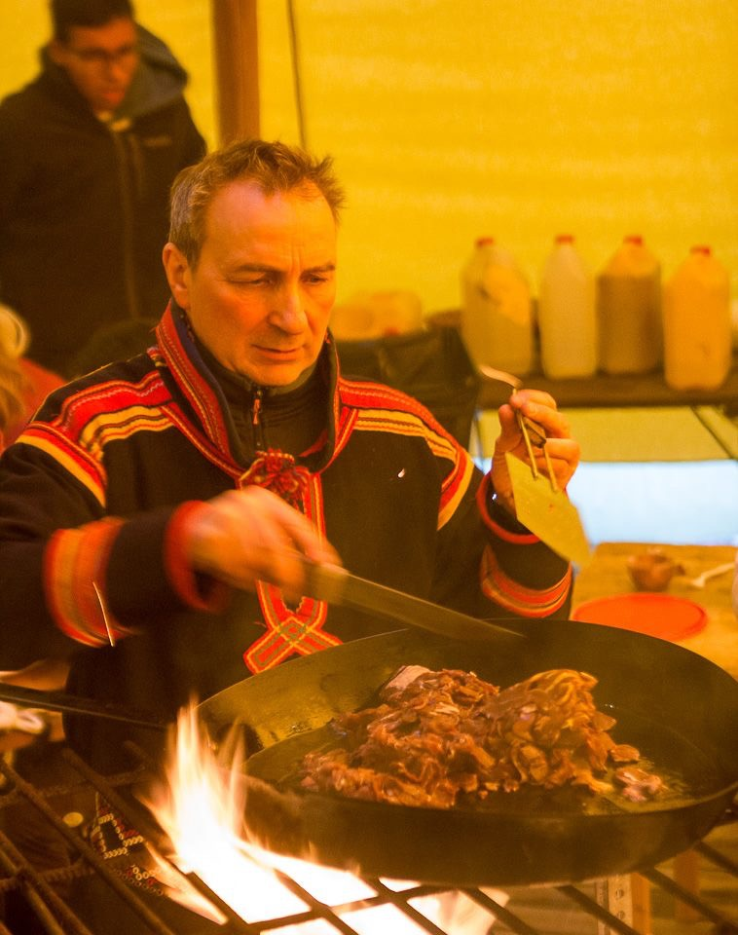
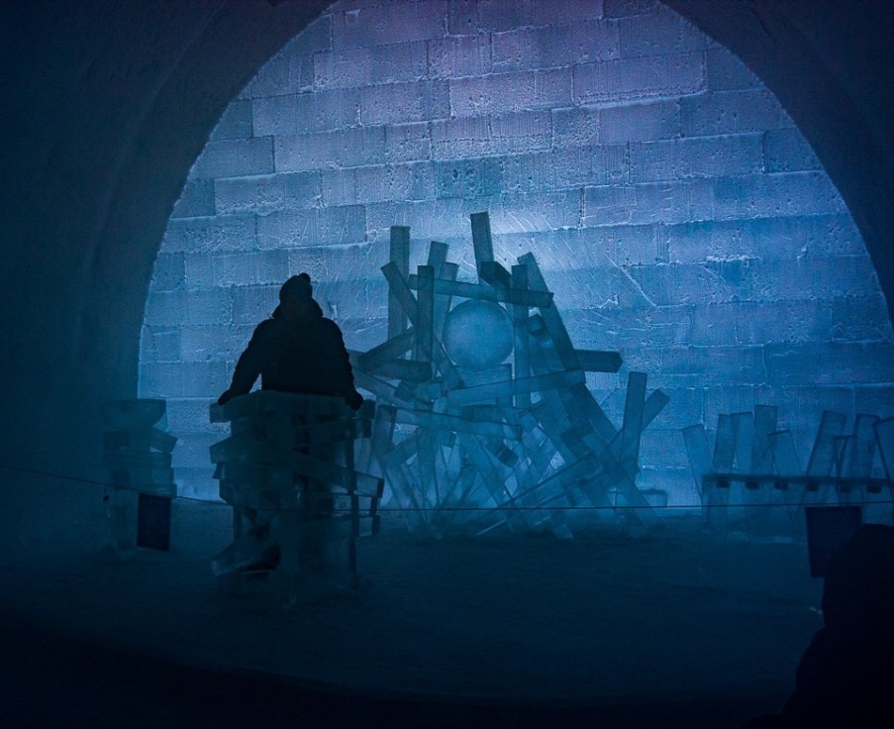

Slide 11
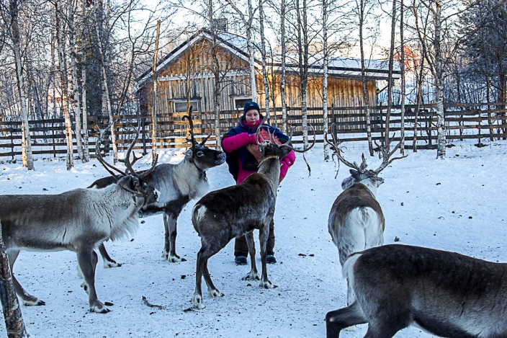
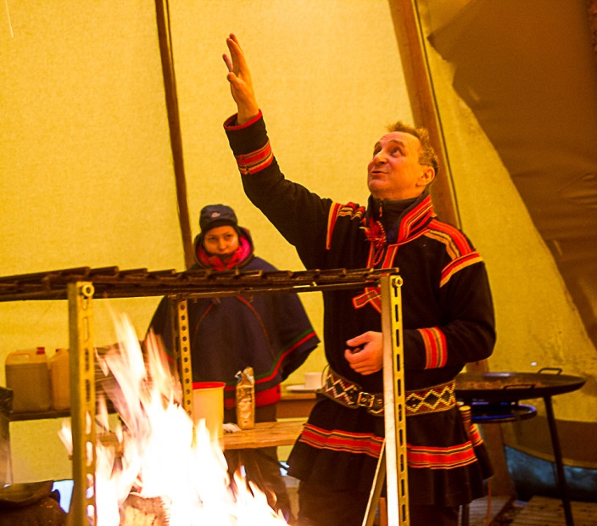
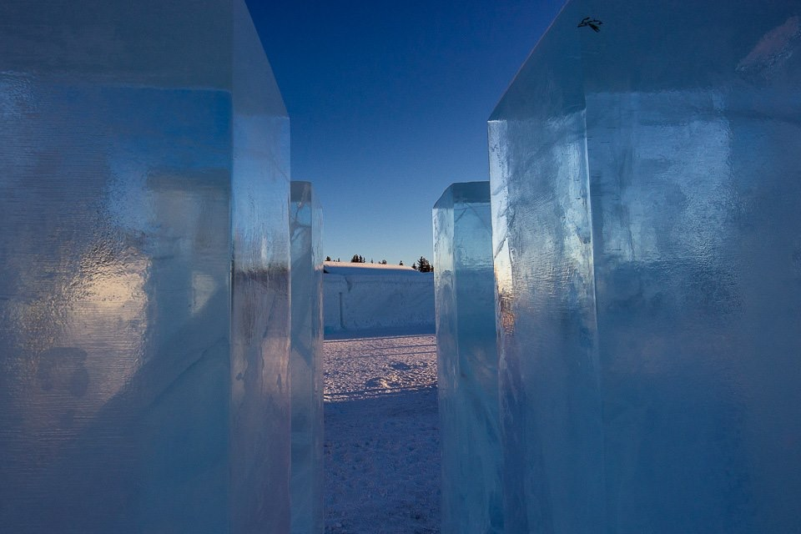

Slide 12
Thursday
On Thursday morning we were transportated to Esrange Rocket Base. It is a rocket range and research centre located outside the town of Kiruna. We could see the short movie about space researches and using rockets. After we came back to the hotel, we went to the Town hall. Students and teachers from Sweden showed us the famous church of Kiruna and surroundings. In the evening there was a party with Swedish smorgasbord at the hostel, with some social activities like singing toghether or quiz-contest prepared by students from Portugal. We also could show our presentations about famous Polish astronomists and scientists.

Slide 13
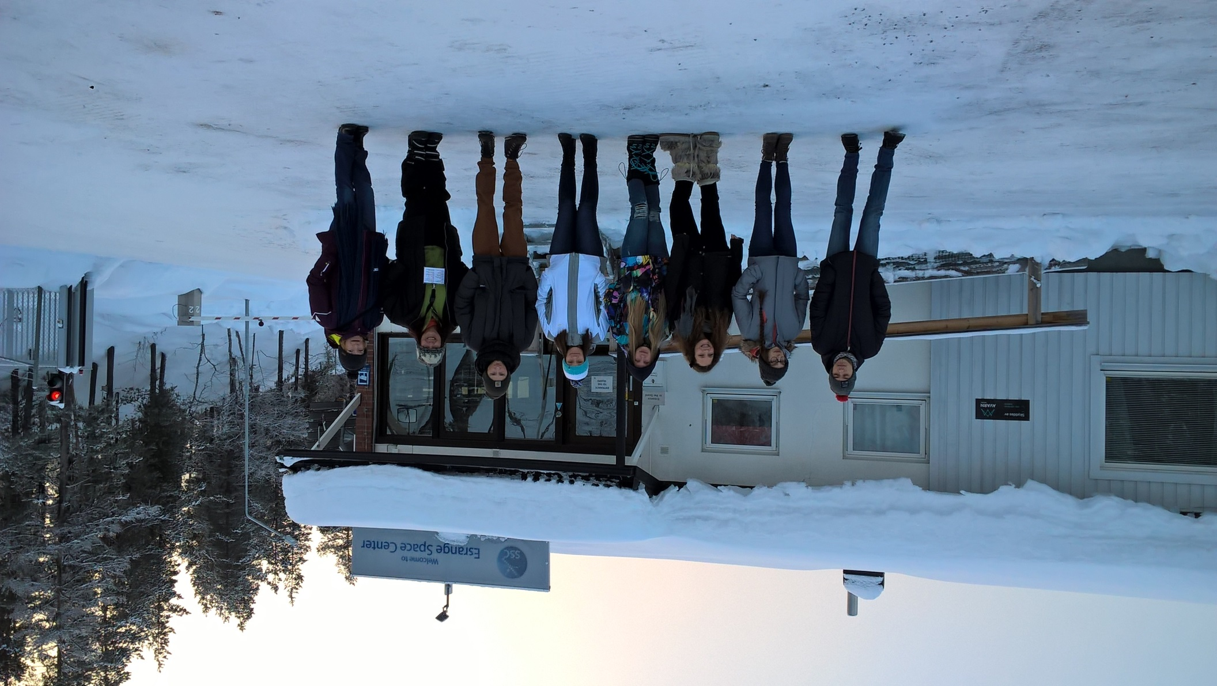

Slide 14
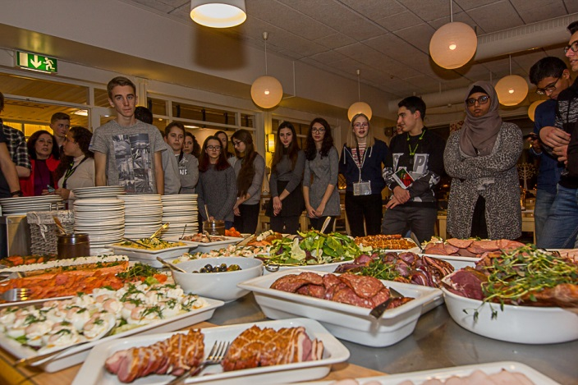
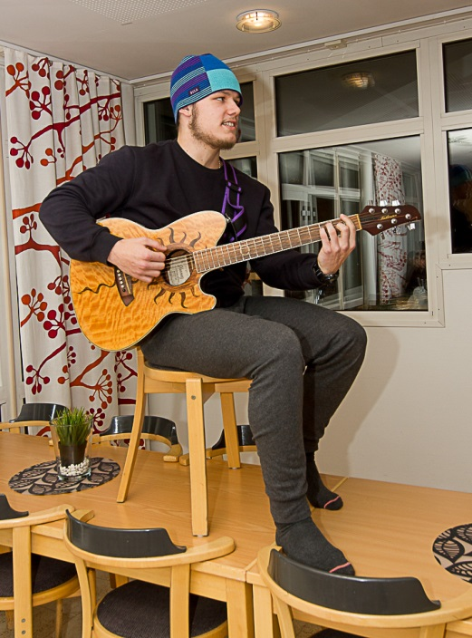
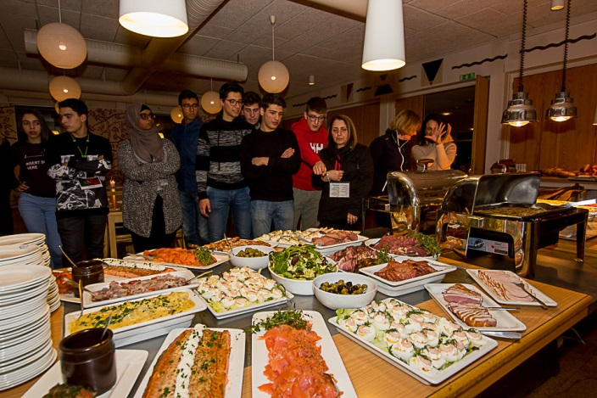

Slide 15
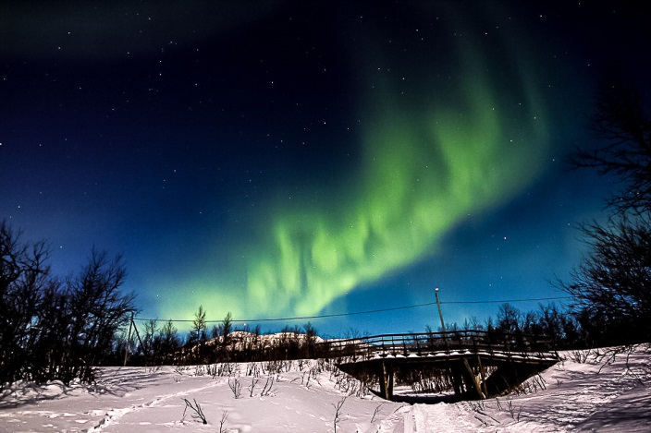
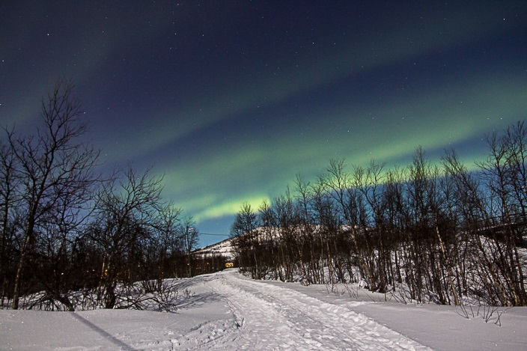
On Thursday evening there was another opportunity to photograph the Northern Lights

Slide 16
Friday
The last day of our travel. On Friday morning we went for a short walk to Kiruna city centre. From there we were transportated by bus to the LKAB mine - the largest and most modern underground iron ore mine in the world. We could see the machines used in main and learn about the process of iron extracting.
Afterwards, we went to the city centre and we split up to smaller groups, but most of us went back to the hotel in order to eat lunch. We had a lot of free time, so we could integrate and talk. One of our favourite integrational activities was teaching each other some words in our mother languages.
In the evening Swedish team organized a goodbye-barbecue. Despite the fact that most of us were tired, everybody had fun. It was also a bit sad evening, because noone wanted to say goodbye and leave that amazing place.

Slide 17
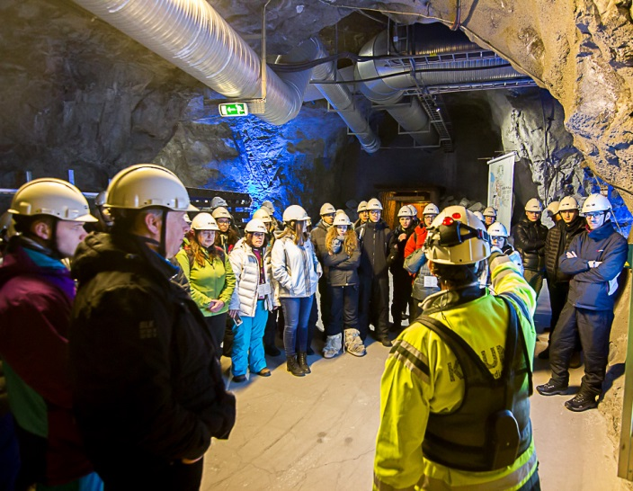
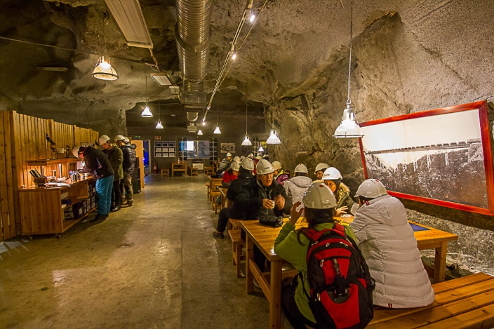
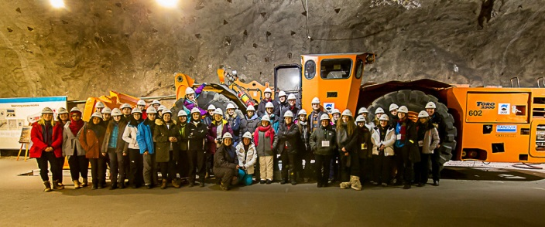

Slide 18
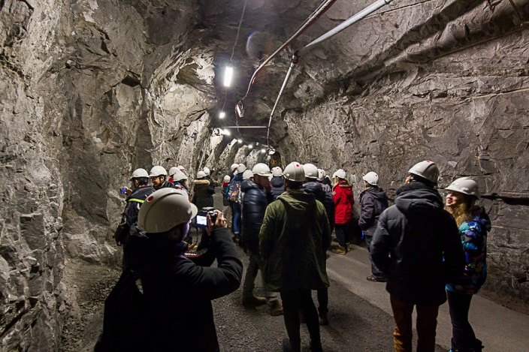
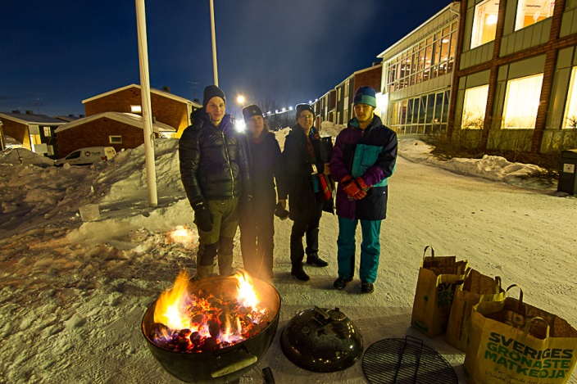

Slide 19
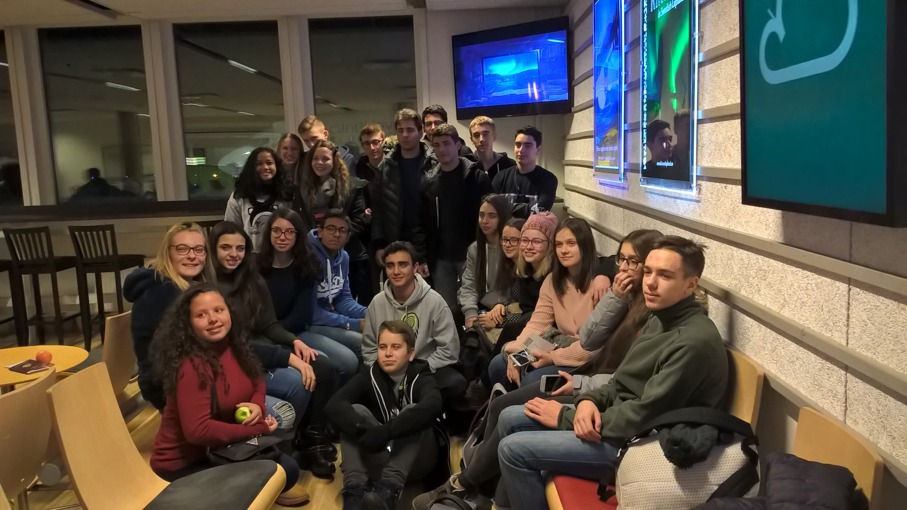
Saturday
On Saturday we had to leave the hotel at 5 a.m, because our flight from Kiruna to Stockholm was at 7 a.m. That was the time, when we had to say goodbye. Everybody was sad, but we promised each other that someday we will meet again.

Slide 20
„Some memories are unforgettable, remaining ever vivid and heartwarming.” ~Joseph B. Wirthlin
Thank you for attention ;)

