Slide 1
A CLIL lesson The Solar System
School of Palekastro

Slide 2
Community
Content
Competence
Communication
TOPIC
Cognition

Slide 3
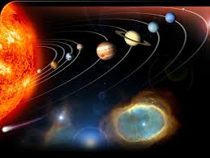
The Solar System
This Unit helps Learners understand the solar system by examining the planets in orbit around the sun, with particular focus on the Earth and its rotational movement, and how this results in night and day

Slide 4
CONTENT
Introduction to the planets that form the Solar System: Mercury, Venus, Earth, Mars, Jupiter, Saturn, Uranus, Neptune
Main characteristics of the planets that form the Solar System
The Earth as a part of the Solar System
Day and Night (Rotation)

Slide 5
Communication
Key Content Words relating to the topic will be introduced
Learners will explore the comparative and the superlative form of a few one- syllable adjectives
They will also learn and use the ordinal numbers
They will use simple structures in the Present Simple (affirmative, negative and interrogative) to communicate

Slide 6
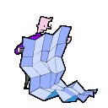
COGNITION
Learners will be using various Cognitive Skills
and will develop both LOTS & HOTS
Recognising and naming the different planets
Understanding the relationship between the planets & their
different features
Applying knowledge of the planets’ characteristics
Comparing the different characteristics of the planets
Remembering the order of the planets in orbit around the sun
Creating a True/False Activity for other LLs
Discussing the importance & the negative effects of the sun
Demonstrating the rotation of the sun and the earth
Understanding what causes light & darkness
Explaining day and night through rotational movement
See Bloom’s Wheel for cognitive learning tasks

Slide 7
COMPETENCE
Learners will:
Develop listening, writing and memorising skills
Work co-operatively in problem-solving groups
Explain the relationship between planets through spoken language

Slide 8
COMMUNITY
Understanding the role of the Sun and planets in everyday life.
Understanding the reason for day and night
Building self-awareness of personal health and safety when being exposed to strong sunlight

Slide 9
Bloom’s Revised Taxonomy of Learning Behaviours
Remember
Understand
Apply
Analyze
Evaluate
Create
Lower Order Thinking Skills - LOTS
Higher Order Thinking Skills - HOTS

Slide 10
Learning Behaviours
We have to remember a concept before we can understand it. We have to understand a concept before we can apply it. We have to be able to apply a concept before we analyze it. We have to analyze a concept before we can evaluate it. We have to remember, understand, apply, analyze,
and evaluate a concept before we can create.

Slide 11
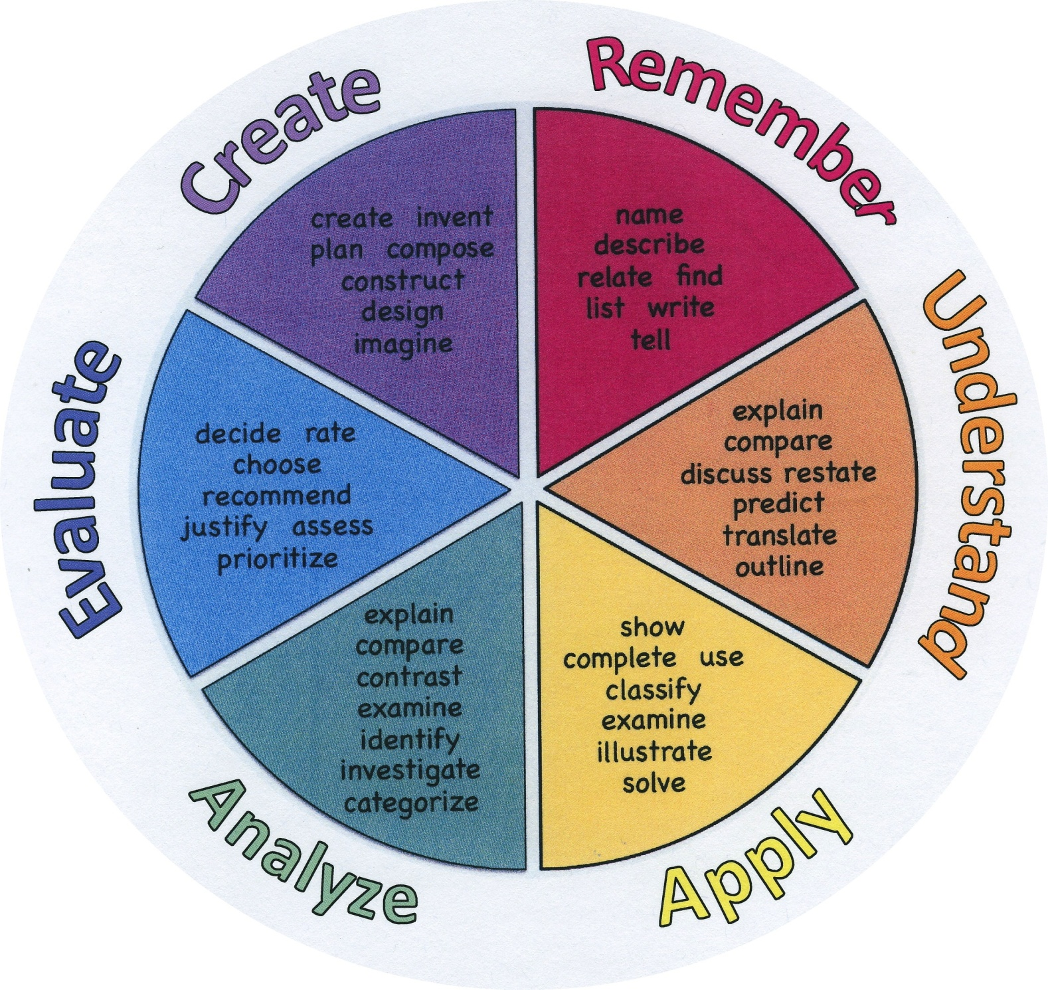
Bloom’s Wheel

