Slide 1
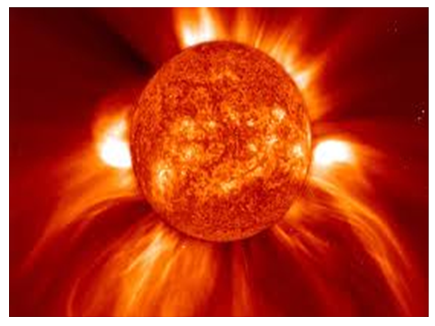
PLANETS
Those that orbit
around the Sun
School of Palekastro

Slide 2
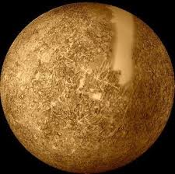
MERCURY

Slide 3
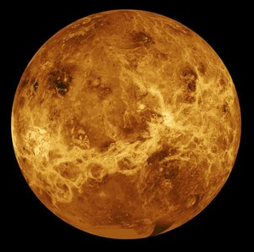
VENUS

Slide 4
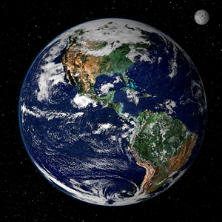
EARTH

Slide 5
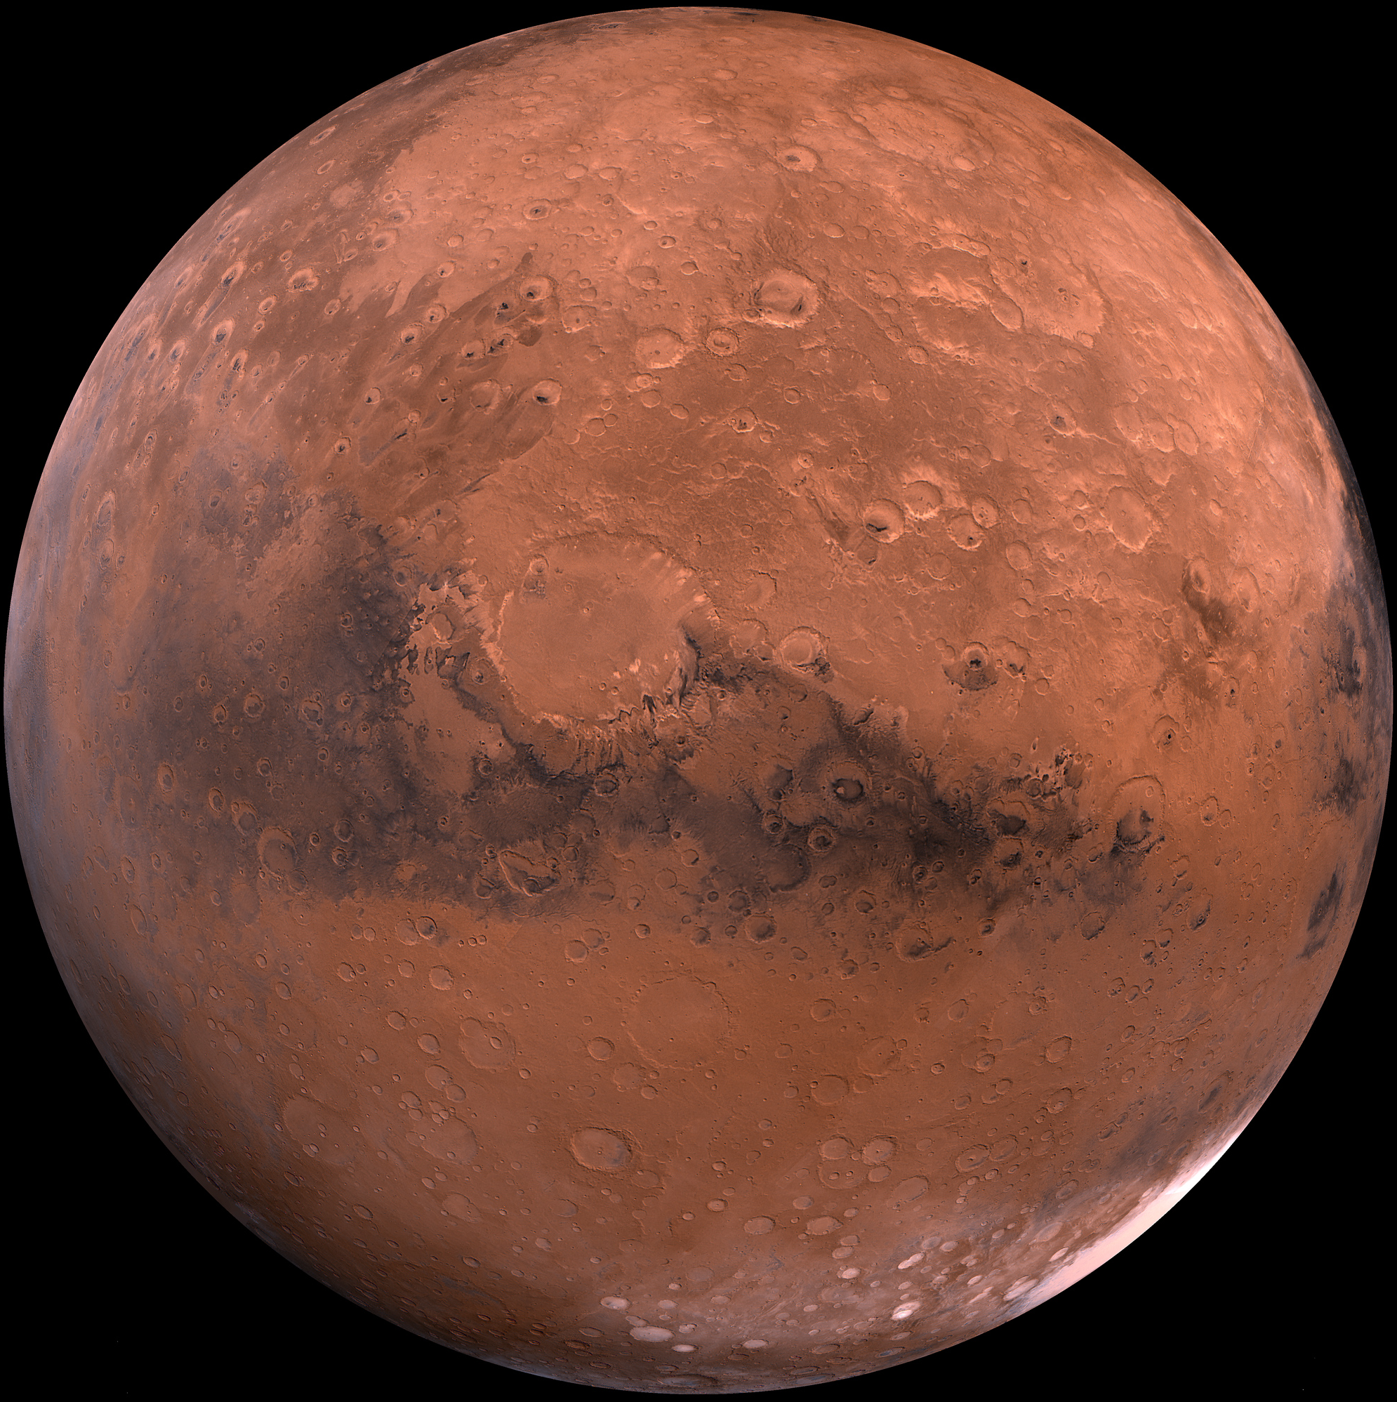
MARS

Slide 6
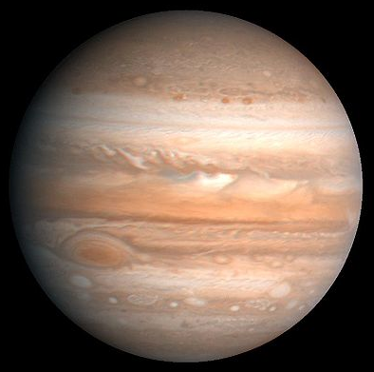
JUPITER

Slide 7
SATURN

Slide 8
URANUS

Slide 9
NEPTUNE

