Slide 1
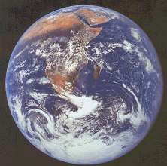
THE EARTH
School of Palekastro

Slide 2
It’s our planet

Slide 3
It’s called the blue planet because ¾ parts of it is covered by water.

Slide 4
It’s the third planet in order from the Sun

Slide 5
It has one satellite:
THE MOON

Slide 6
It makes one orbit around the Sun every 365.27 days.
One year

Slide 7
The Earth rotates on its axis. It needs 24 hours to complete one turn.
One day

Slide 8
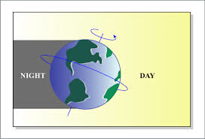
It’s day time in the half of the Earth that faces the Sun.
It’s night time in the other half of the Earth
SUNLIGHT

