Slide 1
Our school
Społeczna School in Świdnica

Slide 2
our school
Our school is one of the smallest schools in Świdnica although it consists nursery school, primery school and secondary school. A head teacher is Mrs. Hanna Turek and we have school mascot- Witosz. I think it is the best school because when I go there everydayI feel just like at my home. Everyone is friendly, nice and helpful.

Slide 3
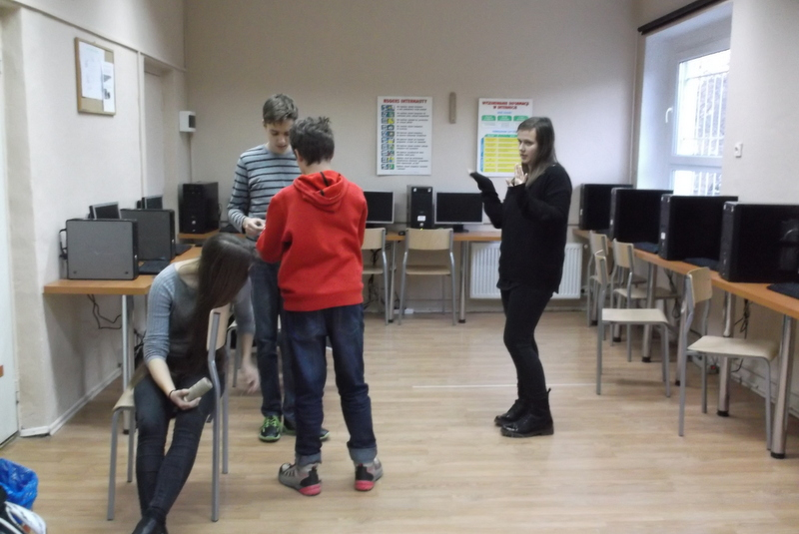
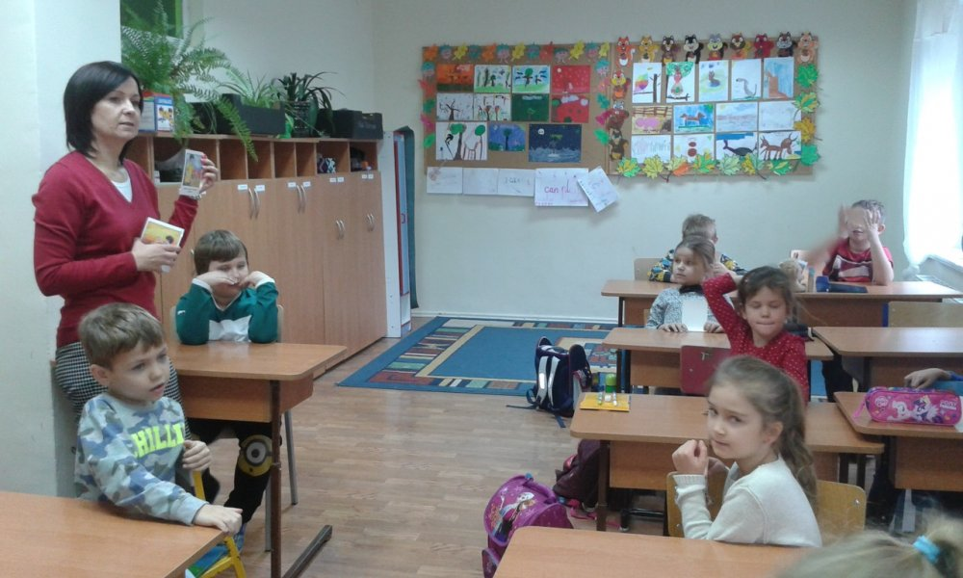
Building of school
Building where our school is located is not too big but it is comfortable. We have sport field, swimming pool, canteen, two quiet rooms where we can relax and learn, audytorium, a small gym, IT room, playground and classes (one class for one grade).

Slide 4
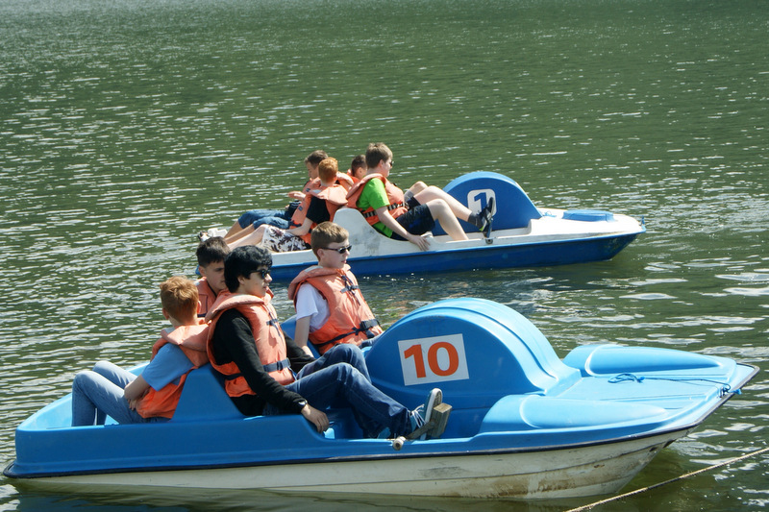
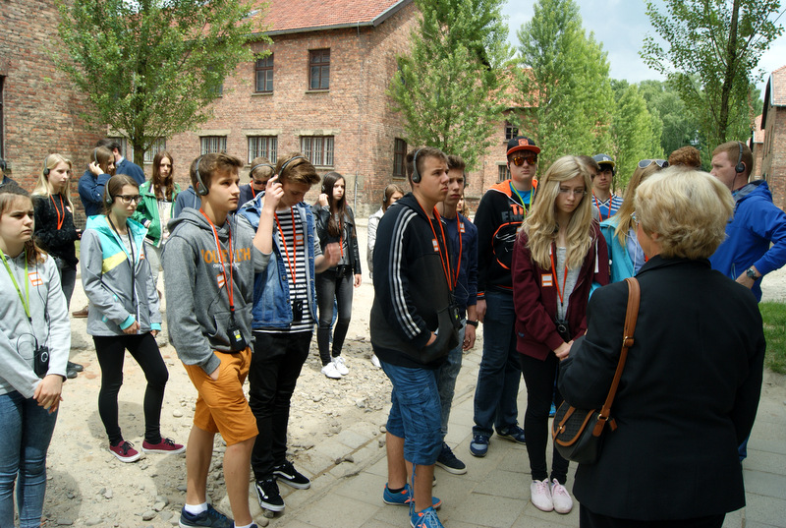
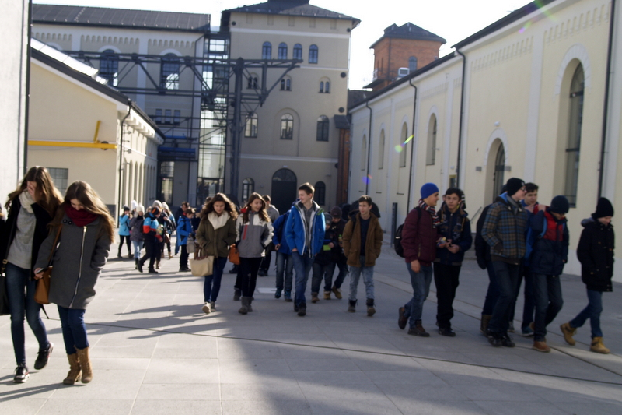
trips
Our school organized two big trip :
1. –autumn trip (1-2 days)
2. –summer trip ,,Zielona Szkoła’’ (5 days)
Students love this trips, because we have great time with our friends and we learn new things . We also visit museums and sights.

Slide 5
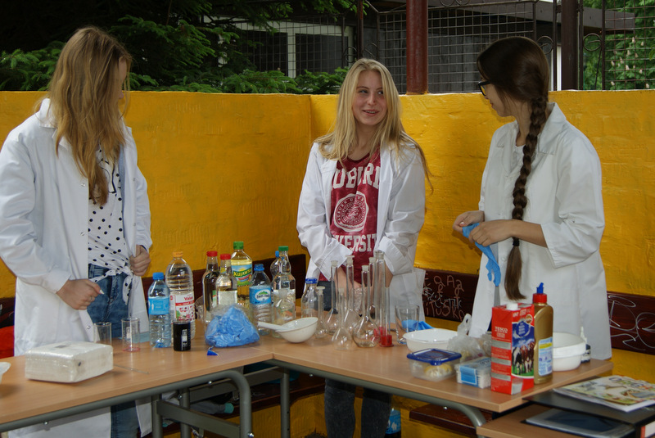
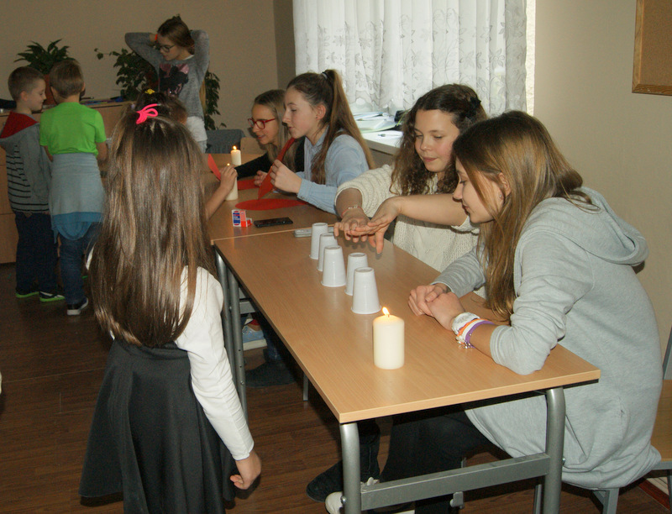
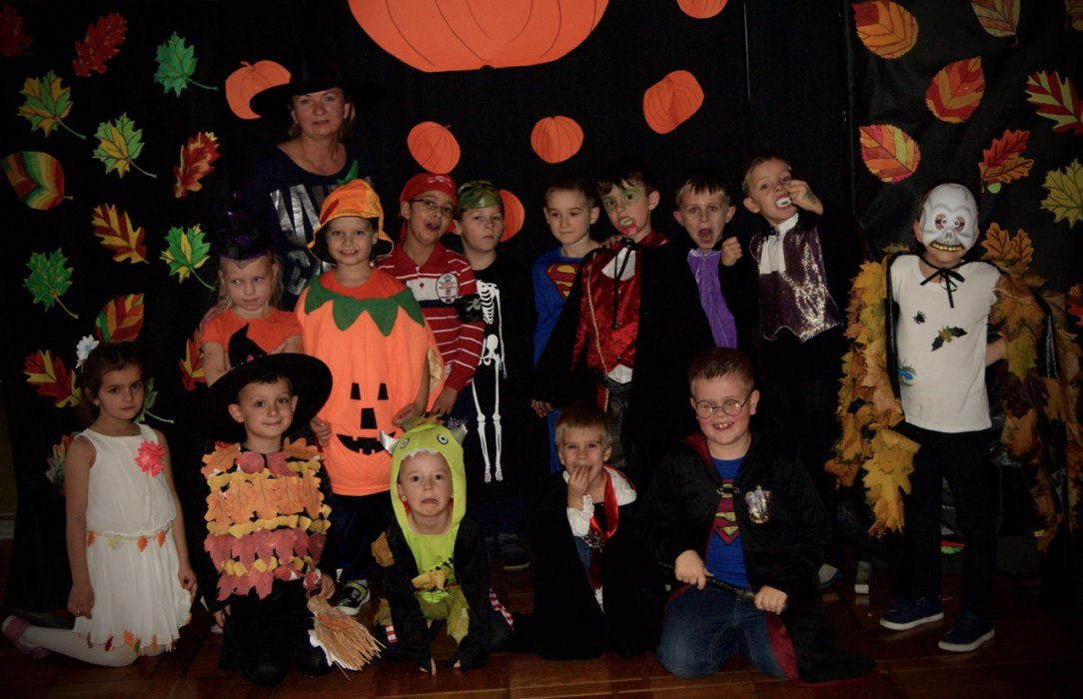
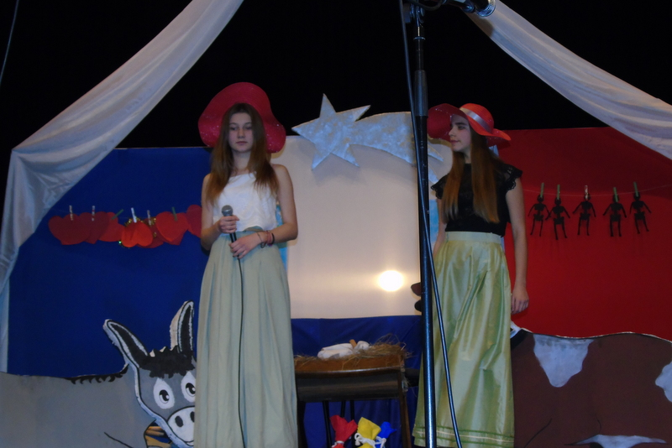
School party
Our school organises also discos, balls and family picnics. It is great to spend together some time and play something, dance, talk or show our talents to our parents.

Slide 6
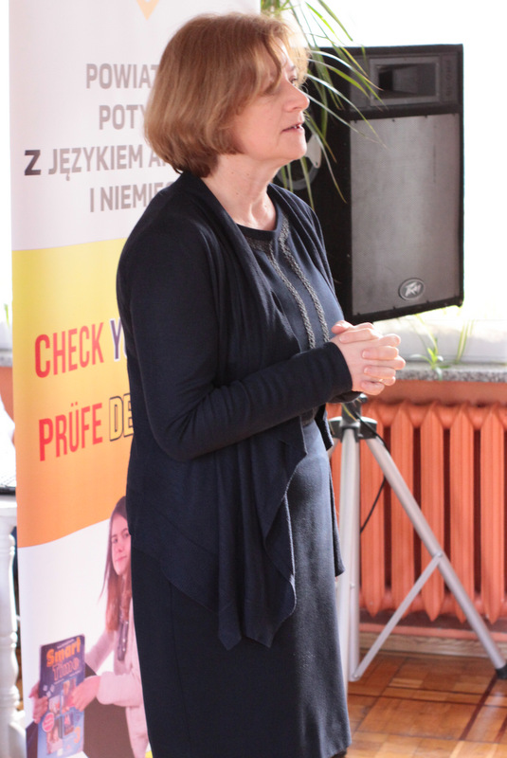
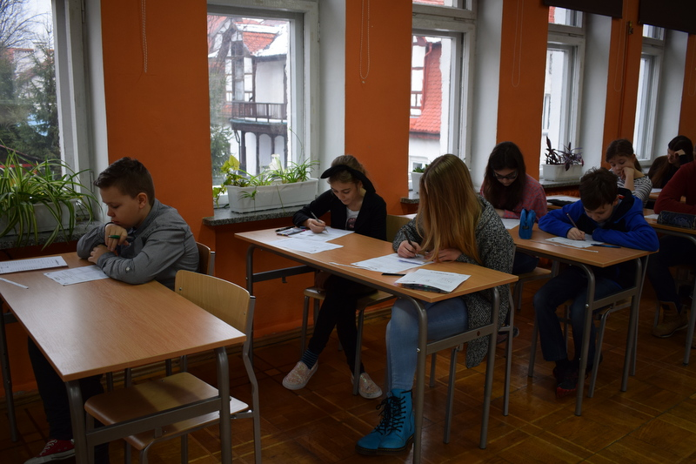
competitions
In our school we can participate in competitions from diffrent branches for example- class league. All students participate in that for a year. We must do exercises in grade and we have then lots of fun and laugh.

Slide 7
ERASMUS+
For 7 months we participate in International Project ERASMUS+.
The project focus on things related to the Cosmos, Stars and Earth. With teenagers from another countries we learn about it and do exercises to get a prize. The prize is a trip to another countries and meeting new friends from this project.

Slide 8
To win we must do exercises for example making poster, presentations about the Cosmos, the Sun itc. and taking part in physics club.
I think it is good lesson for us, because we can meet new people and practise language- English. I really like it.

Slide 9
Thanks for watching ☺
Sandra Suchojad

