Slide 1
FOREST TOUR BEYPAZARI/ANKARA
KEMAL MİLASLI PRİMARY SCHOOL
2/B
MESUT YILMAZ

Slide 2
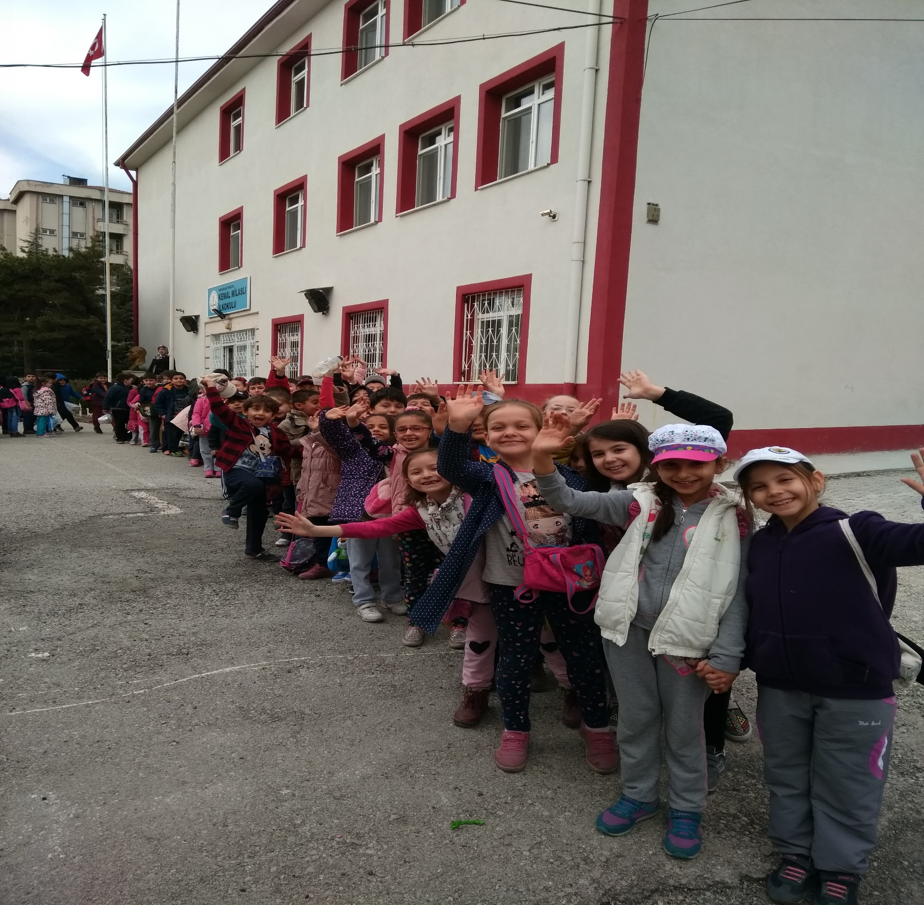
All my students were very excited for this forest tour…

Slide 3
WE WOULD LIKE TO OBSERVE OCCUPATIONAL ECOSYSTEM

Slide 4
Slayt Başlığı Ekle - 1
Kayra find Snail Shell…

Slide 5
Slayt Başlığı Ekle - 1
The children gathered pine cones…

Slide 6
This insect was under a rock.
Ants have started to wake up.
We found the shells of bird eggs.

Slide 7
We met a friend in the forest

Slide 8
We ate our sandwiches with pleasure.

Slide 9
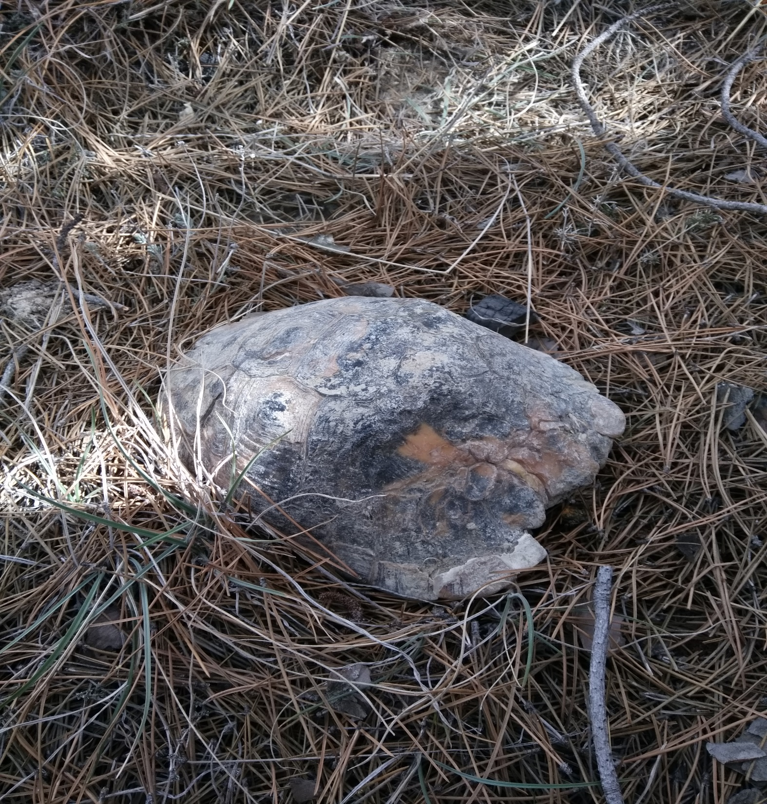
We saw a turtle.

Slide 10
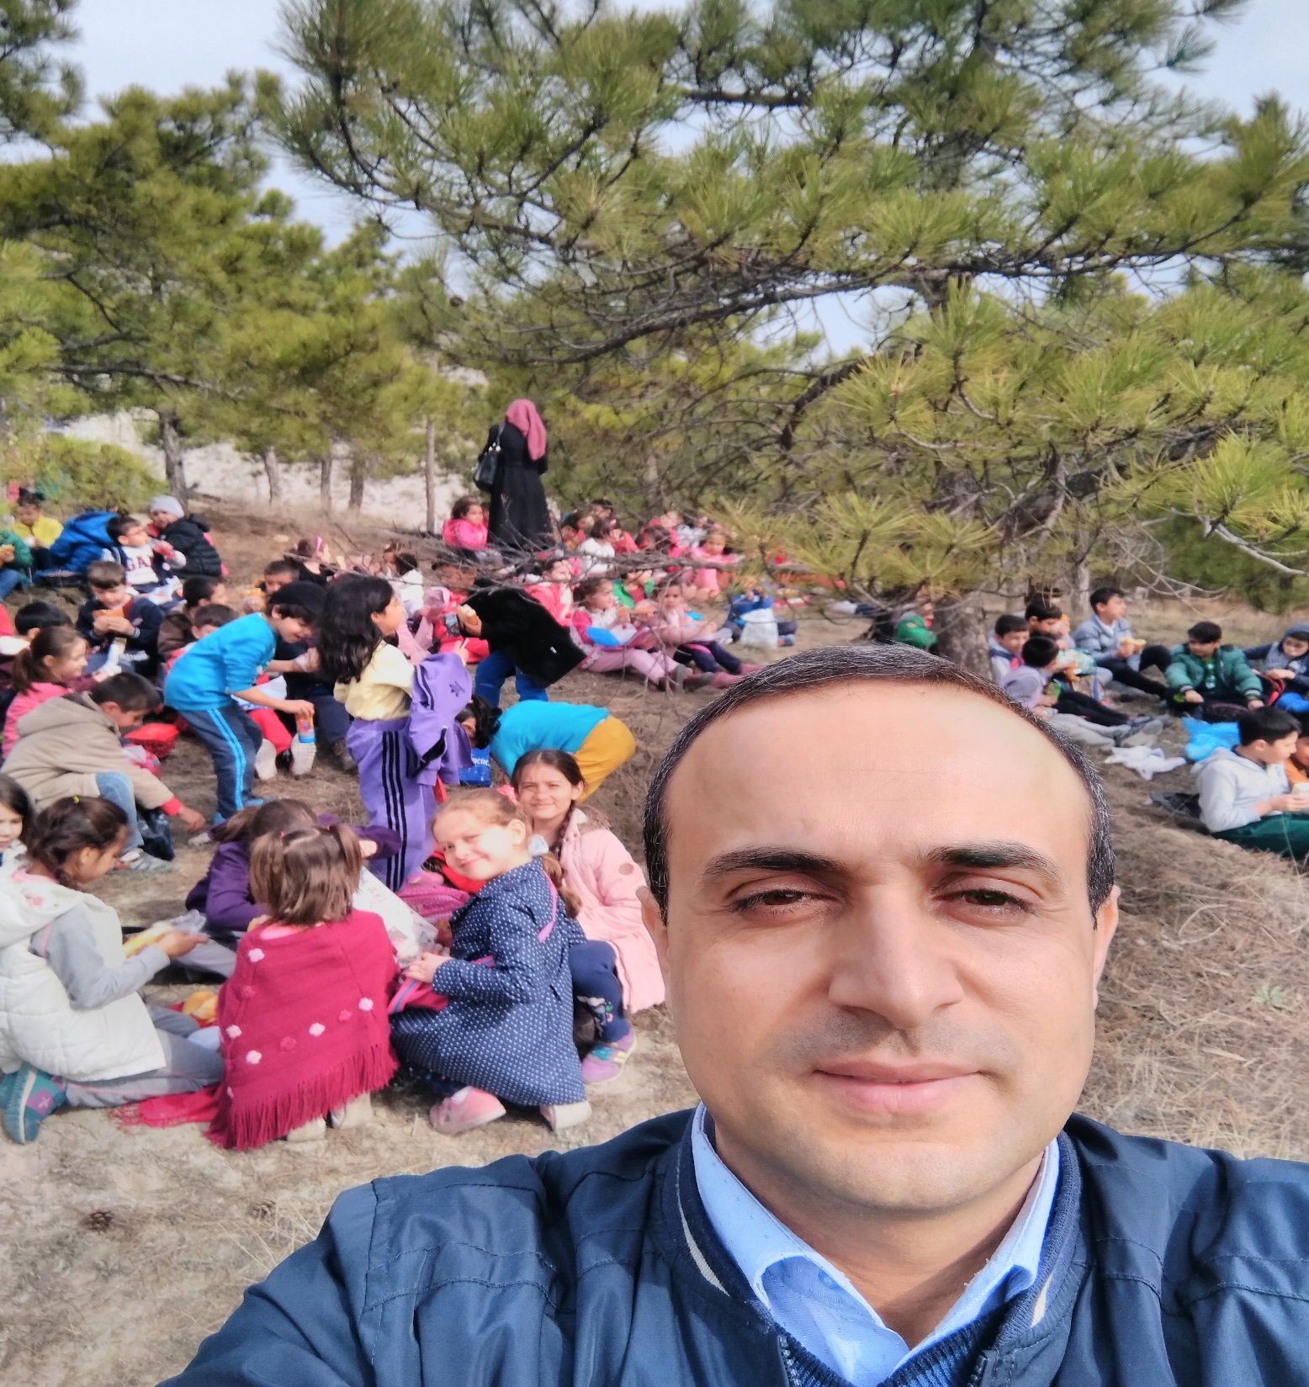
Very nice to see happy children.

Slide 11
Spring to Ankara has not come yet.

Slide 12
… but Spring came to my school, Kemal Milaslı…

