Slide 1
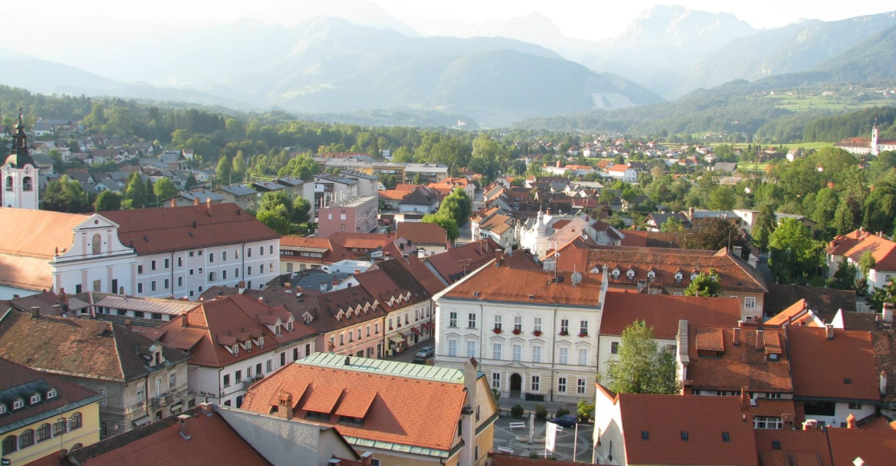
KAMNIK
Ana,Kaja K.,Eva

Slide 2
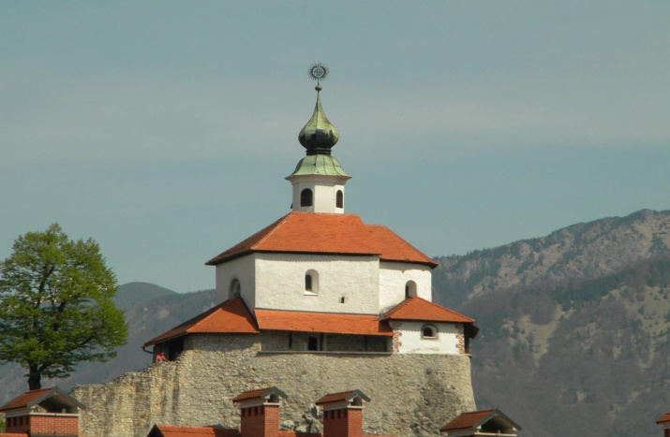
POSITION
a town south of the Kamnik Alps and the center of the homonymous municipality of Kamnik in Slovenia
From the capital city of Slovenia is located 25 km

Slide 3
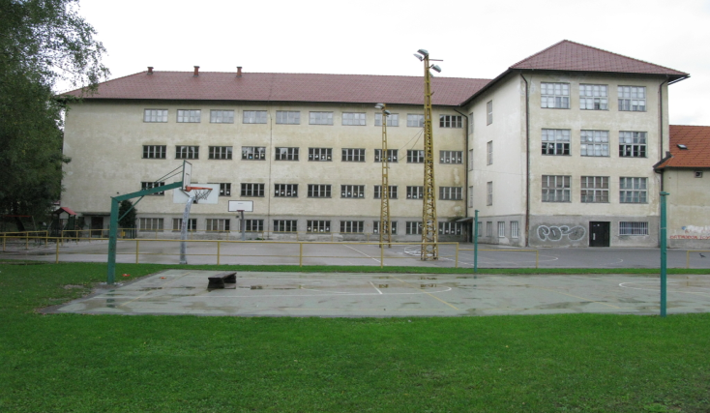
HISTORY
Location Kamnik , said in 1061
In the 13th century walled town and built
several towers.
Some time Kamnik was the capital of Carniola

Slide 4
HISTORY
During the interwar period has significantly evolved particular industry : there have been three factories for the processing of wood ; the most famous was the furniture factory Chair , developed the powder magazine , the newly commenced work factory metal products Titan , tannery Kamnik , works mustard and preserving Eta and textile factory Svilanit . In independent Slovenia industry stagnated . Several factories were shut down .

Slide 5
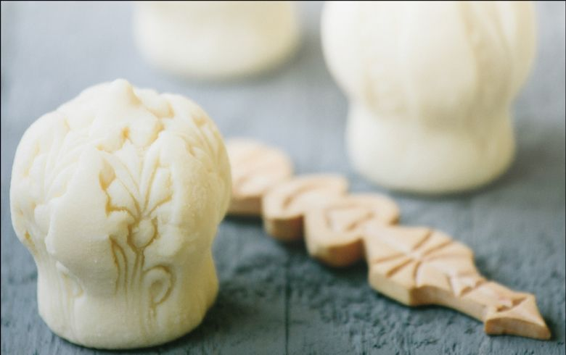
TRNIČ
Four trniči are manufactured so that they are made from cottage cheese, made from hot sour milk with added cream, initially formed lumps and partly dried leaves Šisernik. Slightly dried clumps are finalized and stamped them fonts, wooden planks with carved negative samples. Designed trniči were placed on the shingles over an open hearth, that is smoked, with yellowed. Bytes on Big Mountain had in fact open fireplace where there is smoke free smoke around the room.

